Slide 1
Model profile Magnet-Leakage

Slide 2
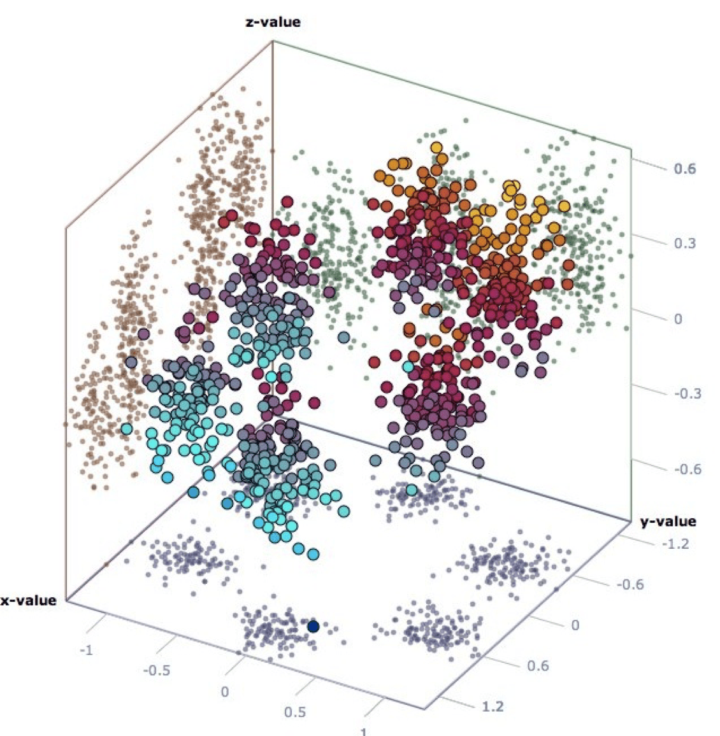
Idea
150 day time window
Helium level
Take raw data and cut it in time samples of e.g. 150 days. (Data of the two variables PHAP and helium level are taken into consideration at this time)
value
phap
2021
date
2024
Embed this data in a latent low dimensonal space, so that similar data samples are close together. This is done by an (convolutional variational) autoencoder approach.
Embedding
Day 0
Day 150
Latent space

Slide 3
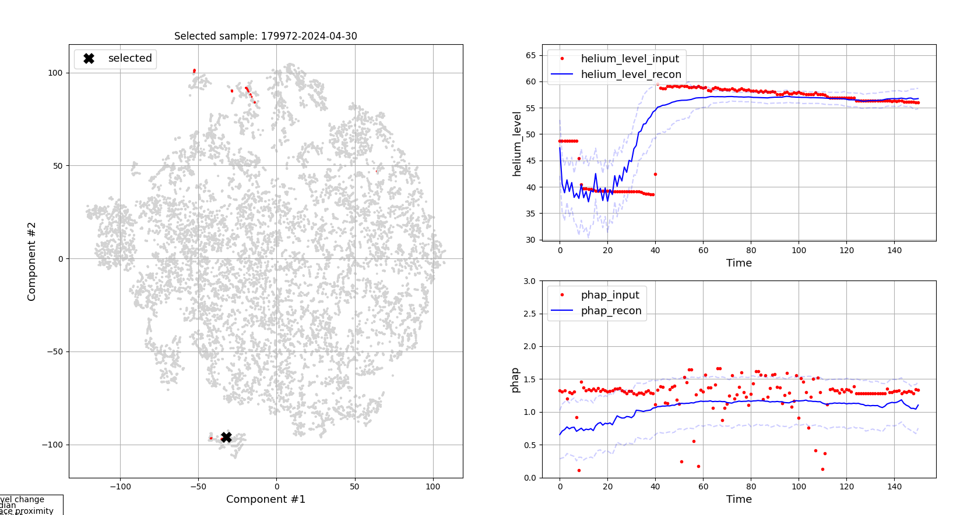
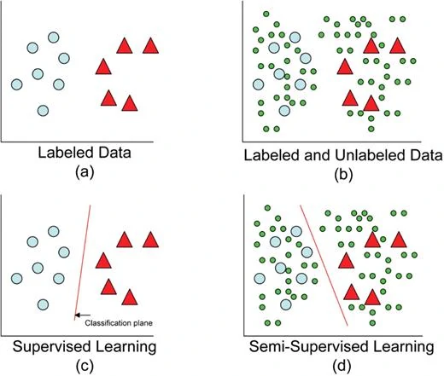
Idea
Label a few samples by hand (leaking vs normal)
2d projection of latent space
Latent space
Train / Retrain semi-supervised model
(4. and 5. can be done iteratively)

Slide 4
Input Data
Magnet Data: Feature Table (Pandas DF)
The example data contains the following:
Data from system 56005
Timepoint = „2024-05-27“
Values of the two variables helium_level and phap
A time-window of 160 days into the past
Normalisation:
For helium_level: Subtraction of the mean value for this sample
Standardscaler for each variable separatly

Slide 5
Semi Supervised Variational Autoencoder Model
Latent space
Input
( -1, 2, 150)
Reconstruction
( -1, 2, 150)
Encoder
( -1, 16)
( -1, 32)
( -1, 8)
( -1, 64)
( -1, 16)
( -1, 128)
( -1, 32)
( -1, 64)
( -1, 128)
Decoder
The autoencoder is trained on all the data, and captures the structure of all the dataset
While training, the classifier adjusted to the few given labeled data samples. But it combines this knowledge with the structure of the dataset and is capable for making predictions on the whole dataset
Label
Classifier

Slide 6





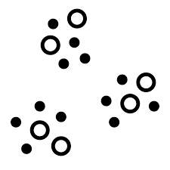

Dataflow
Train and Predict
Prepare features
Feature table
Semi supervised model
Helium loss prediction
Labeling tool
t-SNE Visualization
Labels

Slide 7
Model demonstration
Spectra
Sempra
- some issues with variance in data
- helium loss not as obvious as in Spectra

Slide 8
How to proceed
Integrate „pressure“-variable into model -> MICHAEL
Stabilize model for noisy data -> MICHAEL
Data-labeling using provided tool -> JAMES(DOMAIN EXPERT) + MICHAEL
Prepare final model report -> MICHAEL
Rollout of model and testing in real world scenario? New contract?

