Slide 1
tutorial penggunaan nodeMcu: (sampai point 3)
http://geeknesia.com/tutorial/iot-tutorial/geeknesia-monitoring-dan-controlling-menggunakan-esp-8266-node-mcu-1-0
kecuali library :
gunakan library thingspeak
https://www.arduinolibraries.info/libraries/thing-speak
kalau ingin mencoba geeknesia : https://github.com/Imroy/pubsubclient
Contoh aplikasi :
https://geeknesia.freshdesk.com/support/solutions/articles/6000134062-part-9-geeknesia-monitoring-dan-controlling-menggunakan-esp-8266-node-mcu-1-0

Slide 2
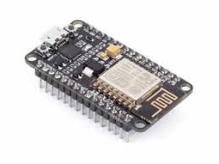
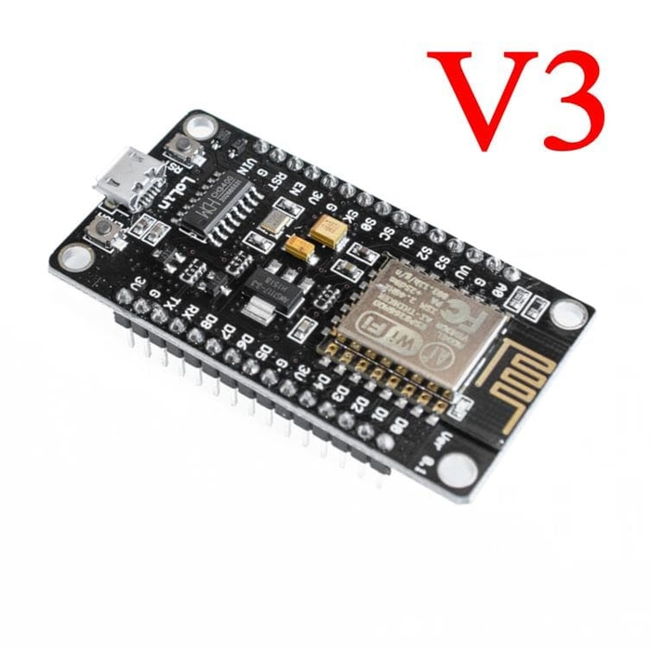
V2
Serial driver : CP210x_
Serial driver : CH340
Claimed to have more robust usb
Bigger than V2 + different pin layout
https://frightanic.com/iot/comparison-of-esp8266-nodemcu-development-boards/

Slide 3
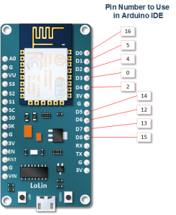
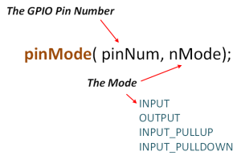

Slide 4
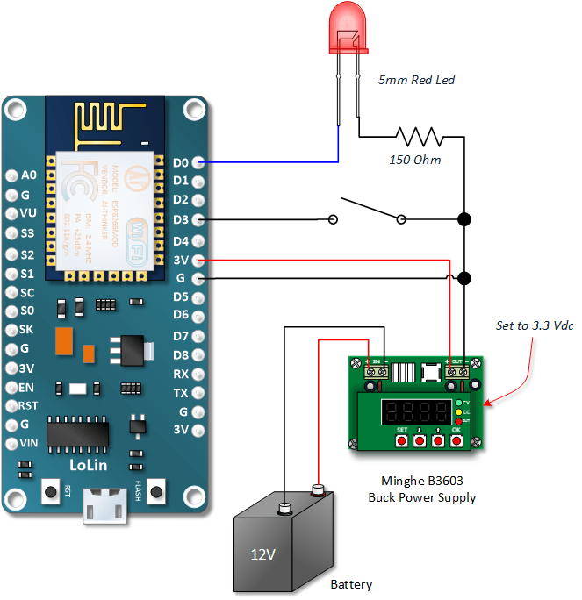
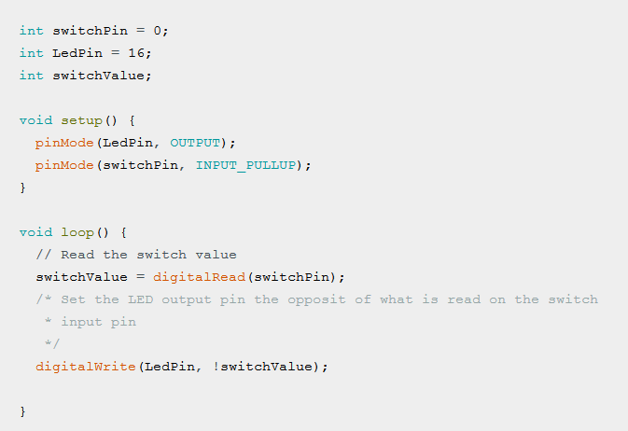

Slide 5
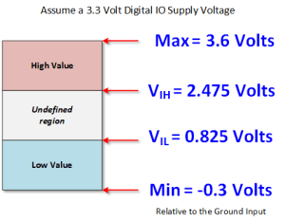
Logic voltage

Slide 6
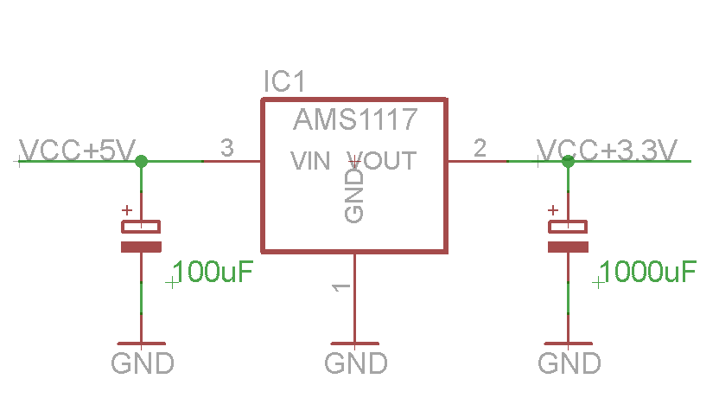
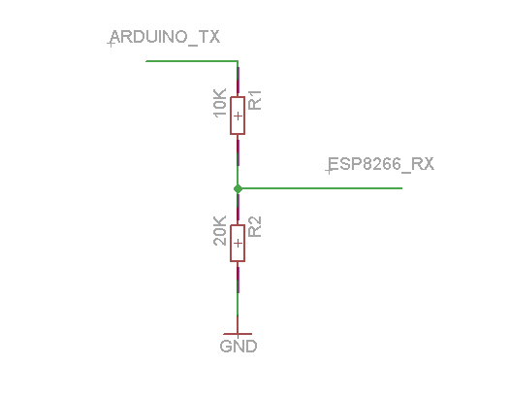
Power supply
5V data to 3.3V data

Slide 7
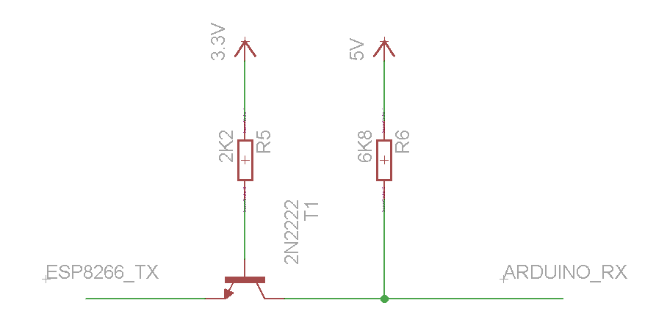
3.3V data to 5V data :
Coba dengan koneksi langsung
Bila arduino tidak dapat membaca level 3.3 , gunakan rangkaian level shifter

