Slide 1
Making an App Interactive
Indra Azimi, S.T., M.T.
D3 Teknik Informatika, Telkom University

Slide 2
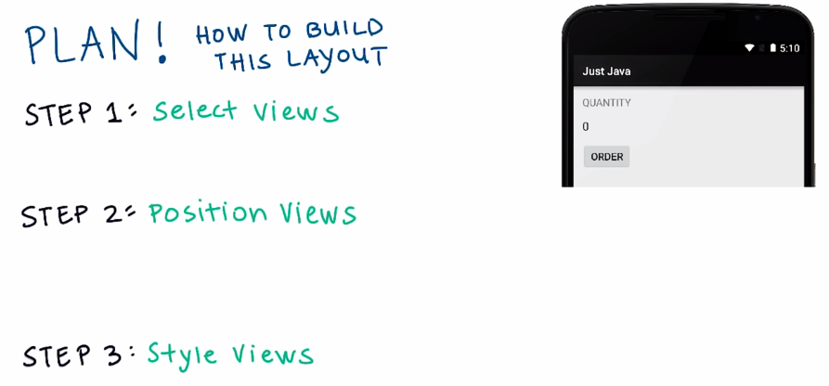
Building Layouts

Slide 3
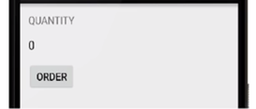
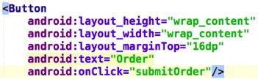
Button

Slide 4
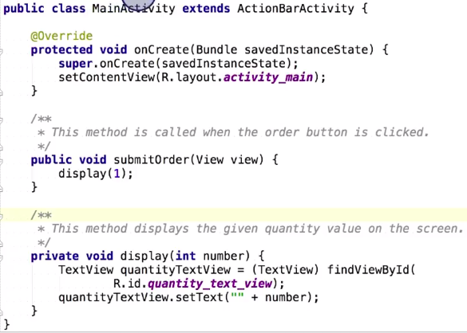
Java Code

Slide 5
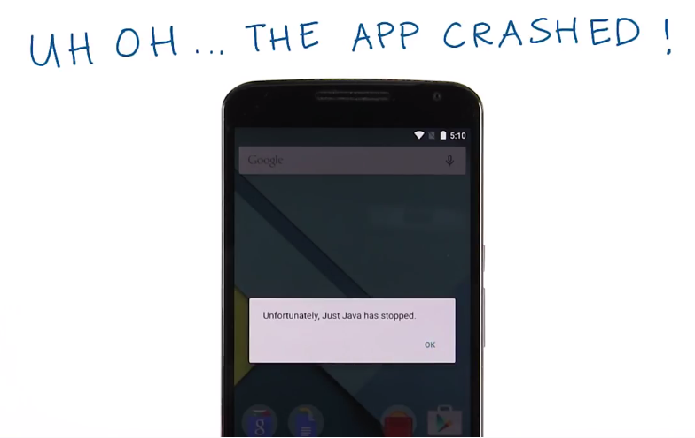
Debugging a crash

Slide 6
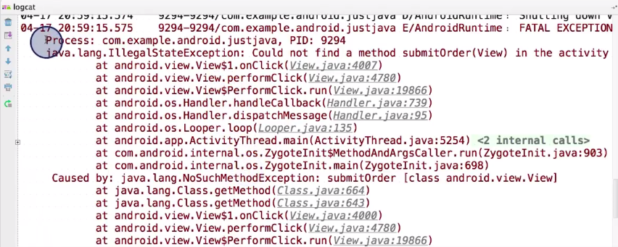
Debugging a crash

Slide 7
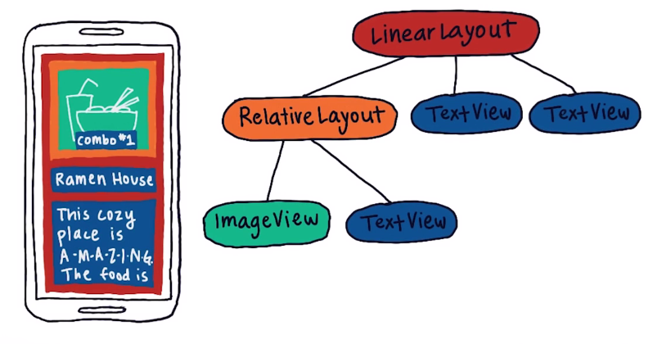
View Hierarchy Diagram

Slide 8
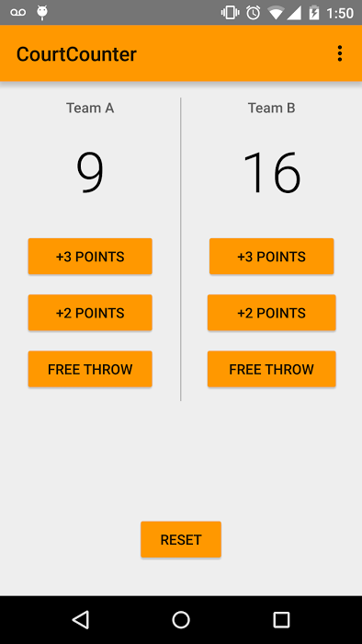
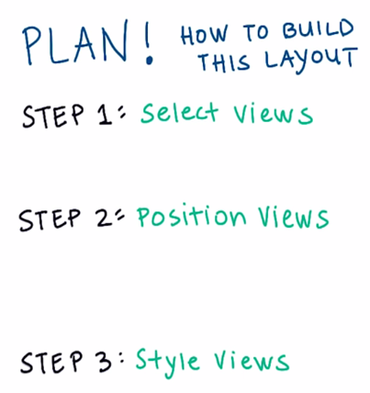
Court counter
Aplikasi untuk menghitung skor pertandingan basket.

Slide 9
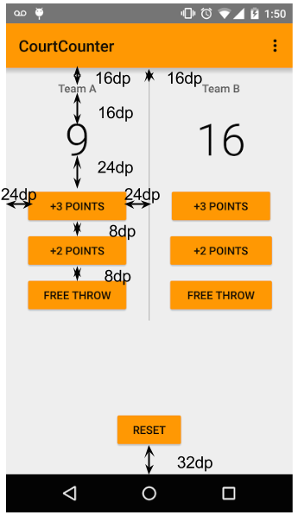
Spesifikasi detail
Title dan button
Background #FF9800
Team Name TextViews:
Size 14sp
Color #616161
Score TextViews
Size 56sp
Color #000000

Slide 10
Referensi
Lesson 2A – 2B: Making an App Interactive
Android Development for Beginners
https://www.udacity.com/course/ud837

