Slide 1
Intents and Activities
Indra Azimi, S.T., M.T.
D3 Teknik Informatika, Telkom University

Slide 2
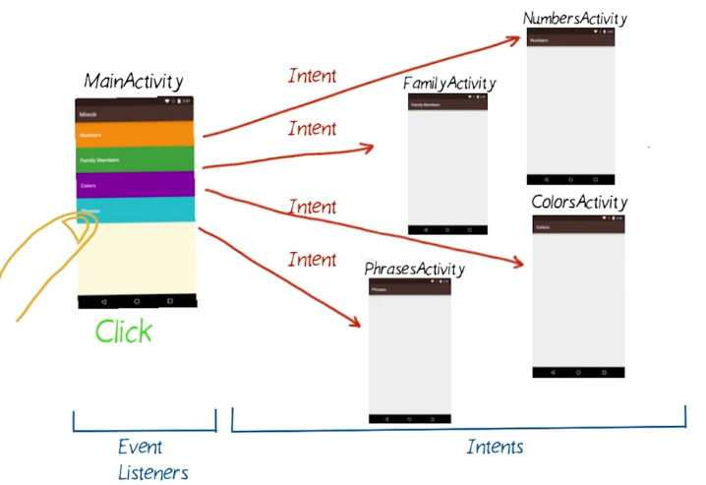
Overview

Slide 3
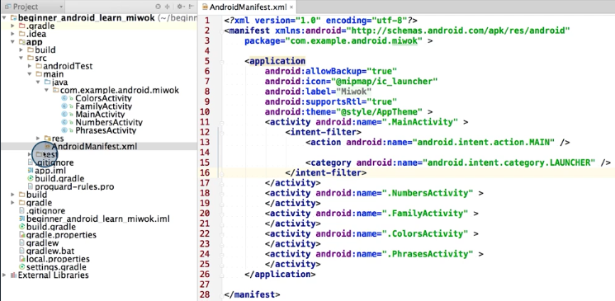
Android manifest
https://developer.android.com/guide/topics/manifest/manifest-intro.html

Slide 4
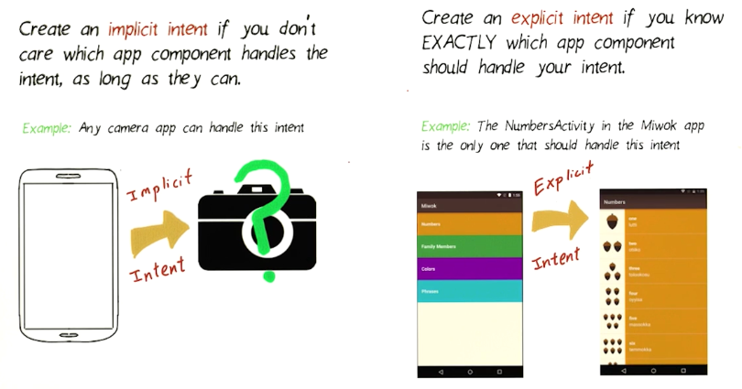
Type of Intents

Slide 5
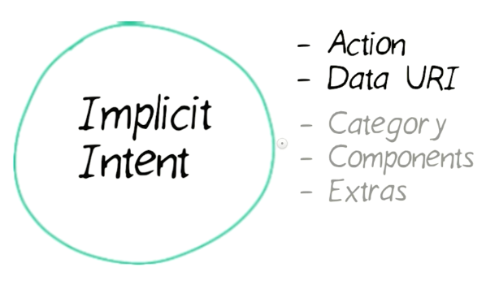
Implicit Intent

Slide 6
Implicit Intent
// only email apps should handle this Intent intent = new Intent(Intent.ACTION_SENDTO); intent.setData(Uri.parse("mailto:")); intent.putExtra(Intent.EXTRA_EMAIL, new String[] {"order@justjava.com"}); intent.putExtra(Intent.EXTRA_SUBJECT, "Just Java order for " + nama); intent.putExtra(Intent.EXTRA_TEXT, pesan); if (intent.resolveActivity(getPackageManager()) != null) { startActivity(intent); }

Slide 7
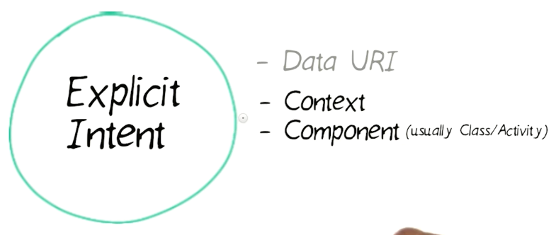
Explicit Intent
// Executed in Activity, so 'this' is the Context Intent intent = new Intent(this, NumbersActivity.class); startActivity(intent);

Slide 8
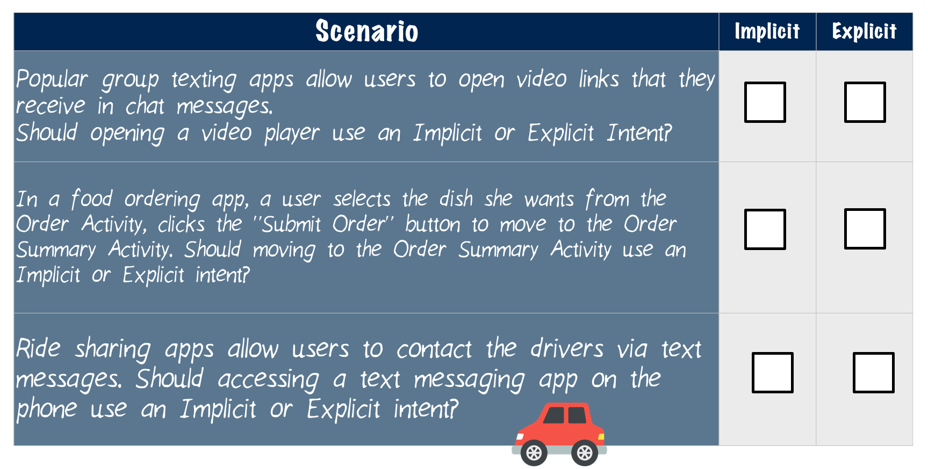
Implicit vs Explicit Intent

Slide 9
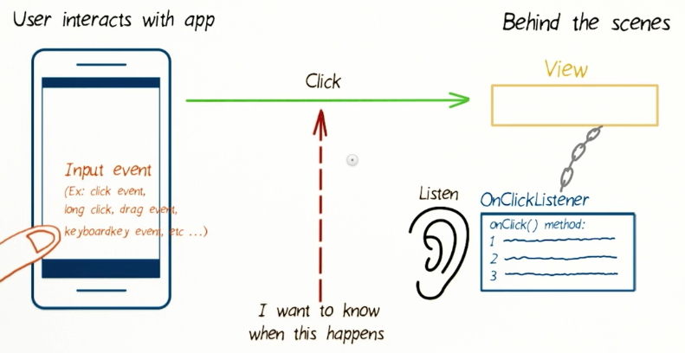
Event Listeners In Android
https://developer.android.com/guide/topics/ui/ui-events.html

Slide 10
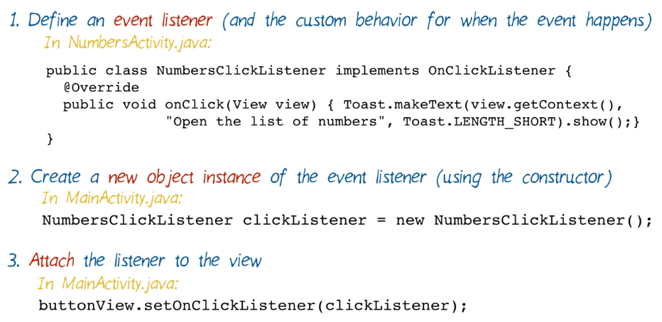
Setup An Event Listener

Slide 11
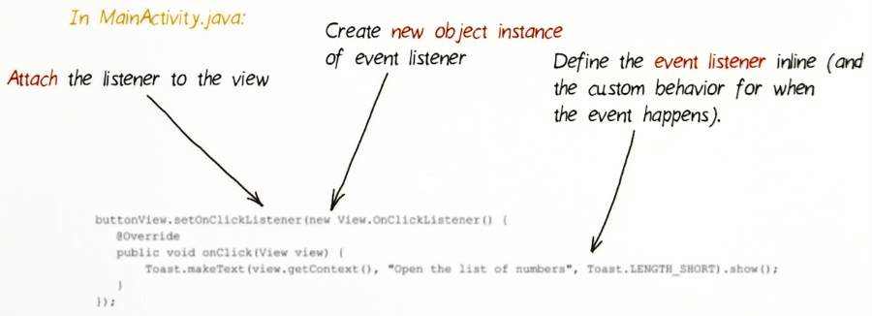
Setup An (Inline) Event Listener

Slide 12
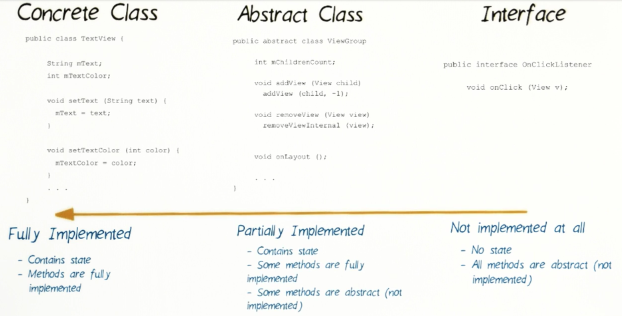
Event Listener is Interface

Slide 13
Why Use Event Listener
To change the behavior of your button while your app is running. You can point your button at another method entirely, or just disable the button by setting an OnClickListener that doesn't do anything.
To allows you to control a button's behavior from somewhere other than its host activity. Fragments always need to use OnClickListeners to control their buttons, since they're not Activities, and won't be searched for listeners defined in onClick.

Slide 14
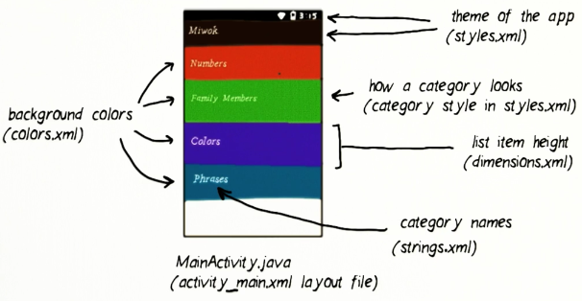
MIWOK APP Starter Code
WHY?
https://github.com/udacity/ud839_Miwok/archive/Starter-code.zip

Slide 15
Referensi
Lesson 1: Intents and Activities
Android Basics: Multi-screen Apps
https://www.udacity.com/course/ud839

