Slide 1
Data, Loops, and Custom Classes
Indra Azimi, S.T., M.T.
D3 Teknik Informatika, Telkom University

Slide 2
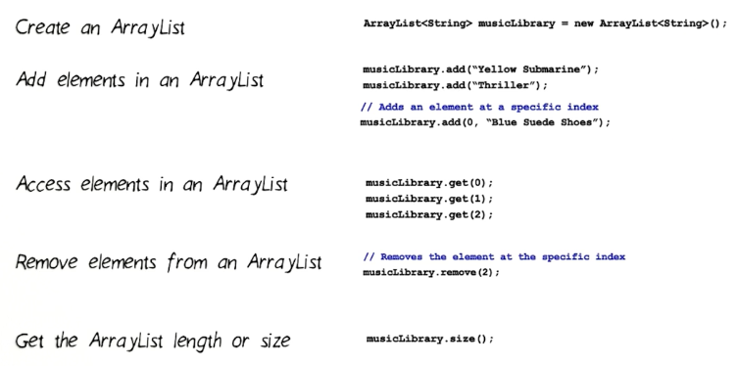
ArrayList

Slide 3
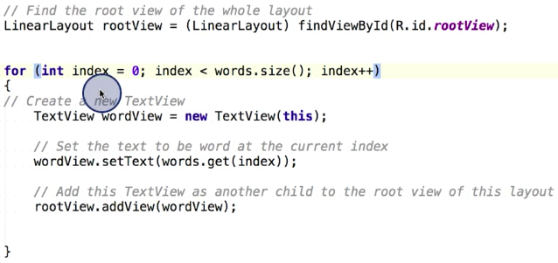
Adding View at Runtime

Slide 4
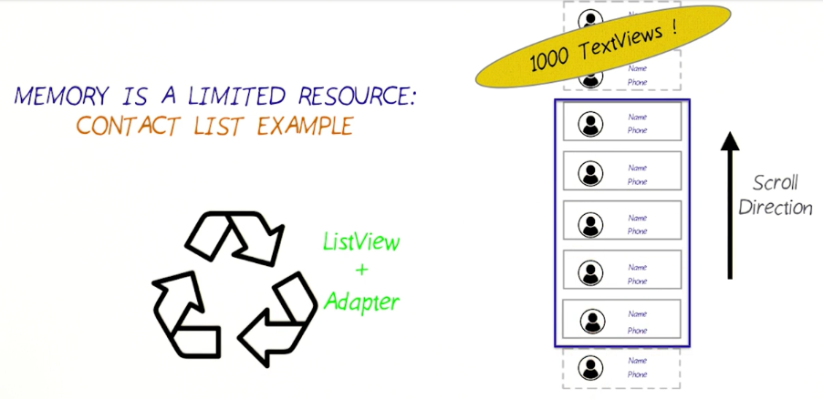

Slide 5
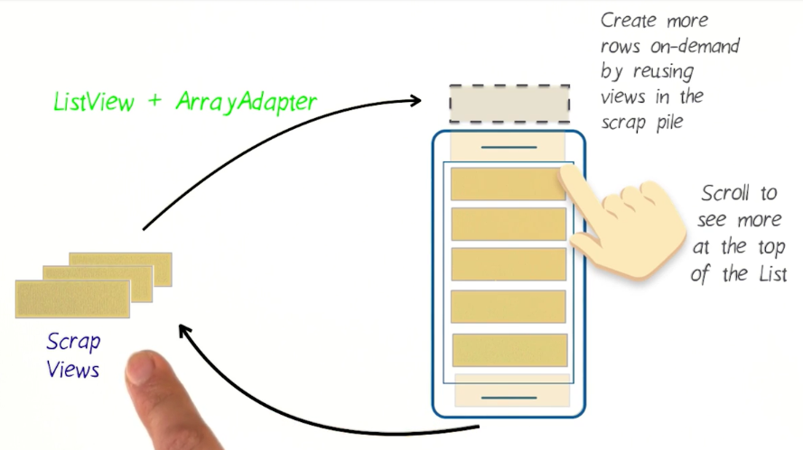
View Recycling

Slide 6
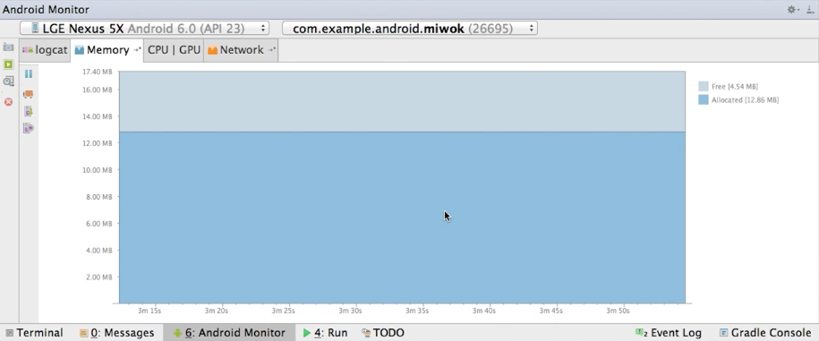
Memory Monitor
https://developer.android.com/studio/profile/am-memory.html

Slide 7
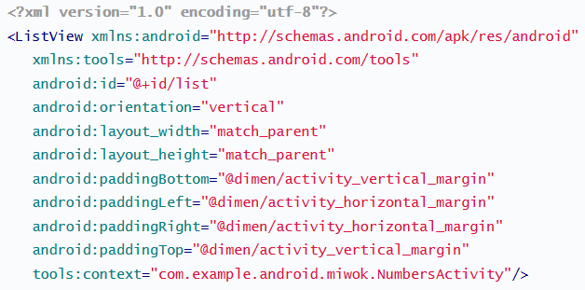
Listview & ArrayAdapter
ArrayAdapter<String> itemsAdapter = new ArrayAdapter<String>( this, android.R.layout.simple_list_item_1, words); ListView listView = (ListView) findViewById(R.id.list); listView.setAdapter(itemsAdapter);

Slide 8
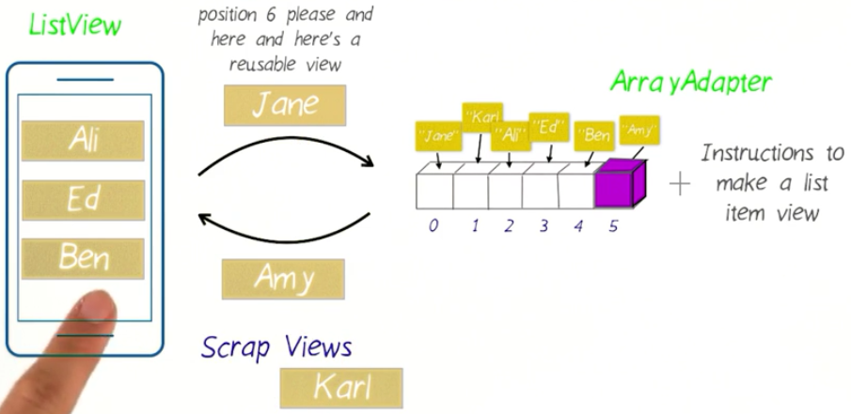
View Recycling

Slide 9
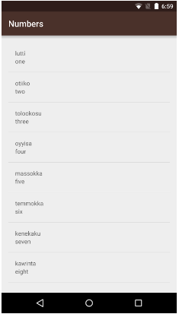
Miwok App
What to do?
Build list item layout
Create data structure
Create custom ArrayAdapter

Slide 10
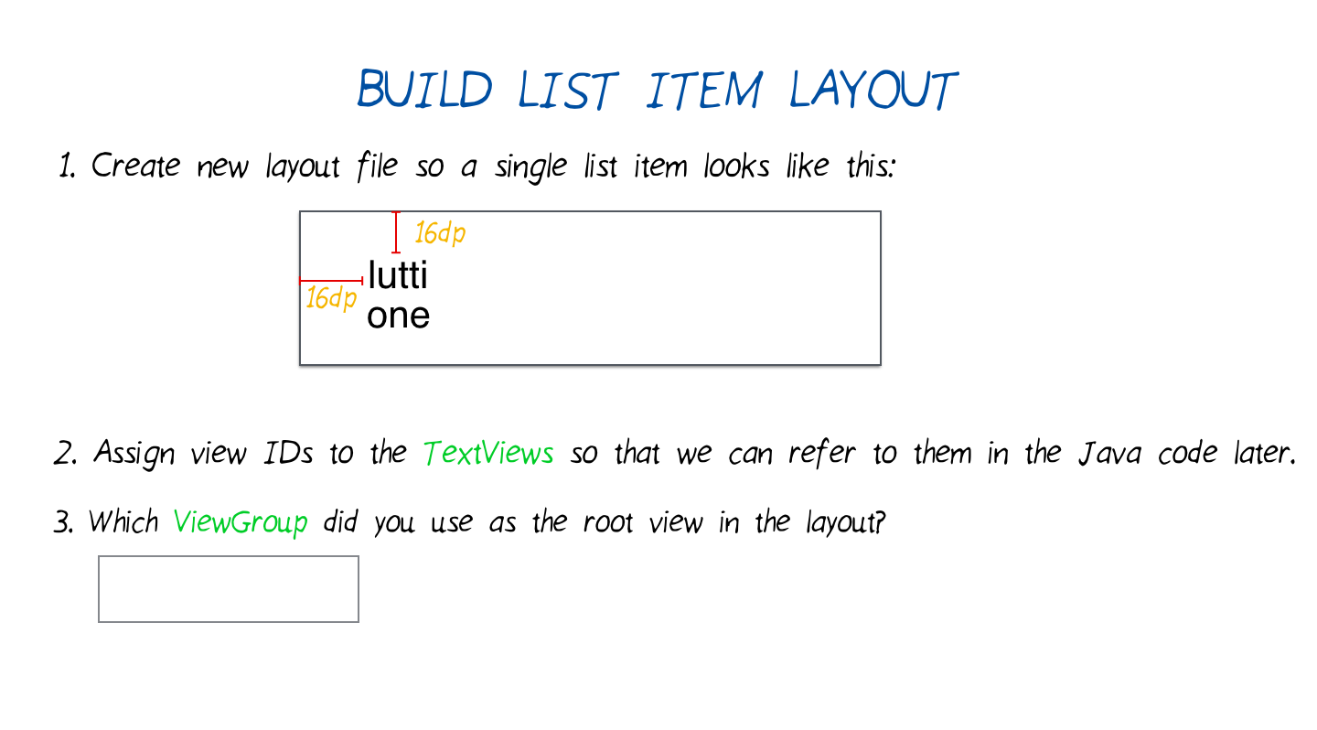
Build List Item Layout

Slide 11
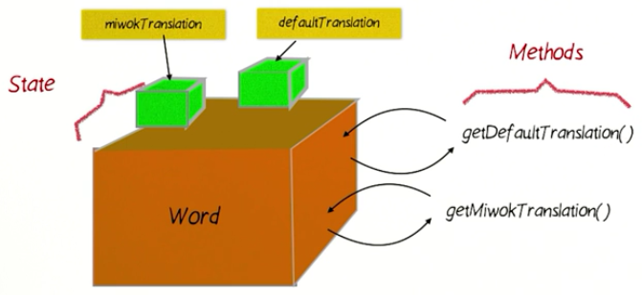
Word Class Data Structure

Slide 12
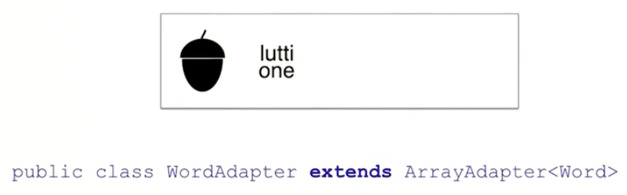
Custom ArrayAdapter
Custom Adapter Sample App
github.com/udacity/ud839_CustomAdapter_Example

Slide 13
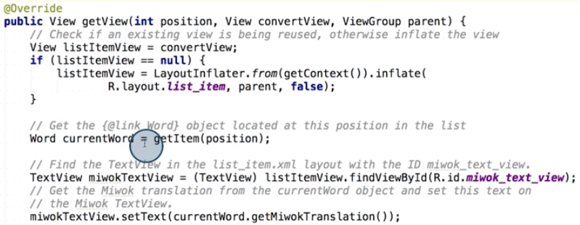
Custom ArrayAdapter

Slide 14
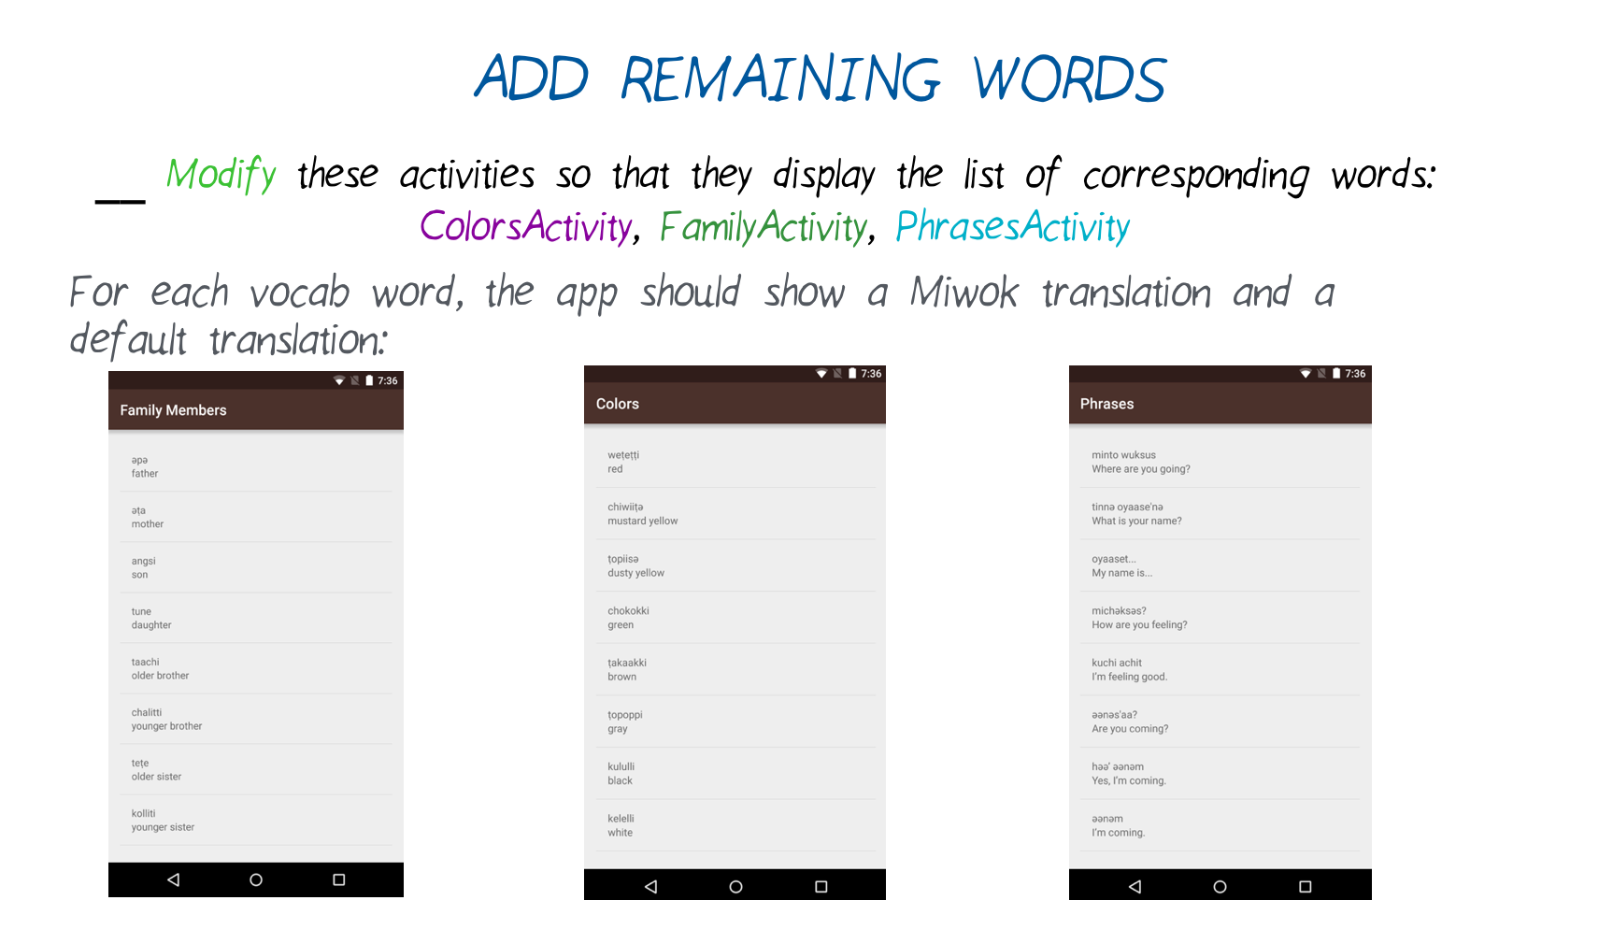
Add Remaining Words
Words list: https://docs.google.com/document/d/16sQ-0r5zMrdRXUwOaYbTLNXADasuSYFpy7K0Bn8oVfg/pub?embedded=true

Slide 15
Referensi
Lesson 2: Data, Loops, and Custom Classes
Android Basics: Multi-screen Apps
https://www.udacity.com/course/ud839

