Slide 1
Images and Visual Polish
Indra Azimi, S.T., M.T.
D3 Teknik Informatika, Telkom University

Slide 2
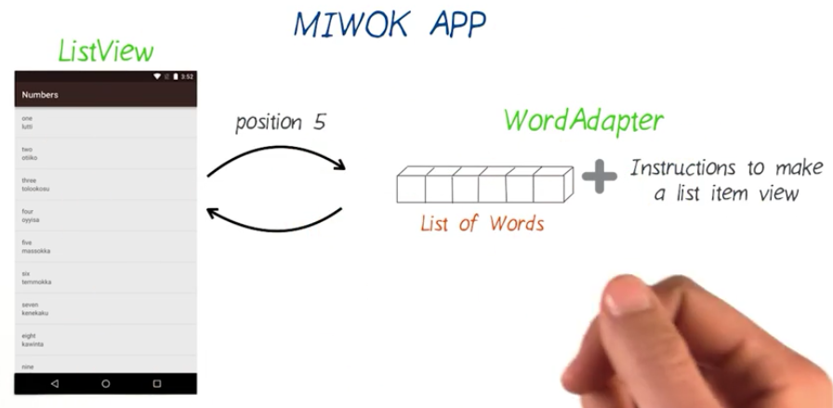
Existing Code Diagram
What’s next?

Slide 3
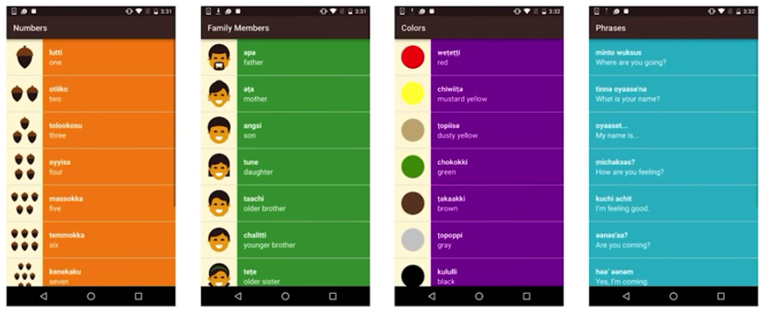
Our Goal

Slide 4
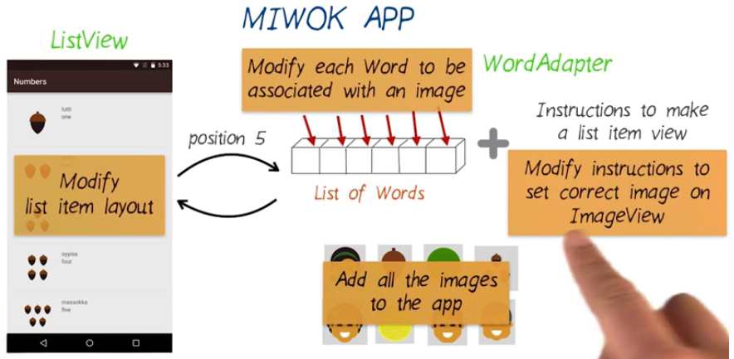
What To Do?

Slide 5
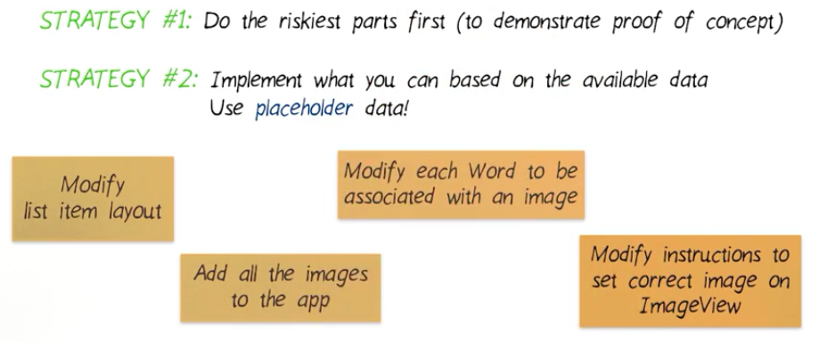
Prioritize Code Changes

Slide 6
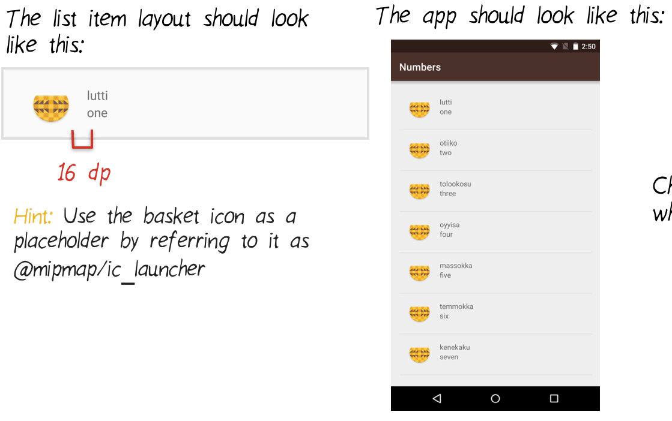
Modify Item Layout

Slide 7
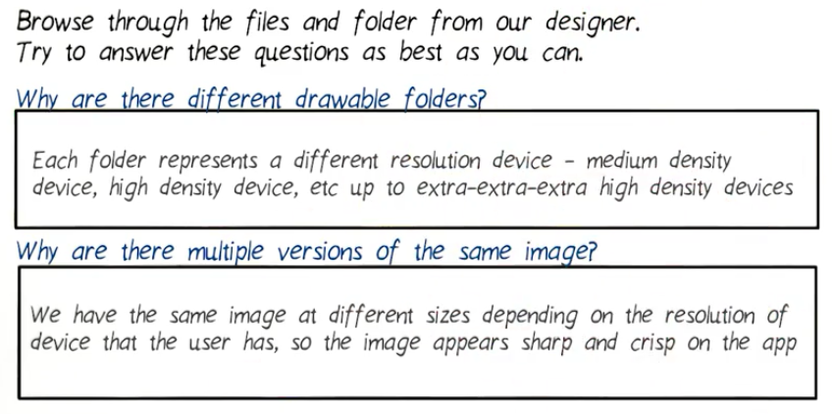
Add Images TO App
https://github.com/udacity/ud839_Miwok/archive/image_assets.zip
material.io/devices

Slide 8
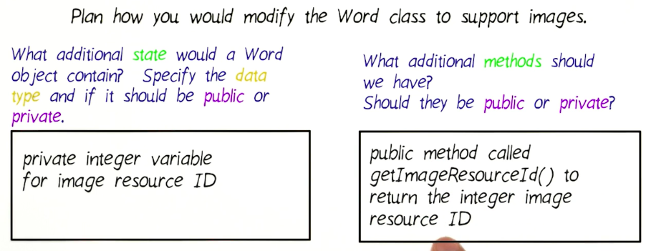
Modify Word Class

Slide 9
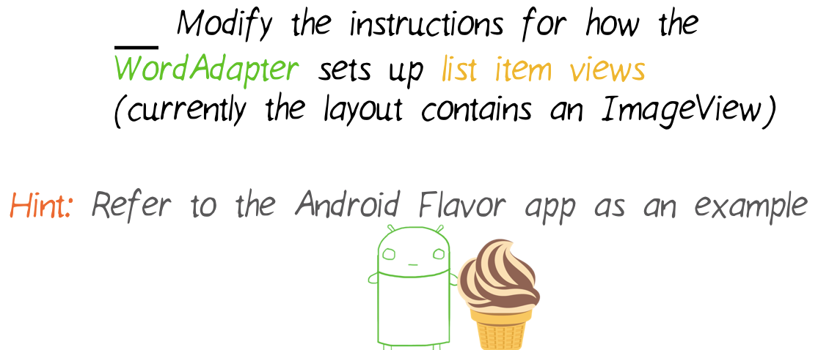
Modify Word Adapter

Slide 10
Visual Polish
Follow redlines here: https://d17h27t6h515a5.cloudfront.net/topher/ 2016/June/577054f6_miwok-redlines/miwok-redlines.pdf

Slide 11
Referensi
Lesson 3: Images and Visual Polish
Android Basics: Multi-screen Apps
https://www.udacity.com/course/ud839

