Slide 1
Navigation Patterns Using Fragments
Indra Azimi, S.T., M.T.
D3 Teknik Informatika, Telkom University

Slide 2
Navigation Pattern
Navigation guides users between different parts of your app. Keep in mind that your app will need to adapt to devices with a variety of screen sizes. This is known as responsive design.
Master Detail
Navigation Drawer
Swipeable Tabs
Calendar-based
https://material.io/guidelines/patterns/navigation.html

Slide 3
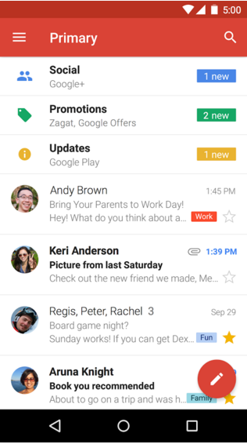
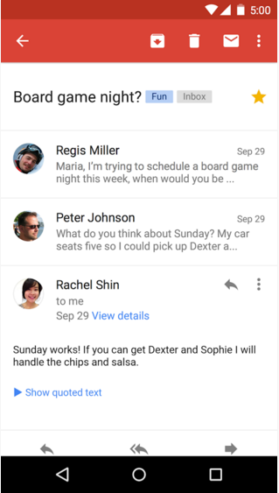
Master Detail (smartphone)
The “master detail layout” consists of a master list of data. When you click one of those items of data, a detailed view of that item appears.

Slide 4
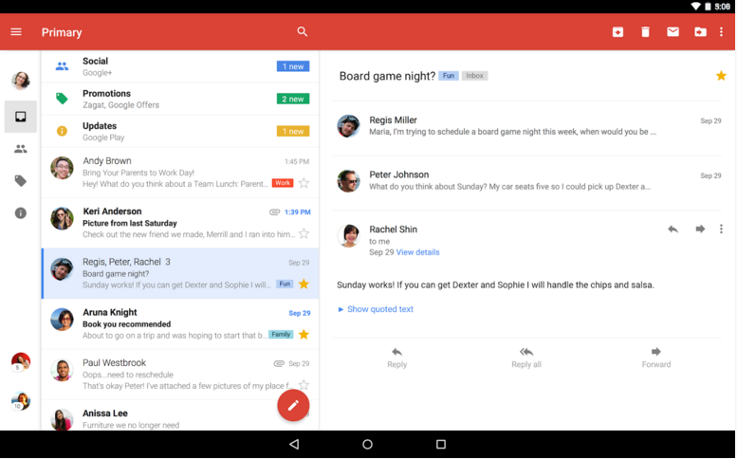
Master Detail (tablet)
When there is more screen real estate available, then we can view the master list of data alongside the detailed view of an item, at the same time.

Slide 5
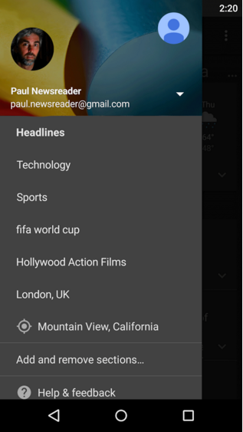
Navigation Drawer
If an app has many screens that are “siblings” to each other, then the different screens can be listed in a “drawer” that pulls out from the left side of the screen.

Slide 6
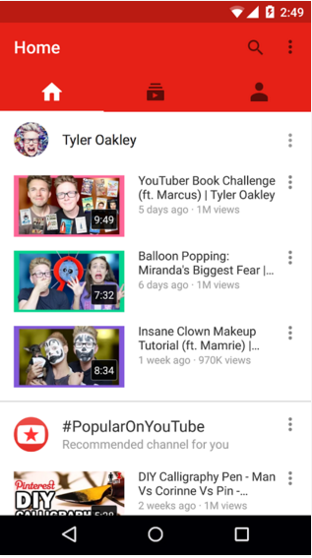
Swipeable Tabs
You can swipe horizontally left and right between different screens, or you can tap one of the tabs across the top of the screen.

Slide 7
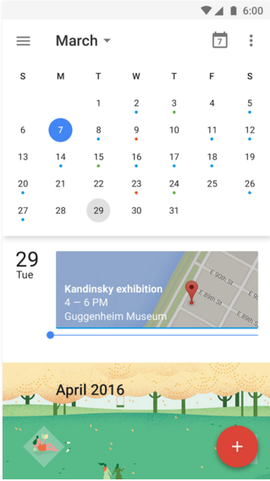
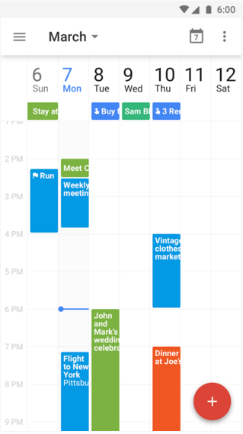
Calendar-based
Has a scrolling agenda view, but you can jump to specific days by using the calendar month view. Or you can view different lengths of time like the week view.

Slide 8
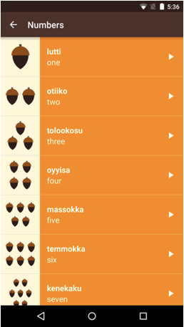
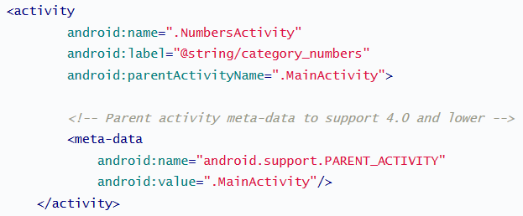
Up Button
The “Up” button ALWAYS leads you to the parent activity.
Back Button
The “Back” button can lead you to the parent activity, or the home screen, or to another app, depending on how you arrived at the current screen.

Slide 9
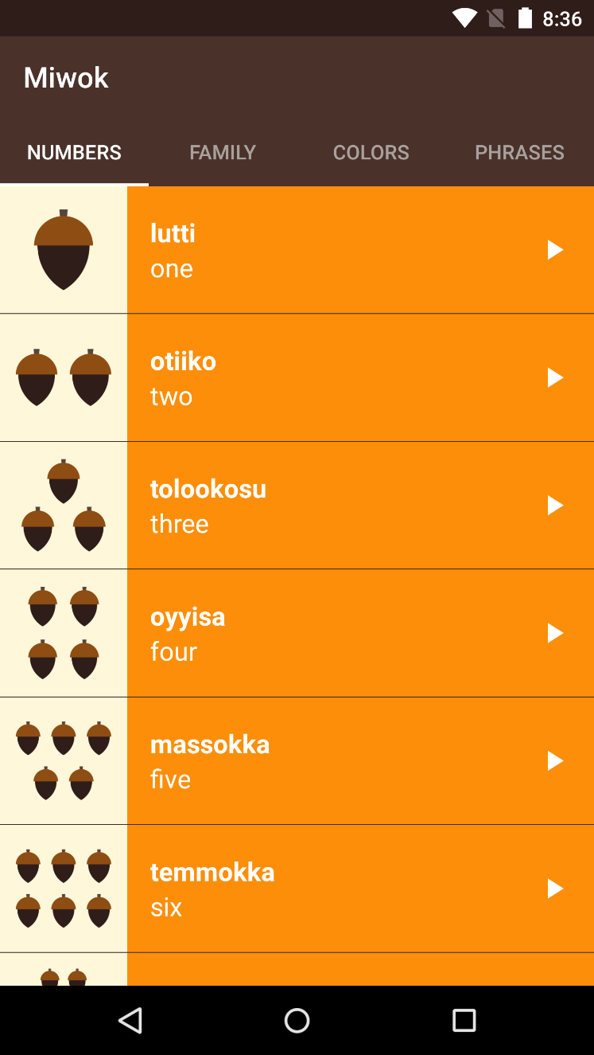
Miwok App 2.0
What to do?
Create a new project: Tabbed Activity.
Refactor the 4 activities into the fragments.
Modify the MainActivity so it contains 4 pages, where each page is a Fragment.

Slide 10
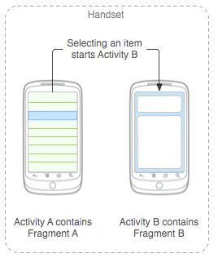
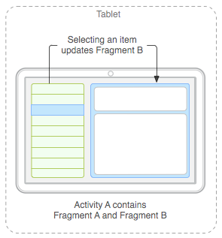
Intro to Fragments

Slide 11
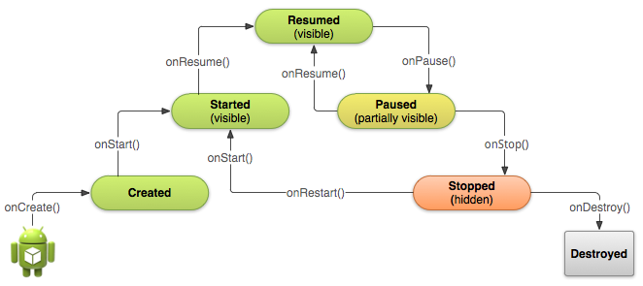
Activity life cycle

Slide 12
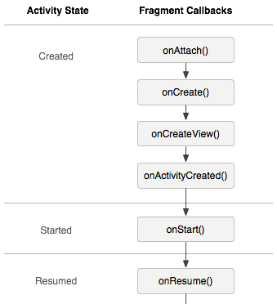
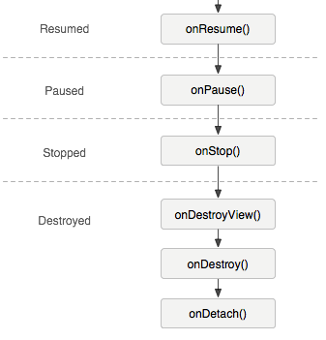
fragment life cycle

Slide 13
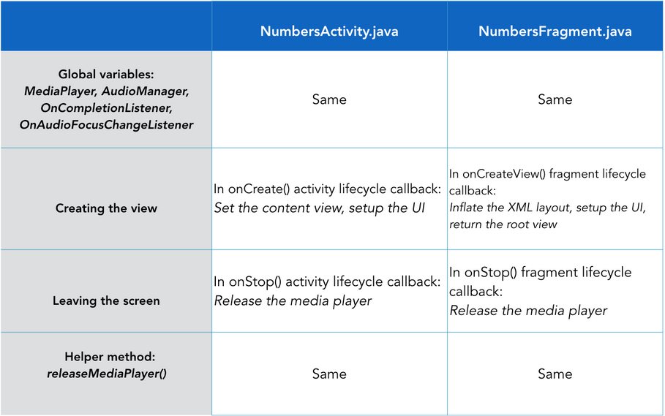
Refactor activitY into fragment

Slide 14
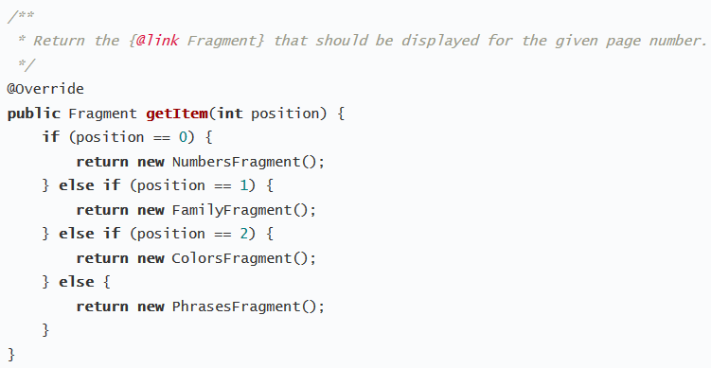
Modify the MainActivity

Slide 15
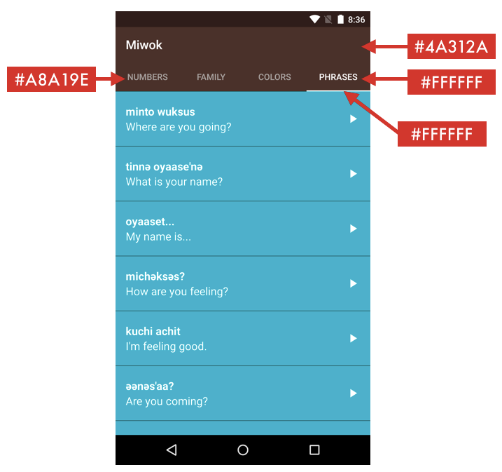
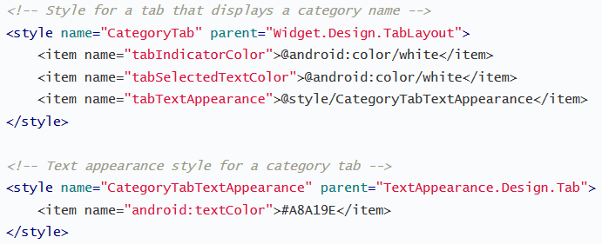
Visual Polish

Slide 16
Referensi
Lesson 5: Navigation Patterns Using Fragments
Android Basics: Multi-screen Apps
https://www.udacity.com/course/ud839

