Slide 1
Database In Android Apps
Indra Azimi, S.T., M.T.
D3 Teknik Informatika, Telkom University

Slide 2
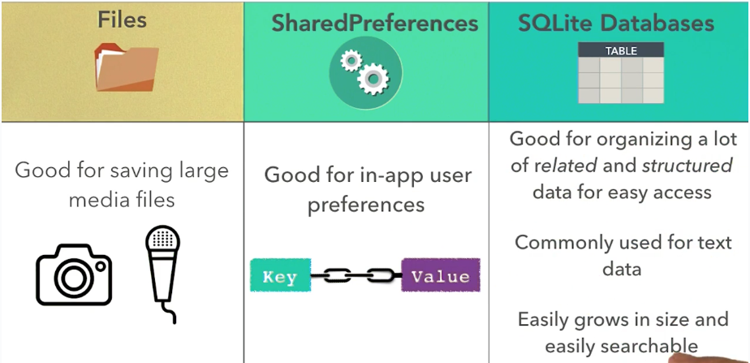
Data Storage Options

Slide 3
Types In SQLite
NULL. The value is a NULL value.
INTEGER. The value is a signed integer, stored in 1, 2, 3, 4, 6, or 8 bytes depending on the magnitude of the value.
REAL. The value is a floating point value, stored as an 8-byte IEEE floating point number.
TEXT. The value is a text string, stored using the database encoding (UTF-8, UTF-16BE or UTF-16LE).
BLOB. The value is a blob of data, stored exactly as it was input.

Slide 4
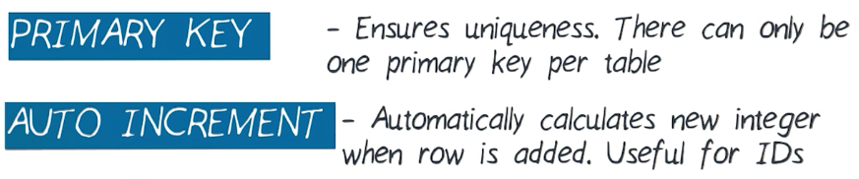

Table Constraints

Slide 5
SQLite Cheat Sheet
https://d17h27t6h515a5.cloudfront.net/topher/2016/September/57ed880e_sql-sqlite-commands-cheat-sheet/sql-sqlite-commands-cheat-sheet.pdf

Slide 6
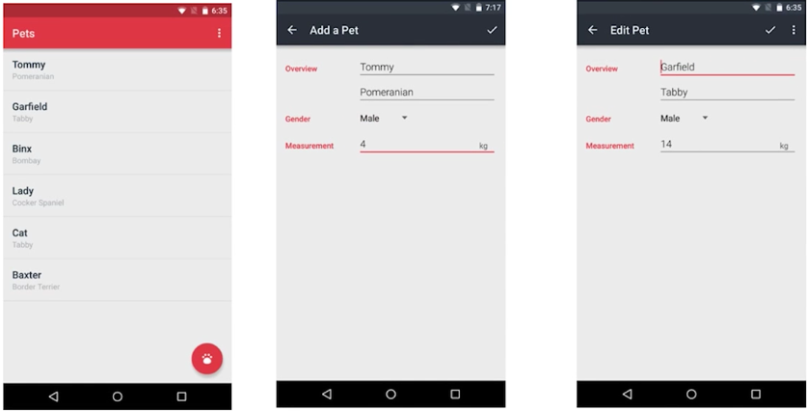
Pets App
Starter code:
https://github.com/udacity/ud845-Pets/archive/starting-point.zip

Slide 7
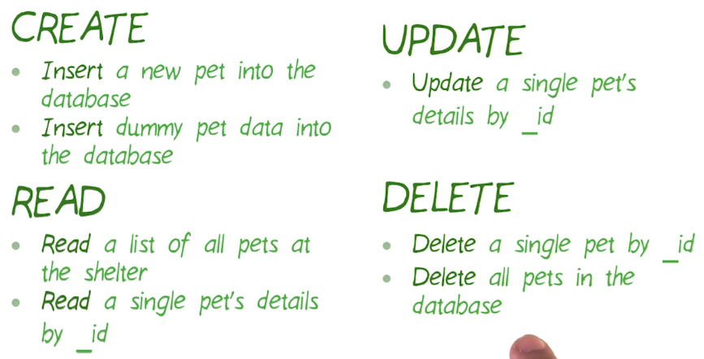
Features For Pets App

Slide 8
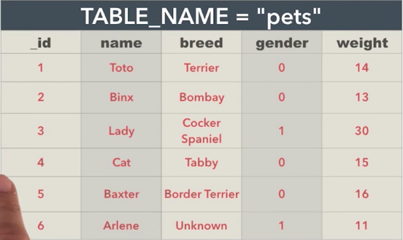
Pets Apps Database

Slide 9
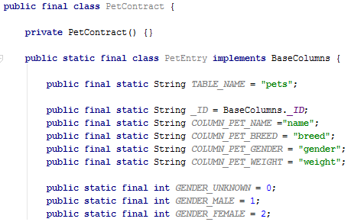
Define Schema & Contract

Slide 10
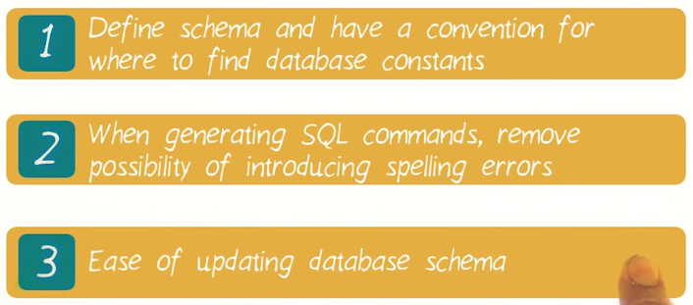
Why Using Contract Class?

Slide 11
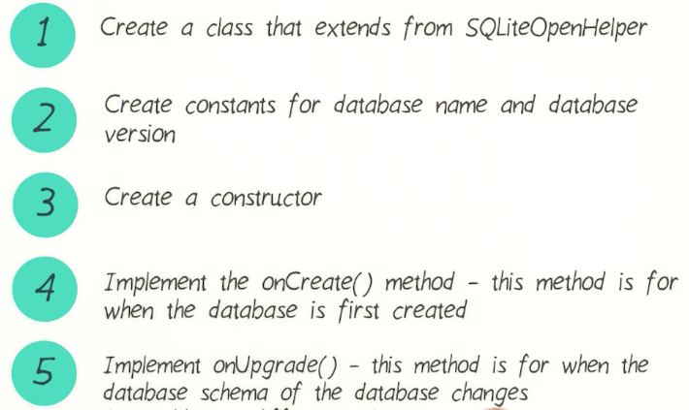
Create Database Using SQLiteOpenHelper

Slide 12
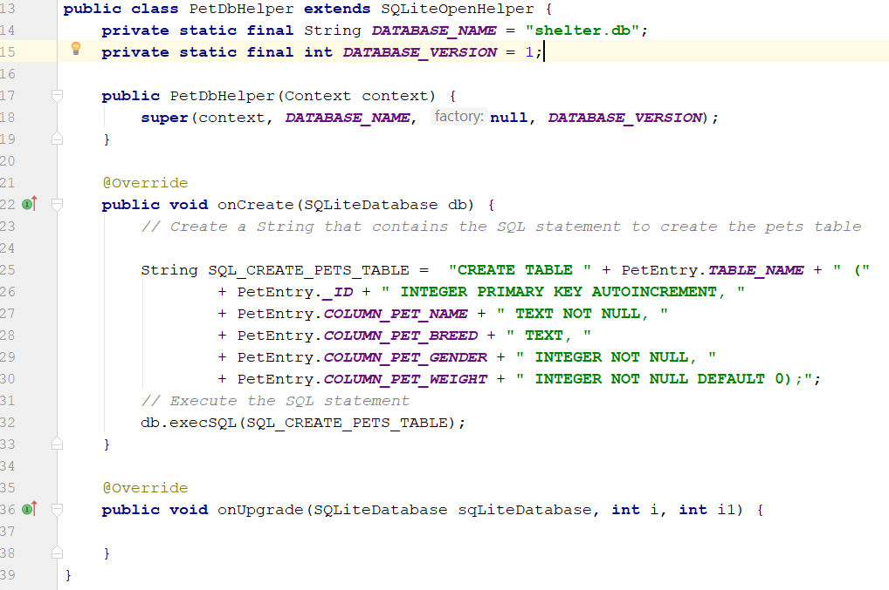
DBHelper example

Slide 13
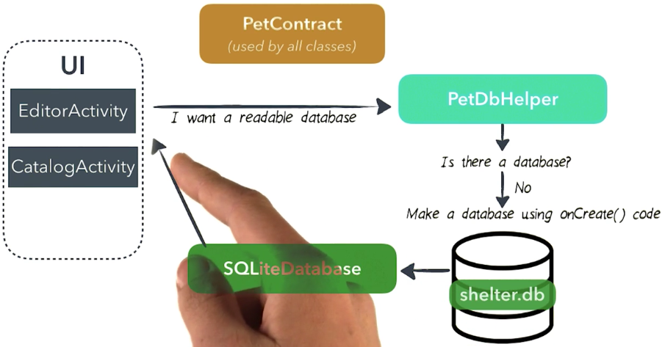
Get Database Connection
SQLiteDatabase

Slide 14
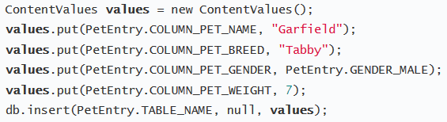
Inserting Data

Slide 15
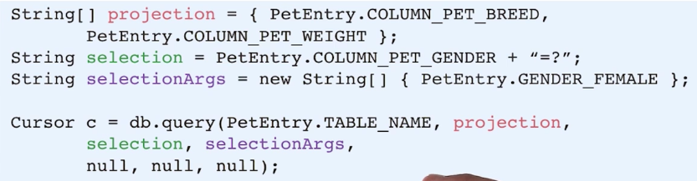
Reading Data

Slide 16
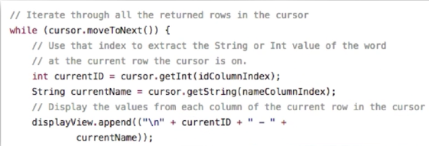
Reading Data (2)

Slide 17
Referensi
Lesson 1: Database Basics
Lesson 2: Using a Database in an Android App
Android Basics: Data Storage
https://www.udacity.com/course/ud8435

