Slide 1
Intro to Content Providers
Indra Azimi, S.T., M.T.
D3 Teknik Informatika, Telkom University

Slide 2
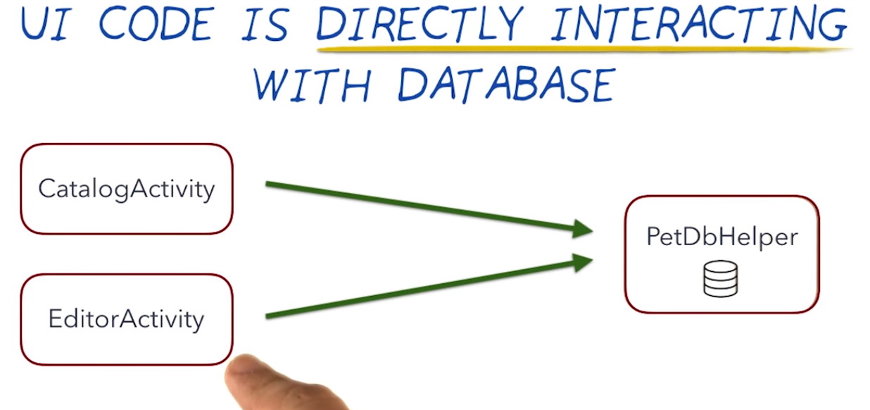
Our Current app

Slide 3
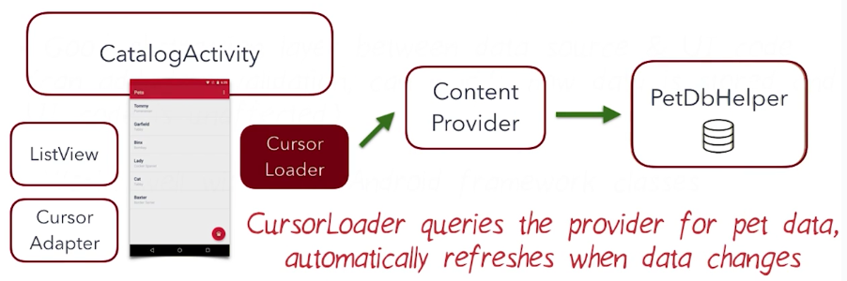
Our Goal

Slide 4
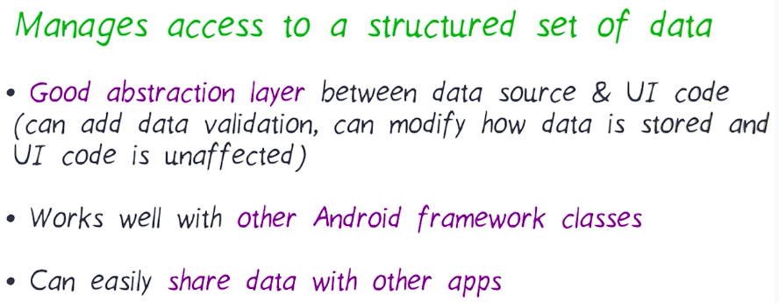
Why Content Provider?

Slide 5
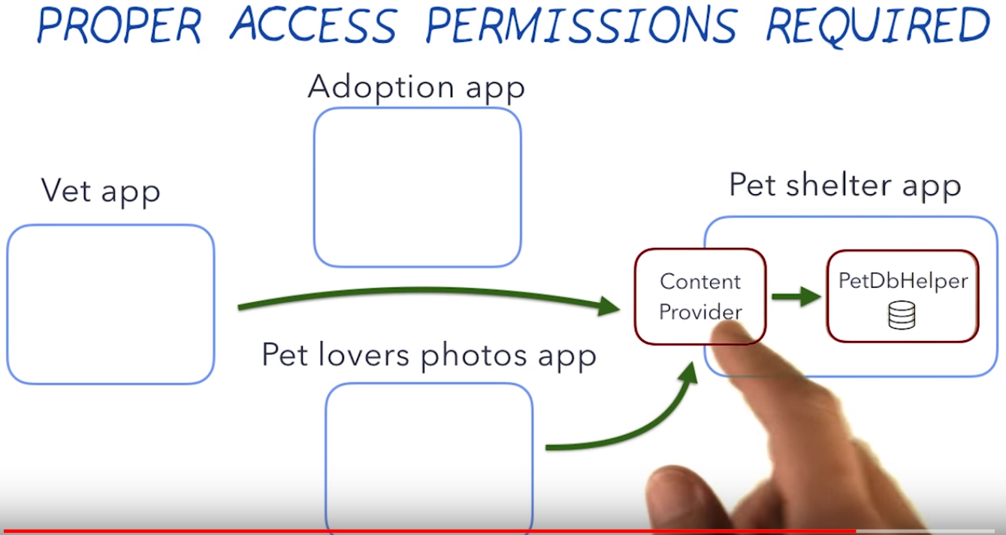
Share data with other app

Slide 6
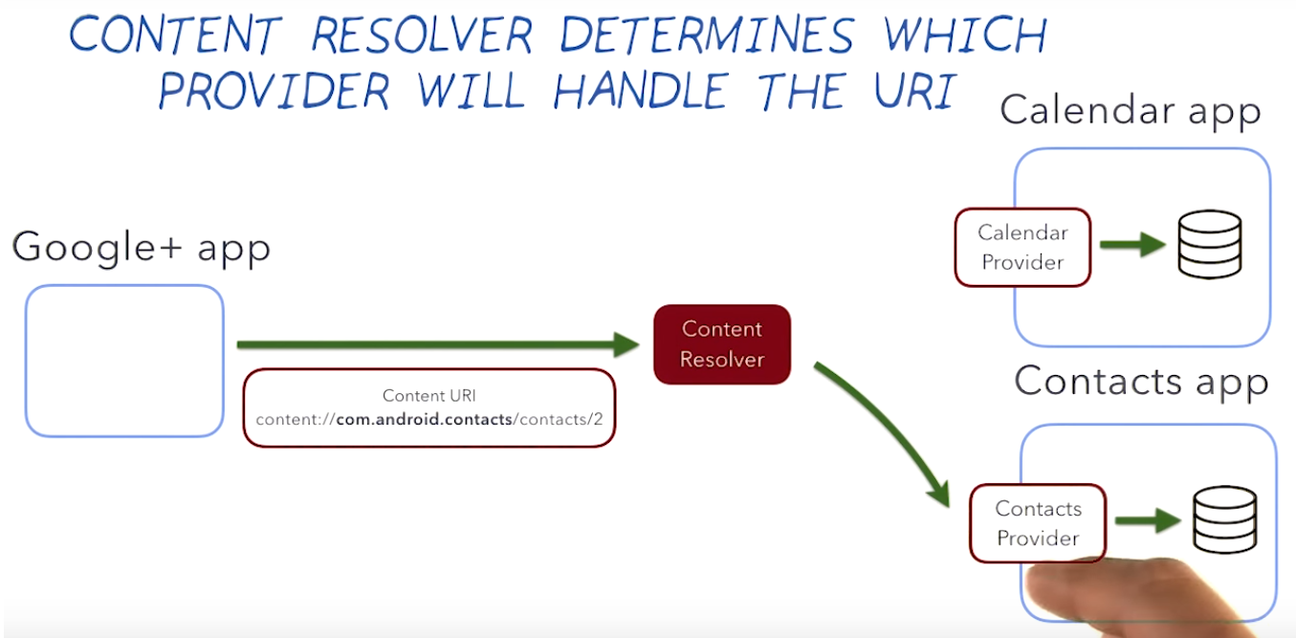
Content Resolver

Slide 7
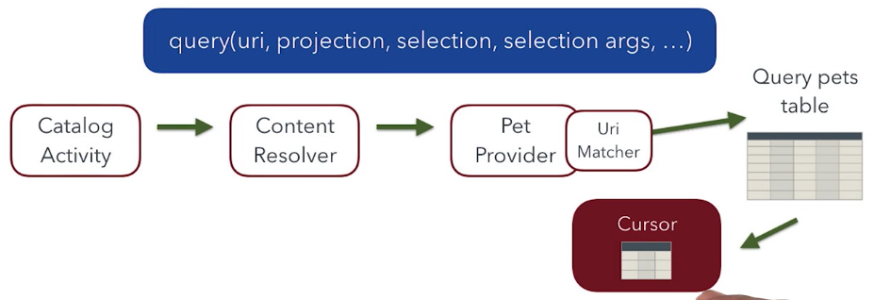
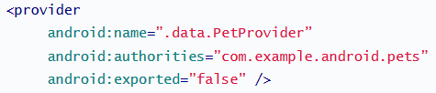
Content Provider Details

Slide 8
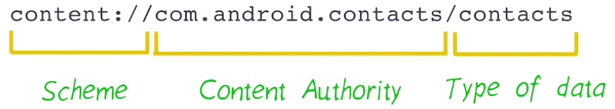
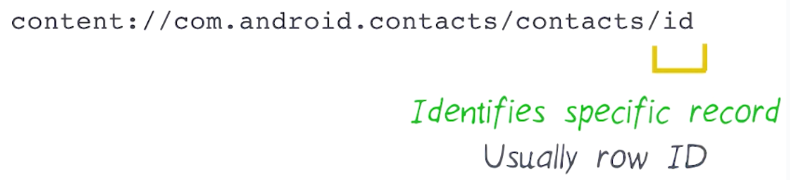
URI: Uniform Resource Identifier
Select ALL rows
Select SINGLE rows

Slide 9
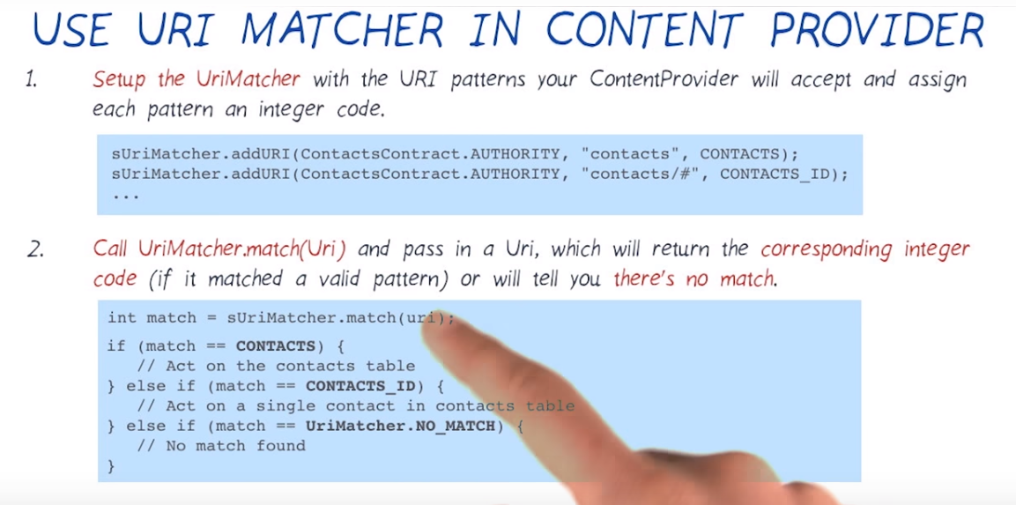
URI Matcher

Slide 10
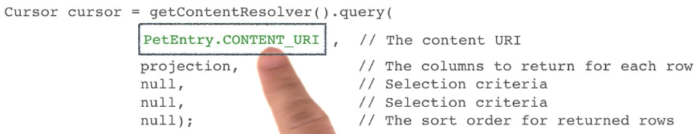
Using Content Provider

Slide 11
Sanity Check
Sanity checking data (data validation or input validation) means doing a quick test to make sure that the data is reasonable within your expectations.
Querying the data doesn’t make any changes to the database, so we don’t need to add any checks there. Deleting data doesn’t add new data either.
However, inserting and updating data DOES add new data to the database, so we need to sanity checks in those provider methods.

Slide 12
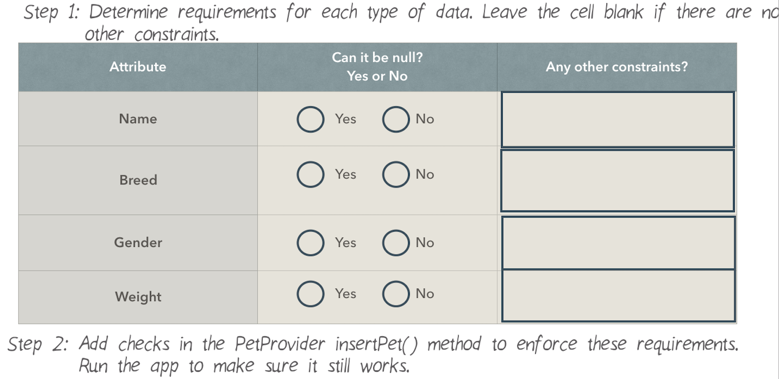
Sanity Check Step

Slide 13
ContentProvider getType()
Return a String that describes the type of the data stored at the input Uri. This String is known as the MIME type, which can also be referred to as content type.
The returned MIME type should start with “vnd.android.cursor.item” for a single record, or “vnd.android.cursor.dir/” for multiple items.
The MIME type strings start with the convention “vnd.android.cursor…”, are followed by the content authority, and the path to the data.

Slide 14
Referensi
Lesson 3: Intro to Content Providers
Android Basics: Data Storage
https://www.udacity.com/course/ud8435

