Slide 1
Json Parsing
Indra Azimi, S.T., M.T.
D3 Teknik Informatika, Telkom University

Slide 2
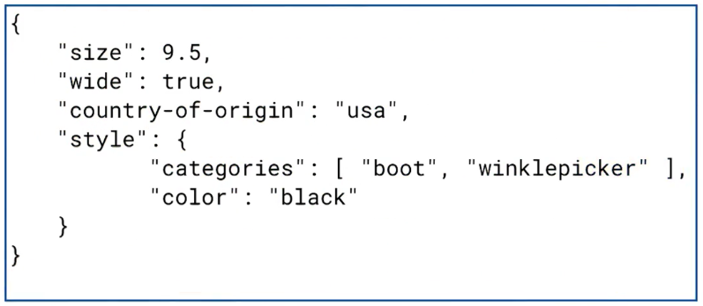
JSON: KEY Value Pairs
JSON (JavaScript Object Notation) is a lightweight data-interchange format.

Slide 3
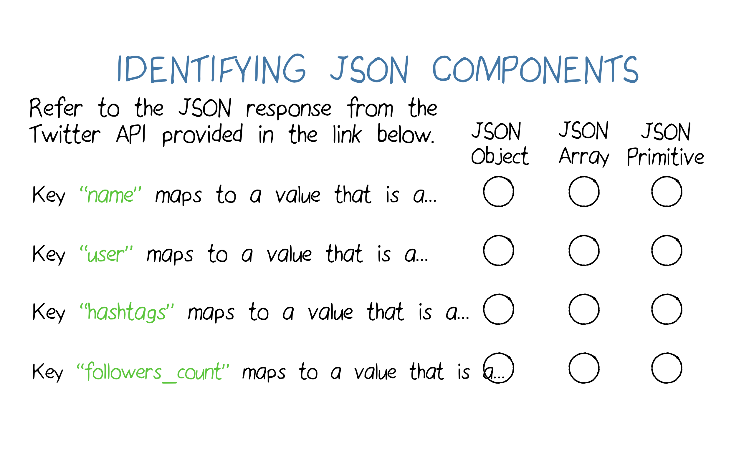
Identify JSON Components
https://developer.twitter.com/en/docs/tweets/post-and-engage/api-reference/get-favorites-list

Slide 4
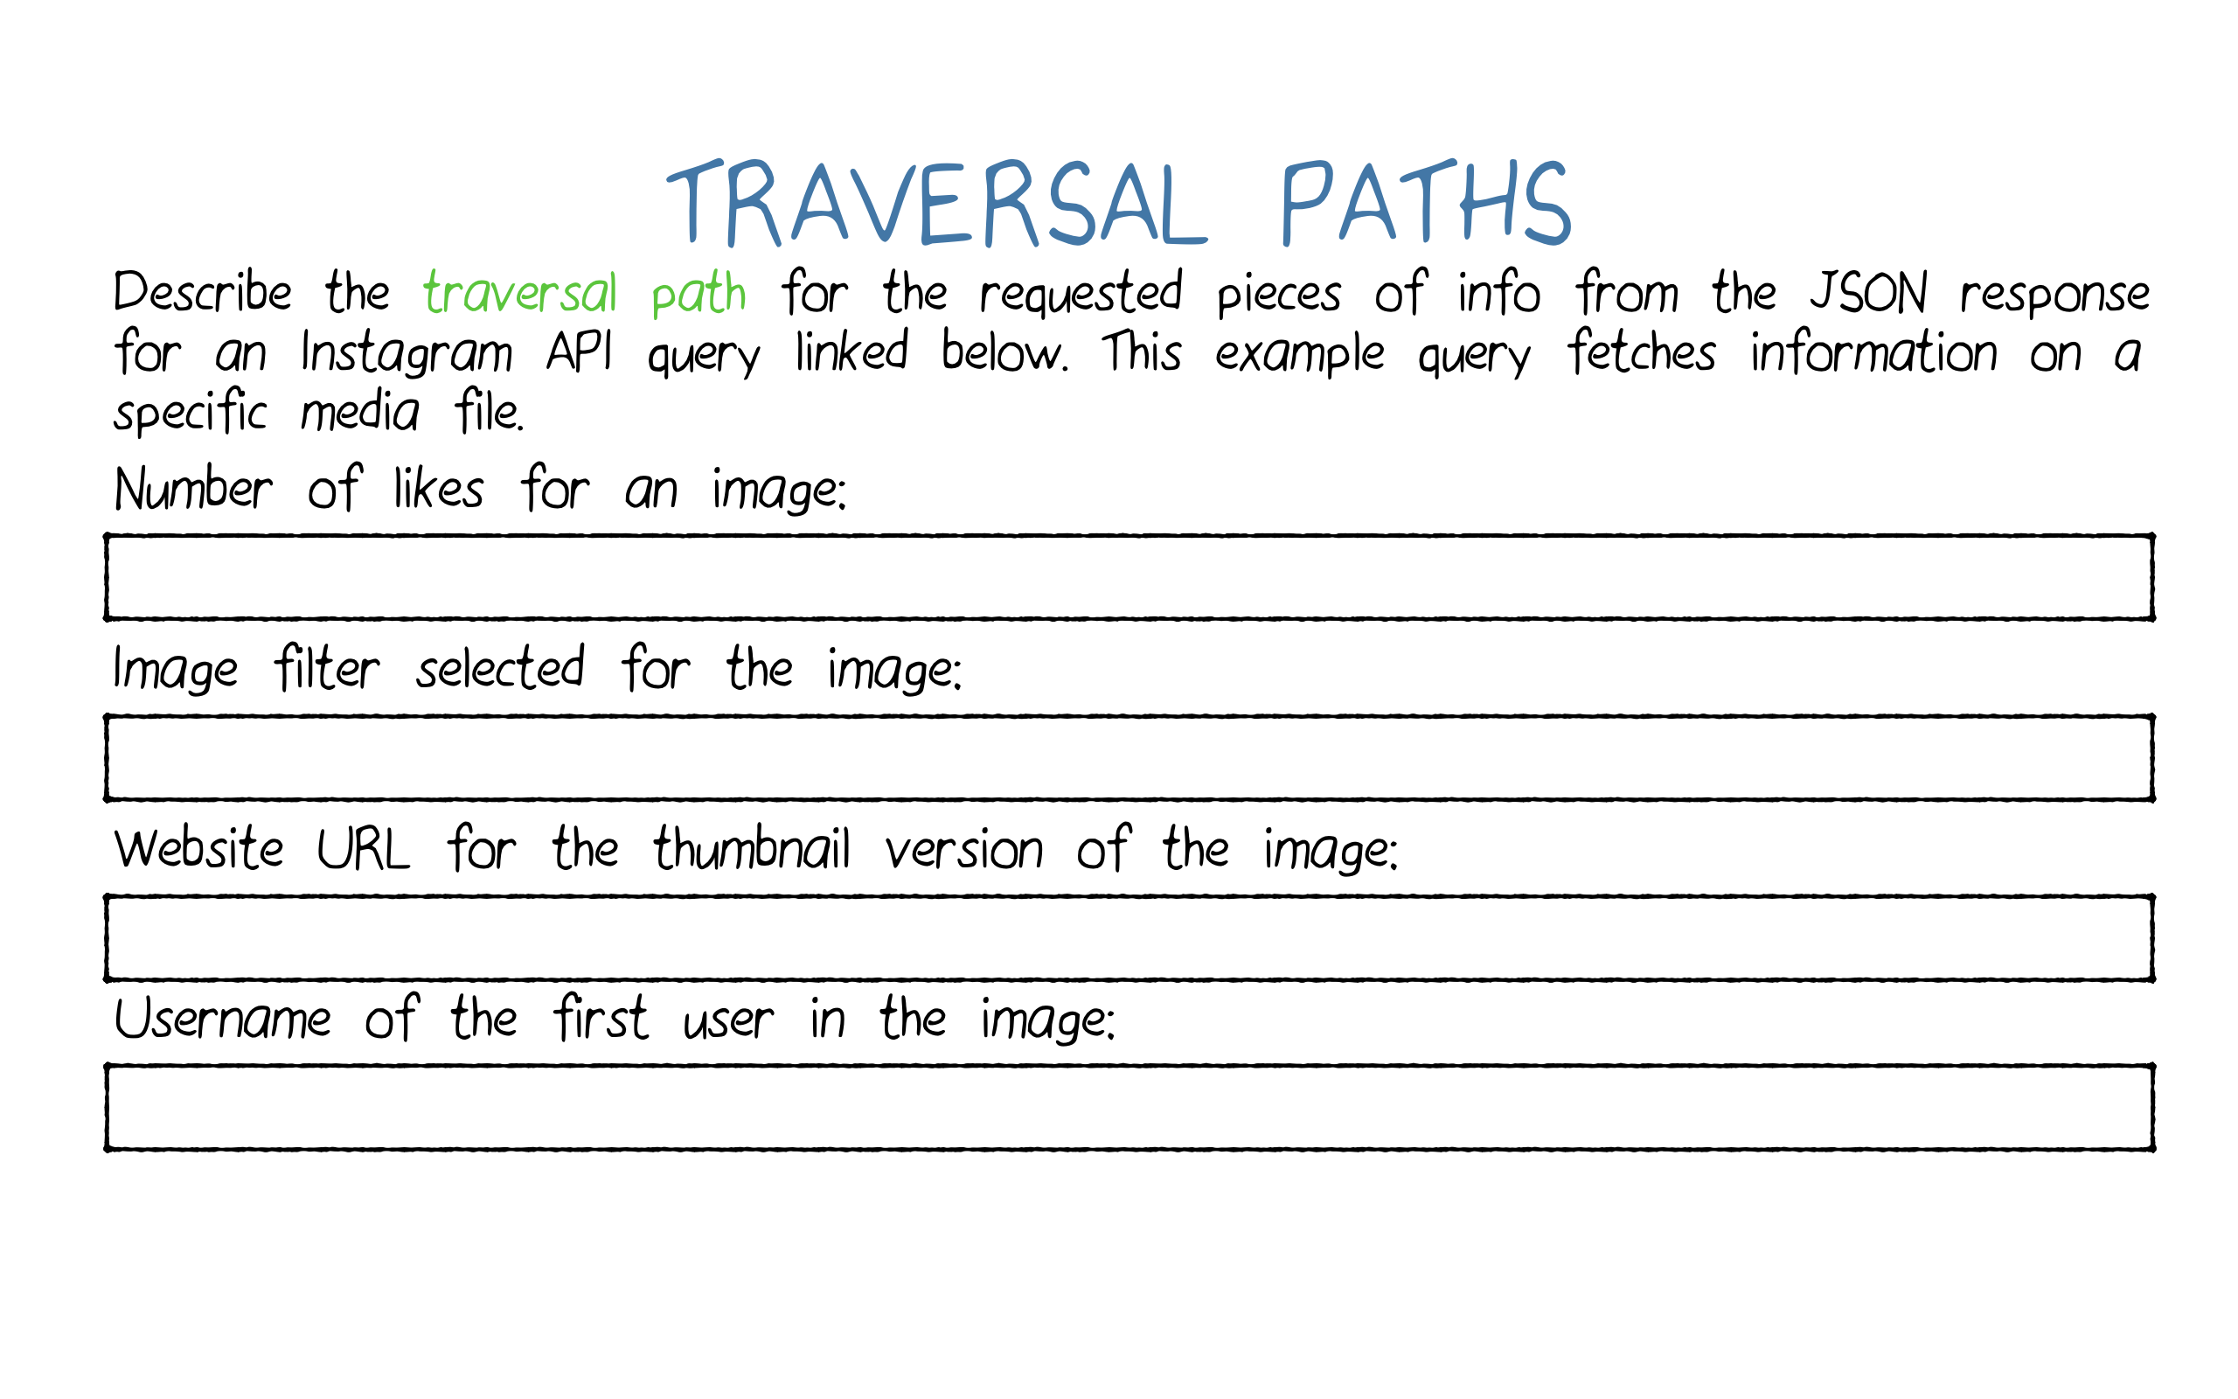
Traverse Nodes in JSON
https://www.instagram.com/developer/endpoints/media/#get_media

Slide 5
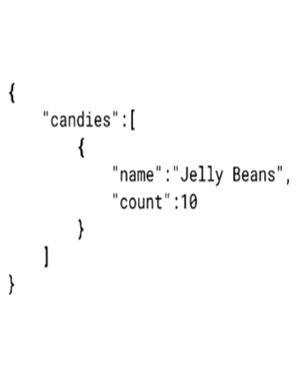
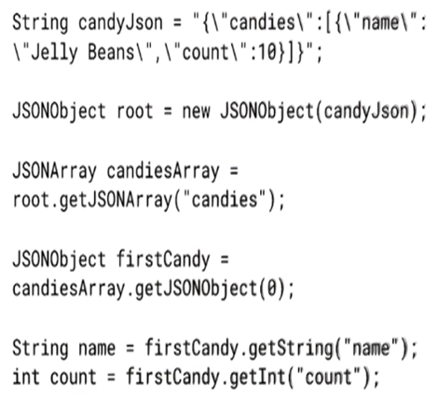
Parsing JSON in Android

Slide 6
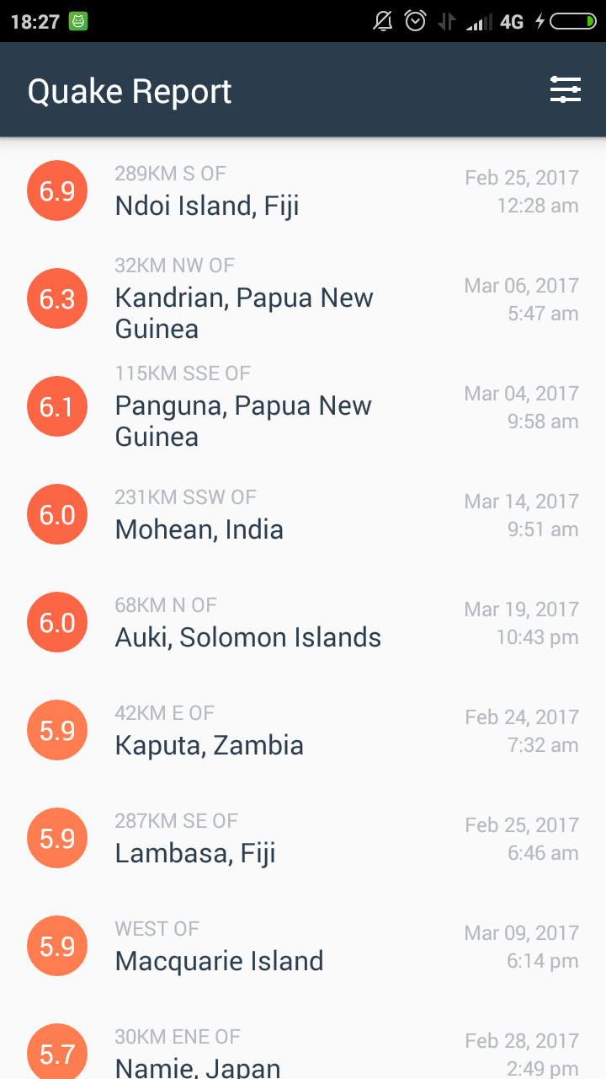
Quake Report
Aplikasi untuk mengetahui gempa bumi.
Download starter code dari link berikut ini:
https://github.com/udacity/ ud843-QuakeReport/archive/ starting-point.zip

Slide 7
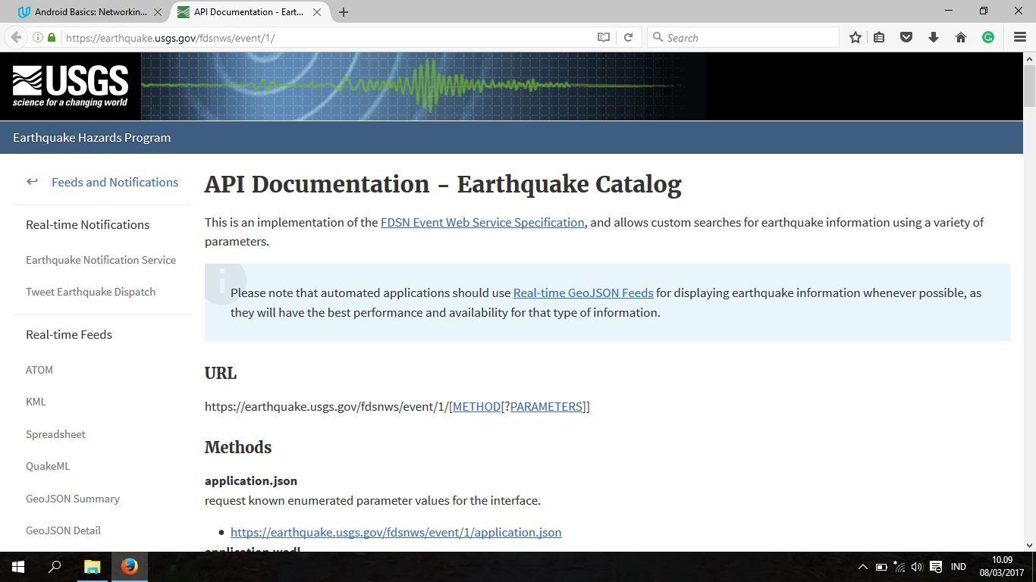
Earthquake Data API
https://earthquake.usgs.gov/fdsnws/event/1/

Slide 8
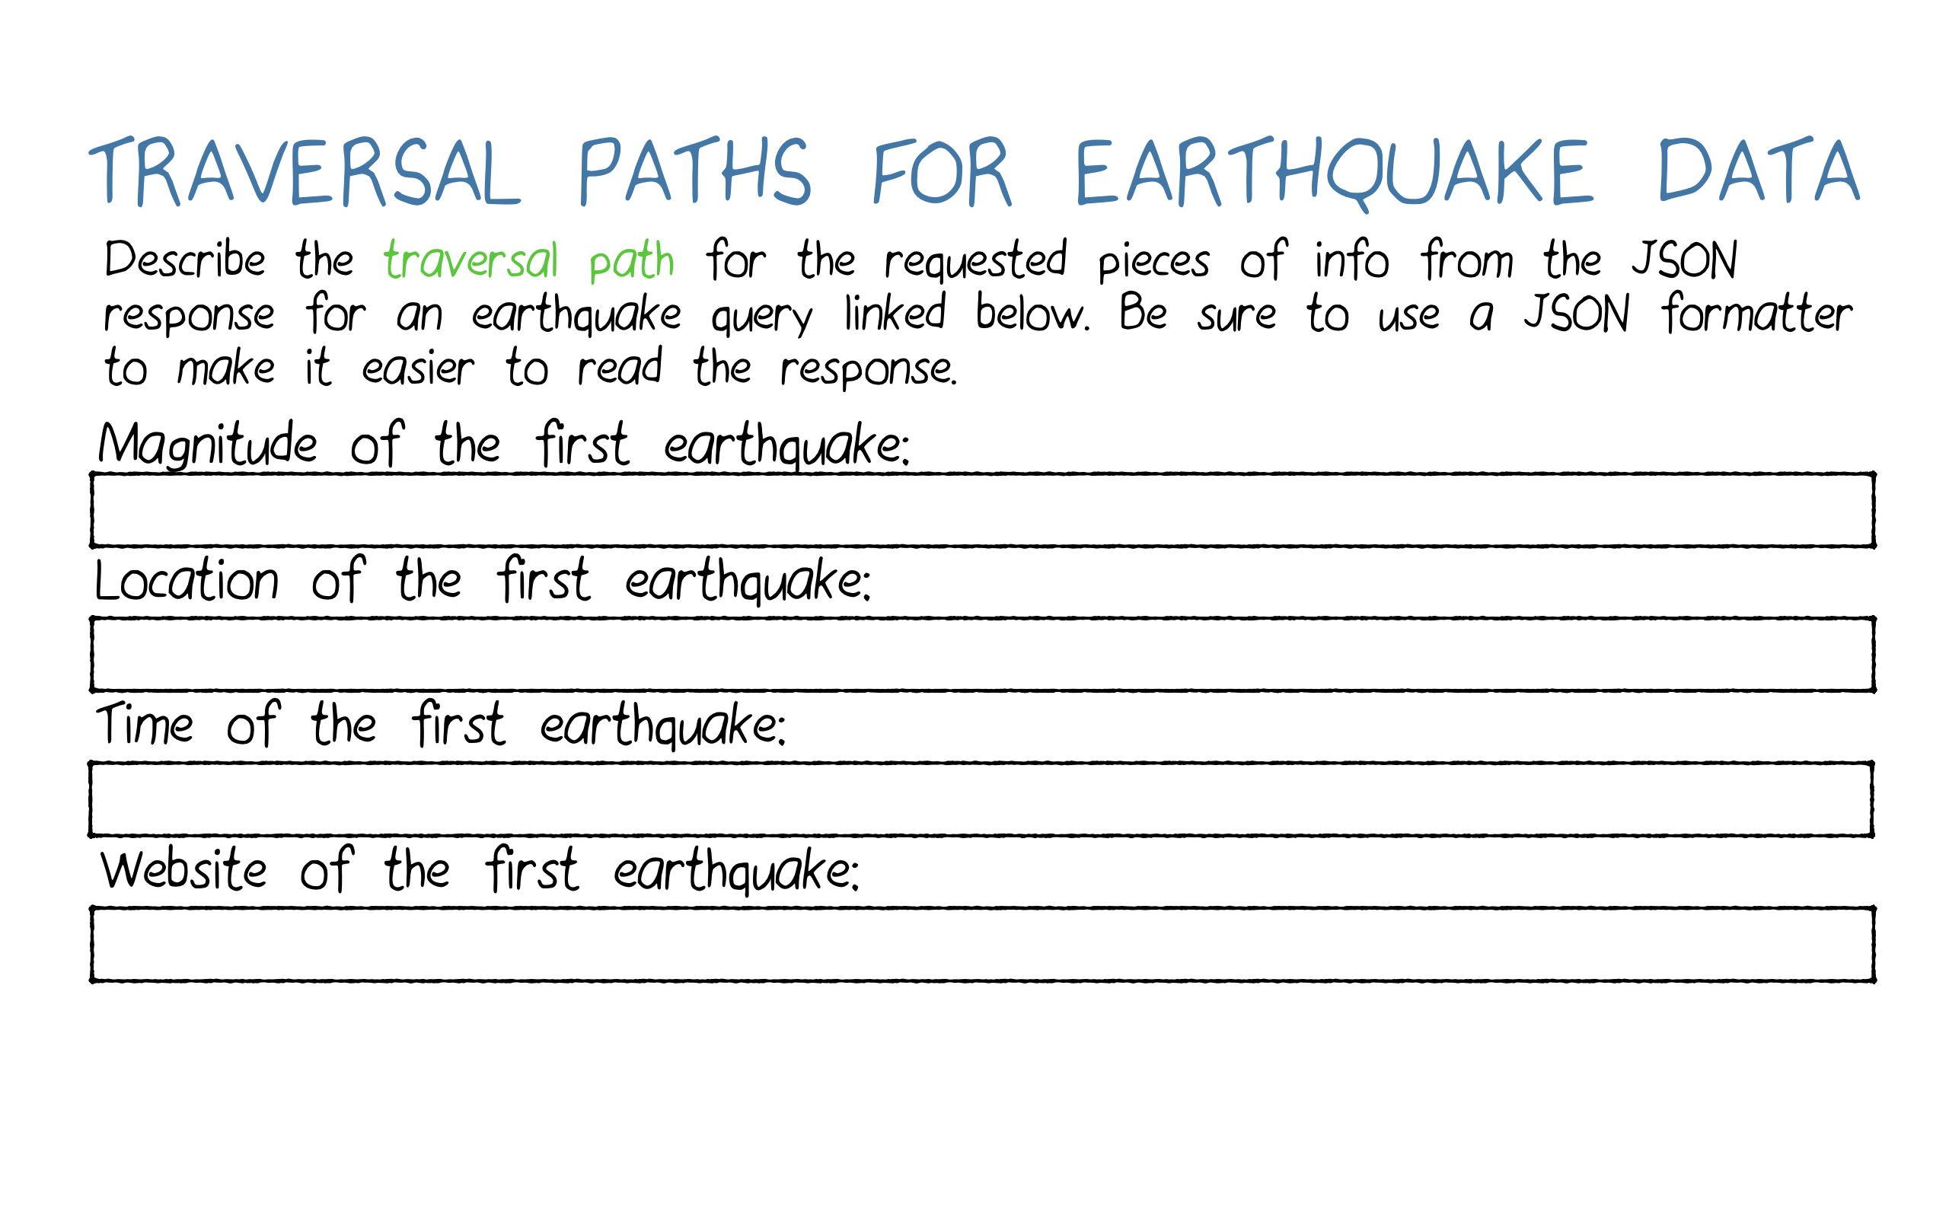
Traverse Nodes in JSON
https://earthquake.usgs.gov/fdsnws/event/1/query?format=geojson &starttime=2018-01-01&endtime=2018-01-31&minmag=6&limit=10

Slide 9
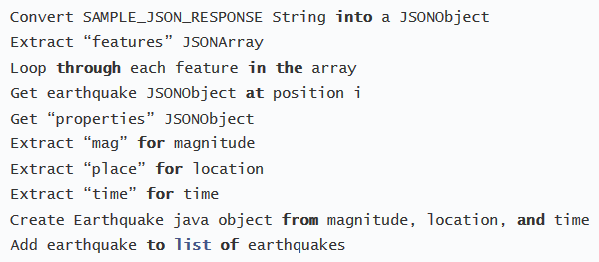
Parse JSON response

Slide 10
PLAN!
Apa yang harus kita lakukan?
Create list_item.xml
Create custom class
Create custom adapter
Modify main activity
Visual polish

Slide 11
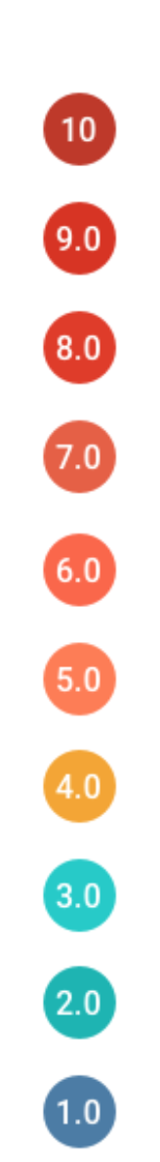
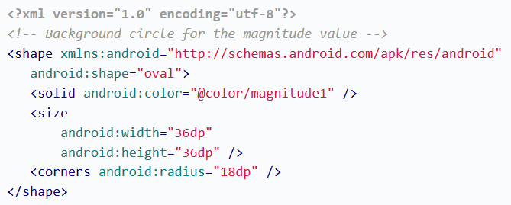
Circle Background

Slide 12
Circle Background
Magnitude | Color Name | Color Code
0 – 2 | magnitude1 | #4A7BA7
2 – 3 | magnitude2 | #04B4B3
3 – 4 | magnitude3 | #10CAC9
4 – 5 | magnitude4 | #F5A623
5 – 6 | magnitude5 | #FF7D50
6 – 7 | magnitude6 | #FC6644
7 – 8 | magnitude7 | #E75F40
8 – 9 | magnitude8 | #E13A20
9 – 10 | magnitude9 | #D93218
10 | magnitude10 | #C03823

Slide 13
Referensi
Lesson 1: JSON Parsing
Android Basics: Networking
https://www.udacity.com/course/ud843

