Slide 1
Menu And Preferences
Indra Azimi, S.T., M.T.
D3 Teknik Informatika, Telkom University

Slide 2
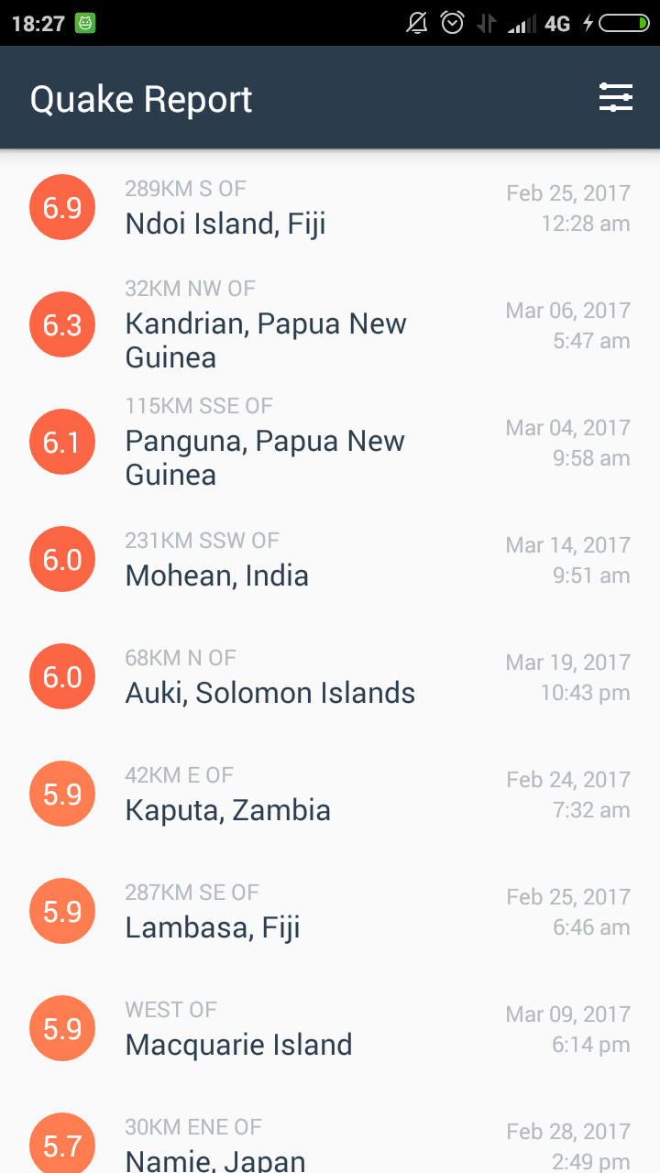
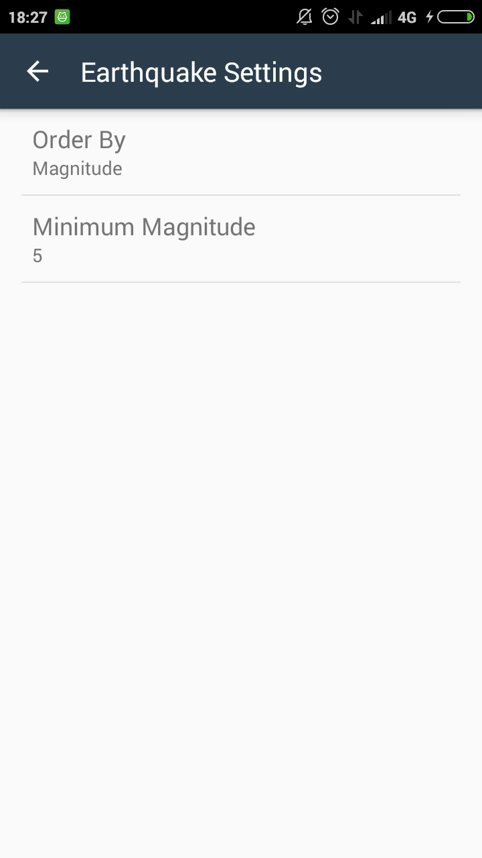

Slide 3
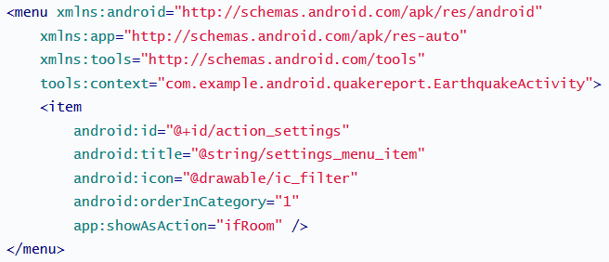
Menu In Android
http://developer.android.com/guide/topics/ui/menus.html

Slide 4
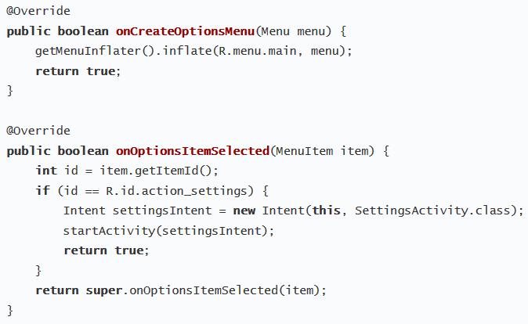

Slide 5
Preferences
A preference is really just a string key associated with a primitive type, String, or set of Strings.
Android will hold onto that data for you even when the app is closed, and even if the phone is turned off.
SharedPreferences handles all the details of reading and writing preference data to the persistent storage (which is a file) on the device.

Slide 6
Preference Screen
Use Android's Preference APIs to build an interface that's consistent with the user experience in other Android apps (including the system settings).
CheckBoxPreference
DialogPreference
EditTextPreference
ListPreference
MultiSelectListPreference
RingtonePreference
SwitchPreference
TwoStatePreference

Slide 7
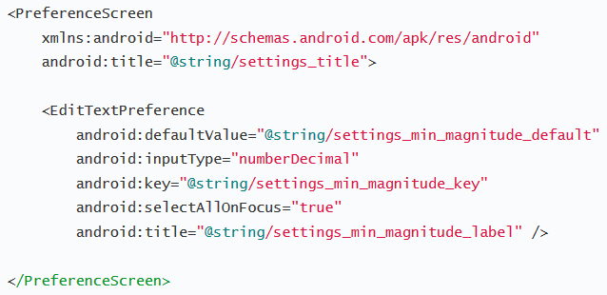
Preference Screen

Slide 8
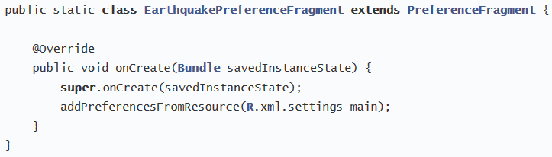
Preference Fragment

Slide 9
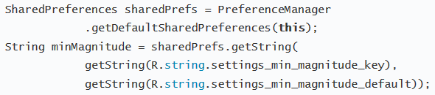
Reading Preference
The only time you should directly interact with the associated SharedPreferences file is when you need to read the value in order to determine your app's behavior based on the user's setting.

Slide 10
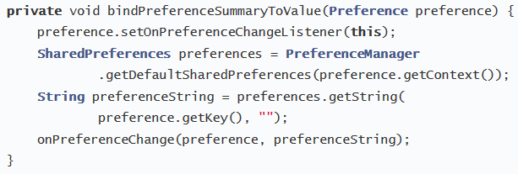
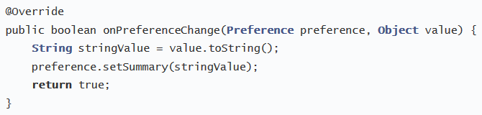
Listen Preference Change

Slide 11
Referensi
Lesson 4: Preferences
Android Basics: Networking
https://www.udacity.com/course/ud843

