Slide 1
Step 9 Provide Effective Feedback and Guidance and Assistance
HTT

Slide 2
Topic
Provide Effective Feedback
Guidance and Assistance

Slide 3
Provide Effective Feedback
feedback topics are discussed :
Acceptable response times.
Dealing with time delays.
Blinking for attention.
The use of sound.

Slide 4
Response times
The Fact Findings :
The optimum response time is dependent upon the task
Dissatisfaction with response time is a function of one’s uncertainty about delay
People will change work habits to conform to response time
Satisfaction with response time is a function of expectations
Constant delays are preferable to variable delays
Very fast or slow response times can lead to symptoms of stress

Slide 5
Web Page Download Times
Test participants rated the response times with the following results:
High (Good): Up to 5 seconds
Average: From 6 to 10 seconds
Low (Poor): Over 10 seconds
Other studies have found the following:
Longer delay times are tolerated by :
Novice users, Older users, People not experienced with high bandwidth connections, New visitors to a site, people performing important tasks, People performing successful tasks, Better content
Exceedingly slow sites can lead people to believe that they made an error

Slide 6
Web Page Download Times
Guideline:
Maximum downloading time should be about 10 seconds.
Use incremental or progressive image presentation.
Images should be
Small
Lean (Low bit depth, resolution, use of fewer colors, and so forth).
Reusable.
Contain pixel height and width dimensions in a tag.
Use thumbnail images to preview larger images.
Use simple background images

Slide 7
Dealing with Time Delays
Button click acknowledgement:
Acknowledge all button clicks by visual or aural feedback within one-tenth of a second.
Waits of up to 10 seconds:
If an operation takes 10 seconds or less to complete, present a “busy” signal until the operation is complete.
Display, for example, an animated hourglass pointer.
Waits of 10 seconds to 1 minute:
If an operation takes longer than 10 seconds to complete, display
A rolling barber’s pole or other large animated object.
Additionally, a progress indicator, percent complete message, or elapsed time message.

Slide 8
Dealing with Time Delays
Waits over 1 minute:
Present an estimate of the length of the wait.
Display a progress indicator, percent complete message, or elapsed time message.
Long, invisible operations:
When an operation not visible to the user is completed, present an acknowledgement that it is completed.
A message Or An auditory tone.
■ Progress indicator:
Along rectangular bar that is initially empty but filled as the operation proceeds.
Dynamically fill the bar.
Fill it with a color or shade of gray.
Fill it from left to right or bottom to top

Slide 9
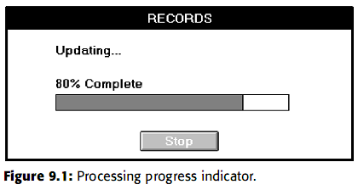
Dealing with Time Delays
Percent complete message: Useful if a progress indicator takes too long to update
Elapsed time message: A message that shows the amount of elapsed time
Web page downloads

Slide 10
Blinking for Attention
Attract attention by flashing an indicator when an application is inactive but must display a message to the user.
To provide an additional message indication, also provide an auditory signal (one or two beeps).
Display the message

Slide 11

Use of Sound
Always use in conjunction with a visual indication.
Use no more than six different tones.
Do not use : Jingles or tunes or Loud signals.
Use tones consistently.
Provide signal frequencies between 500 and 1,000 Hz.
Allow the user to adjust the volume or turn the sound off altogether.
Test the sounds with users over extended trial periods.
Use sounds sparingly

Slide 12
Guidance and Assistance
Preventing Error
Error
Slip
Mistakes
automatic behavior gone awry
results from forming a wrong model or goal and then acting on it
Everyone makes mistakes, so every mistake should be fixable

Slide 13
Problem Management
Prevention
Disable inapplicable choices.
For conversational dialogs, validate entries as close to point of entry as possible
Correction
Preserve as much of the user’s work as possible.
Always give a person something to do when an error occurs
Use selection instead of entry controls.
Accept common misspellings, whenever possible
Use aided entry.
Detection
At character level.
At control level.
When the transaction is completed or the window closed.
Do not obscure item in error.
At window-level validation, use a modeless dialog box to display an error list.

Slide 14
Providing Guidance and Assistance
Guidance can describe in
the form of the system’s hard copy,
online documentation,
computer-based training,
instructional or prompting messages, and
system messages,
Useful guidance and assistance answers the following questions:
What is this?
What does it do?
How do I make it do it?
What is its role in the overall scheme of things?

Slide 15
Problems with Documentation
factors contribute to bad design
Time scale
Organizational factors
Theoretical rationale.
Resources

Slide 16
How Users Interact with Documentation
three broad stages through which a reader interacts with documentation :
finding information that is relevant
understanding what the documentation says
applying that understanding to the current task to solve the problem

Slide 17
How Users Interact with Documentation
principles :
Help Facility
Instructions or Prompting
Contextual Help
Task-Oriented Help
Reference Help
Hints or Tips
Wizards

Slide 18
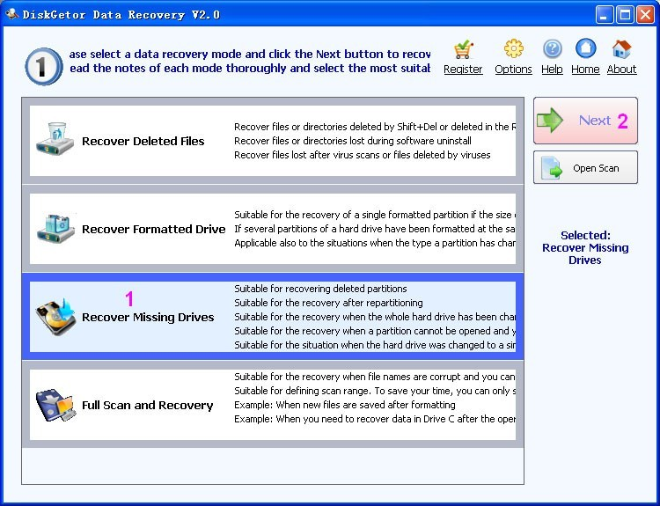
Instructions or Prompting
placed within the body of a screen
Prompting is provided to assist a person in providing what is necessary to complete a screen
Guidelines for writing instructions and prompts are covered in Step 8.

Slide 19

Help Facility
Help Facility Guidelines
Kind:
Training:
Availability:
Structure:
Interaction:
Location:
Content:
Style:
Consistency:
Title:

Slide 20

Contextual Help
Provides information within the context of a task being performed
Help Command Button
■ Description:
— A command button.
■ Purpose:
— To provide an overview of, summary assistance for, or explanatory information about the purpose or contents of a window being displayed.
■ Design guidelines:
–– Present Help in a secondary window or dialog box.

Slide 21

Contextual Help
Status Bar Message
■ Description:
An abbreviated, context-sensitive message related to the screen item with the focus.
Appears in window’s status bar when the primary mouse button is pressed over an item (or keyboard focus is achieved).
■ Purpose:
— To provide explanatory information about the object with the focus.

Slide 22

Contextual Help
ToolTip
Description:
A small pop-up window that appears adjacent to control.
Presented when the pointer remains over a control a short period of time.
Purpose:
Use to display the name of a control when the control has no text label.
Design guidelines:
Make application-specific ToolTips consistent with system-supplied ToolTips.
Use system color setting for ToolTips above to distinguish them.

Slide 23
Contextual Help
What’s This? Command
Description:
A command located on the Help drop-down menu on a primary window.
A button on the title bar of a secondary window.
A command on a pop-up menu for a specific object.
A button on a toolbar.
Purpose:
Use to provide contextual information about any screen object.
Design guidelines:
— Phrase to answer the question “What is this?”
— Indicate the action associated with the item.
— Begin the description with a verb.

Slide 24
Task-Oriented Help
Description:
A primary window typically accessed through the Help Topics browser.
Includes a set of command buttons at the top; Purpose:
To describe the procedural steps for carrying out a task.
Focuses on how to do something.
Design guidelines:
Provide one procedure to complete a task, the simplest and most common.
Provide an explanation of the task’s goals and organizational structure at the start.
Divide procedural instructions into small steps.
Present each step in the order to be executed.

Slide 25
Reference Help
Description:
An online reference book.
Typically accessed through a
Command in a Help drop-down menu.
Toolbar button.
Purpose:
To present reference Help information, either
Design guidelines:
Provide a consistent presentation style, following all previously presented guidelines.
Include a combination of contextual Help, and task-oriented Help, as necessary.
Include text, graphics, animation, video, and audio effects,

Slide 26
Wizards
Description:
A series of presentation pages displayed in a secondary window. — Include : Controls to collect input, Navigation command buttons.
Typically accessed through
Purpose:
To perform a complex series of steps.
To perform a task that requires making several critical decisions.
To enter critical data and for use when the cost of errors is high.
To perform an infrequently accomplished task.

Slide 27
Hints or Tips
Description:
A command button labeled Hints or Tips.
Purpose:
To provide a few important contextual, but specific, items of information related to a displayed screen
Design guidelines:
Provide guidance on only two or three important points.
Locate the button near where its guidance applies.
Write concisely and to the point

Slide 28
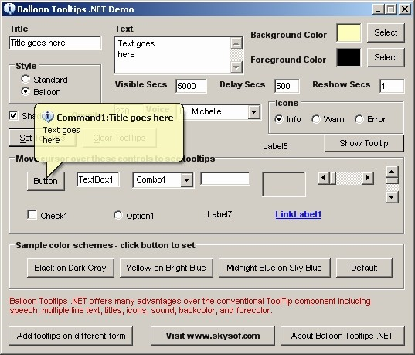

Slide 29
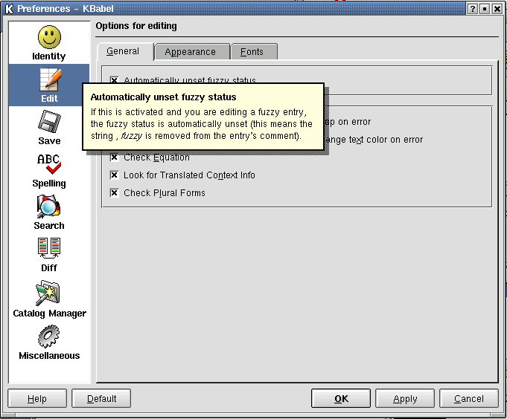

Slide 30
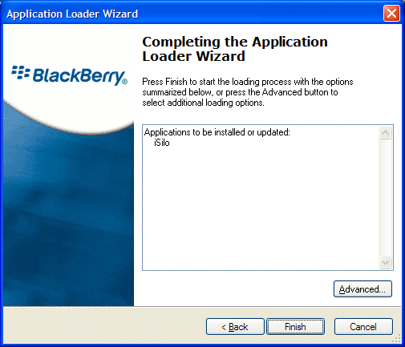

Slide 31
