Slide 1
KARAKTERISTIK ANTARMUKA GRAFIS DAN WEB
- HTT -

Slide 2
Tujuan Perkuliahan
Setelah mengikuti mata kuliah ini mahasiswa dapat:
Memahami perbedaan mendasar antara GUI dan Web UI
Mengerti dan menerapkan prinsip-prinsip pokok di dalam mendesain aplikasi sesuai dengan kebutuhan

Slide 3
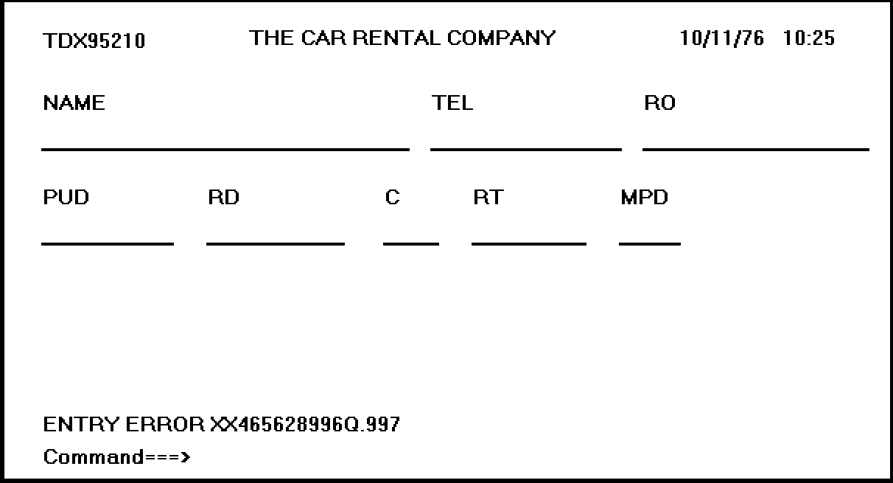
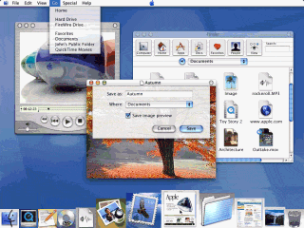
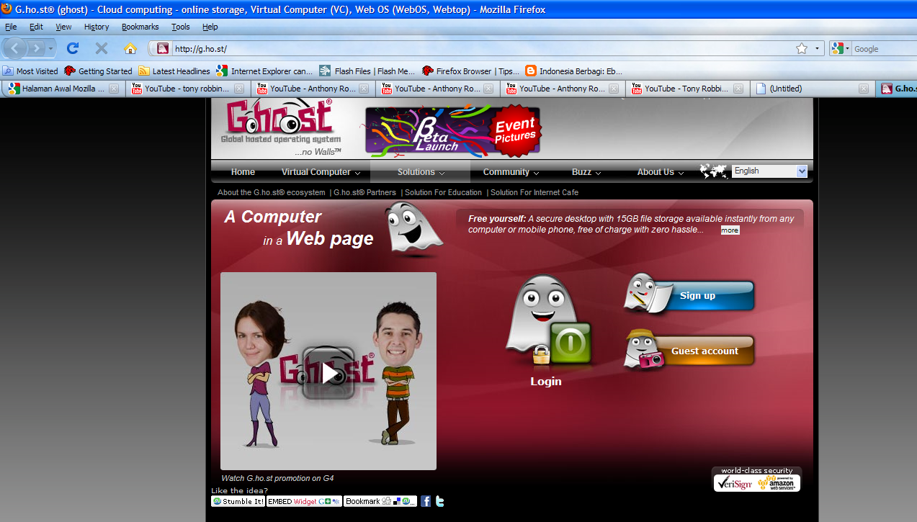
Text Based VS GUI VS Web UI
Text Based
GUI
Web UI
Karakteristik GUI berbeda dengan Text Based Interface
Karakteristik GUI berbeda juga dengan Web UI

Slide 4

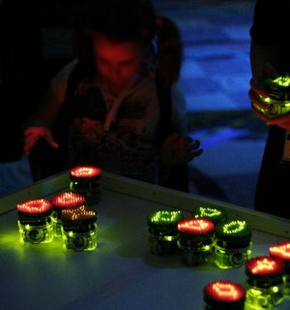
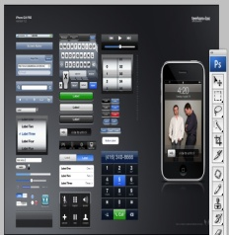

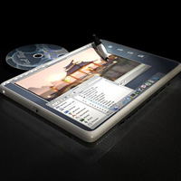
MENU KITA HARI INI :
Karakteristik GUI dan Web UI
INTERACTION STYLE
GUI and Web UI
The merging of graphical business systems and the web
Principles of UI Design

Slide 5
INTERACTION STYLE
An interaction style is simply the method, or methods, by which the user and a computer system communicate with one another
Beberapa jenis Interaction Style :
Command line
Menu Selection
Form Fill in
Direct Manipulation
Anthropomorphic

Slide 6

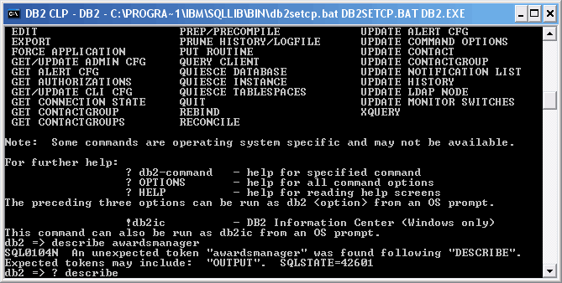
COMMAND LINE
Merupakan interaction style paling awal dari teknologi komputer
Powerfull for Advanced user
Complex Syntax
“Low error tolerant” sehingga bisa menyebabkan user frustasi

Slide 7
MENU SELECTION
Trend UI saat ini di berbagai macam
aplikasi
Utilize a person with much stronger
Recognition
Membantu bagi infrequent user
Label Menu harus dimengerti dan
memiliki arti yang jelas

Slide 8
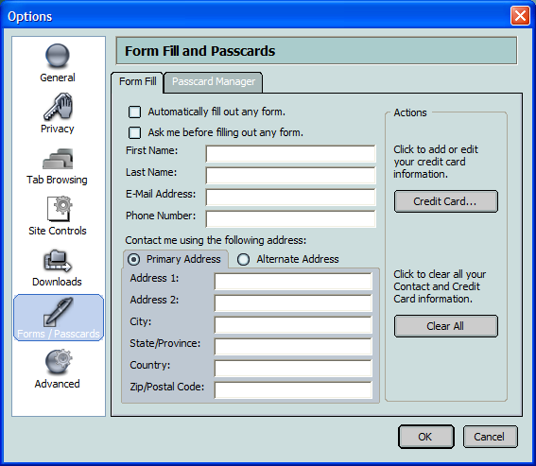
FORM FILL IN
Sangat berguna untuk mengambil
Informasi
Membutuhkan typing skill yang tinggi
Familiar dengan paper form di dunia
nyata

Slide 9
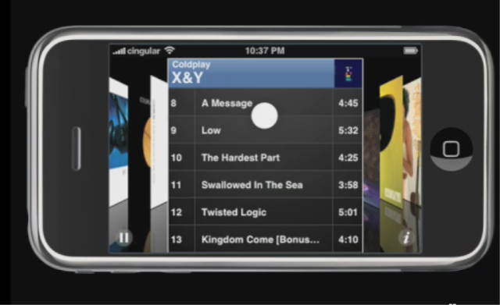
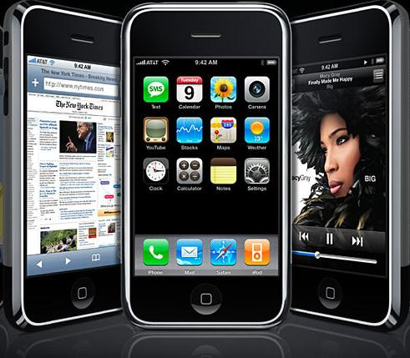
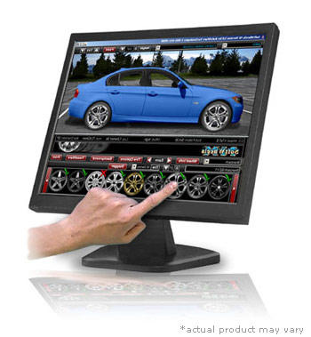
DIRECT MANIPULATION
Memungkinkan User berinteraksi secara
langsung bahkan memanipulasi objek
yang tampil di layar

Slide 10

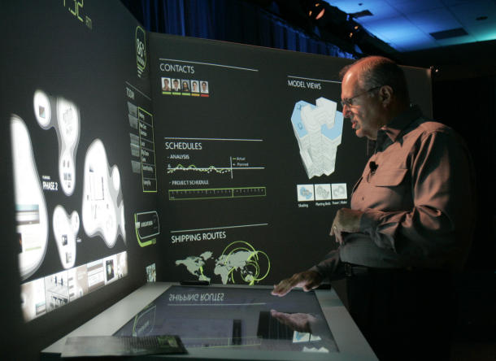
ANTHROPOMORPHIC
An Anthropomorphic interface tries to interact with people the same way people interact with each other. This include spoken natural language dialogues, hand gestures, facial expression and eye movements.

Slide 11
INTERACTION STYLE SUMMARY
STYLE | ADVANTAGES | DISADVANTAGES
Command Line | Powerfull, Flexible, Appeals to expert user, Conserves screen space | Commands must be memorized, requires big learning effort, intolerant of typing errors
Menu Selection | Utilizes recognition memory, reduces interaction complexity, aids decision making process, minimize typing, aids casual users | Consumes screen space, may create complex menu hierarchies, may slow knowledgeable users
Form Fill in | Familiar format, simplifies information entry, requires minimal training | Consumes screen space, requires carefull and efficient design, does not prevent typing errors
Direct Manipulation | Faster Learning, easier remembering, exploits visual/spatial cues, easy error recovery, provides context, immediate feedback | Greater design complexity, window manipulation requirements, requires icon recognition, inefficient for touch typist, increased chance for screen clutter
Anthropomorphic | Natural | Difficult to implement

Slide 12

GUI VS WEB UI

Slide 13
GRAPHICAL USER INTERFACE (GUI)
KARAKTERISTIK SISTEM DIRECT MANIPULATION
Merupakan potret langsung dari kehidupan nyata
Object dan action selalu terlihat
Rapid and incremental Action with visible display of results
Incremental action are easily reversible

Slide 14
GRAPHICAL USER INTERFACE (GUI), cont..
STYLE | ADVANTAGES | DISADVANTAGES
Direct Manipulation | Faster Learning, easier remembering, exploits visual/spatial cues, easy error recovery, provides context, immediate feedback, more attractive, easily augmented with text display, low typing req. | Greater design complexity, window manipulation requirements, requires icon recognition, inefficient for touch typist, increased chance for screen clutter, note always familiat, human comprehension limitation, may consume more screen space, hardware limitation.

Slide 15
CHARACTERISTICS OF GUI
Sophisticated Visual Presentation
Pick and click interaction
A restricted set of interface solution
visualization
Object orientation
Extensive use of a person’s recognition memory
Concurrent performance of function

Slide 16
THE WEB USER INTERFACE
Initially, Web interface design was essentially the design of navigation and the presentation of information. It was about CONTENT not DATA.
Web Page VS Web Application
More user Control
Notes:
Web page VS Web Application ::
Web page’s design intent is to mostly provide information, An application is designed to let a person do and save something

Slide 17
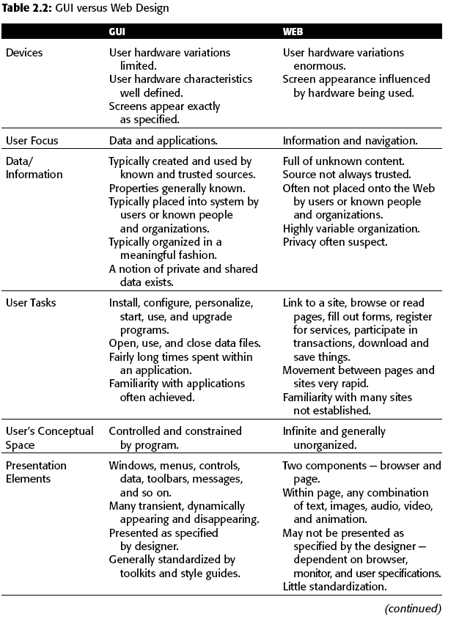

Slide 18
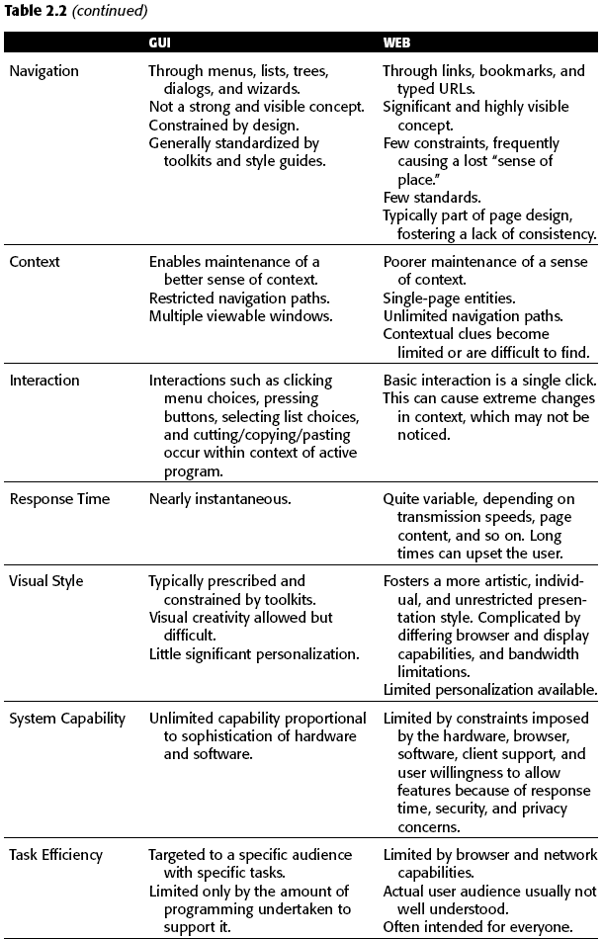

Slide 19
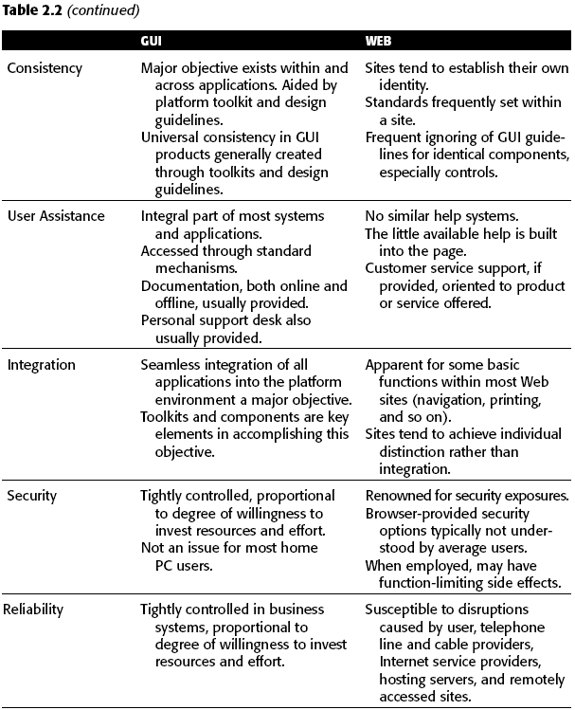

Slide 20
The merging of graphical business systems and the web
Dimension | Web Application | Web Page | In the middle of continuum
The Nature of the relationship with the user | Users must use the program, Users must identifiy, themselves or login to be able to do anything, The program must be reliable, and system failure will be immediately noticed Work is remembered from earlier session | The system does not care who the user are, Login is required to simply give access to more information than would be received anonymously, System failure may not be noticed | Minimal information such as a credit card number or address is remembered
The Conversation style | The style is formal | The style is casual , informal and generic | The style is polite but friendly
The Nature of the interaction | A Large amount of data is entered, complex task are being performed, data is being created, manipulated and permanently stored | No data is entered or changed | A small amount of data is entered and possibly stored, Milestones, checkpoints, endpoints are expected and included
The Frequency of use | It is used daily, it is used for long period (4-8 Hour), it is used to help resolve emergencies | It is used only occasionally, it is used for only few minutes at a time, it is used to find out about something | It is used periodically or episodically

Slide 21
Dimension | Web Application | Web Page | In the middle of continuum
The Perceived distance of the provider | It is viewed as being local in origin, it is viewed as being controlled locally by a data administrator, the response time is fast | The origin is unknown, the origin is viewed as originating somewhere else in the country or overseas, the response time is slow | The origin cannot ascertained or doesn’t matter
Real Time interaction | Data is fed in real time, the information is critical, a delay is life-threatening, long reponses exist but users remain | Time is irrelevant, long response delay exist and cause users to exit | Response is near real time
How much help will users need? | Intense training programs and experience are needed to use and become experts | Every visit is one time session, minimizing or eliminating the need for help | A minimum amount of experience, training or help material is needed
The interaction style | The navigation is controled, controls are complex, the syntax is obejct:Action, there is little or no reversibility, drag and drop manipulation is expected, exit requires users to log off | The navigation is flexible and simple, controls are simple, no object selection is required, action are easily reversed using the back button, no drag-drop manipulation exist, single clicking links are used to navigate | The navigation is flexible, simple data collection exist, user exits by closing web browser
The Presentation style | The Style is subdue and serious | The style is colorfull, graphic, possibly animated, the control are obvious and self explanatory | The style is cooler but attractive
Follow standards | Platform standard compliance exists, the style resembles or matches GUI standard | Few Cross site standard are followed, only intra-site consistently exists | Some common pattern exists

Slide 22
PRINCIPLES OF
UI DESIGN

Slide 23
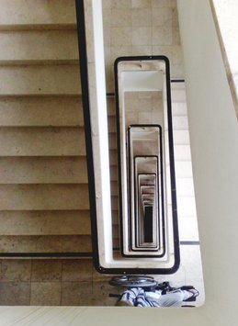
1
Accessibility
Systems should be designed to be usable, without modification, by as many people as possible.
Notes:
Four characteristics of accessible design are perceptibility, operability, simplicity, and
forgiveness. Perceptibility assures that a system’s design can be perceived, regardless of
a person’s sensory abilities. Operability assures that a system’s design can be used,
regardless of a person’s physical abilities. Simplicity assures that all users can easily
understand and use the system, regardless of experience, literacy, or concentration
level. Forgiveness assures that a system minimizes the occurrence of, and consequences
of, errors

Slide 24
2
Aesthetically Pleasing
■ Provide visual appeal by following these presentation and graphic design principles:
Provide meaningful contrast between screen elements.
Create groupings.
Align screen elements and groups.
Provide three-dimensional representation.
Use color and graphics effectively and simply.

Slide 25
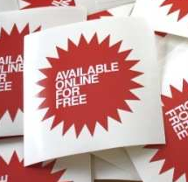
3
Availability
■ Make all objects available at all times.
■ Avoid the use of modes.

Slide 26

4
Clarity
The interface should be visually, conceptually, and linguistically clear including:
Visual elements
Functions
Metaphors
Words and text

Slide 27
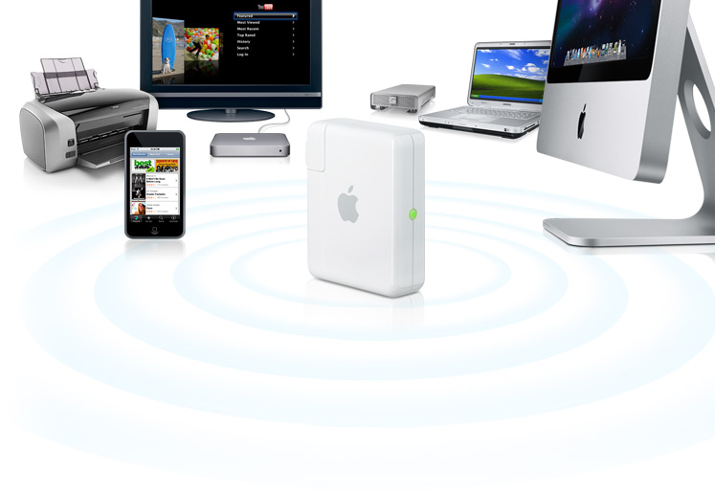
5
Compatibility
■ Provide compatibility with the following:
The user
The task and job
The product
■ Adopt the user’s perspective.

Slide 28
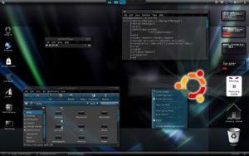
6
Configurability
■ Permit easy personalization, configuration, and reconfiguration of settings to do the following:
Enhance a sense of control.
Encourage an active role in understanding.

Slide 29
7
Consistency
■ A system should look, act, and operate the same throughout. Similar components should:
Have a similar look.
Have similar uses.
Operate similarly.
■ The same action should always yield the same result.
■ The function of elements should not change.
■ The position of standard elements should not change.
Notes:
In addition to increased learning requirements, inconsistency in design has several
other prerequisites and by-products, including:
■■ More specialization by system users.
■■ Greater demand for higher skills.
■■ More preparation time and less production time.
■■ More frequent changes in procedures.
■■ More error-tolerant systems (because errors are more likely).
■■ More kinds of documentation.
■■ More time to find information in documents.
■■ More unlearning and learning when systems are changed.
■■ More demands on supervisors and managers.
■■ More things to do wrong.

Slide 30
8
Control
■ The user must control the interaction.
Actions should result from explicit user requests.
Actions should be performed quickly.
Actions should be capable of interruption or termination.
The user should never be interrupted for errors.
■ The context maintained must be from the perspective of the user.
■ The means to achieve goals should be flexible and compatible with the user’s skills, experiences, habits, and preferences.
■ Avoid modes because they constrain the actions available to the user.
■ Permit the user to customize aspects of the interface, while always providing a proper set of defaults.
Notes:
Control is achieved when a person, working at his or her
own pace, is able to determine what to do, how to do it, and then is easily able to get it
Chapter 2: Characteristics of Graphical and Web User Interfaces 49
done. Simple, predictable, consistent, flexible, customizable, and passive interfaces
provide control. Lack of control is signaled by unavailable systems, long delays in system
responses, surprising system actions, tedious and long procedures that cannot be
circumvented, difficulties in obtaining necessary information, and the inability to
achieve the desired results.

Slide 31
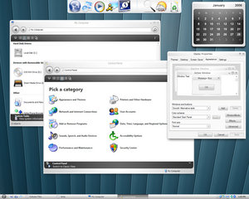
9
Directness
■ Provide direct ways to accomplish tasks.
Available alternatives should be visible.
The effect of actions on objects should be visible.

Slide 32
10
Efficiency
■ Minimize eye and hand movements, and other control actions.
Transitions between various system controls should flow easily and freely.
Navigation paths should be as short as possible.
Eye movement through a screen should be obvious and sequential.
■ Anticipate the user’s wants and needs whenever possible.

Slide 33

11
Familiarity
■ Employ familiar concepts and use a language that is familiar to the user.
■ Keep the interface natural, mimicking the user’s behavior patterns.
■ Use real-world metaphors.

Slide 34
12
Flexibility
■ A system must be sensitive to the differing needs of its users, enabling a level and type of performance based upon:
Each user’s knowledge and skills.
Each user’s experience.
Each user’s personal preference.
Each user’s habits.
The conditions at that moment.
Notes:
Flexibility is the system’s ability to respond to individual differences in people.
Flexibility is not without dangers. Generally as flexibility increases, a system’s
usability decreases.
Another problem with flexibility is that it may not always be used; some people prefer
to continue doing things in the way they first learned.

Slide 35
13
Forgiveness
■ Tolerate and forgive common & unavoidable human errors.
■ Prevent errors from occurring whenever possible.
■ Protect against possible catastrophic errors.
■ Provide constructive messages when an error does occur.

Slide 36
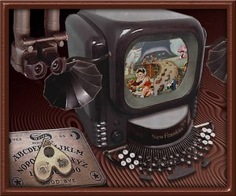
14
Immersion
■ Foster immersion within tasks.
Notes:
Immersion is fostered by one or more of the following conditions
being present (Csikszentmihalyi 1991, in Lidwell, et al., 2003):
■■ Challenges that can be overcome.
■■ Context where a person can focus without significant distraction.
■■ Clearly defined goals.
■■ Immediate feedback about actions and overall performance.
■■ A feeling of control over actions, activities, and the environment.
Immersion is characterized by the following:
■■ A loss of awareness of the worries and frustrations of everyday life.
■■ A loss of concern regarding matters of self (e.g., awareness of hunger or thirst).
■■ A modified sense of time (e.g., hours pass in what seems like minutes).

Slide 37
15
Obviousness
■ A system should be easily learned and understood. A user should know the following:
What to look at
What it is
What to do
When to do it
Where to do it
Why to do it
How to do it
■ The flow of actions, responses, visual presentations, and information should be in a sensible order that is easy to recollect and place in context.

Slide 38
16
Operability
■ Ensure that a system’s design can be used by everyone, regardless of physical abilities.
17
Perceptibility
■ Assure that a system’s design can be perceived, regardless of a person’s sensory abilities.
Notes:
Operability requires that a system always be usable, regardless of a person’s physical
abilities. Operability is achieved by minimizing repetitive actions and sustained
physical effort, fostering control use through making their intents obvious and their
sizes large enough for easy activation, and positioning screen information and controls
so they can be easily accessed whether sitting or standing. Operability also requires
that the design be compatible with assistive technologies.

Slide 39
Positive First Impression
Minimal barriers
Points of prospect
Progressive lures

Slide 40
18
Predictability
■ The user should be able to anticipate the natural progression of each task.
Provide distinct and recognizable screen elements.
Provide cues to the result of an action to be performed.
■ Do not bundle or combine actions.
■ All expectations should be fulfilled uniformly and completely.

Slide 41
19
Recovery
■ A system should permit:
Commands or actions to be abolished or reversed.
Immediate return to a certain point if difficulties arise.
■ Ensure that users never lose their work as a result of:
An error on their part.
Hardware, software, or communication problems.

Slide 42
20
Responsiveness
■ The system must rapidly respond to the user’s requests.
■ Provide immediate acknowledgment for all user actions:
Visual.
Textual.
Auditory.

Slide 43
21
Safety
■ Protect the user from making mistakes.
- Provide visual cues, reminders, lists of choices, and other aids either automatically or upon request.

Slide 44
22
Simplicity
■ Provide as simple an interface as possible.
■ Ways to provide simplicity:
- Use progressive disclosure, hiding things until they are needed.
• Present common and necessary functions first.
• Prominently feature important functions.
• Hide more sophisticated & less frequently used functions.
Provide an obvious visual hierarchy.
Provide defaults.
Minimize screen alignment points.
Make common actions simple at the expense of uncommon actions being made harder.
Provide uniformity and consistency.
Eliminate unnecessary elements.

Slide 45
23
Transparency
■ Permit the user to focus on the task or job, without concern for the mechanics of the interface.
- Workings & reminders of workings inside the computer should be invisible to the user.

Slide 46
24
Trade-Offs
■ Final design will be based on a series of trade-offs balancing often-conflicting design principles.
■ People’s requirements always take precedence over technical requirements.

Slide 47
25
Visibility
■ A system’s status and methods of use must be clearly visible.
■ Improve visibility through:
Hierarchical organization.
Context sensitivity.

