Slide 1
Step - 7
Screen-Based Control

Slide 2
Agenda
Identifying the characteristics and capabilities of the various screen controls
Selecting the proper controls for the user and tasks

Slide 3
Screen Control
Sometimes called ‘widgets’
Widgets: the elements of a screen that constitute its body.
Definition: graphic objects that represent the properties or operations of other objects
Functions:
Permit the entry or selection of a particular value
Permit the changing or editing of a particular value
Display only a particular piece of text, value, or graphic
Cause a command to be performed
Possess a contextual pop-up window

Slide 4
Three Extremely Important Principles
A control must:
Look the way it works
Work the way it looks
“Look” → “enterability” or “clickability”
Used exactly as its design intended
Presented in a standard manner
Example:
Windows XP:
Raised elements can be pressed
Recessed elements can not be pressed
Elements on a flat white background can be opened, edited, or moved.

Slide 5
Fact about Web page design
Unleashed and exposed thousands of instances
Basic principles have been violated
Placing greater value on personal creativity than on interface usability

Slide 6
Operable Controls
… are those that permit:
Entry
Selection
Changing
Editing
Cause a command to be performed
Here are the classes… (next slide)

Slide 7

1 – Operable Buttons
Description
A square or rectangular-shaped control with a label inside that indicates action to be accomplished
The label may consist of text, graphics, or both
Purpose
To start actions
To change properties
To display a pop-up menu
There are two kinds:
Toolbar buttons
Command buttons

Slide 8
1 – Operable Buttons
Advantages
Always visible, reminding one of the choices available
Convenient
Can be logically organized in the work area
Can provide meaningful descriptions of the actions that will be performed
Larger size generally provides faster selection target
Can possess 3-D appearance
Adds an aesthetically pleasing style to the screen
Provides visual feedback through button movement when activated
May permit use of keyboard equivalents and accelerators
Faster than using a two-step menu bar/pull-down sequence
Disadvantages
Consumes screen space
Size limits the number that may be displayed
Requires looking away from main working area to activate
Requires moving the pointer to select

Slide 9
1 – Operable Buttons
To a window:
To cause something to happen immediately
To display another window
To display a menu of options
To set a mode or property value
In a web
Use links to show information
Things to consider:
Usage
Structure
Labels
Size
Number
Location & layout
Organization
Intent indicators
Expansion buttons
Default
Keyboard equivalent / accelerators
Button activation

Slide 10
2 – Text Entry / Read only controls
Usually referred as “field” or “text-box”
Unprotected: a text box into which information can be keyed
Protected: A text box used for display purposes only
Description
Usually rectangular in shape
Usually possesses a caption or label describing the kind of information contained within it
Two types exist
Single-line
Multiple-line
When first displayed, the box may be blank or contain an initial value
Purpose
To permit the display, entering, or editing of textual information
To display read-only information

Slide 11
2 – Text Entry / Read only controls
Advantages
Very flexible
Familiar
Consumes little screen space
Disadvantages
Requires use of typewriter keyboard.
Requires user to remember what must be keyed
Proper usage
Most useful for data that is
Unlimited in scope
Difficult to categorize
Of a variety of different lengths
When using a selection list is not possible

Slide 12

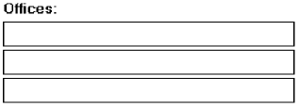

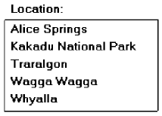

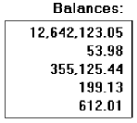

2 – Text Entry / Read only controls
Single occurrence
Multiple occurrence
Or
Read-only / display
Segmentation
If alphanumeric then
left justify
If numeric then right
justify
Or

Slide 13
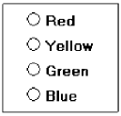

3 – Selection Controls
Presents on the screen all the possible alternatives, conditions, or choices that may exist for an entity, property, or value
Types
Radio button
Check box
Palette
List box
List view control
Drop-down / Pop-up list box
Or

Slide 14
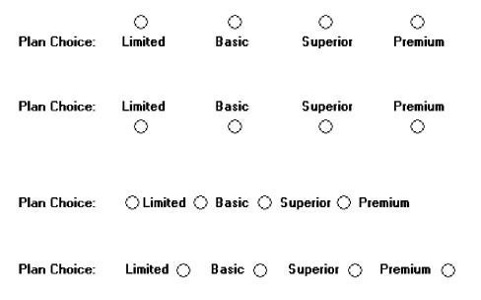
3 – Selection Controls: Radio button
“Only one selection permitted”
Poor
Poor
Poor
Poor
Better

Slide 15
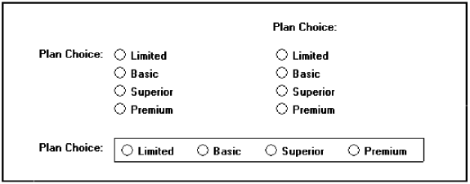
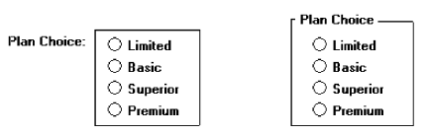

3 – Selection Controls: Radio button
Still better
Best !

Slide 16
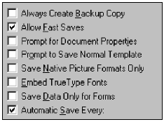
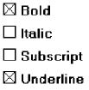
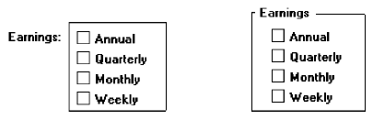
3 – Selection Controls: Check box
“Use for multiple selection”
Best !

Slide 17
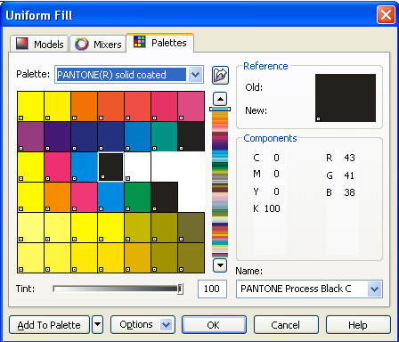
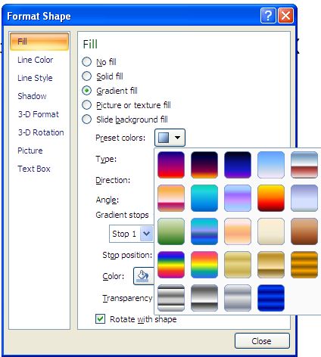
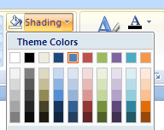
3 – Selection Controls: Palette

Slide 18
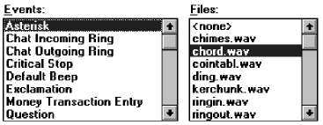
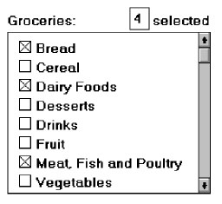
3 – Selection Controls: List box
List box with multiple selection

Slide 19
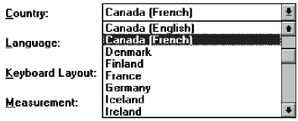
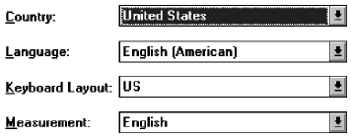
3 – Selection Controls: Drop Down/Pull-down
Then
Droped
Or
Pulled
down
Clicked

Slide 20
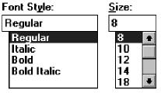


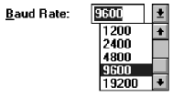
Combination Entry/Selection Controls
Combo boxes
Spin boxes
Combo box - Closed
Combo box - Opened

Slide 21
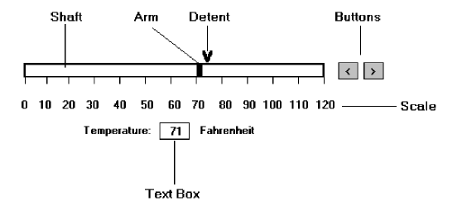
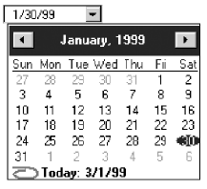
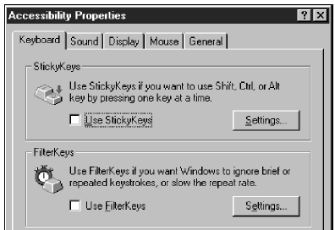
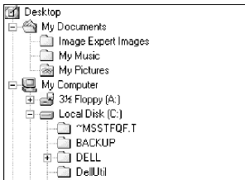
Other Operable Controls
Slider
Date picker
Tabs
Tree view

Slide 22
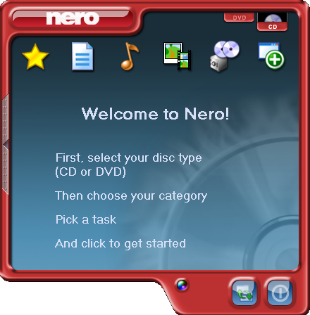
Custom Controls
Implement custom controls with caution
The addition of custom controls adds to this learning and increases system complexity
Images?? Buttons??
Are they clickable?
What is this??
What will happen if
I’m clicking it?
What task?
Where to pick?
I’m sure this are buttons,
Because they looks clickable

Slide 23
Presentation Controls
Static text fields: read-only textual information
Group box: a rectangular frame that surrounds a control or group of controls; optional caption may included.
Column headings: read-only textual information that serves as a heading above columns of text or numbers
Tool tip/balloon tip: a small pop-up window that contains information; could be placed in balloon.

Slide 24
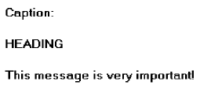

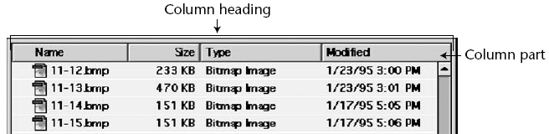
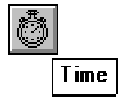
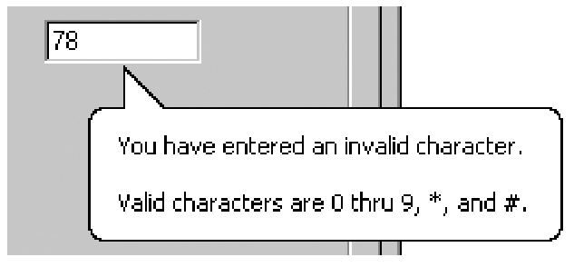
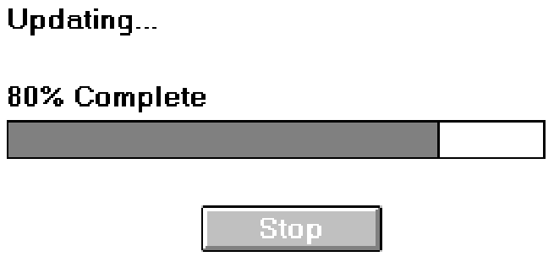
Optional caption
Static text
Tool tip / balloon tip
Progress indicators

Slide 25
Selecting the Proper Controls
Choose familiar controls
Consider the task
Reduce the number of “clicks”
Display as many control choices as possible
When to permit text entry?
Permit text entry if any of the following questions can be answered “Yes”
Is the data unlimited in size and scope?
Is the data familiar?
Is the data not conducive to typing errors?
Will typing be faster than choice selection?
Is the user an experienced typist?

Slide 26
Selecting the Proper Controls
Buttons or Menus for commands?
Consider the following:
Whether or not the command is part of a standard tool set.
The total number of commands in the application.
The complexity of the commands.
The frequency with which commands are used.
Whether or not the command is used in association with another control.

