Slide 1
Step 8 – Clear Text and Messages

Slide 2
Preface
The wording of the interface and its screens is the basic form of communication with the user
Clear and meaningfully crafted words, messages, and text lead to greatly enhanced system usability and minimize user confusion that leads to errors and possibly even system rejection
In this step, general guidelines for choosing the proper
words and writing clear messages and text will be presented

Slide 3
Outline
The concept of readability.
Choosing the proper words.
Writing sentences and messages.
Kinds of messages.
Presenting and writing text.
Window title, conventions, and sequence control guidance
Web Spesific Guidelines :
Presenting and writing page text.
Writing links and headings.
Writing instructions and error messages

Slide 4
Readability
1
The degree to which prose can be understood, based upon the complexity of its words and sentences
Some formula to measure readability :
the Automated Readability Index
the Gunning-Fog Index and
the Dale-Chall-Flesch Reading Ease
Flesch-Kincaid Grade Level
Most reading formulas include only two factors:
The number of syllables or (letters) in a word
The number of words in a sentence

Slide 5
Factors Influence Readability
word length
word commonality
sentence length
number of syllables in a sentence
Information organization, layout and formatting

Slide 6
Readability Guidelines
Write at a readability level below the reading skill level of the intended audience.
Apply all the other principles for clear writing and text presentation

Slide 7
Choosing The Proper Words
2
Do not use
Jargon, words, or terms
Abbreviations or acronyms
Use
Short, familiar words.
Do Not
Stack Words
Hyphenate words
Word contractions, suffixes, and prefixes
Standard alphabetic characters.
Complete words.
Positive terms.
Simple action words; avoid noun strings.
The “more” dimension when comparing.
Consistent words
Punctuation for abbreviations, mnemonics, and acronyms

Slide 8
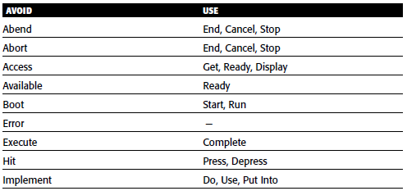
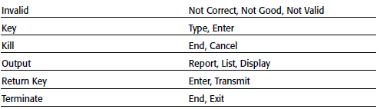
Some Words to Forget

Slide 9
Writing Sentences & Messages
3
Sentences and messages must be
Brief and simple.
Limited to no more than twenty words per sentence.
Limited to no more than six sentences per paragraph.
Written at an eighth grade level or less for the general population.
Directly and immediately usable.
An affirmative statement.
In an active voice.
In the temporal sequence of events
Structured so that the main topic is near the beginning
Of parallel construction

Slide 10
Writing Sentences & Messages
3
Sentences and messages must be of the proper tone:
Nonauthoritarian
Nonthreatening
Nonanthropomorphic
Nonpatronizing
Nonpunishing
Cautious in the use of humor.

Slide 11
Kinds of Messages
Messages are communications provided on the screen to the screen viewer
Screen messages categories:
System Messages
generated by the system to keep the user informed of the system’s state and activities
They are customarily presented within message boxes
Instructional Messages
Sometimes referred to as prompting messages
Messages that tell the user how to work with, or complete, the screen displayed
They may be provided in messages boxes and also within the screen itself.

Slide 12
System Messages Types
Status Messages
Informational messages
Warning messages
Critical messages
Question messages

Slide 13
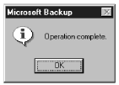
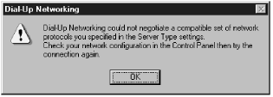
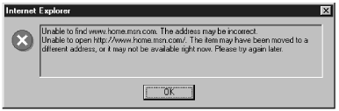
System Messages Examples
Information Messages
Warning Messages
Critical Messages

Slide 14
Writing Message Box Text
Title bar:
Clearly identify the source of the message
The name of the object to which it refers
The name of the application to which it refers.
Do not include an indication of message type.
Use mixed case in the headline style.
Message box:
Provide a clear and concise description of the condition causing the message box to be displayed
Use complete sentences with ending punctuation
State the problem, its probable cause (if known), and what the user can do about it
Avoid contractions & technical jargon

Slide 15
Writing Message Box Text
Provide only as much background information as necessary for the message to be understood
Show only one message box about the cause of condition in a single message
Make the solution an option offered in the message
Avoid multistep solutions
Use consistent words and phrasing for similar situations
Use the word please conservatively
Do not exceed two or three lines
Include the relevant icon identifying the type of message to the left of the text
Center the message text in window

Slide 16
Message Box Controls
Command buttons:
If a message requires no choices to be made but only acknowledgment
Include an OK button
If a message requires a choice to be made, provide a command button for each option
Include OK and Cancel buttons only when the user has the option of continuing or stopping the action
Include Yes and No buttons when the user must decide how to continue
If these choices are too ambiguous, label the command buttons with the names of specific actions

Slide 17
Message Box Controls (cont'd)
If a message allows initiation of an action to correct the situation described,
Include a properly labeled button initiating the corrective action
If a message describes an interrupted process whose state cannot be restored,
Provide a Stop button.
If a message offers an opportunity to cancel a process as well as to perform or not perform an action
Provide a Cancel button
If more details about a message topic must be presented
Provide a Help button

Slide 18
Message Box Controls (cont'd)
Designate the most frequent or least destructive option as the default
Display a message box only when the window of an application is active
Display only one message box for a specific condition
Close box:
Enable the title bar Close box only if the message includes a Cancel button.

Slide 19
Message Location
Use the message line for messages that must not interfere with screen information
Pop-up windows may be used for all kinds of messages, if available
Pop-up windows should always be used for critical messages.

Slide 20
Instructional Messages
Provide instructional information at the depth of detail needed by the user
Locate it at strategic positions on the screen
Display it in a manner that visually differentiates it from other screen elements
In writing, follow all relevant writing guidelines for words, sentences, and messages

Slide 21
Presenting Text
Display prose text in mixed upper- and lower-case letters.
Fonts:
Use plain and simple fonts
Choose a minimum point size of 12 to 14.
Use proportional fonts
Justification:
Left-justify
Do not right-justify
Do not hyphenate words
Line Length:
If fast reading is required, use line lengths of about 75-100 characters

Slide 22
Presenting Text (Cont'd)
If user preference is important, a length of about 50-60 characters is acceptable
Very narrow columns should be avoided
Line endings:
Coincide with grammatical boundaries
Line spacing:
Increase line spacing to enhance legibility and readability
Content:
Use headings to introduce a new topic
Make first sentences descriptive Separate paragraphs by at least one blank line
Start a fresh topic on a new page
Use lists to present facts

Slide 23
Presenting Text (Cont'd)
Emphasize important things by
Positioning
Boxes
Bold typefaces
Indented margins
Provide a screen design philosophy consistent with other parts of the system

Slide 24
Writing Text
Sentences and paragraphs
Use short sentences
Cut the number of sentences
Style
Use the active writing style
Use subjective opinion
Use separate sentences for separate ideas
Keep the paragraphs short
Restrict a paragraph to only one idea
Use the personal writing style
Write as you talk
Use specific examples
Read it out loud

Slide 25
Window title, Conventions, & Sequence Control Guidance
6
Window Title
All windows must have a title located in a centered position at the top
Exception: Windows containing messages
Clearly and concisely describe the purpose of the window
Spell it out fully using an uppercase or mixed-case font.
If title truncation is necessary, truncate it from right to left.
If presented above a menu bar, display it with a background that contrasts with the bar

Slide 26
Conventions
Establish conventions for referring to
Individual keyboard keys
Keys to be pressed at the same time
Field captions
Names supplied by users or defined by the system.
Commands and actions

Slide 27
Sequence Control Guidance
Consider providing a guidance message telling how to continue at points in the dialog when
A decision must be made
A response needs to be made to continue
Consider indicating what control options exist at points in the dialog where several alternatives may be available
Permit these prompts to be turned on or off by the user

Slide 28
Presenting & Writing Page Text
7
The most important part of a Web site is its content, a well-written site is a necessity
Poorly written content has been found to increase user confusion, increase comprehension errors, increase reading times, and reduce user satisfaction
Content re-written properly for presentation on a Web site has been found to reduce the time to perform a task by 80 percent, improve one’s memory of the content by 100 percent, and increase user satisfaction by 37 percent (Morkes and Nielsen, 1998)

Slide 29
Words & Presentation of Page Text
Words
Minimize the use of words that call attention to the Web
Presentation
Provide text that contrasts highly with the background

Slide 30
Writing Page Text
Style:
Use a style reflecting the needs of the site users
Write objectively
Use the inverted pyramid organization
Be concise, using only about half the number of words of conventional text
Each paragraph should
Be short
Contain only one main idea
Links:
Minimize within-text links
Place them at the beginning or end of paragraphs or sections of text

Slide 31
Writing Page Text
Scanning:
Make text scannable by using
Bulleted listings
Tables
Headings and subheadings
Highlighted and emphasized important issues
Short paragraphs
International audience:
Consider internationalization needs
Testing:
Test for legibility and readability

Slide 32
Writing Link Labels
8
Create meaningful labels that use the following:
Descriptive, differentiable, predictive, and active wording
Keywords positioned at the beginning
Content that is concise but long enough to be understood
Wording that clearly indicates link destination or resulting action
Link names that match with their destination page
Integrate embedded links smoothly into the text
Ensure that embedded links are descriptive
Make only a few words the active link
Do not spread links over two lines
Standalone links should not exceed one sentence in length
Provide glosses or link labels to assist link understanding

Slide 33
Link Titles
Provide link titles that describe
The name of site the link will lead to (if different from current site).
The name of subsection the link will lead to (if staying within current site).
The kind of information to be found at the destination.
How the linked information relates to the anchor link and the current page content.
How large the linked information is.
Warnings about possible problems to be encountered at the other end.
Restrict titles to no more than 60 characters.

Slide 34
Page Title
Provide a page title
That possesses meaningful keywords
Whose first word is its most important descriptor
That makes sense when viewed completely out of context
That is different from other page titles
That is written in mixed case using the headline style
Do not highlight keywords

Slide 35
Headings and Headlines
Create meaningful headings and headlines that quickly communicate the content of what follows
Make the first word an important information-carrying one
Skip leading articles (the and a)
Create meaningful subheadings to break up large blocks of text

Slide 36
Instructions
9
Do not use phrasing that indicates a certain page order or flow
Explain where “Up” leads too
Phrase term in a browser-independent manner
Minimize “Click here” instructions
Say “Select this link”

Slide 37
Error Messages
Provide helpful and precise error messages for
Incomplete or incorrectly keyed, entered, or selected data
Requests for documents that do not exist or cannot be found
Redisplay a message on the page to which it relates
Present them in a visually distinctive and noticeable manner

Slide 38
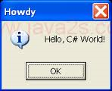
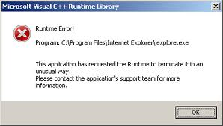
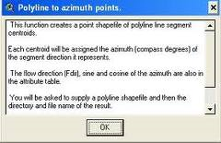
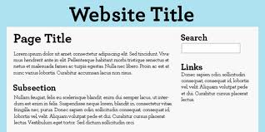
Example

