Slide 1
TCD, visibility and Other Causes that affect Traffic Delays (US and GA)
Project One: Maria Fe, Franchesca Rivas, Jason Caravella

Slide 2
Introduction
Using a data set we found on Kaggle we wanted to determine the causes of traffic delays and the severity each had
Each member of the team focused on different causes and the severity related to each
Compare Georgia to National Trends

Slide 3
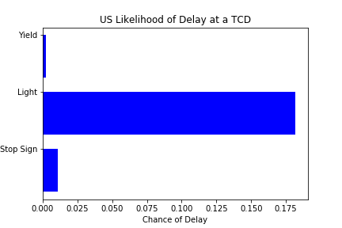
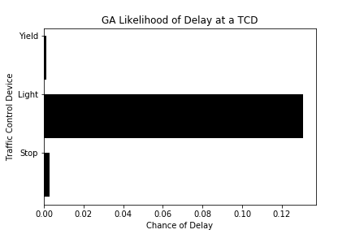
Traffic Control Devices

Slide 4
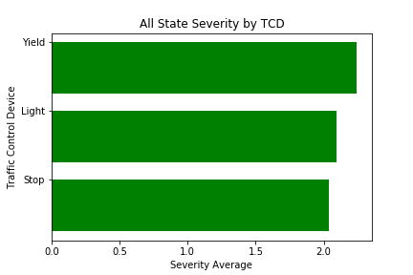
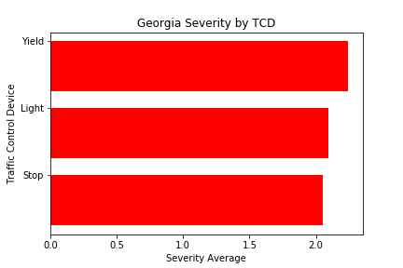
Traffic Control Delay Severity

Slide 5
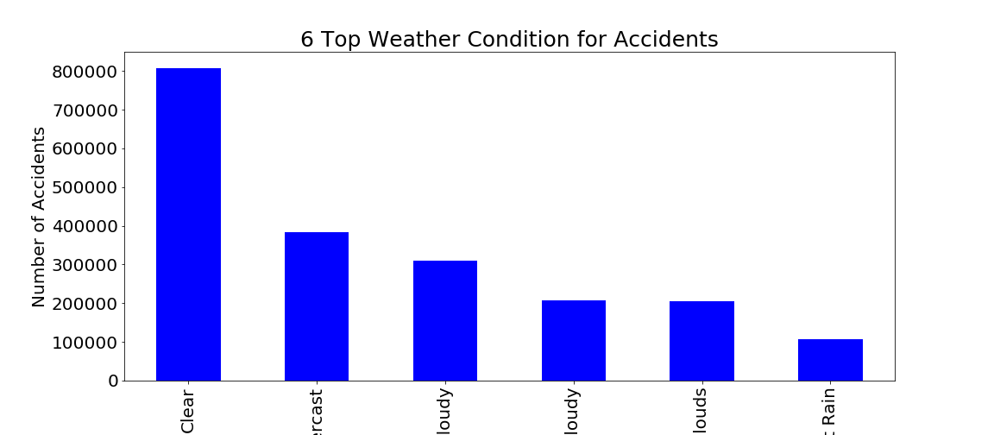
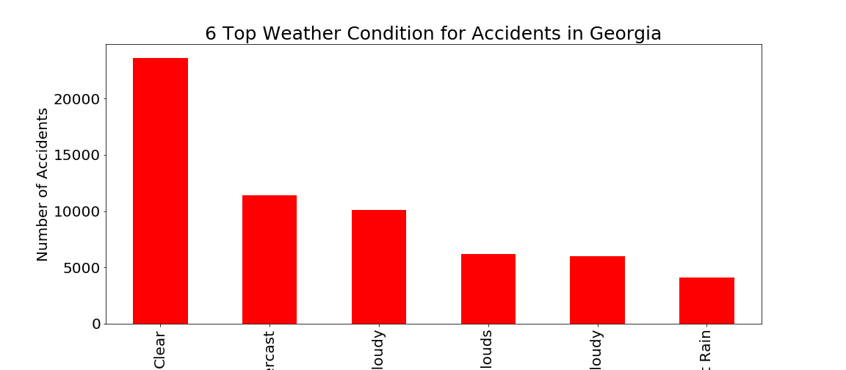
Weather

Slide 6
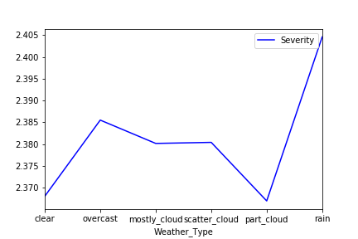
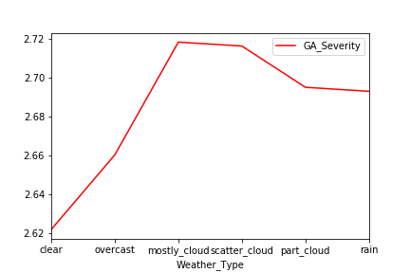
Weather Severity

Slide 7
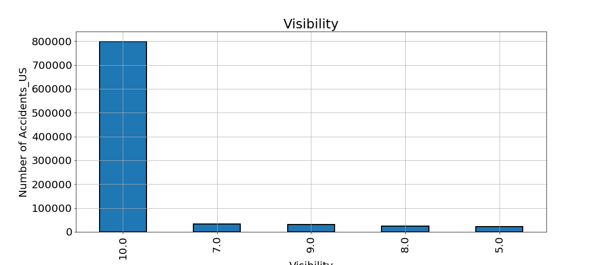
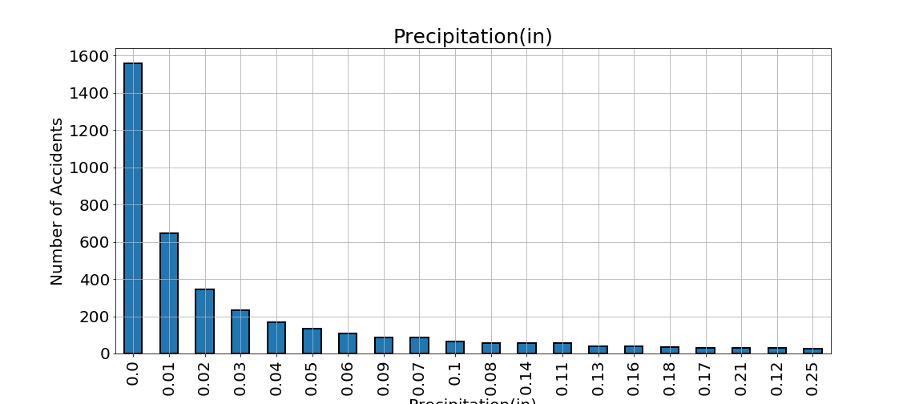
Other Weather Factors

Slide 8
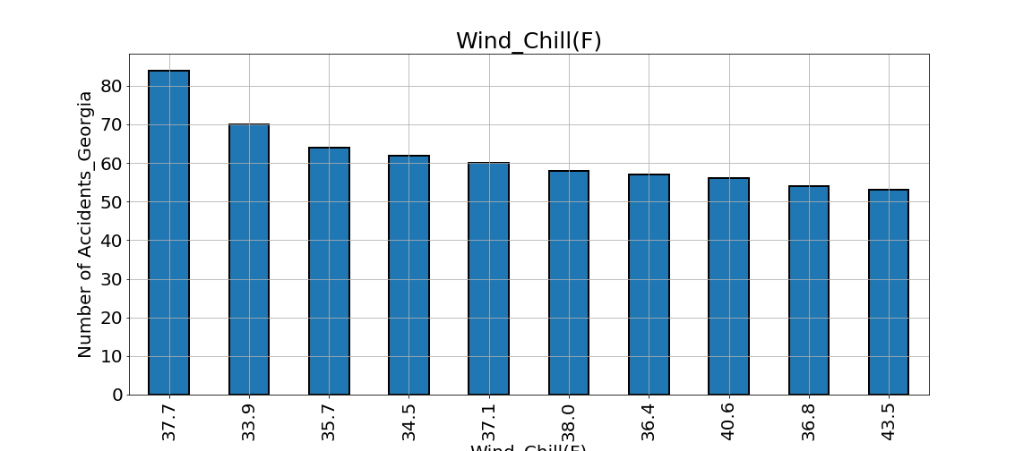
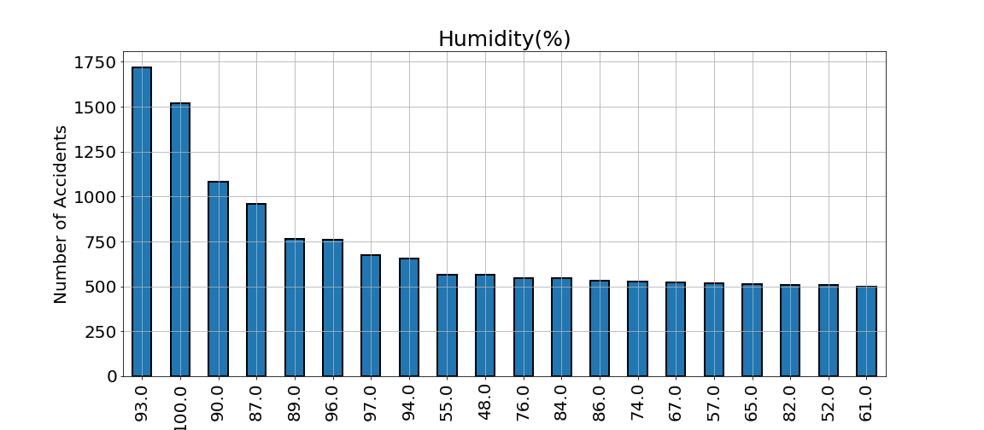
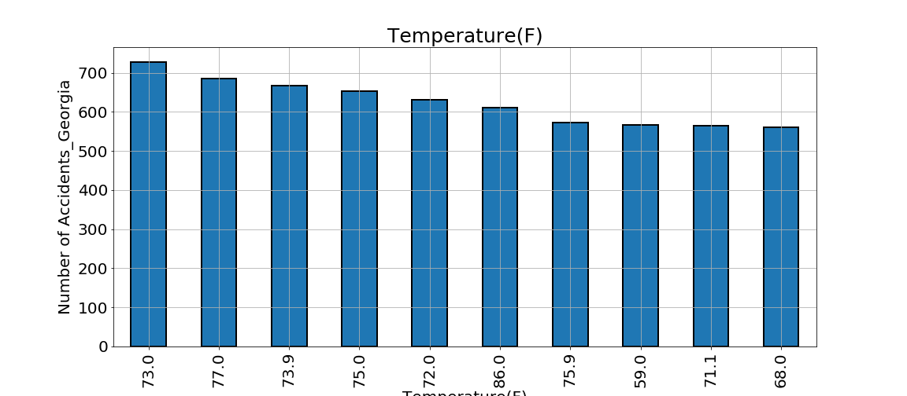
Weather that Doesn’t Affect Traffic

Slide 9
Summary
Traffic Control Devices
Most delays at Traffic Control Delays occur at Traffic Lights
Severity at Yield Signs have the greatest severity
Limited difference between the US and Georgia
Weather
Most delays occur when the weather is clear
Nationwide, delays that occur during rain are the most severe
In Georgia, when clouds are involved severity is greatest
Visibility and Rain increase the likelihood of a traffic delay
Temperature, Windchill and Humidity have no affect on traffic

Slide 10
Questions?

