Slide 1
TCD, visibility and Weather Affect on Traffic(US and GA)
Project One: Maria Fe, Franchesca Rivas, Jason Caravella

Slide 2
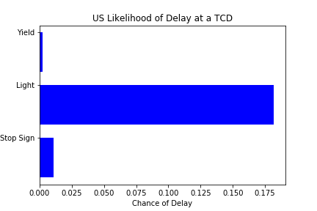
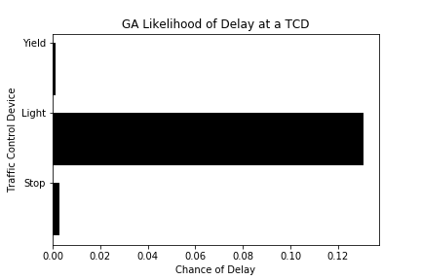
Likelihood of Delay due to Traffic Controls

Slide 3
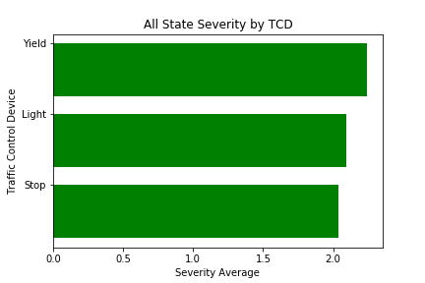
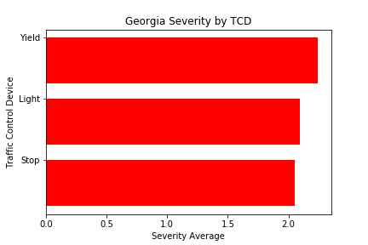
Traffic Control Delay Severity

Slide 4
Maria

Slide 5
Franchesca

