Slide 1
Point Cloud Surface Reconstruction
A Self Learning Based Approach

Slide 2
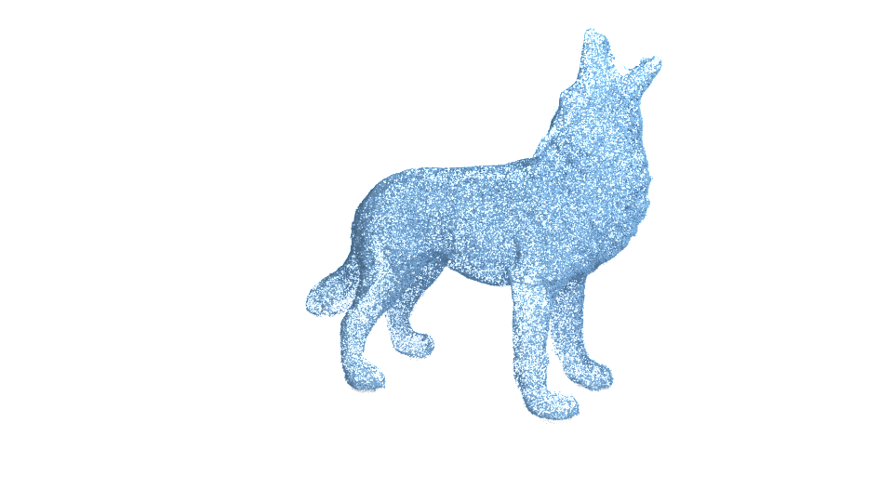
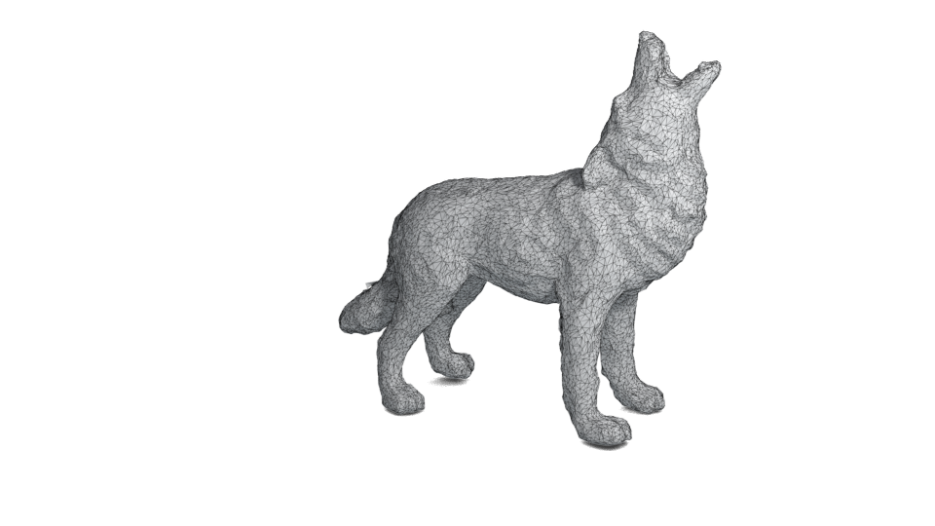
Surface Reconstruction, What & Why?
Notes:
Surface reconstruction is a long standing problem in computer graphics and visualization.

Slide 3
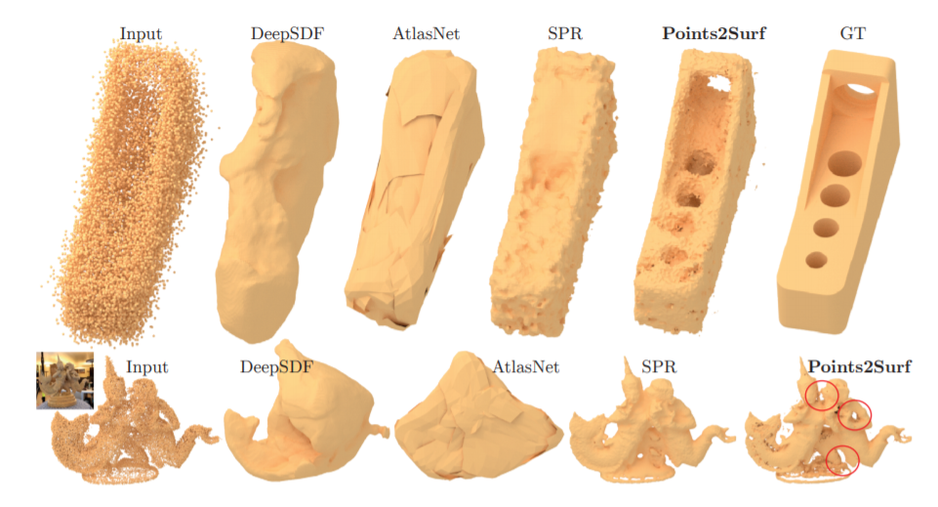
Pre-Trained Models

Slide 4
Mathematical Models
Open3d
Works with sufficiently Huge Point Cloud data
But what to do when our dataset is small?

Slide 5
Self-Training Algorithms
Generating an Implicit Function using a NN.
Training an individual network for each point cloud
Removes bias towards New Data
But how to train it?
Notes:
An implicit function will help us to generate the surface of

Slide 6
Pipeline of our Algorithm
Improving Delaunay Triangulation
Building dataset using Ray Algorithm
Neural Network Training

Slide 7
Improving Delaunay Triangulation
Delaunay from cgal comes with a lot of noise edges and does not provide a watertight output.
K-means algorithm is used for clustering the points to 20 clusters. Removal of edges going from one cluster to another.

Slide 8
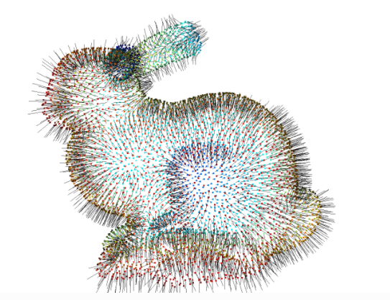
Improving Delaunay Triangulation
Calculated closest clusters and allowed them to make edges between them.
Open3d tool is used to find the normal to each point.
Only allowed edges that make a certain angle to the vertex normal.

Slide 9
Building Dataset
Generation of 20K data points for NN training.
Each Point is classified into 3 Categories: Outside -> 1 On Boundary -> 0 Inside -> -1
Ray algorithm is used for classification.

Slide 10
Building Dataset
Sampling Points
Randomly pick points on triangle
Displace the vertices along normal
C
A
B
E
D

Slide 11
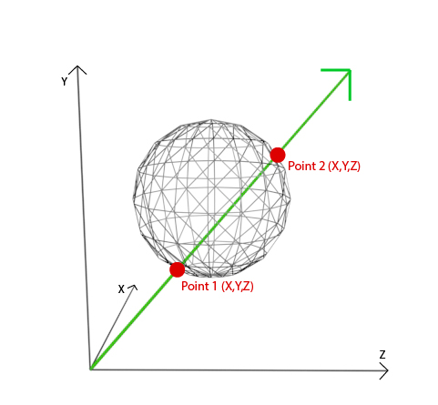
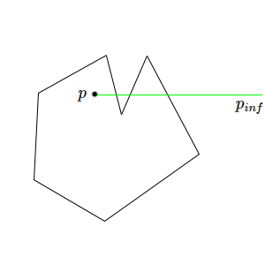
Building Dataset
To classify the data point: pass a ray from point and calculate no of intersection with the object

Slide 12
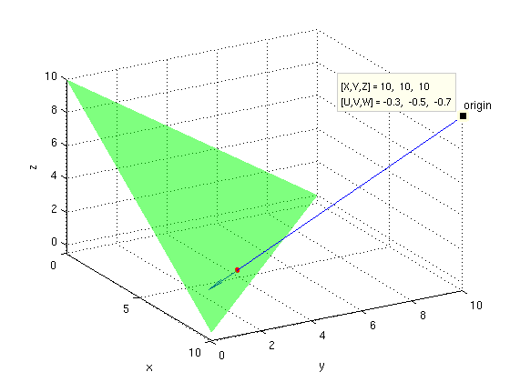
Building Dataset
#Triangles intersected
#Times Ray intersect with object
Moller-Trumbore algorithm is used to calculate intersection.

Slide 13
Building Dataset
Intersection of the ray at vertices or edges should be taken care.
Ray’s on 6 random directions are generated & avg is considered.
r
P

Slide 14
Training Neural Network
Using the dataset, we will train a Neural Network.
We train the network to replicate the surface function
Overfitting is the key to obtain maximum accuracy.
Not a generalized model.

Slide 15
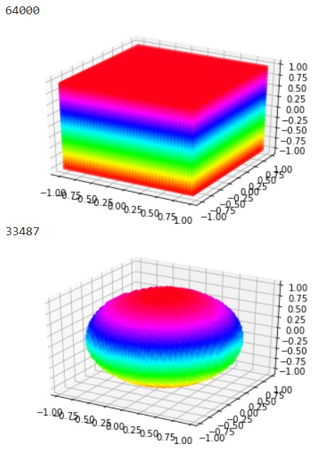
Training Neural Network
Proof of Concept
Generated 64K points to replicate a sphere function.

Slide 16
Training Neural Network
Complex figures ---> Complex surface function
Complex surface functions
---> Large NN’s.
---> Huge Data
---> Good choice of Activation, loss functions
---> Good Selection of depth and width of NN.

Slide 17
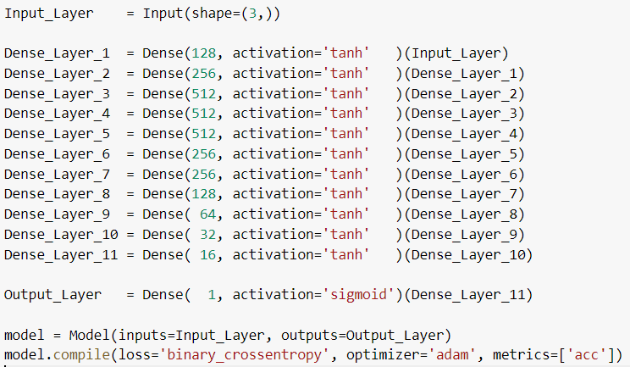
Training Neural Network

Slide 18
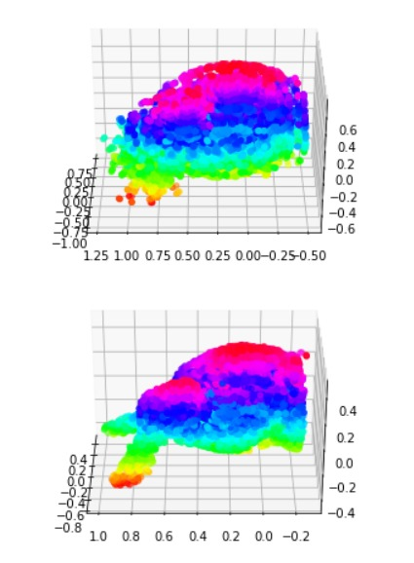
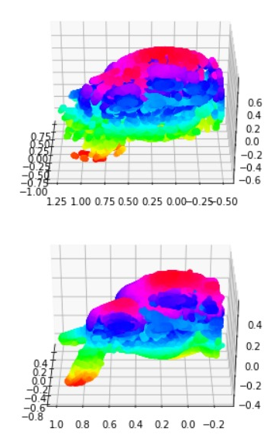
Training Neural Network

Slide 19
Results & Conclusions
Statistical Results:
Using 20K dataset, trained model resulted in 98.5% accuracy.
Entire training took around 5 minutes and 2GB Ram on Google Colab.
The Ray Algorithm used to build dataset took around 90 minutes to generate 20K points

Slide 20
Results & Conclusions
Costly in time as compared to other models like open3d.
Compensated time by producing better results in terms of smoothness and accuracy.
In this project we explored an alternate way to generate an implicit function of the surface in the form of a NN.
Notes:
General NN’s output the re-constructed surface. In our case, we are creating an implicit function to do that. Also, not used pre-trained models and other mathematical models.

Slide 21
Limitations and Future Scope
Perfecting Delaunay Triangulation
Building accurate Datasets
Normalizing NN in case of small datasets
Better visualization of reconstructed surfaces.
Notes:
Delaunay Triangulation : Watertight, removing wrapping of triangles.

