Slide 1
GRID — NOTEBOOK
notebook-engine
A grid-quantized sketch canvas for rapid wireframing.
rust • actix-web • canvas • GRID design system

Slide 2
THE GAP
Exploratory layout thinking has no good home.
FIGMA
PAPER
THIS
Too heavy
No snap, no undo
Snap + undo
Every sketch becomes a commitment. Edit history is structural. Exploration is expensive.
Fast but illegible once iterated. Nothing aligns. Changes mean redrawing the whole page.
Grid keeps everything aligned. Ctrl+Z rewinds. Right-click prunes. Zero commitment.

Slide 3
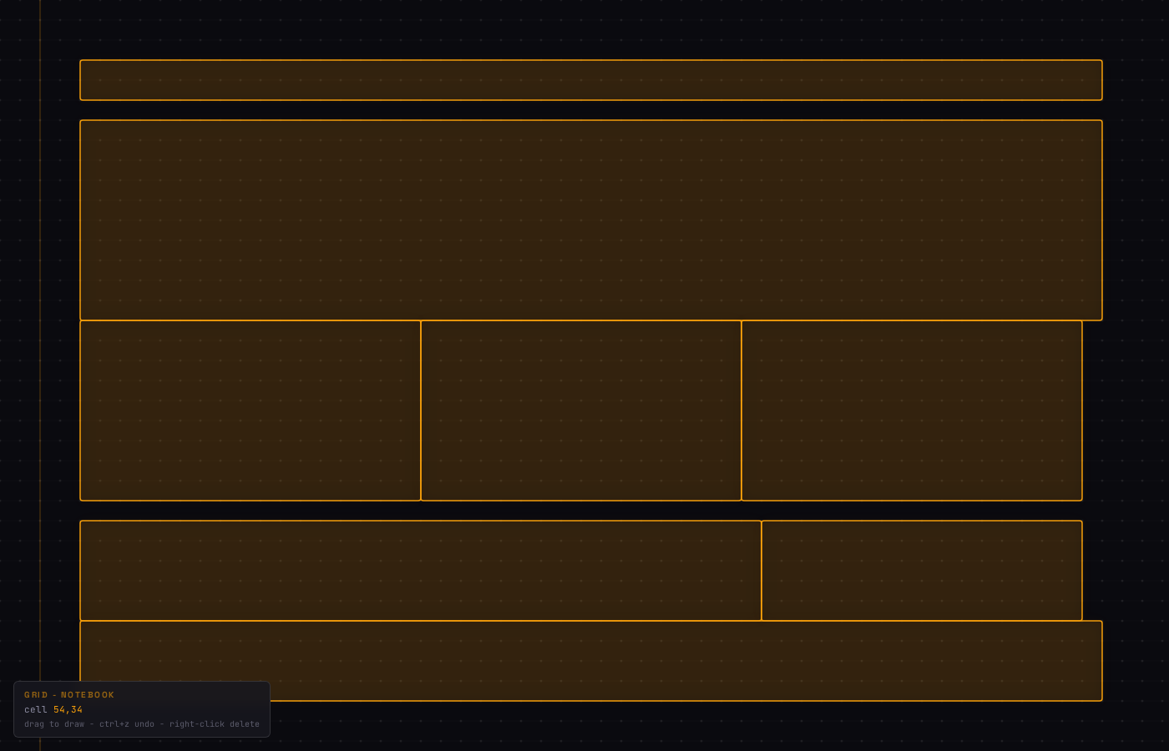
USE CASE — LANDING PAGE WIREFRAME
Sketch the shape of a page in under a minute.
WHAT YOU SEE
Nav bar — thin header
Hero — large tall section
Feature cards — 3 equal tiles
CTA + sidebar — split band
Footer — thin closer
Pattern reads without a single label.

Slide 4

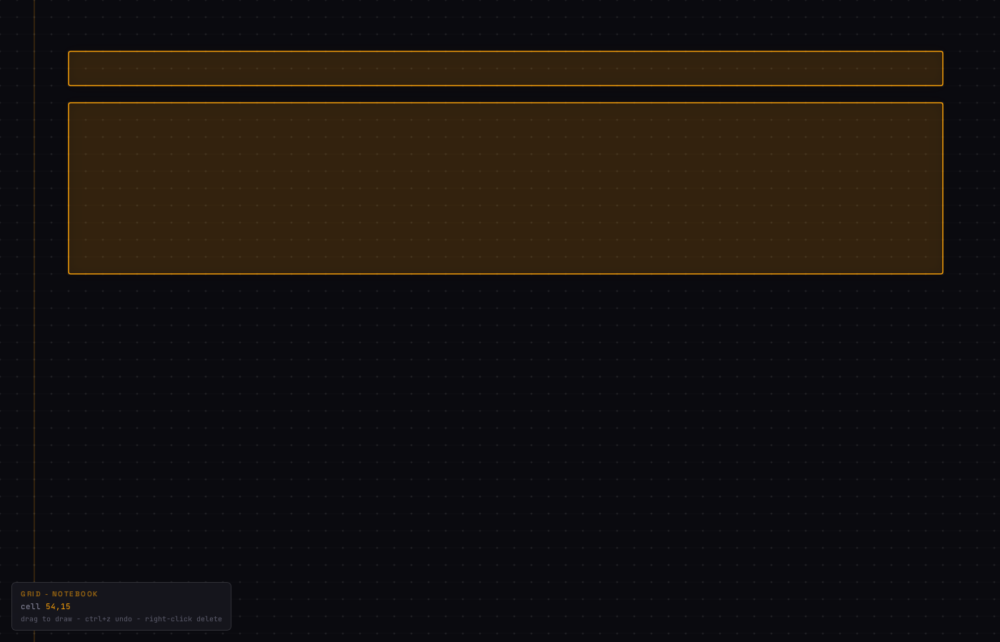
WORKFLOW — THREE DRAGS
Each drag commits a region. Each region sharpens the page.
01 EMPTY
02 SKELETON
03 COMPLETE
Open. Grid visible.
Margin defines the page edge.
Two drags.
Nav + hero commit the top of the page.
Six more drags.
A full landing page, sized and aligned.
drag to commit ctrl+z to undo right-click to remove

Slide 5
UNDER THE HOOD
Small surface. One idea, executed cleanly.
ARCHITECTURE
WHAT'S NEXT
server
Rust • actix-web • tracing
Persistence — POST /api/blocks, blocks survive refresh
routing
GET / • GET /api/grid • GET /static/{file}
Hot-reload — --dev flag serves /static from disk
geometry
GridConfig::quantize(x, y) — shared in Rust + JS
Text labels — click a block, type a name (NAV, HERO)
client
Vanilla canvas — no framework, no bundler
Export — write blocks → HTML skeleton with CSS grid
style
GRID design system — dark-first, amber primary
Multi-colour — a second palette for categorical sketches
tests
4 integration tests against the public lib
~/gruff/workspace/rust-prototype • cargo run

