Slide 1
USKT Official Website
Explore Services, News and Updates

Slide 2
Group Members
Presented by:
Syeda Mahnoor Gillani(leader)046
Haiqa Aftab(002)
Alina 084
Presented to:
Mam Azka Mir

Slide 3
Contents
Introduction
Problem Statement
Solution
Comparison
Conclusion

Slide 4
Introduction
USKT website provides information and updates to its users.
The website is designed for students and staff.
It ensures easy access to all information in one place.

Slide 5
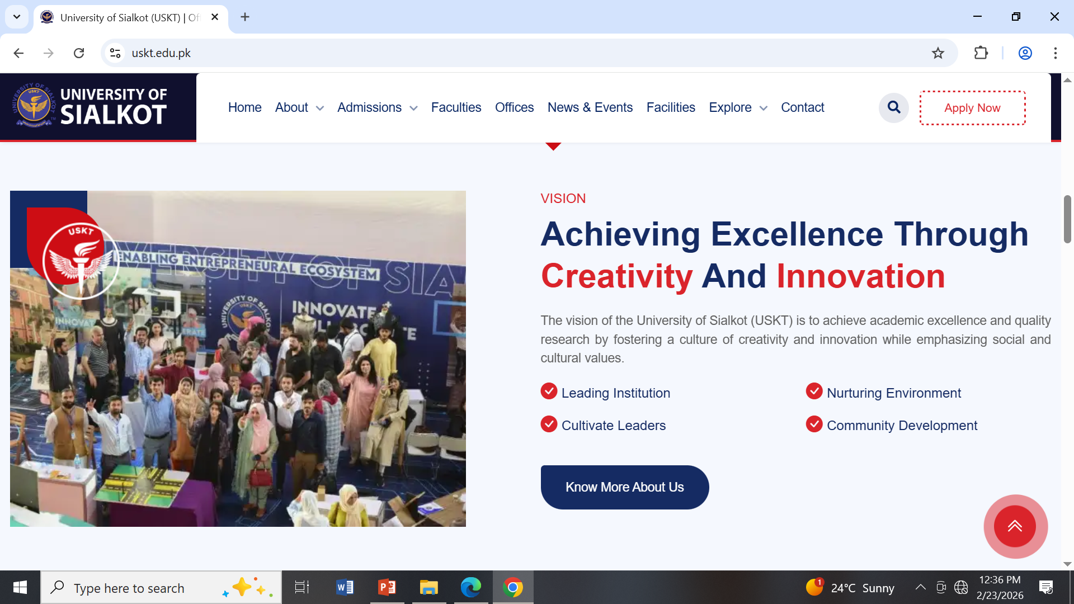
Problem Statement
Previously, information about USKT services was scattered.
Users faced difficulty in finding updates and contact details.
Website solves these issues by:
1. Centralizing information.
2. Providing easy navigation.
3. Providing basic and needed navigation.

Slide 6
Project Planning
Objective: Design a modern and informative website for USKT.
Ideas:
Home Page, About Us, Login page, Registration page, Services, Contact Form, pictures.
Easy navigation.
Timeline:
Planning & Analysis – 10 days.
Design & Layout – 1 week.
Testing & Final Review – 1 week.
Resources Need: Notepad, File Explorer, font awesome icons.

Slide 7
Analysis
Target Audience: Students and staff.
Problem Identified: Scattered information and not cleared.
Solution: Centralized website with clear structure and easy navigation.

Slide 8
Requirement Specification
Functional Requirements:
1. Home Page with latest information and updates.
2. About Us Page to explain USKT mission.
3.Login page .
4. Contact Form for user inquiries.
5. Gallery / Media Section to show images and events.
Non-Functional Requirements:
1. Responsive design, Clean and readable layout, Easy navigation,
Consistent color scheme and fonts.

Slide 9
Components
HTML: To create pages for our Website.
CSS: It is useful for Designing and stylings to make our website impactful.

Slide 10
Design and Layout
Color scheme: Blue & White (clean and professional).
Simple and clear navigation menu.
Background pictures.
Icons (used for clearance).
Buttons.(to link pages).

Slide 11
Technical Details
Languages used: HTML, CSS.
Hosting platform: (e.g., GitHub Pages).

Slide 12
Process
Tags: Tags which we use in our website.
<h1> </h1>,<h2></h2>,<h3></h3>,<button></button><style></style>
<body></body>,<head></head>,<a></a>,<form></form>,<li></li>,
<textarea></textarea>,<div></div>, <br>,<label></label>.

Slide 13
Challenges and Solution
Challenges: Create website for a normal user.
Solution: Clear information.

Slide 14
Conclusion
USKT website is modern, accessible, and informative.
Provides easy access to services, news, contact information.
Future plans: Live news, interactive gallery, feedback system.

