Slide 1
Introduction to object oriented programming using PHP
Lecture 4

Slide 2
Objectives
Property defaults
Local/Global Variables
Visibility/Access Control
Accessor and Mutator Methods
Parent/Child relationship
extends keyword
Types of Inheritance
Extending constructors/destructors
parent keyword
Protected visibility
Basic OOP Principles (Review)

Slide 3
Property defaults
In PHP, properties may include initialization (default) values during declaration.
This feature is commonly used if no constructor is defined for the class.
However, there is a limitation to this feature:
Default property values must be literal values and not a result of an expression.

Slide 4
Property defaults
class BankAccount {
public $type = "Savings";
public $number;
public $name;
public $balance = 0;
public static $totalAccounts = 0;
...
class BankAccount {
public $type;
public $number = ++self::$totalAccounts;
public $name;
public $balance = 1+2+3;
public static $totalAccounts = 0;
...
Valid
Not Valid

Slide 5
Local Variables
A variable declared within a method definition is called a local variable. It is said to have local scope.
All method parameters are local variables
If two methods each have a local variable of the same name, they are still two entirely different variables
public function method1() {
$newVariable = 100;
}
public function method2() {
$newVariable = 200;
}

Slide 6
Parameters
A parameters is often thought of as a placeholder that is filled in by the value of its corresponding argument. However, a parameter is more than that: it is actually a local variable.
When a method is invoked, the value of its argument is computed, and the corresponding parameter (i.e., local variable) is initialized to this value
Even if the value of a parameter is changed within a method (i.e., it is used as a local variable) the value of the argument cannot be changed.
more on this in a later lecture

Slide 7
Pass By Value
<?php
class MyNewClass {
public static function method1($newVariable) {
$newVariable = $newVariable * 10;
echo $newVariable; // Outputs 100
}
}
$var = 10;
MyNewClass::method1($var);
echo $var; // Outputs 10
?>

Slide 8
Global Variables
The PHP language has support for global variables, however, its use is highly discouraged.
To use global variables, a variable must explicitly be “imported” using the keyword global.
A variables that has been declared global can be modified and for this reason is highly discouraged.

Slide 9
The dangers of global
<?php
class MyNewClass {
public static function method1() {
global $var;
$var = 100;
}
}
$var = 10;
MyNewClass::method1();
echo $var; // Outputs 100
?>

Slide 10
Visibility/Access Control
Access control, which is also called visibility, dictates how accessible a class’s properties and methods are.
In PHP, there are three levels of visibility: public, private & protected.

Slide 11
Public vs Private modifiers
The public modifier means that there are no restrictions on where a property or method can be used.
Note: methods will have public visibility if no other visibility is stated.
The private modifier means that an property or method cannot be accessed by outside of the class.

Slide 12
Public vs Private modifiers
In most situations, properties should have the visibility of private.
In contrast, most methods are public, and thus provide controlled access to the object.
Usually, methods are private only if used as helper methods for other methods in the class.

Slide 13
Public vs Private modifiers
It may seem odd for a class to have properties and methods that are inaccessible but there are many times where some of the internal data shouldn’t be accessible externally.
For example, our database class needs an internal database connection, but there’s no reason why that connection should be accessible outside of the class (in fact, it shouldn’t be).
This is a classic example of encapsulation.
Encapsulation means that the data and methods of a class are combined into a single unit (i.e., a class object), which hides the implementation details.

Slide 14
Example: private.php

Slide 15
Accessor and Mutator Methods
Accessor methods allow the programmer to obtain the value of an object's instance variables.
The data can be accessed but not changed
The name of an accessor method typically starts with the word get
Mutator methods allow the programmer to change the value of an object's instance variables in a controlled manner.
Incoming data is typically tested and/or filtered
The name of a mutator method typically starts with the word set
Sometimes these are referred to as getter and setter methods

Slide 16
Example
Let’s apply what we’ve learned to the bank account class:
Modify all properties of the BankAccount class so they have private visibility.
Add getter & setter methods to the BankAccount class.

Slide 17
BankAccount.php
<?php
class BankAccount {
private $type;
private $number;
private $name;
private $balance;
private static $totalAccounts = 0;
public static function numberOfAccounts() {
return self::$totalAccounts;
}
public function __construct($type, $name) {
$this->type = $type;
$this->name = $name;
$this->balance = 0;
$this->number = ++self::$totalAccounts;
}
public function deposit($amount) {
$this->balance += $amount;
}
public function withdrawal($amount) {
if ($this->balance >= $amount) {
$this->balance -= $amount;
} else {
echo "Insufficient funds <br>";
}
}
public function setName($fullName) {
$this->name = $fullName;
}
public function getName() {
return $this->name;
}
public function setNumber($number) {
$this->name = $number;
}
public function getNumber() {
return $this->getNumber;
}
public function setType($type) {
$this->type = $type;
}
public function getType() {
return $this->type;
}
public function getBalance() {
return $this->balance;
}
}
?>

Slide 18
Parent/Child Relationship
PHP has full support for object inheritance.
A parent class is defined just as any other class. It may contain properties and methods within it.
It is unaware that it may be a parent class.
A child class must be explicitly told to inherit from a parent class. It will automatically have all the properties and methods that the parent class has and it can have additional methods and/or properties as well.
Inheritance is especially advantageous because it allows code to be reused, without having to copy it into the definitions of the child classes.
Parent
Property 1 Property 2
Method1() Method2()
Child
Property 3 Property 4
Method3() Method4()
Child inherits Property 1 & 2, Method1 & 2 from Parent

Slide 19
extends keyword
To define a child class from a parent, use the extends keyword.
As written, the class Child class will possess all the properties and methods of its parent, Parent.
<?php
class Parent {
}
?>
<?php
class Child extends Parent {
}
?>
Parent.php
Child.php

Slide 20
Inheritance Example
Let’s use another example to illustrate how inheritance works in PHP.
Consider the following scenario:
Suppose we are designing a record-keeping program that has records for salaried employees and hourly employees.
These are all classes of people who share the property of being employees.
Employees who are paid an hourly wage are one subset of employees.
Another subset consists of salaried employees who are paid a fixed wage each month.

Slide 21
Inheritance Example
All employees share certain characteristics in common:
All employees have a name and a hire date
The methods for setting and changing names and hire dates would be the same for all employees
Some employees have specialized characteristics:
Hourly employees are paid an hourly wage, while salaried employees are paid a fixed wage
The methods for calculating wages for these two different groups would be different

Slide 22
Inheritance Example
Within PHP, a class called Employee can be defined that includes all employees.
This class can then be used to define classes for hourly employees and salaried employees.
Class Employee defines the properties name and hireDate in its class definition.
Employee
name hireDate

Slide 23
Example 1: Employee.php

Slide 24
Employee.php
<?php
class Employee {
private $name;
private $hireDate;
}
?>

Slide 25
Inheritance Example
Since an hourly employee is an employee, it is defined as a child of the class Employee.
Salaried employees are also employees, therefore they will also be a child of the class Employee.
When a child class is defined, it inherits the properties and methods of the parent class that it extends.
Class HourlyEmployee and SalariedEmployee have all class Employees properties, but they are not specified in its class definition.
Employee
name hireDate
HourlyEmployee
SalariedEmployee

Slide 26
Example 2: HourlyEmployee.php SalariedEmployee.php

Slide 27
Example 2
<?php
require_once('Employee.php');
class HourlyEmployee extends Employee {
}
?>
<?php
require_once('Employee.php');
class SalariedEmployee extends Employee {
}
?>
HourlyEmployee.php
SalariedEmployee.php

Slide 28
Inheritance Example
Class HourlyEmployee has additional properties wageRate and hours that are specified in its class definition.
Class HourlyEmployee has getter and setter methods for each property and an additional property calculateWage which calculates the total pay.
Employee
name hireDate
HourlyEmployee
wageRate hours
calculateWage() setWageRate() getWageRate() setHours() getHours()
SalariedEmployee

Slide 29
Inheritance Example
Just as it inherits the instance variables of the class Employee, the class HourlyEmployee inherits all of its methods as well.
The class HourlyEmployee inherits the methods getName, getHireDate, setName, and setHireDate from the parent class Employee.
Any object of the class HourlyEmployee can invoke one of these methods, just like any other method.
Employee
name hireDate
setName() getName() setHireDate() getHireDate()
HourlyEmployee
wageRate hours
calculateWage() setWageRate() getWageRate() setHours() getHours()
SalariedEmployee

Slide 30
Example 3: Employee.php HourlyEmployee.php

Slide 31
Example 3
<?php
require_once('Employee.php');
class HourlyEmployee extends Employee {
private $wageRate;
private $hours;
public function calculateWage() {
return $this->wageRate * $this->hours;
}
public function getWageRate(){
return $this->wageRate;
}
public function setWageRate($wageRate){
$this->wageRate = $wageRate;
}
public function getHours(){
return $this->hours;
}
public function setHours($hours){
$this->hours = $hours;
}
} //End of HourlyEmployee
$joe = new HourlyEmployee();
var_dump(get_class_methods($joe));
var_dump($joe);
?>
HourlyEmployee.php

Slide 32
Example 3
<?php
class Employee {
private $name;
private $hireDate;
public function getName() {
return $this->name;
}
public function setName($name) {
$this->name = $name;
}
public function getHireDate() {
return $this->hireDate;
}
public function setHireDate($hireDate) {
$this->hireDate = $hireDate;
}
} // End of Employee Class
Employee.php

Slide 33
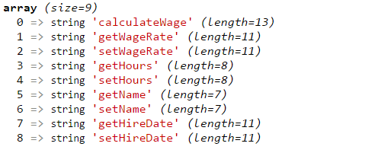
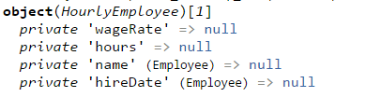
Example 3 Results
All methods of the $joe object
All properties of the $joe object

Slide 34
Types of Inheritance
There are different types of inheritance:
Single inheritance
Multilevel Inheritance
Hierarchical Inheritance
Multiple Inheritance
PHP supports all types of inheritance except for multiple inheritance.

Slide 35
Single Inheritance
Single inheritance enables a child class to inherit properties and behaviour from a single parent class.
Parent
Property 1 Property 2
Method1()
Child
Property 3 Property 4
Method2()

Slide 36
Multilevel Inheritance
Multilevel inheritance is a technique or process in which a child class is inherited from another child class.
You can think of it in terms of a family tree.
We have a parent class, child 1 class is inherited from parent class and child 2 class is inherited from child 1 class.
Therefore, child 2 class will have all the properties and functionality possessed by parent class and child 1 class combined.
Parent
Property 1 Property 2
Method1()
Child 1
Property 3 Property 4
Method2()
Child 2
Property 5 Property 6
Method3()

Slide 37
Hierarchical Inheritance
Hierarchical inheritance is when more than one class is derived from a single parent.
Employee
Property 1 Property 2
Method1()
HourlyEmployee
Property 3 Property 4
Method2()
SalariedEmployee
Property 5 Property 6
Method3()

Slide 38
Inheriting Constructors
There are two methods that are common to many classes: Constructors and Destructors.
Parent and child classes may contain a constructor, however, how does the parent class invoke its constructor when a child class is created?
As a rule, PHP will always call the constructor for the class just instantiated. The same rule applies for destructors.
Employee
name hireDate
__construct() setName() getName() setHireDate() getHireDate()
HourlyEmployee
wageRate hours
__construct() calculateWage() setWageRate() getWageRate() setHours() getHours()

Slide 39
parent keyword
Sometimes, you may want a child class to use a constructor from the parent class to initialize all the data inherited from the parent class.
To access a constructor of a parent class from the child class, use the parent keyword.
The parent keyword can be used from any child class to access any public method in its parent class.
Employee
name hireDate
__construct() setName() getName() setHireDate() getHireDate()
HourlyEmployee
wageRate hours
__construct() calculateWage() setWageRate() getWageRate() setHours() getHours()

Slide 40
Example 4: Employee.php HourlyEmployee.php

Slide 41
Example 4
<?php
class Employee {
private $name;
private $hireDate;
public function __construct($name, $hireDate) {
$this->name = $name;
$this->hireDate = $hireDate;
}
public function getName() {
return $this->name;
}
public function setName($name) {
$this->name = $name;
}
public function getHireDate() {
return $this->hireDate;
}
public function setHireDate($hireDate) {
$this->hireDate = $hireDate;
}
} // End of Employee Class
Employee.php

Slide 42
Example 4
<?php
require_once('Employee.php');
class HourlyEmployee extends Employee {
private $wageRate;
private $hours;
public function __construct($name, $hireDate,
$wageRate, $hours) {
parent::__construct($name, $hireDate);
$this->wageRate = $wageRate;
$this->hours = $hours;
}
public function calculateWage() {
return $this->wageRate * $this->hours;
}
public function getWageRate() {
return $this->wageRate;
}
public function setWageRate($wageRate) {
$this->wageRate = $wageRate;
}
public function getHours() {
return $this->hours;
}
public function setHours($hours) {
$this->hours = $hours;
}
} //End of HourlyEmployee Class
$joe = new HourlyEmployee("Joe", "07/01/2011", 30, 40);
var_dump($joe);
?>
HourlyEmployee.php

Slide 43
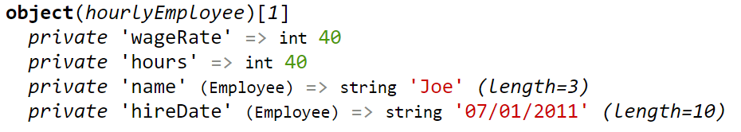
Example 4 Results
All properties of the $joe object
$joe is an object of type HourlyEmployee with the following initialized properties.
Remember: wageRate & hours property are part of the child class, name & hireDate properties of the parent class

Slide 44
Protected visibility
Recall, access control dictates how accessible a class’s properties and methods are. In other words: where the class’s members can be referenced and where they are inaccessible.
We have already learnt about public and private visibility, now we introduced the third and last level of visibility.
Protected properties and methods can only be accessed within the class and any child classes. This means that should name or hireDate be made protected, you could still access these properties directly within the HourlyEmployee or any other child class of Employee.
Employee
name hireDate
__construct() setName() getName() setHireDate() getHireDate()
HourlyEmployee
wageRate hours
__construct() calculateWage() setWageRate() getWageRate() setHours() getHours()

Slide 45
Protected visibility
A final note on protected visibility:
The protected modifier provides very weak protection compared to the private modifier.
It allows direct access to any property or method defined in a child class.
In the case of properties, this allows us to bypass any additional validation before accessing/modifying the property.
Therefore, properties should normally not be marked protected
Employee
name hireDate
__construct() setName() getName() setHireDate() getHireDate()
HourlyEmployee
wageRate hours
__construct() calculateWage() setWageRate() getWageRate() setHours() getHours()
Best practice states that all properties should be marked with private visibility. This ensures that integrity of the data is maintained.

Slide 46
OOP Review
The remaining slides review basic Object Oriented Programming principles.

Slide 47
Parameter vs Argument
Formally, a parameter is the variable received by a method and argument is the item passed in.
Do not be surprised to find that people often use the terms parameter and argument interchangeably.
When you see these terms, you may have to determine their exact meaning from context
public function deposit($amount) {
...
}
$johnsSavingsAccount->deposit(10);
Parameter
Argument

Slide 48
Public vs Protected vs Private
Public properties or method are the most accessible.
They are accessible to methods within the class itself and outside of the class.
Public
Protected properties and methods can only be accessed within the class and any child classes
Protected
Private
Private properties or methods are the most restrictive.
They are only accessible within the class that defines them.

Slide 49
Application Programming Interface
The API or Application Programming Interface for a class is a description of how to use the class.
A programmer need only read the API in order to use a well designed class.
An example of APIs we’ve been using is the MySQL APIs available in PHP;
Mysqli
PDO_MySQL

Slide 50
Information Hiding and Abstraction
Information hiding is the practice of separating how to use a class from the details of its implementation.
Abstraction is another term used to express the concept of discarding details in order to avoid information overload

Slide 51
Encapsulation
Encapsulation means that the data and methods of a class are combined into a single unit (i.e., a class object), which hides the implementation details.
Knowing the details is unnecessary because interaction with the object occurs via a well-defined and simple interface
In PHP, hiding details is done by marking them private

Slide 52
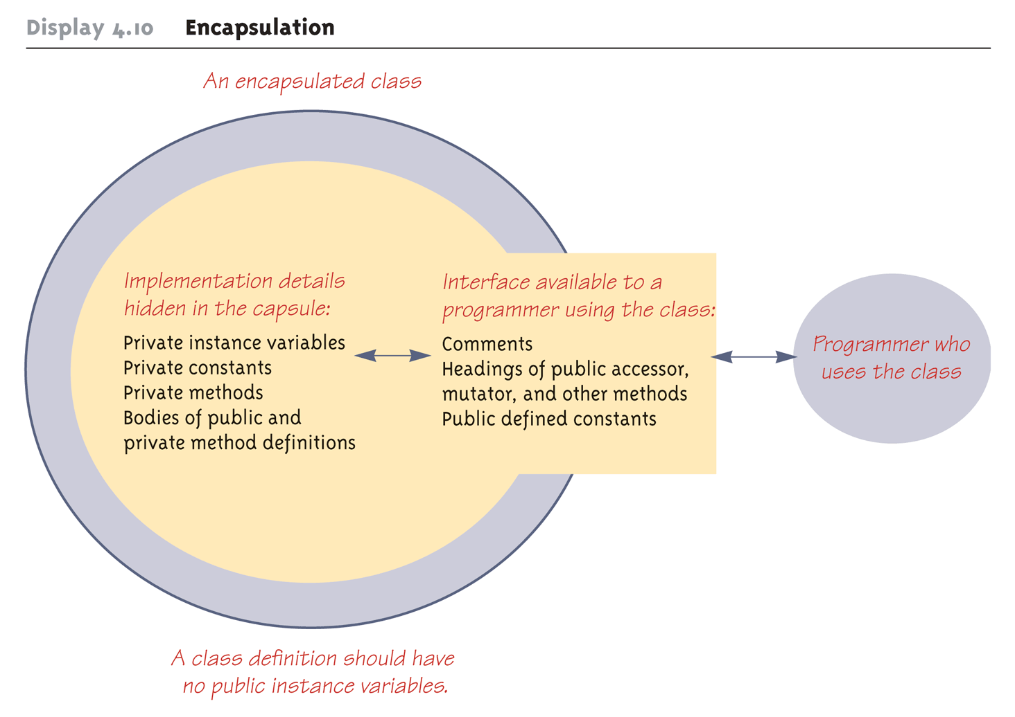
Encapsulation
Source: Absolute Java 5th, Walter Savitch

Slide 53
Introduction to Inheritance
Children inherit many things from their parents. Some of the traits are physical. Some are visible, some aren’t (DNA).
Children usually modify some of the behavior and traits and pass some of them on to their own children.
All object-oriented languages support some type of inheritance. In fact, inheritance is one of the most important concepts in object oriented programming.
Definition of inheritance: “to receive from a parent or ancestor by genetic transmission”
Source: http://www.merriam-webster.com/dictionary/inheriting

Slide 54
Introduction to Inheritance
In programming, Inheritance is the process by which a new class is created from another class.
Just as humans inherit qualities from their parents, objects inherit qualities from their parent objects.
Of course, in object oriented programming, qualities are properties and methods.
Through inheritance, you can define one class that is “born” with the same properties and methods as another.
The inherited child class can even have its own unique qualities that the parent doesn’t have.

Slide 55
OOP terms
A parent class is a class which can be used to define new child classes.
A parent class is also known as a base class or superclass.
A child class is also known as a derived class or subclass.
Parent
Property 1 Property 2
Method1() Method2()
Child
Property 3 Property 4
Method3() Method4()

Slide 56
OOP terms
In UML class diagrams, inheritance is represented using an arrow between two classes.
The arrow should go from the child class to the parent class (points towards the parent).
Furthermore, UML class diagrams do not repeat the inherited properties and methods in the child class.
Parent
Property 1 Property 2
Method1() Method2()
Child
Property 3 Property 4
Method3() Method4()

Slide 57
The end of Lecture 04

