Slide 1
Intermediate php Techniques
Lecture 7

Slide 2
Objectives
Fluent Setters
Interfaces
PHP Arrays
PHP Functions
is_array()
explode()
implode()
array_push()
array_pop()
array_shift()
array_unshift()
compact()
count()
Iterators
Casting
Anonymous Functions/Closures
Auto-Loader

Slide 3
Fluent Setters
Sometimes calling mutator methods on objects can become cumbersome. Each call must be made on an object of the appropriate type.
Notice the various calls to the setter methods of the HourlyEmployee object
As an alternative, conversion to Fluent setters can be used to improve the look and functionality of the previous code.
<?php
class HourlyEmployee {
private $name;
private $wageRate;
private $hours;
public function setName($name) {
$this->name = $name;
}
public function setWageRate($wageRate) {
$this->wageRate = $wageRate;
}
public function setHours($hours) {
$this->hours = $hours;
}
} //End of HourlyEmployee Class
$joe = new HourlyEmployee();
$joe->setName("Joe");
$joe->setWageRate(40);
$joe->setHours(40);
?>

Slide 4
Fluent Setters
For Fluent setters to work, each method must return a reference to itself.
By doing so, the current object is returned back to the calling line of code.
The programmer can then proceed to call an additional method.
This is referred to as method chaining.
<?php
class HourlyEmployee {
private $name;
private $wageRate;
private $hours;
public function setName($name) {
$this->name = $name;
return $this;
}
public function setWageRate($wageRate) {
$this->wageRate = $wageRate;
return $this;
}
public function setHours($hours) {
$this->hours = $hours;
return $this;
}
} //End of HourlyEmployee Class
$joe = new HourlyEmployee();
$joe->setName("Joe")
->setWageRate(40)
->setHours(40);
?>

Slide 5
Interfaces
Similar to the abstract class is an interface. Interfaces, like abstract classes, identify the functionality (i.e., the methods) that must be defined by a specific class.
To create an interface, use the interface keyword. Then, within the curly brackets, define the method signatures, not their actual implementation:
Interface names often end with the word “Interface”, but this is not required.
Note that all methods in an interface must be public. Also, interfaces may only identify methods; they never include properties.
<?php
interface SomeInterface {
public function someFunction($var);
}

Slide 6
Interfaces
To associate an interface to a class, use the implements operator in the class definition:
The class must then define all of the methods listed in the interface, or a fatal error will occur.
The fatal error created by having a class implement an interface without implementing all of the interface’s methods.
<?php
class Someclass implements SomeInterface {}

Slide 7
Abstract Class vs. Interface
The difference between an interface and an abstract class may seem subtle. Remember that an abstract class is meant to be extended by a more specific class, of which you’ll probably create an object instance.
Conversely, an interface is not inherited by a class, so you should not think of an interface as a way of loosely defining an entire object. Instead, an interface establishes a contract for the functionality that a class must have, regardless of the class type.

Slide 8
Abstract Class vs. Interface
Another way of distinguishing between abstract classes and interfaces is that abstract classes still have an “is a” relationship with the derived class. Interfaces do not have “is a” relationships with derived classes, although you could say that the derived class has a “has the same behaviors as” relationship with an interface.
A good example is the PHP Iterator interface defined within the Standard PHP Library (SPL):
The Iterator interface dictates the methods that must exist in a class in order for PHP to be able to loop through an instance of that class.

Slide 9
Interfaces
Another benefit that interfaces have is that classes in PHP cannot inherit from multiple parents. Classes, however, can implement multiple interfaces by separating each by a comma:
The instanceof operator may be used to test if a class implements an interface.
<?php
class Someclass implements SomethingInterface, SomethingElseInterface {}

Slide 10
Interface Example
<?php
interface EmployeeInterface {
public function doWork();
}
class Accountant implements EmployeeInterface {
public function doWork() {
echo "Crunching numbers...<br>";
}
}
class Salesman implements EmployeeInterface {
public function doWork() {
echo "Making phone calls...<br>";
}
}
$employees = [new Accountant(), new Salesman()];
foreach($employees as $employee) {
if ($employee instanceof Accountant) {
echo "Accountant is ";
} elseif ($employee instanceof Salesman) {
echo "Salesman is ";
}
$employee->doWork();
}

Slide 11
Interfaces
Interfaces may also define constants and may themselves implement another interface of their own:
Interface constants cannot be overridden by a class/interface that inherits them.
<?php
interface PersonInterface {
const name = "Nick";
public function sayName();
}
interface EmployeeInterface extends PersonInterface {
public function doWork();
}

Slide 12
PHP Arrays
Because of their power and flexibility, arrays are widely used in most PHP programming. In fact, the only native PHP data structure is an array.
Recall from PHP I, arrays are used to store collections of elements. These elements can be native data types or, as we’ve seen so far, objects.

Slide 13
Creating Arrays
Creating an array in PHP can be done a couple different ways.
Before PHP 5.4, calls to array() needed to be made. Beyond PHP 5.4, a new short array syntax was implemented as a simpler alternative.
<?php
$newArray = array ();
$newArray = array('key' => 'value');
$newArray2 = [];
$newArray2 = ['key' => 'value'];

Slide 14
Array Functions
PHP provides plenty of helpful built-in array functions.
http://php.net/manual/en/ref.array.php
It’s helpful to be aware of commonly used functions and their usage.
We’ll cover only a small subset of the array functions available in PHP.

Slide 15

Array Functions (is_array)
is_array() is a built-in PHP function used to determine if the provided variable is an array. A boolean true/false is returned based upon the test.
Usage:
bool is_array ( mixed $var )
<?php
$newArray = [];
$newArray = ['key' => 'value'];
var_dump( is_array($newArray) );

Slide 16
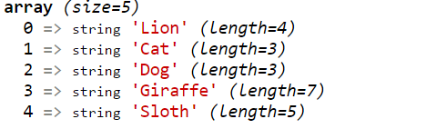
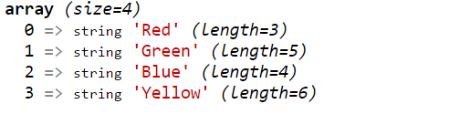
Array Functions (explode)
explode() is a built-in PHP function used to create an array by splitting a string based upon a delimiter.
Usage:
array explode ( string $delimiter , string $string )
<?php
$animals = "Lion Cat Dog Giraffe Sloth";
$arrayOfAnimals = explode(" ", $animals);
var_dump($arrayOfAnimals);
$colours = "Red,Green,Blue,Yellow";
$arrayOfColours = explode(",", $colours);
var_dump($arrayOfColours);

Slide 17
Array Functions (implode)
implode() is a built-in PHP function used to create an string by joining array elements. It performs the opposite of explode.
Usage:
string implode ( string $glue , array $pieces )
<?php
$arrayOfAnimals = ["Lion", "Cat", "Dog", "Giraffe", "Sloth"];
$animals = implode(" ", $arrayOfAnimals);
var_dump($animals);
$arrayOfColours = ["Red", "Green", "Blue", "Yellow"];
$colours = implode(" and ", $arrayOfColours);
var_dump($colours);

Slide 18
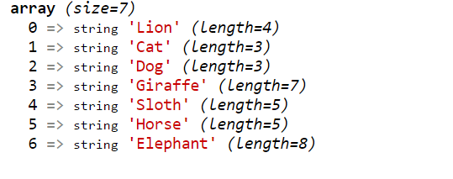
Array Functions (array_push)
array_push() is a built-in PHP function which adds a new element to the end of an existing array. From PHP.net – “array_push() treats array as a stack, and pushes the passed variables onto the end of array. The length of array increases by the number of variables pushed.”
Usage:
int array_push ( array $array , mixed $value1 [, mixed $... ] )
<?php
$arrayOfAnimals = ["Lion", "Cat", "Dog", "Giraffe", "Sloth"];
$animal = "Elephant";
array_push($arrayOfAnimals, "Horse", $animal);
var_dump($arrayOfAnimals);

Slide 19

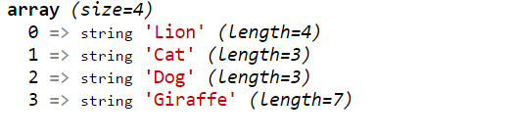
Array Functions (array_pop)
array_pop() is a built-in PHP function used to remove and return the last element from an array.
Usage:
mixed array_pop ( array $array )
<?php
$arrayOfAnimals = ["Lion", "Cat", "Dog", "Giraffe", "Sloth"];
$lastElement = array_pop($arrayOfAnimals);
var_dump($lastElement);
var_dump($arrayOfAnimals);

Slide 20

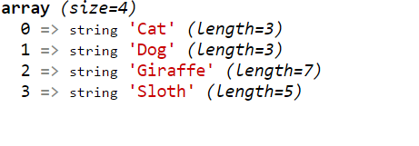
Array Functions (array_shift)
array_shift() is a built-in PHP function used to remove and return the first element from an array. Once removed, the array is shrunk and shifted so the first element resides in index 0.
Usage:
mixed array_shift ( array $array )
<?php
$arrayOfAnimals = ["Lion", "Cat", "Dog", "Giraffe", "Sloth"];
$firstElement = array_shift($arrayOfAnimals);
var_dump($firstElement);
var_dump($arrayOfAnimals);

Slide 21
Array Functions (array_unshift)
array_unshift() is a built-in PHP function used to add a new element to the beginning of an array.
Usage:
int array_unshift ( array $array , mixed $value1 [, mixed $... ] )
<?php
$arrayOfAnimals = ["Cat", "Dog", "Giraffe", "Sloth"]; array_unshift($arrayOfAnimals, "Lion");
var_dump($arrayOfAnimals);

Slide 22

Array Functions (compact)
compact() is a built-in PHP function used to create an array containing variables and their values. For each value passed to the function, compact looks for a variable with the same name and adds it to the array such that the variable name becomes the key and the contents of the variable become the value for that key.
Usage:
array compact ( mixed $value1 [, mixed $... ] )
<?php
$sql = "SELECT * FROM `table` WHERE title = :title AND director = :director";
$title = "Star Wars"; $director = "George Lucas";
$bindVals = compact("title", "director");
var_dump($bindVals);

Slide 23

Array Functions (count)
count() is a built-in PHP function used to return the number of elements in an array.
Usage:
int count ( mixed $array )
<?php
$arrayOfAnimals = ["Lion", "Cat", "Dog", "Giraffe", "Sloth"];
echo count($arrayOfAnimals);

Slide 24
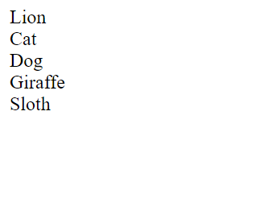
Array Functions
reset() , current(), next(), previous() and end() are related functions used to control iteration over an array. They all take an array as a parameter and can be used to control the location of the internal pointer of an array.
<?php
$arrayOfAnimals = ["Lion", "Cat", "Dog", "Giraffe", "Sloth"];
reset($arrayOfAnimals);
while (current($arrayOfAnimals)) {
echo current($arrayOfAnimals) . "<BR>";
next($arrayOfAnimals);
}

Slide 25

Casting
As you know already, PHP is a loosely typed language that allows you to declare a variable and its type simply by using it. PHP will also automatically convert values from one type to another whenever required. This is called implicit casting.
However, at times PHP’s implicit casting may not be what you want.
Note: $a & $b are integers. By default, PHP converts the output to floating point so it can give the most precise value (4.666…)
<?php
$a = 9;
$b = 4;
$c = $a / $b;
echo $c;
Output:

Slide 26

Casting
What if we had wanted $c to be an integer instead? There are various ways in which we could achieve this, one of which is to force the result of $a/$b to be cast to an integer value using the integer cast type (int).
This is called explicit casting. Note that in order to ensure that the value of the entire expression is cast to an integer, we place the expression within parentheses. Otherwise, only the variable $a would have been cast to an integer—a pointless exercise, as the division by $b would still have returned a floating-point number.
<?php
$a = 56;
$b = 12;
$c = (int) ($a / $b);
echo $c;
Output:

Slide 27
Casting
PHP also has built-in functions to convert from one type to another. It’s useful to know how to convert from one type to another using both methods.
Below is a table with the cast types and their equivalent built-in functions:
Cast Type | Function | Description
(int) (integer) | intval() | Covert to an integer by dropping the decimal point
(bool) (boolean) | boolval() | Covert to a Boolean
(float) (double) (real) | floatval() | Covert to a floating-point number
(string) | strval() | Covert to a string
(array) | settype( $var, “array”) | Covert to an array
(object) | settype( $var, “object”) | Covert to an object

Slide 28
Anonymous Functions
Anonymous functions, also called Closures or Lambda functions, are functions without a name.
The ability to create Anonymous functions was added in PHP 5.3 and further expanded in PHP 5.4
Anonymous functions are created by defining a function as you would any other, but without a name.
To later reference the function the unnamed definition needs to be assigned to variable.

Slide 29
Example: Anonymous Functions
Instead of assigning a string or number to the variable, you’re assigning a function definition. For this reason, a semicolon is required at the end to complete the assignment statement.
<?php
$hello = function($who) {
echo "<p> Hello $who</p>";
};

Slide 30

Example: Anonymous Functions
<?php
$hello = function($who) {
echo "<p> Hello $who</p>";
};
$hello("World!");
To invoke the Anonymous function, add parenthesis to the variables name.
Because this function accepts an argument, add a value inside the parentheses.

Slide 31
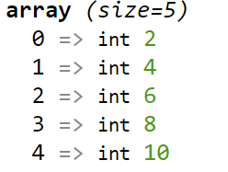
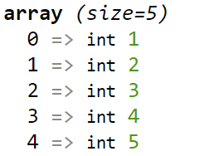
Anonymous Functions
This particular use of Anonymous functions has its benefits.
Several functions in PHP take a function as an argument.
Example:
The array_map() function takes a function as its first argument and an array as its second.
The array_map() function will apply the function argument to each element within the array.
<?php
$double = function($elem) {
return $elem * 2;
};
$arrayOfNum = [1,2,3,4,5];
var_dump(array_map($double , $arrayOfNum));
var_dump($arrayOfNum);
Note:
The original array is not changed by the map function

Slide 32
Pass By Value
NOTE:
In the last example, no modifications were made to the original array by the Anonymous function.
This is because of a concept called “Pass By Value”.
Later, we will see how to modify elements directly from within the function using an opposing concept called “Pass By Reference”.

Slide 33
Anonymous Functions
Alternatively to the last example, Anonymous functions can be directly substituted for the first argument of the array_map() function.
Example:
<?php
$arrayOfNum = [1, 2, 3, 4, 5];
var_dump(array_map(
function ($elem) {
return $elem * 2;
}
, $arrayOfNum)
);
var_dump($arrayOfNum);
Anonymous function as first argument to the array_map function

Slide 34
Benefits of Anonymous Functions
There are several benefits to this approach:
Related code the function definition and its implied invocation is kept tightly together
PHP will only need to maintain the closure’s definition while the function is being directly used.

Slide 35
Autoloading Classes
The most common and logical way to modularize files in an application is to place each class definition in its own file.
In such cases, the class file has to be required by the script that needs to create an object of that type.
In the first project, you have been using the bootstrap.php script to load all class files prior to their invocation.
<?php require_once('config.php'); require_once('Database.php'); require_once('Session.php'); require_once('Category.php'); require_once('Entry.php'); require_once('Comment.php'); require_once('User.php’); ?>

Slide 36
Autoloading Classes
This may work for small projects, but as the number of classes grow, this quickly becomes an impractical method to load class files.
Additionally, when classes rely upon one another (through the use of inheritance, for example) the order in which classes are loaded become critically important.
<?php
class ClassB extends ClassA { }
require_once('ClassB.php');
require_once('ClassA.php');

Slide 37
Autoloading Classes
Thankfully, the developers behind PHP created a workaround to the tiresome process of always including class definition files.
Starting in PHP 5.0, PHP included a new magic method which was automatically invoked when references to a class that hadn’t been loaded yet. This method was called __autoload()
Unfortunately, it has a major limitation and in PHP 5.1.2, a replacement function was introduced called spl_autoload_register().
As of PHP 8.0, the __autoload() function has now been removed.

Slide 38
Autoloading Classes
The spl_autoload_register function has the following signature:
bool spl_autoload_register( [callable $autoload_function] )
The first parameter is a function, which, when added, is registered in a queue to be run whenever the __autoload() function would have been invoked.
Effectively, the queue overrides the default behavior of the __autoload() function allowing you to define your own functions to load classes.
Note: All functions in the queue are invoked in order they were registered

Slide 39
Autoloading Classes
To create the autoloader script, define a function that will know how to include class files for you:
Note: this function assumes that the classes are placed in a sub-directory called “classes”.
Note: by using the is_readable() function we check if the file exists & is readable before we try to access it.
function autoloader($class) {
$ext = '.php';
if(is_readable(__DIR__ . '/classes/'. $class . $ext)) {
require_once(__DIR__ . '/classes/'. $class . $ext);
}
}

Slide 40
Autoloading Classes
To enable autoloading, register your loading function with PHP:
For each new object type created in the following code, the autoload function will be invoked automatically:
Thanks to the autoloader function, the script automatically requires the ClassA.php & ClassB.php (within the classes/ directory).
Note: that this does assume that the class names and class filenames are identical (minus the extensions).
spl_autoload_register('autoloader');
$obj1 = new ClassA();
$obj2 = new ClassB();

Slide 41

Autoloader Example
<?php
spl_autoload_register(function ($class) {
$ext = '.php';
$file = 'classes/' . $class . $ext;
echo "Autoloading class $file <br>";
if (is_readable($file)) {
require_once($file);
}
});
$obj1 = new ClassA();
$obj2 = new ClassB();
Output:

Slide 42
Autoloading Classes
By using the autoloader, instead of automatically loading every class file, only required classes will be loaded (saving memory/time).
Important Note: Although class names in PHP are case-insensitive, some operating systems use case-sensitive file structures. Ex. If your class is called MyClass, you should consider naming the file MyClass.php and creating objects using:
$obj = new MyClass();

Slide 43
The end of Lecture 07

