Slide 1
Intermediate php Techniques
Lecture 12

Slide 2
Objectives
Serialization
Securing Passwords
File Handling

Slide 3
Serialization
It’s very easy to store simple data types, such as strings and numbers, in a session, file, or database, as you already know.
But complex data types, such as arrays and objects, are not easily stored in their original state.
Those flat storage mediums cannot directly support multifaceted formats like arrays and objects.
The solution is to convert the complex data type into a simple data type. This is done in PHP using Serialization

Slide 4
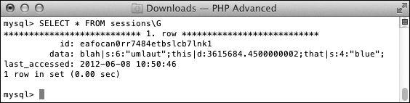
Serialization Example
You’ve already seen serialization in action when you stored session information into a database:
This serialized value says that indexed at blah is a string six characters long with a value of umlaut. Indexed at this is a decimal with a value of 3615684.4500 (and so on). Indexed at that is a string four characters long with a value of blue.
Source: PHP Advanced and OOP 3rd

Slide 5
Serialization
Serialized information for simple types has the following format:
A datatype specifier such as s, i, d or b (string, integer, decimal, boolean) followed by a colon, followed by the actual data, followed by a semicolon.
Example: s:6:”umlaut”;
Arrays have key-value pairs contained in curly braces:
Example: [10, 11, 12] serialized is a:3:{i:0;i:10;i:1;i:11;i:2;i:12;}
“a” representing an array, “3” representing the number of elements.

Slide 6
Serialization
Data can be converted using the PHP function serialize() and unserialize().
That says that the data is an array, consisting of three elements. The first element uses a string for its key, containing five characters, with a value of Karen. That element has a string for its value, containing seven characters, with a value of Toronto. And so on.
From that string, the data can be reconstituted into its complex format via the unserialize() function:
<?php
$data = array('Karen' => 'Toronto', 'Stephanie' => 'Boston', 'Jessica' => 'State College');
$sData = serialize($data);
$data = unserialize($sData);

Slide 7
Serialization
The process is the same with objects, with two exceptions. First, the serialized version of the object will only store the values of the object’s attributes, along with the name of the object’s class. The object’s methods will not be stored (this is fine; they’ll come back to the object when the object is unserialized).
The second difference is that PHP needs access to the object’s class definition in order to re-create the object. As long as PHP can do that, the original object will be properly reconstituted, retaining its attribute values and able to invoke its methods once again.

Slide 8
Serialization Example
Here’s an example of a serialized object taken from the last assignment:
Above, this serialized object determined by the “O” has the name USEROBJ which is type “User”.
The 6 represents the number of properties stored within the object. The first property is of type string denoted by “s”. Here’s where things get confusing. The number 5, which follows, indicates there 5 characters in the property name “id”. There also has an \0*\0 in the property name which was added by the serialize method.
The question begs: Why does it state a 5 character length when our User class only contains the property name “id” (clearly 2 chars in length)? and what is the purpose of \0*\0?
USEROBJ|O:4:"User":6:{s:5:“\0*\0id";s:1:"2";s:11:“\0*\0username";s:4:“nick";s:11:“\0*\0password";s:4:"1234";s:8:“\0*\0email";s:20:"sylvestn@uwindsor.ca";s:15:“\0*\0verifystring";s:16:"omlglxahbfafuhal";s:9:“\0*\0active";s:1:"1";}

Slide 9
Serialization Example
To answer this question, let’s look at another example:
The \0 in the above serialization string are NUL bytes. As you can see private and protected members are serialized with rather peculiar names: Private properties are prefixed with \0ClassName\0 and protected properties with \0*\0.
class Test {
public $public = 1;
protected $protected = 2;
private $private = 3;
}
$data2 = new Test();
echo serialize($data2);
Output:
O:4:"Test":3:{s:6:"public";i:1;s:12:"\0*\0protected";i:2;s:13:"\0Test\0private";i:3;}

Slide 10
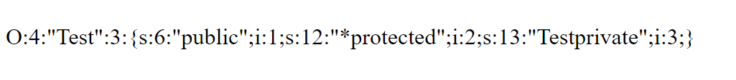
Serialization Example
Interestingly, when this string is output using the echo command, \0 (NUL bytes) are removed:
Note: The Testprivate property is still a private property however it appears like a public property.
We can identify private properties because their string length (13) is 2 characters longer than the number of characters in the string “Testprivate” (11).

Slide 11
Custom Serialization
PHP offers a mechanism which allows for custom serialization formats. It delegates the actual serialization to the __serialize magic method. Conversely, the __unserialize magic method will be automatically called to perform an unserialize action. For example, consider this class:
class Test2 {
private $age = 36;
private $name = "Nick";
public function __serialize() {
return ['age' => $this->age, 'name' => $this->name];
}
public function __unserialize($str) {
$this->age = $str['age’];
$this->name = $str['name’];
}
}

Slide 12
Custom Serialization
It will be serialized as follows:
class Test2 {
private $age = 36;
private $name = "Nick";
public function __serialize() {
return ['age' => $this->age, 'name' => $this->name];
}
public function __unserialize($str) {
$this->age = $str['age’];
$this->name = $str['name’];
}
}

Slide 13
Serialization
Now, given that long explanation, if you go to store an object in the session, PHP will automatically serialize and unserialize the data on the fly.
This process will work as long as PHP can access the corresponding class definitions when the session is started again. This explains the following fatal error you may have gotten in the project when you swapped the class loading in the initialization (before we added the auto-loader).
require_once('Session.php');
require_once('User.php');

Slide 14
String Hashing & Password Storage
You may have noticed that in the Blog assignment, you stored passwords within the logins table in a secured fashion
Securing passwords is a complex subject which deserves some careful attention.
But there is some good news; PHP provides you tools so that implementation is relatively easy.

Slide 15
String Hashing & Password Storage
Hash functions are used to convert a string to pseudo-unique output. The output can then be used to fingerprint a string, or to store a one-directional representation of it.
This is not the same as encryption!
Examples of hashing algorithms are:
md5() - fast. Do not use for passwords. Can be used to fingerprint a file or other string. Returns a 32-character hexadecimal number.
sha1() - fast. Better than md5, but don’t use it for passwords. Returns a 40-character hexadecimal number result.

Slide 16
String Hashing & Password Storage
Strong hashing algorithms are used to store passwords because they cannot be reversed.
If weaknesses in a hashing algorithm are discovered, the community looks for something better.
Hashing algorithms are made stronger by the addition of a salt. Which prevents the hashed result from being the same when it is hashed twice (ex in two different applications). Always use a salted hash algorithm for passwords so that the hashes in your application will be different from another application even if the user uses the same password.
Slower algorithms tend to be better for security because it takes an attacker longer to generate hashes. As hardware gets stronger, we need slower algorithms!

Slide 17
String Hashing & Password Storage
Historically there have been a lot of problems in the PHP community with developers using outdated and no longer secure hash algorithms for passwords - or even storing passwords in plain text! Yikes!
You can still find modern applications that use md5 or sha1 for passwords. Not good.

Slide 18
String Hashing & Password Storage
To solve all this confusion, today PHP provides built in functions which always provide us with the strongest recommended hash algorithm.
password_hash() - slow, strong, salted, one-way hash for passwords. Returns a string result. Use this!
password_verify() - verifies that a password matches a hash. Use this!
Cool detail: password_hash() returns the algorithm used as well as the result. So that password_verify() knows which one to use. So even if a newer algorithm becomes the default, old hashes can still be verified!

Slide 19
String Hashing & Password Storage
As of PHP 5.5, the default algorithm used in password_hash() is BCRYPT
password_hash() with BCRYPT will always produce a 60 character output which can be directly stored into the DB.
PHP recommends that you store the result in a database column that can expand beyond 60 characters (255 recommended) to potentially make room for better algorithms in the future.
Algo
Cost
Salt (22 chars)
Hashed Password
$2y$10$TEYQ1TOsOTtEoMhU5eUQKOGB5zIVt5wvX9hiDKw0akGjsYgsGOz5m

Slide 20
String Hashing & Password Storage
<?php
$hashed = password_hash("right_pass", PASSWORD_BCRYPT);
$result = password_verify("right_pass", $hashed);
if($result) {
echo "<b>{$hashed}</b>";
} else {
echo "Passwords do not match";
}
echo "<br>";
$result = password_verify("wrong_pass", $hashed);
if($result) {
echo "<b>{$hashed}</b>";
} else {
echo "Passwords do not match";
}
Output

Slide 21
PHP File Handling
MySQL is not the only way to store data on the web server. Sometimes it can be quicker and more convenient to directly access file on the hard disk.
Examples in which you might wanted to do this are:
Uploading images for user profiles
Uploading document sharing to other users
Processing log files

Slide 22
Uploading Files
Uploading files to a web server is a subject that seems daunting, however PHP makes it very easy. The general process of a file transfer is as follows:
Using a form with a special encoding type, select and upload a file
Your browser will handle transfer details between it and the webserver
PHP will accept the uploaded file and perform some pre-processing
PHP will automatically generate a special file object in a PHP superglobal

Slide 23
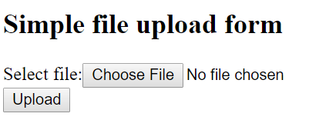
Uploading Files
Consider the following form:
Notice the enctype field. This tells the browser to transmit binary encoded data.
The name field is simply an arbitrary name, however, this will be used to identify the file in the receiving PHP script
<!DOCTYPE html>
<html lang="en">
<head>
<meta charset="UTF-8">
<title>File Upload</title>
</head>
<body>
<h2>Simple file upload form</h2>
<form method="post" action="fileupload.php"
enctype="multipart/form-data">
Select file:<input type="file" name="file">
<br>
<input type="submit" value="Upload">
</form>
</body>
</html>

Slide 24
Uploading Files
Files sent to the PHP server are automatically pre-processed. Information about the file(s) is placed in the superglobal $_FILES. Specifically, five things are stored in the $_FILES superglobal.
Array Element | Contents
$_FILES[‘file’][‘name’] | The name of the uploaded file
$_FILES[‘file’][‘type’] | The content type of the file
$_FILES[‘file’][‘size’] | The file’s size in bytes
$_FILES[‘file’][‘tmp_name’] | The name of the temp file stored on the server
$_FILES[‘file’][‘error’] | The error code resulting from the file upload

Slide 25
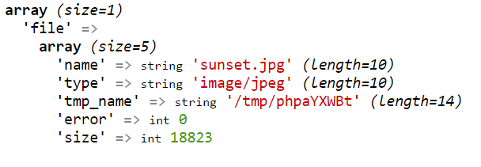
Uploading Files
<?php
if ($_FILES) {
var_dump($_FILES);
} else {
echo "No Files uploaded!";
}
Part of the pre processing, PHP will determine the MIME type and size of the file uploaded.
For security reasons, PHP will automatically rename the newly uploaded file and move it to a temporary directory on the server. The filename chosen is random and its location is defined in the server’s php.ini file.
It is the programmers responsibility to determine the files validity, rename and move the file to is destination before it can be used.

Slide 26
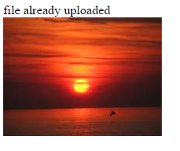
Uploading Files
To move an uploaded file, use the built-in PHP function :
move_uploaded_file( src, dest );
Provide the source filename (in this case the temporary filename) and the destination directory and filename.
You can check if the filename already exists by simply invoking the file_exists( file ) function.
<?php
if ($_FILES) {
$tmp_filename = $_FILES['file']['tmp_name'];
$filename = $_FILES['file']['name'];
if (!file_exists($filename)) {
move_uploaded_file($tmp_filename, $filename);
} else {
echo "File already uploaded <br>";
}
echo "<img src=\"$filename\">";
} else {
echo "No Files uploaded!";
}

Slide 27
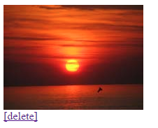
Deleting Files
<?php
if ($_FILES) {
$tmp_filename = $_FILES['file']['tmp_name'];
$filename = $_FILES['file']['name'];
if (!file_exists($filename)) {
move_uploaded_file($tmp_filename, $filename);
} else {
echo "file already uploaded <br>";
}
echo "<img src=\"$filename\"><br>";
echo "<a href='deletefile.php'>[delete]</a>";
} else {
echo "No Files uploaded!";
}

Slide 28

Deleting Files
<?php
$file = 'sunset.jpg';
if (file_exists($file)) {
unlink($file);
echo "File $file successfully deleted";
} else {
echo "File deletion failed";
}
One can delete a file by using the PHP function unlink ( $filename )
It goes without saying, caution should be taken when using this command.

Slide 29
Deleting Files
Never accept filenames or locations directly from the user.
This could lead to loss of data:
Consider the following:
<?php
$file = $_GET['file'];
if (file_exists($file)) {
unlink($file);
echo "File $file successfully deleted";
} else {
echo "File deletion failed";
}

Slide 30
The end of Lecture 12

