Slide 1
Information Visualization Project Proposal and Dataset
G01-A
70493 – Tiago Nascimento
76102 – Miguel Cruz
76394 – Daniel Trindade

Slide 2
DOMAIN
01

Slide 3

Domain
High level description

Slide 4
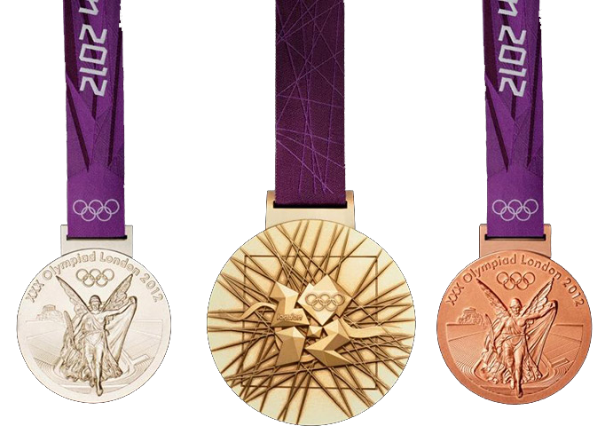
Domain
High level description

Slide 5
Domain
High level description
Who has the most gold medals of all time?
Which country has been better in tennis since the year 1896?
Which country had the best female athletes in 2004?

Slide 6
Domain
High level description
Who has the most gold medals of all time?
Which country has been better in tennis since the year 1896?
Which country had the best female athletes in 2004?
Statistics…

Slide 7
DATASET
02

Slide 8
Dataset
Dataset description
We have 2 datasets:
One from an article in The Guardian,
It has information about All podium winners, in every sport, since the first Edition of the Olympic Games in 1896 until 2008.

Slide 9
Dataset
Dataset description
We have 2 datasets:
The other from The World Bank,
It represents the population’s size of every country since 1960.

Slide 10
TASKS
03

Slide 11
Tasks
Task 1 – Browse
“Show a list of the countries with the most gold medalists, in total, in a given year”
Task 2 – Identify
“Show the country with the most medalists in Judo of all time”
Task 3 - Locate
“Show the position of the country in the overall standings”

Slide 12
Tasks
Task 4 - Explore
“Using the derivative variable nºmedallists/nºpopulation, show the list of countries with the highest coefficient”
Task 5 - Compare
“Show the medals each country won”

Slide 13
Example QUESTIONS
04

Slide 14
Questions
1 – What countries had the most gold medallists in the first games, in 1896?
2 – What country has the most medallists in Judo?
3 – What are the standings of the USSR in 1964?
4 – See the countries with the most medallists per capita in 2008.
5 – How do the USSR and Russia’s cumulative scores compare?

Slide 15
Data Sample
05

Slide 16
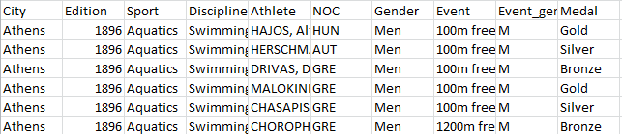
Data Sample
(from “all_medallists.csv”):

Slide 17
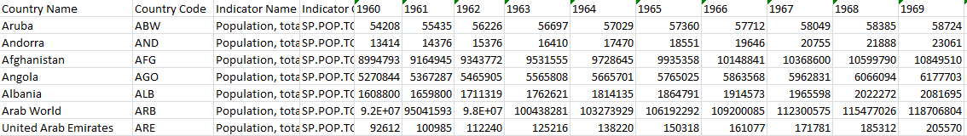
Data Sample
(from “population.csv”):

