Slide 1

LELEC2350-Electromagnetic Waves
Presentation on Dispersion of a broadband signal in a waveguide
Group Member:
Carbonnelle Gautier
Chowdhury Kamrul
Professor:
Craeye Christophe

Slide 2
Simulation of dispersion of a broadband signal in a waveguide
Defining Spatial and Temporal Grids
z_min = 0.
z_max = 10.
z_step = 1.0e-3
z = np.arange(z_min, z_max, z_step)
t_min = 0.
t_max = 7.0e-8
t_step = 1.0e-10
t = np.arange(t_min, t_max, t_step)
t_indices = np.arange(t.size)
Frequency Domain Setup
f_s = 1/t_step
f_step = f_s/t.size
f_0 = 3.0e9
sigma_f_0 = 0.3e9
f_c = 2.0e9
freqs = np.fft.ifftshift(np.fft.fftfreq(t.size, d=t_step))
spect = sg.windows.gaussian(t.size, std=sigma_f_0/f_step)
spect = np.convolve(f_step/(2*sigma_f_0*np.sqrt(2*np.pi)) *
(np.abs(np.abs(freqs) - f_0) < f_step/2), spect, mode='same')
Non-Dispersive Wave Calculation
k_1 = 2*np.pi*freqs/c
H_1 = np.exp(-1j*np.outer(z, k_1))
E_1 = np.fft.ifft(np.fft.fftshift(H_1*spect, axes=1), norm='forward')
Dispersive Wave Calculation
k_low = np.array(np.abs(freqs) < f_c, dtype=complex)
k_low *= -2j*np.pi*np.sqrt(np.abs(f_c**2-freqs**2))/c
k_hi = np.array(np.abs(freqs) >= f_c, dtype=complex)
k_hi *= 2*np.pi*np.sign(freqs)*np.sqrt(np.abs(freqs**2-f_c**2))/c
k_2 = k_low + k_hi
H_2 = np.exp(-1j*np.outer(z, k_2))
E_2 = np.fft.ifft(np.fft.fftshift(H_2*spect, axes=1), norm='forward')

Slide 3
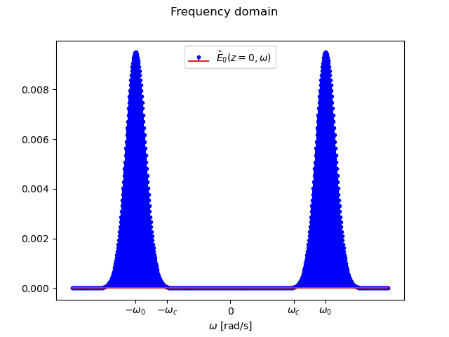
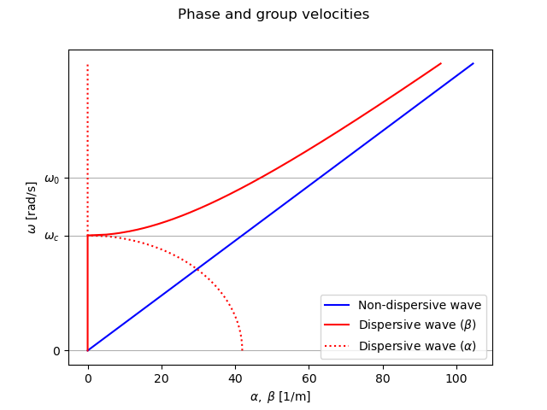
Simulation of dispersion of a broadband signal in a waveguide

