Slide 1

LELEC2350-Electromagnetic Waves
Presentation on Dispersion of a broadband signal in a waveguide
Group Member:
Carbonnelle Gautier
Chowdhury Kamrul
Professor:
Craeye Christophe

Slide 2
Simulation of dispersion of a broadband signal in a waveguide
Defining Spatial and Temporal Grids
Frequency Domain Setup
(Non-)Dispersive wavenumber Setup (see 2nd graph)
Transfer function in (non-)dispersive media
H = np.exp(-1j*np.outer(z, k))
Product in frequency domain + IFFT
E = np.fft.ifft(np.fft.fftshift(H * spect, axes=1), norm='forward')

Slide 3
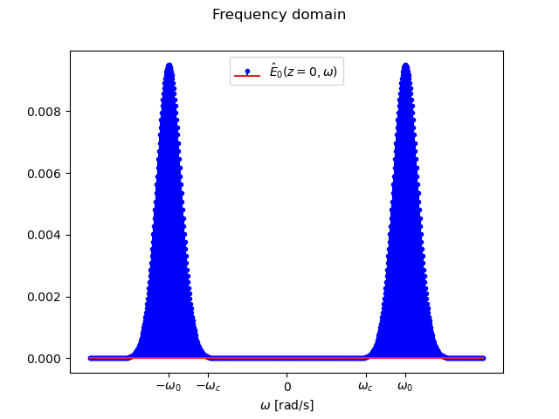
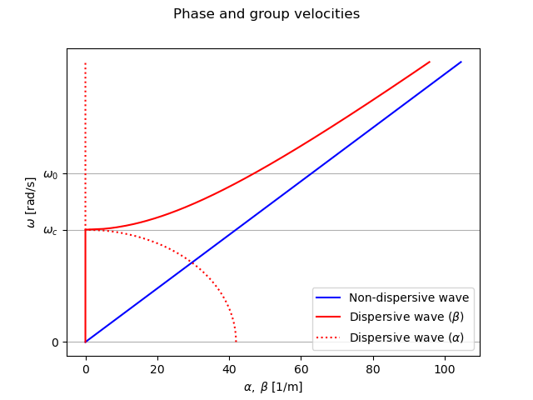
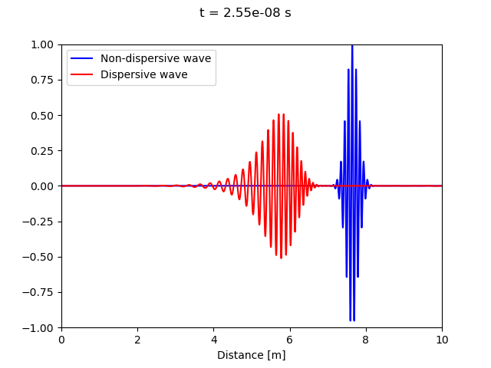
Simulation of dispersion of a broadband signal in a waveguide

