Slide 2
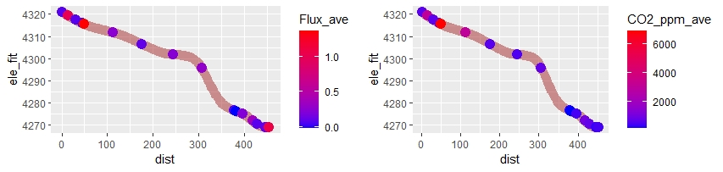
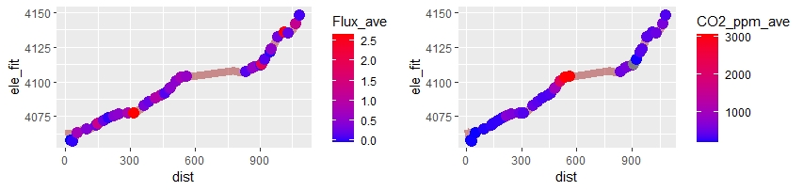
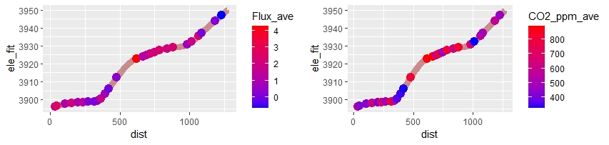
ANTENAS
GAVILAN
COLMILLO

Slide 3
Notes
One Vaisala is old, one is new, need to correct for both, but particularly the old one. Also, I stupidly don’t have temp and pressure for ANTE. A true bummer.
Add DOC water samples
Calc K600
Also I have river width data

Slide 4
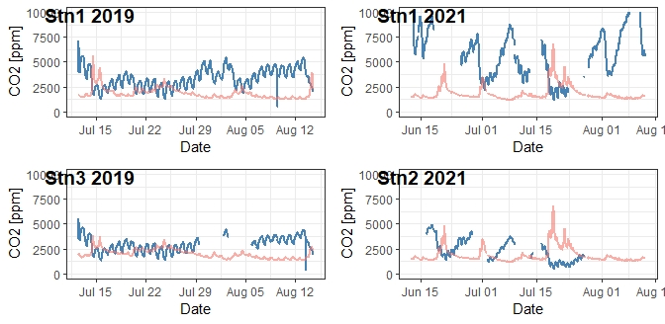

Slide 5
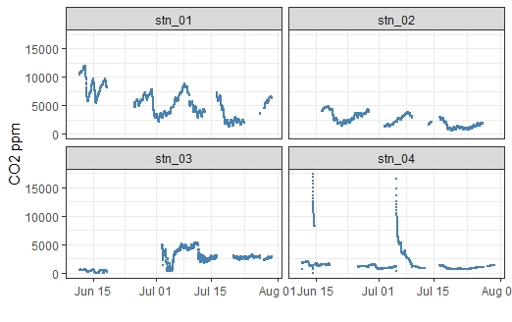
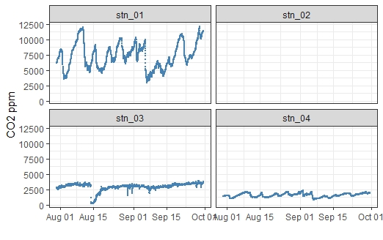
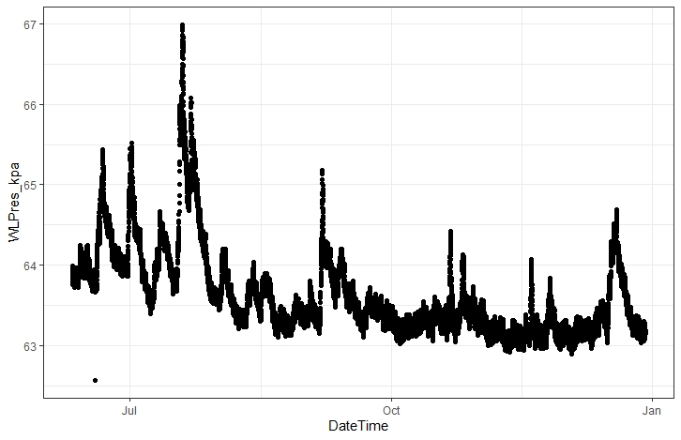
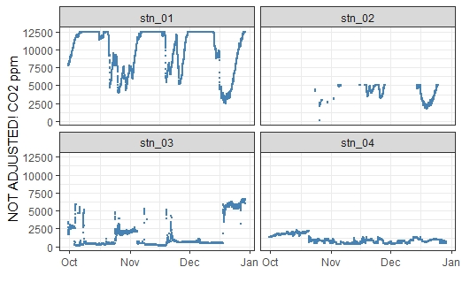

Slide 6
Stray thoughts
If the short incubation time for methane throws doubt on methane samples, doesn’t that also throw doubt on Picarro samples from 2019? Maybe we should revisit this?
Beaver Related – we could think about me (and Tessa) running the IC. Theoretically it’s cheaper (according to Joseph), and we actually get lower detection on bromide, nitrate, nitrite.

