Slide 2
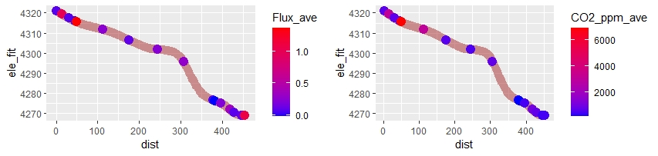
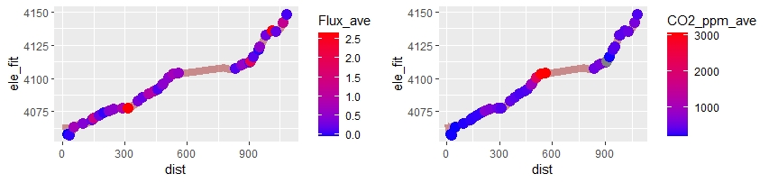
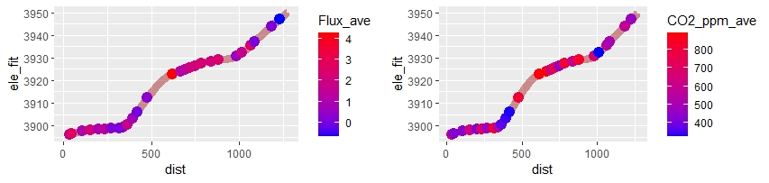
ANTENAS
GAVILAN
COLMILLO

Slide 3
Notes
One Vaisala is old, one is new, need to correct for both, but particularly the old one. Also, I stupidly don’t have temp and pressure for ANTE. A true bummer.
Add DOC water samples
Calc K600
Also I have river width data

Slide 4
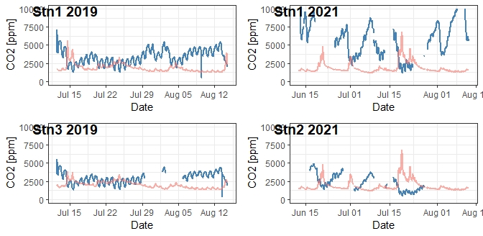

Slide 5
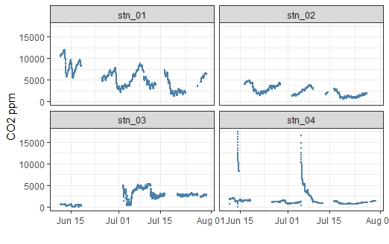
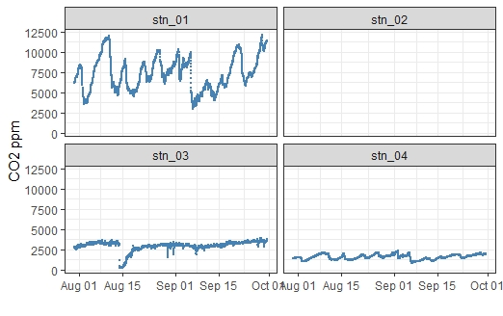
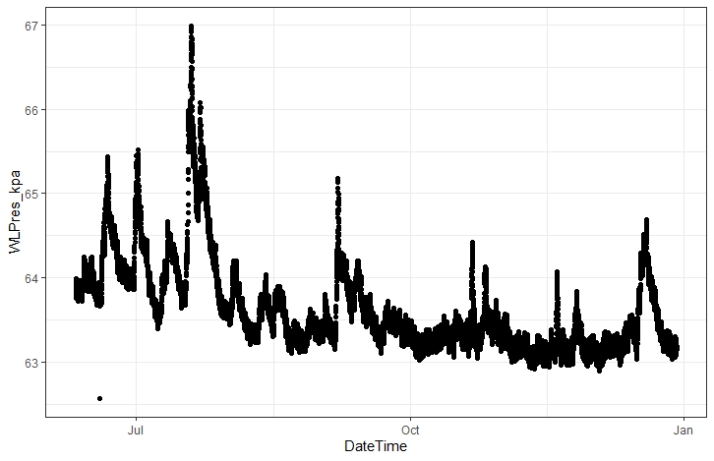
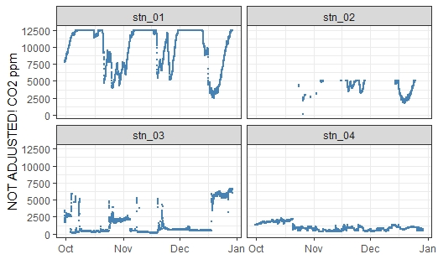

Slide 6
Stray thoughts
If the short incubation time for methane throws doubt on methane samples, doesn’t that also throw doubt on Picarro samples from 2019? Maybe we should revisit this?
Beaver Related – we could think about me (and Tessa) running the IC. Theoretically it’s cheaper (according to Joseph), and we actually get lower detection on bromide, nitrate, nitrite.

Slide 7
Nitrogen injection

Slide 9
Calc k600
Make k600 vs discharge relationship
Calc flux through this time period
K600 + co2 = flux
Weird stn 4 spikes? Maybe to do with water table
George Allen
https://www.nsf.gov/awardsearch/showAward?AWD_ID=2145628

Slide 10
Email Ricardo
Replace DO caps
Download everything
Take measurments of co2 with spare vaisala

Slide 11
Summer plans
Undergrades --- nitrogen injections?
Precipitation drives CO2

Slide 12
Puerto Rico
Or UTAH
apply

Slide 13
fulbright
Pass comps?
Pad cv more

Slide 14
https://www.conocophillips.com/sustainability/sustainability-news/story/testing-drone-technology-to-detect-and-quantify-emissions/

