Slide 2
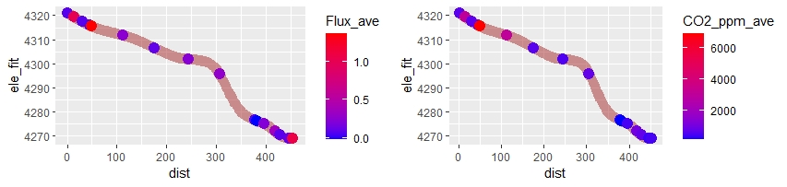
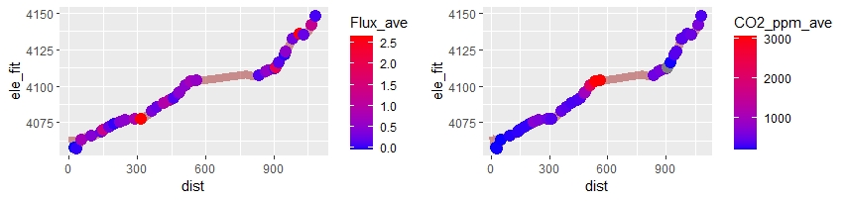
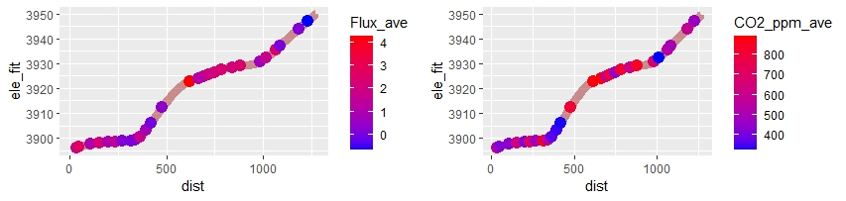
ANTENAS
GAVILAN
COLMILLO

Slide 3
Notes
One Vaisala is old, one is new, need to correct for both, but particularly the old one. Also I stupidly don’t have temp and pressure for ANTE. A true bummer.
Add DOC water samples
Calc K600
Also I have river width data

Slide 4
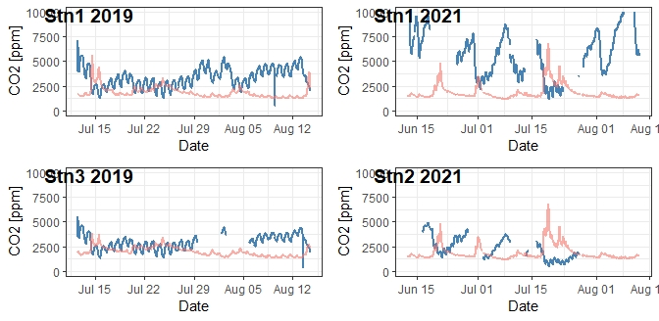

Slide 5
