Slide 1
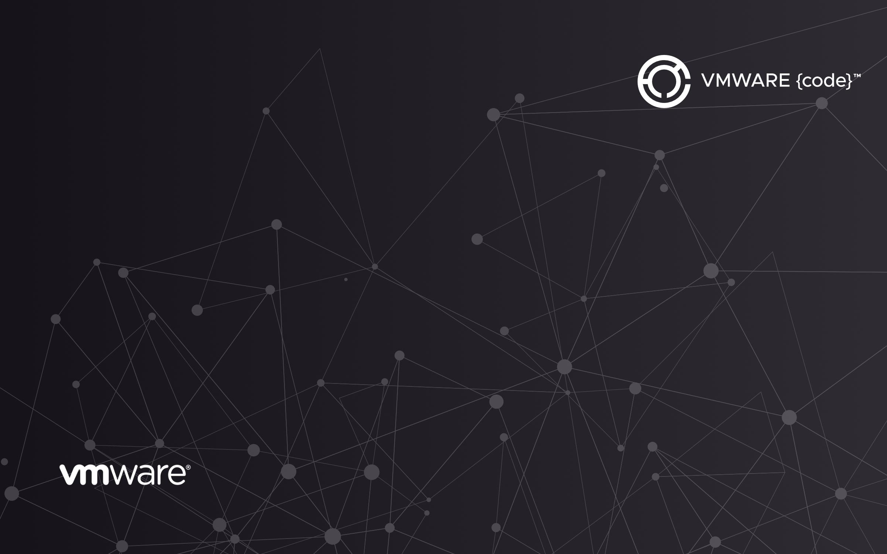
Administration Modernization:
Building and Deploying Containers to vSphere Integrated Containers

Slide 2
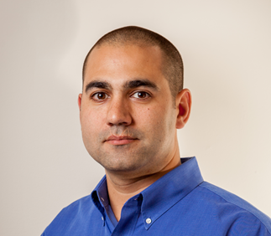
Justin P. Sider
Chief Information Officer at Belay Technologies Inc.
https://belaytech.com
Personal Blog
https://invoke-automation.blog
Github
https://github.com/jpsider
Twitter/Slack
@jpsider
​VMware vExpert (x5)
​VMware Code Coach (2020)
​

Slide 3
Agenda
Why is this important?
Home lab Setup
Identifying a candidate script
Building a Container
Running a Container
Deploying the Container to vSphere Integrated Containers
Running a Container in the VIC
Environmental Variables
Takeaway

Slide 4
Why is this important?
It’s cool
No more running Important scripts on someones logged in session/desktop
More like a Developer
Advancing your skills
Simplified runtime environment
Forces you to write better code

Slide 5
Homelab setup
Application
Long-Running
PowerCLI Script
VIC Appliance
Containers
vCenter
Virtual Container Host
PowerShell 7
Inside PhotonOS
Hypervisors
Intel Nuc

Slide 6
Identifying a Candidate script
Start Simple!
Must have error handling
Idempotent
Can run on a loop/timer
Does not create excessive logs
Connect to vCenter
Run a Report
Send an Email

Slide 7
Building a Container
Create a directory with the important things
Script
Docker file
Properties file (if needed)
docker build . -t codeconnect01
Docker Command
Option(s)
-t (--tag) ~ Specify a Container name
Location of dockerfile

Slide 8
Running a Container locally
docker run -i codeconnect01
Docker Command
Container Tag (name)
Option(s)
-i (--interactive)

Slide 9
Deploy a container to VIC
Login to VIC registry
docker login 192.168.2.230
Tag the Container image
docker tag codeconnect01 192.168.2.230/default-project/codeconnect01
Push the image to the VIC registry
docker push 192.168.2.230/default-project/codeconnect01
Docker Command
Registry
Docker Command
Base
Container
Registry/project/desiredContainerName
Docker Command
Tagged Container Name

Slide 10
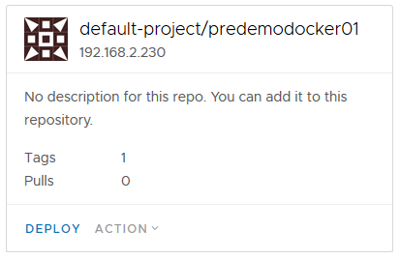
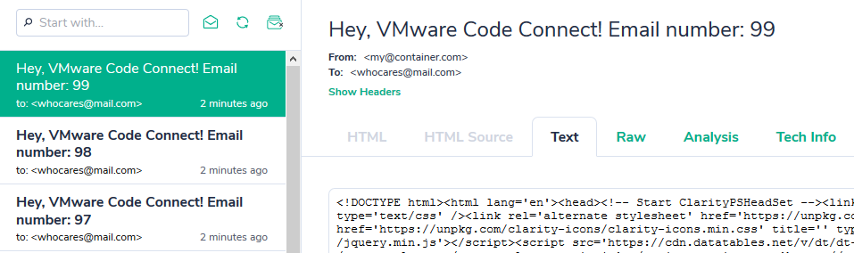
Running a Container in the VIC
You will see this during the Demo. It’s easy!

Slide 11
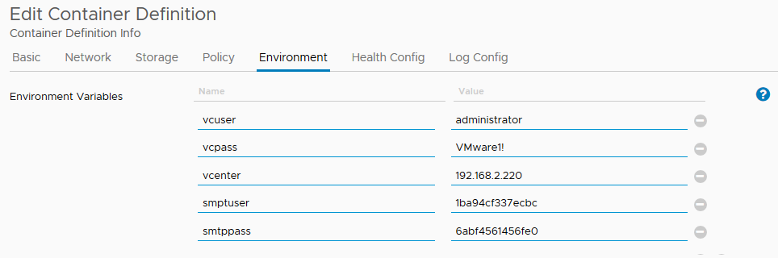
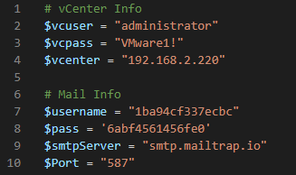
Environmental variables
Used at Runtime
Created by the Developer
Versus packaging variables in config files or Scripts

Slide 12
The Takeaway
You get to use VMware technologies to expand your skills.
It’s not terribly difficult
You might like it
Great for running important scripts in large team environments
There is plenty more to learn and build upon

Slide 13
Resources
Code Available on CodeCon Github!
https://github.com/vmwarecodeconnect/CodeConnect2020/tree/master/Justin/Resources
vSphere Integrated Containers Documentation
https://vmware.github.io/vic-product/assets/files/html/1.5/
Docker and Self Signed Certificate work arounds
https://docs.docker.com/registry/insecure/#use-self-signed-certificates
SendMail Testing (free online tool)
https://blog.mailtrap.io/powershell-send-email/

Slide 14
DEMO TIME

