Slide 1
HTML Content
Building Personal Websites
Lecture 03 | HTML Content

Slide 2
HTML Tags
Class vs ID
Input Fields
Building Personal Websites
Lecture 03 | HTML Content

Slide 3
Default Tags
Tag | Description
< h1 > … < h6 > | Headers [1 = smallest, 6 = largest]
< p > | Paragraph of Text
< a > | Link Webpage
< img > | Image/Graphic
< video > | Video
< br > | Line Break
More References: https://www.w3schools.com/tags/ref_byfunc.asp
Building Personal Websites
Lecture 03 | HTML Content

Slide 4
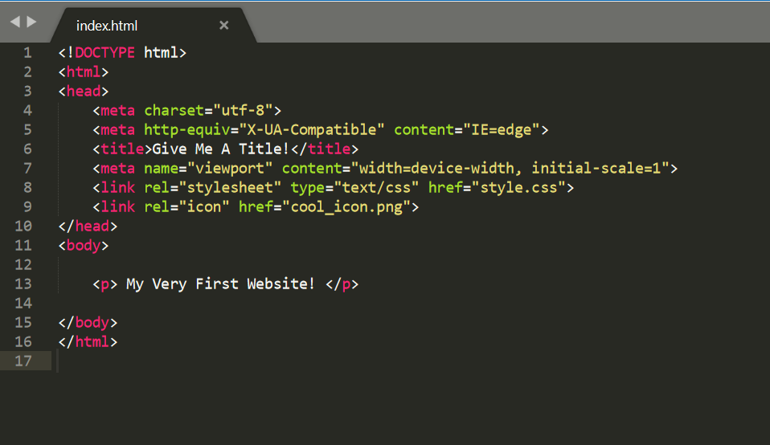
Tags Review
HTML comes in Tag:Content pairs
< tag content=“content” >
< tag > content </ tag >
The type of tag dictates what form it is
source | html_starter.html
Building Personal Websites
Lecture 03 | HTML Content

Slide 5
Tags Review
HTML comes in Tag:Content pairs
Tag | Type | Description
< h1 > … < h6 > | 2 | Headers [1 = smallest, 6 = largest]
< p > | 2 | Paragraph of Text
< a > | 2 | Link Webpage
< img > | 1 | Image/Graphic
< video > | 1 | Video
< br > | 1 | Line Break
< tag content=“content” >
< tag > content </ tag >
The type of tag dictates what form it is
Building Personal Websites
Lecture 03 | HTML Content

Slide 6
Tags Review
Type 1 Tag Example
<img src=“assets/smiley-face.jpeg”>
Type 2 Tag Example
<p> PHP => Programmers Hate PHP </p>
Building Personal Websites
Lecture 03 | HTML Content

Slide 7
Tags Review
What type is this?
<a href=“www.coolmathgames.com”> My Favorite Website </a>
Type 2!
<a> My Favorite Website </a>
Building Personal Websites
Lecture 03 | HTML Content

Slide 8
Loading Images
Locally
<img src=“assets/smiley-face.jpeg”>
Online
<img src=“www.google-images/smiley-face.jpeg”>
*If the server hosting the image goes down, then your website won’t be able to display it.
Building Personal Websites
Lecture 03 | HTML Content

Slide 9
HTML Tags
Class vs ID
Input Fields
Building Personal Websites
Lecture 03 | HTML Content

Slide 10
Classes & IDs
A class in CSS is defined as
.class {
property: value;
}
An ID in CSS is defined as
#id-name {
property: value;
}
We will go over this in more detail in the CSS lecture.
Building Personal Websites
Lecture 03 | HTML Content

Slide 11
Classes & IDs
Say we define the following in style.css
.classy-text {
color: orange;
}
#id-text {
color: red;
}
What is displayed as a result of the following in index.html?
<p class=classy-text> I’ve got class </p>
<p id=id-text> I’ve got no class </p>
<p class=classy-text> I’ve also got class </p>
Building Personal Websites
Lecture 03 | HTML Content

Slide 12
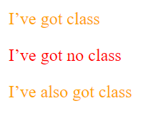
Classes & IDs
What is displayed as a result of the following in index.html?
<p class=classy-text> I’ve got class </p>
<p id=id-text> I’ve got no class </p>
<p class=classy-text> I’ve also got class </p>
Building Personal Websites
Lecture 03 | HTML Content

Slide 13
Classes & IDs
Say we define the following in style.css
.classy-text {
color: orange;
}
.italic-text {
color: italic;
}
What is displayed as a result of the following in index.html?
<p class=‘classy-text italic-text’> I’ve got multiple classes </p>
Building Personal Websites
Lecture 03 | HTML Content

Slide 14

Classes & IDs
What is displayed as a result of the following in index.html?
<p class=‘classy-text italic-text’> I’ve got multiple classes </p>
Building Personal Websites
Lecture 03 | HTML Content

Slide 15
Classes & IDs
Say we define the following in style.css
.classy-text {
color: green;
}
.classier-text {
color: red;
}
What color will the following element be?
The most recent declaration.
<p class=‘classy-text classier-text’> I’ve got multiple classes </p>
Building Personal Websites
Lecture 03 | HTML Content

Slide 16
Classes & IDs
Say we define the following in style.css
#classy-id {
color: green;
}
#classier-id {
color: red;
}
What color will the following element be?
Neither. Elements with multiple IDs are undefined.
<p id=‘classy-id classier-id’> I’m a bad example </p>
Building Personal Websites
Lecture 03 | HTML Content

Slide 17
Classes & IDs
Classes are useful when you want to stack properties on an element
<p class=‘first-class second-class … nth-class’> I work fine! </p>
IDs are useful when you want unique properties for a group of elements
<p id=only-one> I only need one ID! </p>
Building Personal Websites
Lecture 03 | HTML Content

Slide 18
HTML Tags
Class vs ID
Input Fields
Building Personal Websites
Lecture 03 | HTML Content

Slide 19
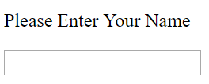
Input Fields
HTML has specific input tags to handle entry fields
<p> Please enter your name </p>
<input type=”text” id=‘name-field’>
We will learn later how to use JQuery to parse the input
Building Personal Websites
Lecture 03 | HTML Content

Slide 20
Input Fields
Input fields can take one of multiple forms
<input type=”button”>
<input type=”checkbox”>
<input type=”color”>
<input type=”date”>
<input type=”email”>
<input type=”fileupload”>
<input type=”password”>
<input type=”reset”>
<input type=”submit”>
<input type=”url”>
And many more…
See https://www.w3schools.com/tags/tag_input.asp
Building Personal Websites
Lecture 03 | HTML Content

Slide 21
Live Demo
Building Personal Websites
Lecture 03 | HTML Content

