Slide 1
Interactive Elements
Building Personal Websites
Lecture 04 | Interactive Elements

Slide 2
Class Hierarchy
Basic Interactions: A CSS Approach
Building Personal Websites
Lecture 04 | Interactive Elements

Slide 3

.parent {
background: blue;
width: 200px;
height: 200px;
}
.child {
background: orange;
display: inline-block;
width: 100px;
height: 100px;
margin: 50px;
}
< div class=parent >
< div class=child > </ div >
</ div >
Building Personal Websites
Lecture 04 | Interactive Elements

Slide 4
.parent {
background: blue;
width: 200px;
height: 200px;
}
.parent > .child {
background: orange;
display: inline-block;
width: 100px;
height: 100px;
margin: 50px;
}
< div class=parent >
< div class=child > </ div >
</ div >
Building Personal Websites
Lecture 04 | Interactive Elements

Slide 5
We can assign the same properties to multiple classes & IDs
.parent, .parent2 {
background: blue;
width: 200px;
height: 200px; }
‘parent > child’ allows us to reference a class or ID by the immediate parent
.parent > .child {
background: orange;
display: inline-block;
width: 100px;
height: 100px;
margin: 50px; }
.parent2 > .child {
background: green;
display: inline-block;
width: 100px;
height: 100px;
margin: 50px; }
Building Personal Websites
Lecture 04 | Interactive Elements

Slide 6
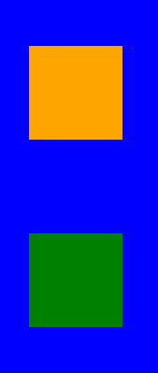
.parent, .parent2 {
background: blue;
width: 200px;
height: 200px;
}
.parent > .child {
background: orange;
display: inline-block;
width: 100px;
height: 100px;
margin: 50px;
}
.parent2 > .child {
background: green;
display: inline-block;
width: 100px;
height: 100px;
margin: 50px;
}
< div class=parent >
< div class=child > </ div >
</ div >
< div class=parent2 >
< div class=child > </ div >
</ div >
Building Personal Websites
Lecture 04 | Interactive Elements

Slide 7
.parent > .child
Looks for class ‘child’ as an immediate descendant of ‘parent’
.parent .child
Looks for class ‘child’ as any descendant of ‘parent’
.parent > *
Looks for any immediate descendant of ‘parent’
.parent *
Looks for any descendant of ‘parent’
Building Personal Websites
Lecture 04 | Interactive Elements

Slide 8
.parent + .child
Looks for class ‘child’ immediately after (not inside) class ‘parent’
.parent ~ .child
Looks for class ‘child’ immediately before (not inside) class ‘parent’
.parent:first-child
Looks for first child of ‘parent’
.parent:last-child
Looks for last child of ‘parent’
Building Personal Websites
Lecture 04 | Interactive Elements

Slide 9
< div class=great-grandparent >
< div class=grandparent >
< div class=parent >
< div class=me >
< div class=child > </ div >
</ div >
< div class=sibling >
< div class=niece > </ div > < div class=nephew > </ div >
</ div >
</ div >
</ div >
</ div >
How many ways to select ‘me’?
Building Personal Websites
Lecture 04 | Interactive Elements

Slide 10
< div class=great-grandparent >
< div class=grandparent >
< div class=parent >
< div class=me >
< div class=child > </ div >
</ div >
< div class=sibling >
< div class=me > </ div > <!--IMPOSTER-->
< div class=nephew > </ div >
</ div >
</ div >
</ div >
</ div >
How many ways to select ‘me’?
Building Personal Websites
Lecture 04 | Interactive Elements

Slide 11
Class Hierarchy
Basic Interactions: A CSS Approach
Building Personal Websites
Lecture 04 | Interactive Elements

Slide 12
.element:hover
Activated when cursor hovers over element
.element:active
Activated when cursor clicks (and holds) element
Building Personal Websites
Lecture 04 | Interactive Elements

Slide 13

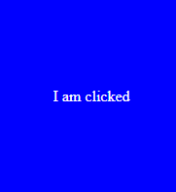
.click-me {
background: orange;
color: white;
text-align: center;
line-height: 200px;
width: 200px;
height: 200px;
}
.click-me:active {
background: blue;
}
.click-me:active::before {
content: “I am clicked”;
}
< div class=click-me > Click me! </ div >
Building Personal Websites
Lecture 04 | Interactive Elements

Slide 14
.a {
color: black;
}
.a:hover {
color: yellow;
text-style: underline;
}
< a href=‘http://www.poptropica.com/’ > Some Fun Games </ a >
Affects every < a > tag
Building Personal Websites
Lecture 04 | Interactive Elements

Slide 15
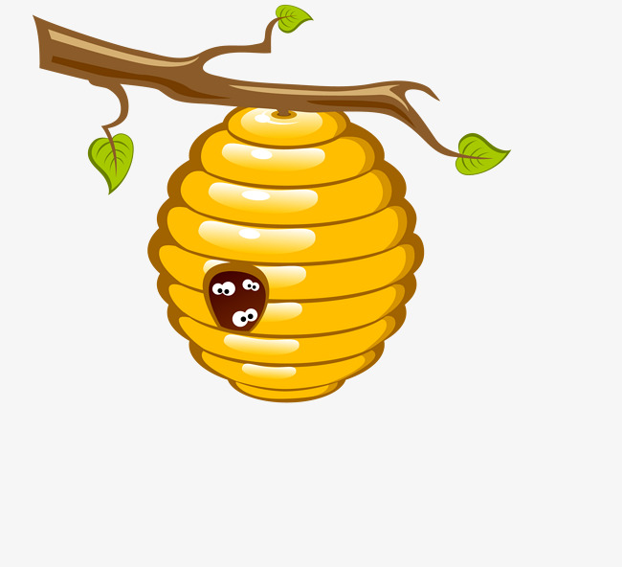
Hive Demo
Building Personal Websites
Lecture 04 | Interactive Elements

