Slide 1
Basic Animations
Building Personal Websites
Lecture 05 | Basic Animations

Slide 2
Animations: Overview
Transition Property
Building Personal Websites
Lecture 05 | Basic Animations

Slide 3



Δ
3 Properties define an animation
Change in property (Δ)
Time (t)
Interpolation (I)
If two animation cycles share the same 3 properties, they are the same
Building Personal Websites
Lecture 05 | Basic Animations

Slide 4
Change in Property (Δ)
x-position: 0m;
x-position: 1000m;
Building Personal Websites
Lecture 05 | Basic Animations

Slide 5
Time (t)
Takes 10 minutes to walk to work
Building Personal Websites
Lecture 05 | Basic Animations

Slide 6
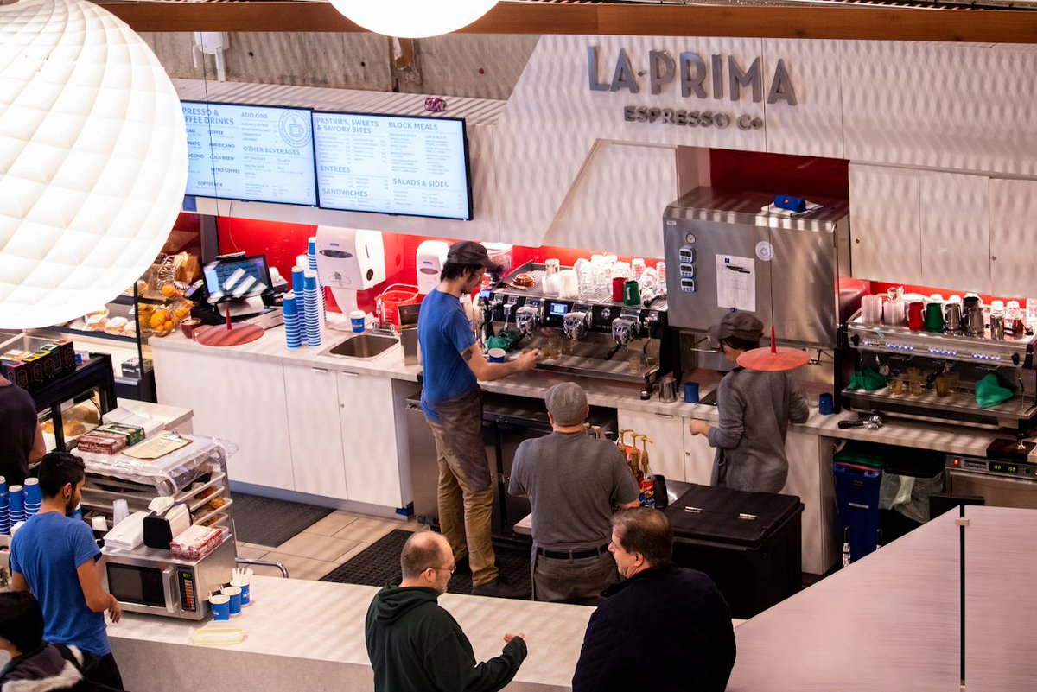
Interpolation (I)
Building Personal Websites
Lecture 05 | Basic Animations

Slide 7
Interpolation (I)
speed
Interpolation tells us what the man does during the range of time t
Building Personal Websites
Lecture 05 | Basic Animations

Slide 8
This is possible too
speed
Building Personal Websites
Lecture 05 | Basic Animations

Slide 9
This is possible too
Change in property (Δ) None (We start and end in the same place)
Time (t) 10 mins
Interpolation (I) sin( 2*pi * t / 10 )
Building Personal Websites
Lecture 05 | Basic Animations

Slide 10
Animations: Overview
Transition Property
Building Personal Websites
Lecture 05 | Basic Animations

Slide 11
.css-transition {
width: 50%;
}
.css-transition:hover {
width: 100%;
transition-property: width; transition-duration: 2s; transition-timing-function: linear; transition-delay: 1s;
}
Change in property (Δ) width += 50%
Time (t) 2 sec
Interpolation (I) (50 / 2) (%/sec)
When we hover, the width increases linearly by 50% over 2 seconds with a 1 second delay.
When we unhover, the width decreases linearly by 50% over 2 seconds with a 1 second delay.
Building Personal Websites
Lecture 05 | Basic Animations

Slide 12
.css-transition:hover {
width: 100%;
transition-property: width; transition-duration: 2s; transition-timing-function: linear; transition-delay: 1s;
}
.css-transition:hover {
width: 100%;
transition: width 2s linear 1s;
}
These two are equivalent.
Building Personal Websites
Lecture 05 | Basic Animations

Slide 13
.css-transition {
width: 50%;
height: 50%;
opacity: 0.5;
}
.css-transition:hover {
width: 100%;
height: 100%;
opacity: 1;
transition: width 2s linear 1s,
height 2s linear 1s;
opacity 3s cubic 0s;
}
We specify an animation cycle for each value we want to animate over.
Building Personal Websites
Lecture 05 | Basic Animations

Slide 14
.css-transition {
width: 50%;
height: 50%;
opacity: 0.5;
}
.css-transition:hover {
width: 100%;
height: 100%;
opacity: 1;
transition: width 2s linear 1s,
height 2s linear 1s;
opacity 3s cubic 0s;
}
We specify an animation cycle for each value we want to animate over.
So we can animate values independently, even if they are in the same class or ID.
Building Personal Websites
Lecture 05 | Basic Animations

Slide 15
Transition Timing Functions
linear
ease
ease-in
ease-out
ease-in-out
Building Personal Websites
Lecture 05 | Basic Animations

Slide 16
Transition Timing Functions
Easing Demo
https://www.w3schools.com/css/tryit.asp?filename=trycss3_transition_speed
Building Personal Websites
Lecture 05 | Basic Animations

Slide 17
Transition Timing Functions
Can also specify custom easing properties
.css-transition:hover {
width: 100%;
transition: width 2s cubic-Bezier(.17,.67,.83,.67) 1s;
}
Easy Interface (Highly Recommend Bookmarking)
http://cubic-bezier.com/#.17,.67,.83,.67
Building Personal Websites
Lecture 05 | Basic Animations

Slide 18

Live Problemo
Building Personal Websites
Lecture 05 | Basic Animations

