Slide 1
Introduction to JQuery
Building Personal Websites
Lecture 06 | Intro to JQuery

Slide 2
JavaScript Review
What Is JQuery?
JQuery Syntax
Useful Applications of JQuery
Building Personal Websites
Lecture 06 | Intro to JQuery

Slide 3
Variable Declarations
var a; // variable
var b = "init"; // string
var c = "Hi" + " " + "Joe"; // = "Hi Joe"
var d = 1 + 2 + "3"; // = "33"
var e = [2,3,5,8]; // array
var f = false; // boolean
src=https://htmlcheatsheet.com/js/
Building Personal Websites
Lecture 06 | Intro to JQuery

Slide 4
Variable Declarations
Variables are not bounded to types upon declaration.
var a = “Look I’m a string!”;
a = 5;
a = “Nope, back to a string again”;
src=https://htmlcheatsheet.com/js/
Building Personal Websites
Lecture 06 | Intro to JQuery

Slide 5
Loops
var sum = 0;
for (var i = 0; i < 100; i++) {
sum += i;
}
console.log(sum)
var sum = 0;
var i = 0;
while (i < 100) {
sum += i;
i++;
}
console.log(sum)
src=https://htmlcheatsheet.com/js/
Building Personal Websites
Lecture 06 | Intro to JQuery

Slide 6
If/Else & Switch
if (today == “Sunday”) {
sleep(8.64e+7);
}
else if (today == “Monday”) {
goto School;
}
else if (today == “Tuesday”) {
goto School;
forget_lunch();;
}
switch(today) {
case(“Sunday”):
sleep(8.64e+7);
case(“Monday”):
goto School;
case(“Tuesday”):
goto School;
forget_lunch();
}
“
src=https://htmlcheatsheet.com/js/
Building Personal Websites
Lecture 06 | Intro to JQuery

Slide 7
Objects
CMU_Student = {
first_name = “jon ”
last_name = ‘doe ”
age = 20
height = 6
favorite_restaurant = “gallo”
hobbies = function() {
return this.first_name + this.last_name + “likes ” + this.favorite_restaurant;
}
}
var student = new CMU_Student()
console.log( student.hobbies() )
“jon doe likes gallo”
src=https://htmlcheatsheet.com/js/
Building Personal Websites
Lecture 06 | Intro to JQuery

Slide 8
Objects
CMU_Student = {
first_name = “jon ”
last_name = ‘doe ”
set_name = function(first, last) {
this.first_name = first;
this.last_name = last; }
age = 20
height = 6
favorite_restaurant = “gallo”
hobbies = function() {
return this.first_name + this.last_name + “likes ” + this.favorite_restaurant;
}
}
src=https://htmlcheatsheet.com/js/
Building Personal Websites
Lecture 06 | Intro to JQuery

Slide 9
Objects
var student = new CMU_Student()
console.log( student.hobbies() )
What will this print?
student.set_name(“bob”, “ross”)
console.log( student.hobbies() )
What will this now print?
src=https://htmlcheatsheet.com/js/
Building Personal Websites
Lecture 06 | Intro to JQuery

Slide 10
JavaScript Review
What Is JQuery?
JQuery Syntax
Useful Applications of JQuery
Building Personal Websites
Lecture 06 | Intro to JQuery

Slide 11
/ j • que • ry / (noun)
A fast and lightweight JavaScript Library that allows for quick and easy HTML element selection, event handling, document traversal, css manipulation and animations. An essential part of every web-developer’s toolkit.
Building Personal Websites
Lecture 06 | Intro to JQuery

Slide 12
Installing JQuery (Locally)
Download JQuery library
https://jquery.com/
Include path to JQuery file in all HTML file headers
< html >
< head >
…
<script src=“/directory/of/jquery/file/jquery.min.js"></script>
…
</ head >
Building Personal Websites
Lecture 06 | Intro to JQuery

Slide 13
Installing JQuery (Online)
Include path to JQuery Online Library in all HTML file headers
< html >
< head >
…
<script src="https://ajax.googleapis.com/ajax/libs/jquery/3.2.1/jquery.min.js"></script>
…
</ head >
Building Personal Websites
Lecture 06 | Intro to JQuery

Slide 14
Installing JQuery
Locally
+
Does not require an internet connection to work.
-
Takes up additional space and may require additional loading times
If uploaded to a slow server when deployed.
Online
+
Faster loading, less space required
-
Cannot be used without an internet connection. If this version goes offline,
then so does your site.
Building Personal Websites
Lecture 06 | Intro to JQuery

Slide 15
Installing JQuery
Recommendations
Use the Online version by default, but always have a local copy installed in case of internet failure.
When deploying site, switch to local version.
Building Personal Websites
Lecture 06 | Intro to JQuery

Slide 16
JavaScript Review
What Is JQuery?
JQuery Syntax
Useful Applications of JQuery
Building Personal Websites
Lecture 06 | Intro to JQuery

Slide 17
Jquery Syntax
$(document).ready(function() {
$(“class/ID”).event( function_to_handle_event() {} );
});
It is important to add everything within a document-ready function so the HTML
can load before the JavaScript.
Building Personal Websites
Lecture 06 | Intro to JQuery

Slide 18
Jquery Syntax
index.html
interactions.js
< div class=cool-class ></ div >
var click = 0;
$(“.cool-class”).click( function() { click++ } );
Counts the number of times the div is clicked
Building Personal Websites
Lecture 06 | Intro to JQuery

Slide 19
Jquery Syntax
style.css
interactions.js
.cool-class:acive {
background: green;
}
$(“.cool-class”).click( function() {
$(this).css(“background”, “green”); } );
Are these the same operation?
Building Personal Websites
Lecture 06 | Intro to JQuery

Slide 20
Jquery Syntax
Can also use JavaScript to redirect the flow of interactions
var clicks = 0;
$(“.cool-class”).click( function() {
clicks++;
if(clicks > 10)
$(this).css(“background”, “red”);
else
$(this).css(“background”, “green”); } );
What does this do?
Building Personal Websites
Lecture 06 | Intro to JQuery

Slide 21
Jquery Syntax
var clicks = 0;
$(“.cool-class”).click( function() {
clicks++;
if(clicks % 2 == 0)
$(this).css(“background”, “red”);
else
$(this).css(“background”, “green”); } );
What does this do?
Building Personal Websites
Lecture 06 | Intro to JQuery

Slide 22
Jquery Syntax
var clicks = 0;
$(“.cool-class”).click( function() {
clicks++;
if(clicks % 2 == 0)
$(this).css(“background”, “red”);
else
$(this).css(“background”, “green”); } );
What does this do?
Building Personal Websites
Lecture 06 | Intro to JQuery

Slide 23
Jquery Syntax
var clicks = 0;
$(“.cool-class”).click( function() {
clicks++;
if(clicks % 2 == 0) {
$(this).css(“background”, “red”);
$(this).css(“color”, “green”);
$(this).css(“font-size”, “35px”); }
else{
$(this).css(“background”, “blue”);
$(this).css(“color”, “white”);
$(this).css(“font-size”, “15px”); }
);
This seems like a lot…
Can we do it in less lines?
Building Personal Websites
Lecture 06 | Intro to JQuery

Slide 24
Jquery Syntax
style.css
interactions.js
.cool-class {
background: blue;
color: white;
font-family: 15px;
}
.cooler {
background: red;
color: green;
font-family: 35px;
}
$(“.cool-class”).click( function() {
if( $(this).hasClass("cooler") )
$(this).removeClass("cooler");
else
$(this).addClass("cooler");
);
Building Personal Websites
Lecture 06 | Intro to JQuery

Slide 25
JavaScript Review
What Is JQuery?
JQuery Syntax
Useful Applications of JQuery
Building Personal Websites
Lecture 06 | Intro to JQuery

Slide 26
Can search for HTML elements
Adds listeners to classes/IDs to listen for changes
Add event handlers (different from CSS handlers)
Custom animation algorithms
Text/JSON parsing
Building Personal Websites
Lecture 06 | Intro to JQuery

Slide 27
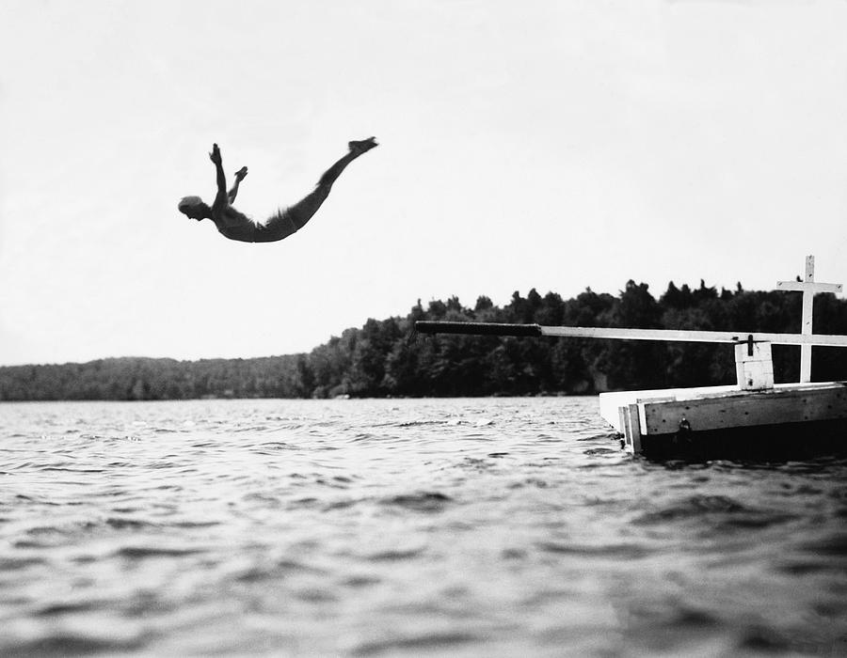
Swan Dive Demo
Building Personal Websites
Lecture 06 | Intro to JQuery

