Slide 1
JSON Parsing
Building Personal Websites
Lecture 10 | JSON Parsing

Slide 2
What is a JSON
Reading/Writing to JSONs
JSON for Web Development
Building Personal Websites
Lecture 10 | JSON Parsing

Slide 3
J S O N S O O T H E R S
N O T I C E
Building Personal Websites
Lecture 10 | JSON Parsing

Slide 4
J A V A
S C R I P T O B J E C T
N O T A T I O N
Building Personal Websites
Lecture 10 | JSON Parsing

Slide 5
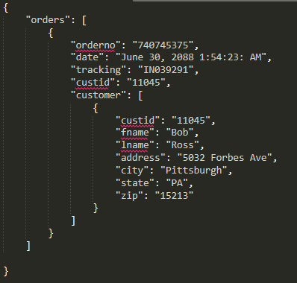
Building Personal Websites
Lecture 10 | JSON Parsing

Slide 6
What is a JSON
Reading/Writing to JSONs
JSON for Web Development
Building Personal Websites
Lecture 10 | JSON Parsing

Slide 7
$.getJSON( “data.json", function( data ) {
var name = data[“orders”][0][“customer”][0][“fname”];
name += “ “;
name = data[“orders”][0][“customer”][0][“lname”];
console.log(name);
});
Building Personal Websites
Lecture 10 | JSON Parsing

Slide 8
$.getJSON( “data.json", function( data ) {
var name = data[“orders”][0][“customer”][0][“fname”];
name += “ “;
name = data[“orders”][0][“customer”][0][“lname”];
console.log(name);
});
object
array
Building Personal Websites
Lecture 10 | JSON Parsing

Slide 9
$.getJSON( “data.json", function( data ) {
data[“orders”][0][“customer”][0][“fname”] = ‘John’;
data[“orders”][0][“customer”][0][“lname”] = ‘Doe’;
});
object
array
Building Personal Websites
Lecture 10 | JSON Parsing

Slide 10
What is a JSON
Reading/Writing to JSONs
JSON for Web Development
Building Personal Websites
Lecture 10 | JSON Parsing

Slide 11
Benefits of using JSONs
Great for storing large amounts of data
Easy to parse
Sounds like “Jason”, so you won’t forget it
Downsides of using JSONs
Comparatively slow read-write times
Easily breachable (don’t store personal data in it).
Building Personal Websites
Lecture 10 | JSON Parsing

Slide 12
$.getJSON( “data.json", function( data ) {
$.each( data, function( key, val ) {
console.log(val);
});
});
What will this print?
Building Personal Websites
Lecture 10 | JSON Parsing

Slide 13

Manually tag data so users can search for it by tags
function search( tag ) {
$.getJSON( “data.json", function( data ) {
$.each( data, function( key, val ) {
for( var k = 0; k < val.length; k++ ) {
if( val[k] == tag )
console.log( key );
}
});
});
}
Building Personal Websites
Lecture 10 | JSON Parsing

Slide 14
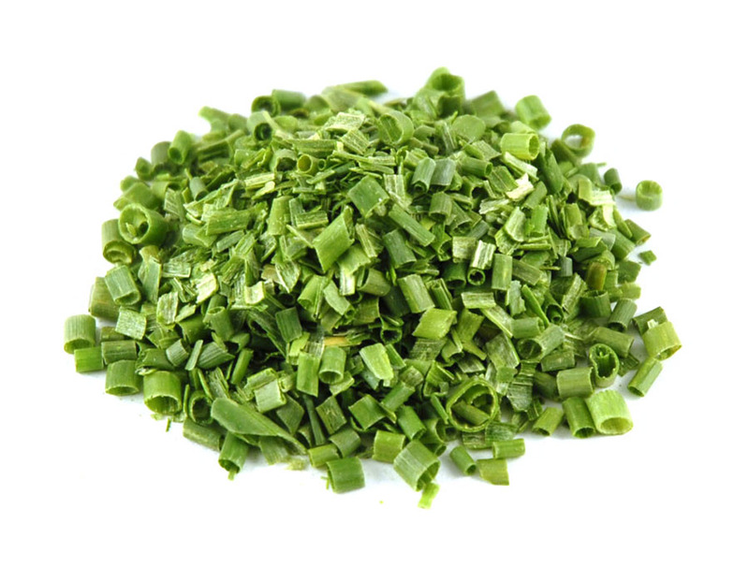
Chive Demo
Building Personal Websites
Lecture 10 | JSON Parsing

