Slide 1
Intro to CSS
Building Personal Websites
Lecture 04 | Intro to CSS

Slide 2
Introduction to the CSS Workflow
Margins vs Padding
The Position Parameter
Creating a Navigation Bar
Building Personal Websites
Lecture 04 | Intro to CSS

Slide 3
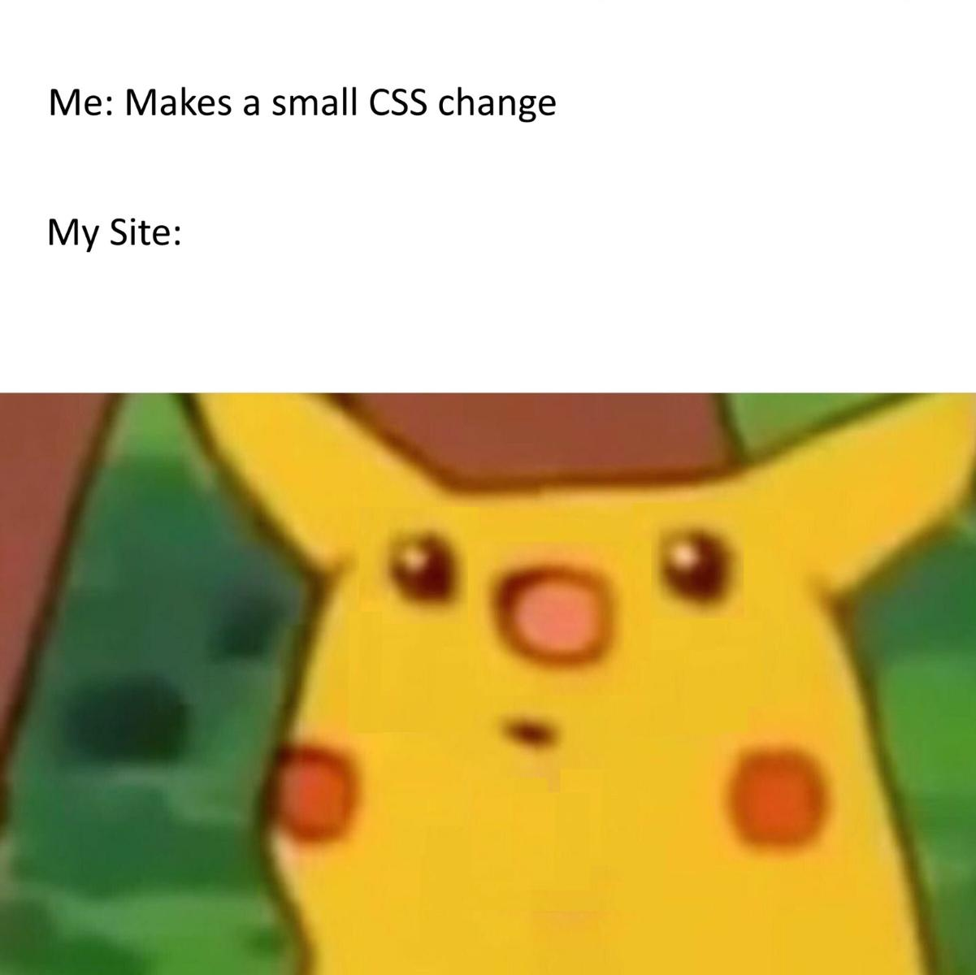
Building Personal Websites
Lecture 04 | Intro to CSS

Slide 4
Classes & IDs (Review)
A class in CSS is defined as
.class {
property: value;
}
An ID in CSS is defined as
#id-name {
property: value;
}
Building Personal Websites
Lecture 04 | Intro to CSS

Slide 5
Classes & IDs (Review)
Are these the same if applied to a div?
.im-a-class {
color: blue;
width: 100px;
height: 100px;
}
#im-an-id {
color: blue;
width: 100px;
height: 100px;
}
Building Personal Websites
Lecture 04 | Intro to CSS

Slide 6
Adding CSS to HTML
We can have a separate style.css file,
.im-a-class {
color: blue;
width: 100px;
height: 100px;
}
And link it to our index.html file.
<head>
<link rel="stylesheet” type="text/css" href="style.css“>
</head>
<body>
<div class=im-a-class> </div>
</body>
Building Personal Websites
Lecture 04 | Intro to CSS

Slide 7
Adding CSS to HTML
Or we can integrate the CSS directly into index.html body.
<head>
</head>
<body>
<style type=‘text/css’>
.im-a-class {
color: blue;
width: 100px;
height: 100px;
}
</style>
<div class=im-a-class> </div>
</body>
Generally good style to define CSS before HTML.
Building Personal Websites
Lecture 04 | Intro to CSS

Slide 8
Adding CSS to HTML
Or we can even include it directly into the div.
<head>
</head>
<body>
<div style=“color:blue; width: 100px; height:100px;” > </div>
</body>
Okay to do this a few times, but do not make a habbit.
Building Personal Websites
Lecture 04 | Intro to CSS

Slide 9
Tag | Type | Description
width/height | size | sets width & height of div
color | color | sets element color of div
background-color | color | sets background color of div
font-family | font | sets font for text
font-size | font | sets font size for text
font-style | font | set to italic, bold, or underlined
text-align | font | set to left, right, or center
display | position | sets the type of rendering of div
position | position | sets the positional rendering of div
float | position | sets how the positions of nearby divs interact
overflow | position | determines if elements can overflow a div
opacity | color | sets opacity of a div
margin | position | sets the margin of a div
padding | position | sets the padding of a div
transition | animation | sets the time and interpolation of a transition
z-index | position | higher z-index will display on top
Building Personal Websites
Lecture 04 | Intro to CSS

Slide 10
Introduction to the CSS Workflow
Margins vs Padding
The Position Parameter
Creating a Navigation Bar
Building Personal Websites
Lecture 04 | Intro to CSS

Slide 11
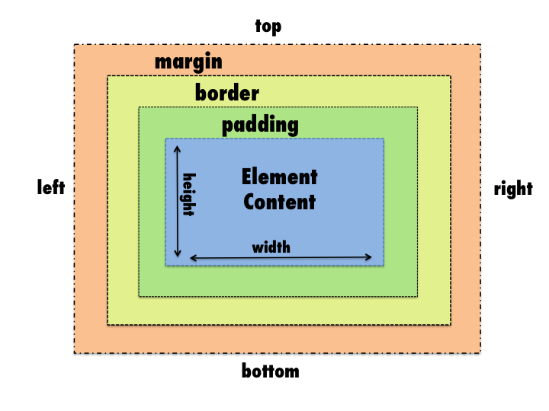
Building Personal Websites
Lecture 04 | Intro to CSS

Slide 12
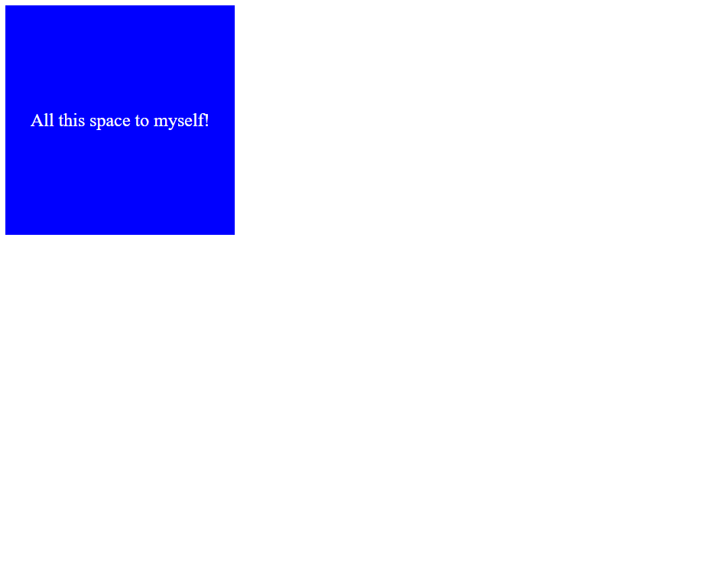
Centering Text
Text-align horizontally centers, and line-height vertically centers text.
<style>
.space-hogger {
background-color: blue;
color: white;
text-align: center;
line-height: 200px;
width: 200px;
height: 200px;
}
</style>
<div class=space-hogger> All this space to myself!</div>
Building Personal Websites
Lecture 04 | Intro to CSS

Slide 13
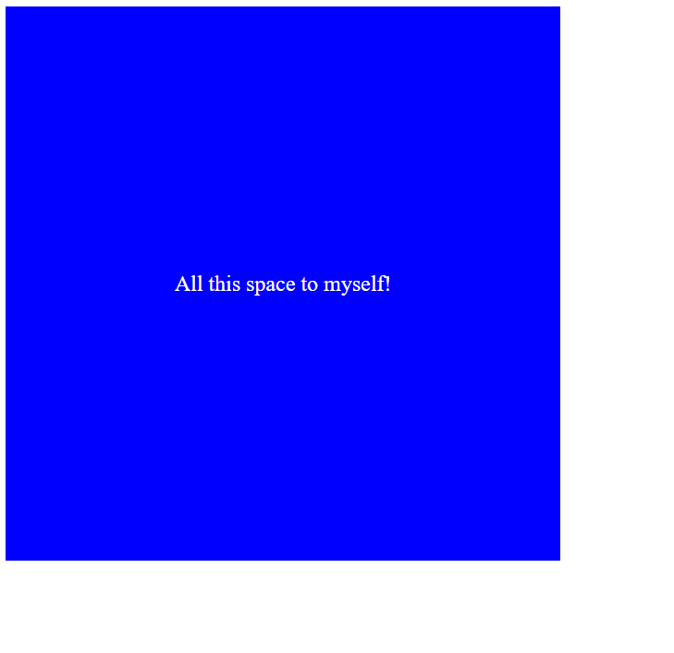
Padding
Padding expands the active area of the region and copies its properties to the expanded regions.
<style>
.space-hogger {
background-color: blue;
color: white;
text-align: center;
line-height: 200px;
width: 200px;
height: 200px;
padding: 100px;
}
</style>
<div class=space-hogger> All this space to myself!</div>
100px
Building Personal Websites
Lecture 04 | Intro to CSS

Slide 14
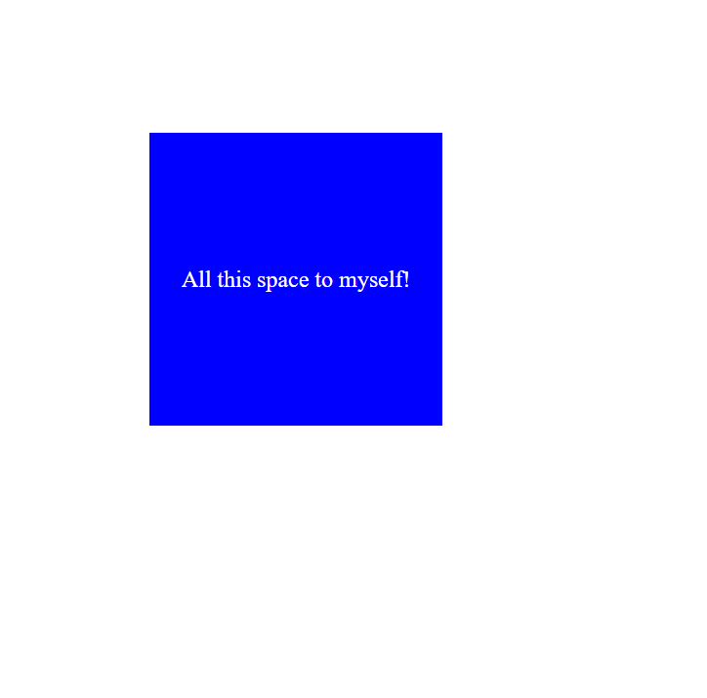
Margin
Margin expands the region without copying the properties to the expanded regions.
<style>
.space-hogger {
background-color: blue;
color: white;
text-align: center;
line-height: 200px;
width: 200px;
height: 200px;
margin: 100px;
}
</style>
<div class=space-hogger> All this space to myself!</div>
100px
Building Personal Websites
Lecture 04 | Intro to CSS

Slide 15
Margins, Paddings & Borders
What does the following code generate?
<style>
.space-hogger {
background-color: blue;
color: white;
text-align: center;
line-height: 200px;
width: 200px;
height: 200px;
padding: 100px;
margin: 100px;
border: 5px solid black;
}
</style>
<div class=space-hogger> All this space to myself!</div>
Hint:
Building Personal Websites
Lecture 04 | Intro to CSS

Slide 16
Introduction to the CSS Workflow
Margins vs Padding
The Position Parameter
Creating a Navigation Bar
Building Personal Websites
Lecture 04 | Intro to CSS

Slide 17

Static
Default behavior that places blocks at the next available point
.orange {
background-color: orange;
width: 100px;
height: 100px;
position: static; }
.blue {
background-color: blue;
width: 100px;
height: 100px;
position: static; }
Why is this not the next available point?
Because divs have implied margin-left/right: 100%
Building Personal Websites
Lecture 04 | Intro to CSS

Slide 18
Relative
Identifies a reference point so that all transformations will be relative to that point
.orange {
background-color: orange;
width: 100px;
height: 100px;
position: relative; }
.blue {
background-color: blue;
width: 100px;
height: 100px;
position: relative; }
Building Personal Websites
Lecture 04 | Intro to CSS

Slide 19

Absolute
Shares same reference point as parent
.orange {
background-color: orange;
width: 100px;
height: 100px;
position: absolute; }
.blue {
background-color: blue;
width: 100px;
height: 100px;
position: absolute; }
(blue overlaps orange)
Building Personal Websites
Lecture 04 | Intro to CSS

Slide 20
Fixed
Reference point is top of HTML file. Stays on screen even after scrolling.
.orange {
background-color: orange;
width: 100px;
height: 100px;
position: fixed; }
.blue {
background-color: blue;
width: 100px;
height: 100px;
position: fixed; }
(blue overlaps orange)
Building Personal Websites
Lecture 04 | Intro to CSS

Slide 21
Sticky
Relative when onscreen, static when offscreen. Generally used for Nav Bars.
.orange {
background-color: orange;
width: 100px;
height: 100px;
position: sticky;
top: 0px; }
.blue {
background-color: blue;
width: 100px;
height: 100px;
position: sticky;
top: 100px; }
Building Personal Websites
Lecture 04 | Intro to CSS

Slide 22
Introduction to the CSS Workflow
Margins vs Padding
The Position Parameter
Creating a Navigation Bar
Building Personal Websites
Lecture 04 | Intro to CSS

Slide 23
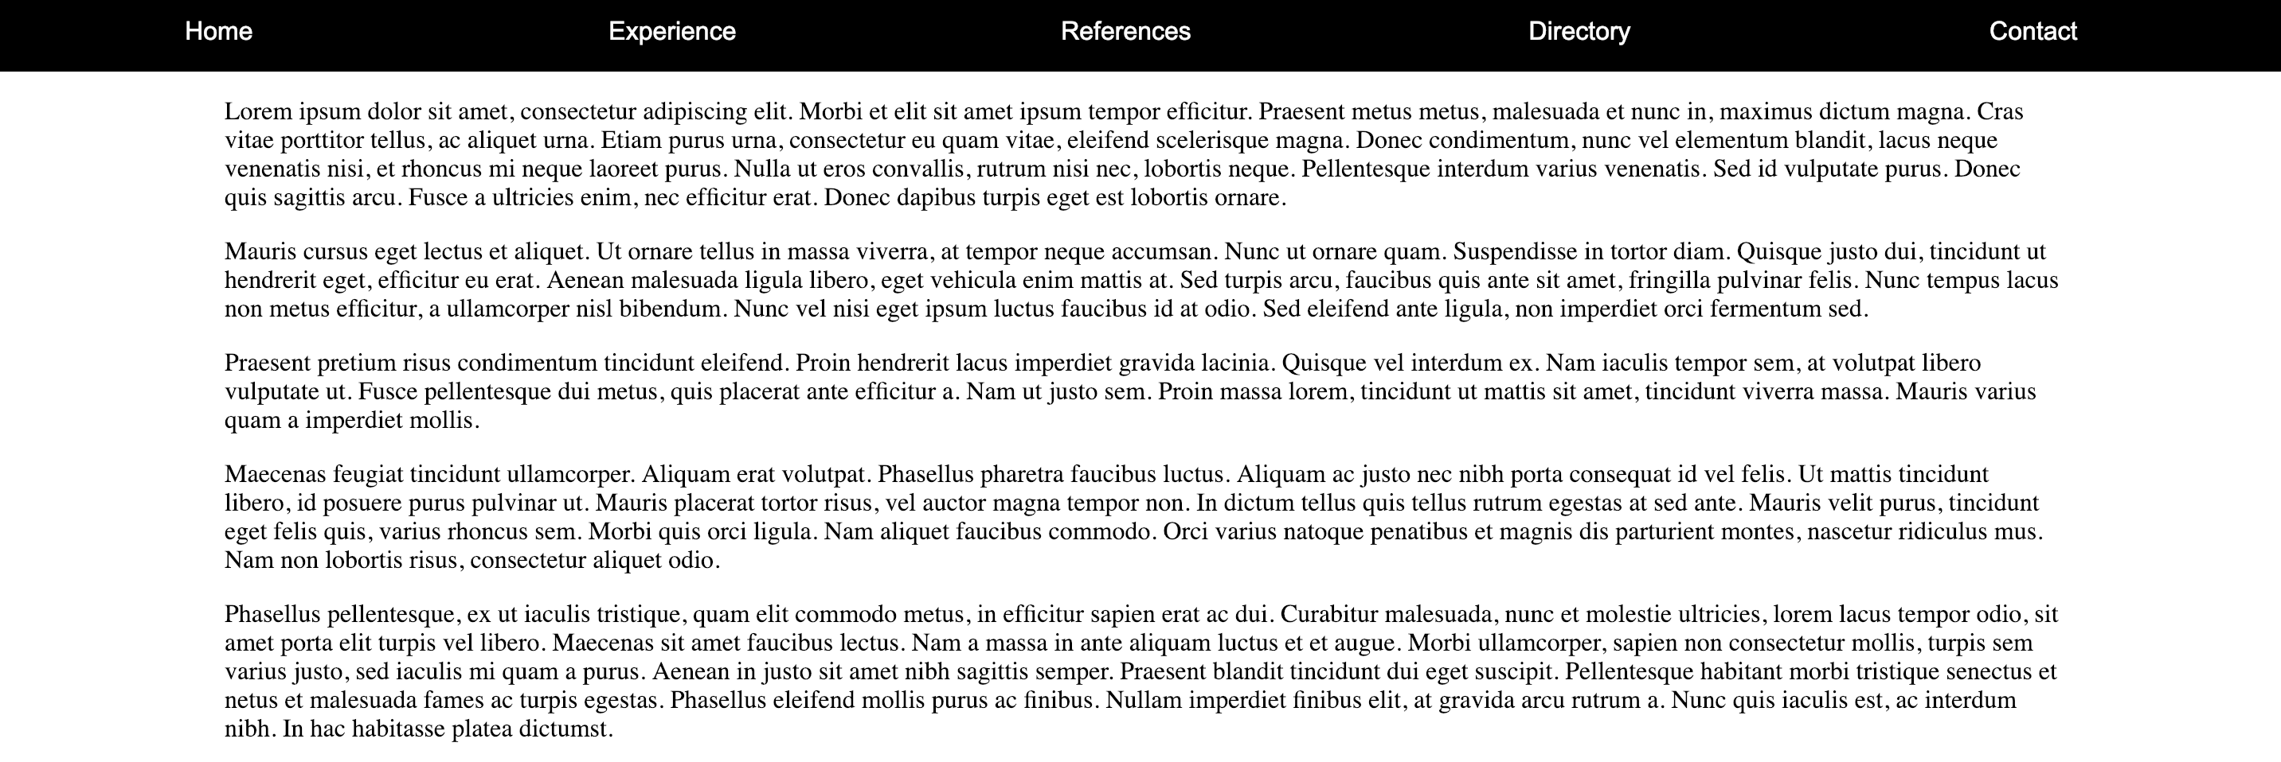
Types of Nav Bars
The purpose of a Navigation Bar is to provide redirection to other pages of the site.
Navigation Bars are generally found at the top of a website and come in two forms:
Static: Nav Bar stays at the top and leaves when you scroll.
Sticky/Fixed: Nav Bar follows you when you scroll.
nav_bar.html
Building Personal Websites
Lecture 04 | Intro to CSS

Slide 24
Static Nav Bar
Creates a static Nav Bar:
.nav-bar {
width: 100%;
height: 50px;
margin: 0;
background: black; }
.nav-bar > .element {
width: 19.5%;
line-height: 50px;
text-align: center;
color: white;
display: inline-block;
margin: 0;
font-family: Arial;
text-decoration: none; }
100%x50px Black Nav Bar
Space For 5 White Text Links
How to increase number of Links?
Building Personal Websites
Lecture 04 | Intro to CSS

Slide 25
Sticky Nav Bar
Creates a Sticky Nav Bar:
.nav-bar {
width: 100%;
height: 50px;
margin: 0;
background: black;
position: sticky;
top: 0; }
.nav-bar > .element {
width: 19.5%;
line-height: 50px;
text-align: center;
color: white;
display: inline-block;
margin: 0;
font-family: Arial;
text-decoration: none; }
Code provided in nav_bar.html
Building Personal Websites
Lecture 04 | Intro to CSS

Slide 26
Homework Ideas
Use position, margin, and padding parameters to organize content.
Create a Nav Bar at the top of the page (sticky or static).
Building Personal Websites
Lecture 04 | Intro to CSS

Slide 27
Live Demo
Building Personal Websites
Lecture 04 | Intro to CSS

