Slide 1
Basic Animations
Building Personal Websites
Lecture 07 | Basic Animations

Slide 2
Animations: Overview
Basic Animations: A CSS Approach
Keyframing Animations
Building Personal Websites
Lecture 07 | Basic Animations

Slide 3



Δ
3 Properties define an animation
Change in property (Δ)
Time (t)
Interpolation (I)
If two animation cycles share the same 3 properties, they are the same
Building Personal Websites
Lecture 07 | Basic Animations

Slide 4
Change in Property (Δ)
x-position: 0m;
x-position: 1000m;
Building Personal Websites
Lecture 07 | Basic Animations

Slide 5
Time (t)
Takes 10 minutes to walk to work
Building Personal Websites
Lecture 07 | Basic Animations

Slide 6
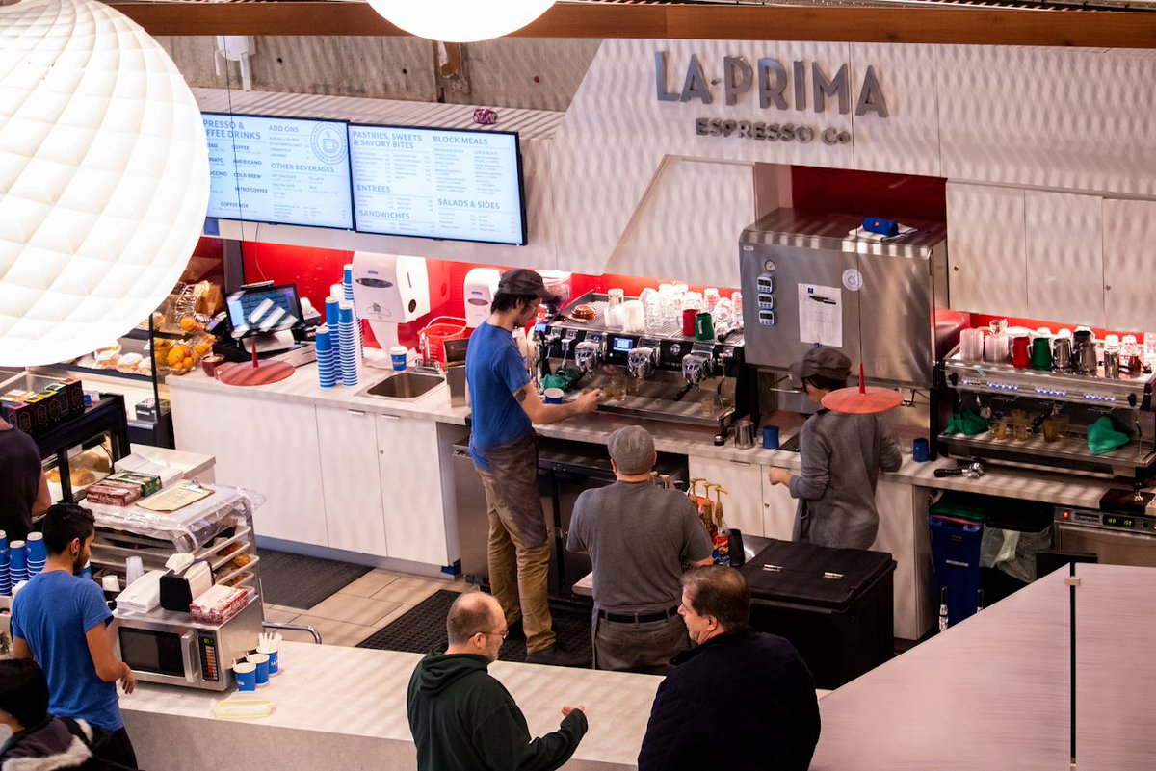
Interpolation (I)
Stops for a cup of coffee
Building Personal Websites
Lecture 07 | Basic Animations

Slide 7
Interpolation (I)
speed
Interpolation tells us what the man does during the range of time t
Building Personal Websites
Lecture 07 | Basic Animations

Slide 8
Interpolation (I)
speed
This is also possible too.
Building Personal Websites
Lecture 07 | Basic Animations

Slide 9
Interpolation (I)
Change in property (Δ) None (We start and end in the same place)
Time (t) 10 mins
Interpolation (I) sin( 2*pi * t / 10 )
Building Personal Websites
Lecture 07 | Basic Animations

Slide 10
Animations: Overview
Basic Animations: A CSS Approach
Keyframing Animations
Building Personal Websites
Lecture 07 | Basic Animations

Slide 11
Transition Property
.css-transition {
width: 50%; }
.css-transition:hover {
width: 100%;
transition-property: width; transition-duration: 2s; transition-timing-function: linear; transition-delay: 1s; }
Change in property (Δ) width += 50%
Time (t) 2 sec
Interpolation (I) (50 / 2) (%/sec)
When we hover, the width increases linearly by 50% over 2 seconds with a 1 second delay.
When we unhover, the width decreases linearly by 50% over 2 seconds with a 1 second delay.
Building Personal Websites
Lecture 07 | Basic Animations

Slide 12
Transition Property
These two are equivalent.
.css-transition:hover {
width: 100%;
transition: width 2s linear 1s;
}
.css-transition:hover {
width: 100%;
transition-property: width; transition-duration: 2s; transition-timing-function: linear; transition-delay: 1s; }
Building Personal Websites
Lecture 07 | Basic Animations

Slide 13
Transition Property
We can have separate animation cycles for different values.
.css-transition {
width: 50%;
height: 50%;
opacity: 0.5;
}
.css-transition:hover {
width: 100%;
height: 100%;
opacity: 1;
transition: width 2s linear 1s,
height 2s linear 1s;
opacity 3s cubic 0s;
}
Or we can have all properties share the same interpolation.
.css-transition {
width: 50%;
height: 50%;
opacity: 0.5;
}
.css-transition:hover {
width: 100%;
height: 100%;
opacity: 1;
transition: all 2s linear 0s, }
Building Personal Websites
Lecture 07 | Basic Animations

Slide 14
Transition Timing Functions
linear
ease
ease-in
ease-out
ease-in-out
Building Personal Websites
Lecture 07 | Basic Animations

Slide 15
Transition Timing Functions
Easing Demo
https://www.w3schools.com/css/tryit.asp?filename=trycss3_transition_speed
Building Personal Websites
Lecture 07 | Basic Animations

Slide 16
Transition Timing Functions
Can also specify custom easing properties
.css-transition:hover {
width: 100%;
transition: width 2s cubic-Bezier(.17,.67,.83,.67) 1s;
}
Easy Interface (Highly Recommend Bookmarking)
http://cubic-bezier.com/#.17,.67,.83,.67
Building Personal Websites
Lecture 07 | Basic Animations

Slide 17
Animations: Overview
Basic Animations: A CSS Approach
Keyframing Animations
Building Personal Websites
Lecture 07 | Basic Animations

Slide 18
Keyframing Animations
Animation keyframes obey the following format:
@keyframes name {
from {property: value;}
to {property: value;) }
For multiple keyframes:
@keyframes name {
0% {property: value;}
25% {property: value;}
50% {property: value;}
75% {property: value;}
100% {property: value;) }
Building Personal Websites
Lecture 07 | Basic Animations

Slide 19
Keyframing Animations
To bind keyframes to an event:
animation-name: name;
To set the duration of an animation:
animation-duration: 5s;
To set the interpolation of an animation:
animation-timing-function: linear;
To set the interpolation of an animation:
animation-delay: 1s;
Building Personal Websites
Lecture 07 | Basic Animations

Slide 20
Looping Animations
Define the direction the animation plays:
animation-direction: normal; /* animation plays forwards */
animation-direction: reverse; /* animation plays backwards */
animation-direction: alternate; /* animation plays forwards then forwards */
animation-direction: alternate-reverse; /* animation plays backwards then forwards */
Define the number of iterations the animation plays:
animation-iteration-count: 5; /* animation loops 5 times */
animation-iteration-count: infinite; /* animation loops forever */
Building Personal Websites
Lecture 07 | Basic Animations

Slide 21
Setting Animations
These two are equivalent.
.css-transition:hover {
animation-name: name;
animation-duration: 5s;
animation-timing-function: linear;
animation-delay: 1s;
animation-iteration-count: infinite;
animation-direction: alternate; }
.css-transition:hover {
animation: name 5s linear 1s infinite alternate; }
Building Personal Websites
Lecture 07 | Basic Animations

Slide 22
Setting Animations
What’s the issue with this?
@keyframes cycle {
0% {left: 10px;}
50% {left: 70px;}
100% {left: 50px;} }
.css-transition {
left: 0px; }
.css-transition:hover {
animation: cycle 2s linear 0s 1 alternate; }
Animation starts by snapping right 10px and ends snapping left 10px.
Building Personal Websites
Lecture 07 | Basic Animations

Slide 23
Animation Fill Mode
We can modify how animation cycles start and end:
animation-fill-mode: none; /* animation reverts back to initial values */
animation-fill-mode: forwards; /* animation holds on last keyframe */
animation-fill-mode: backwards; /* animation reverts and holds on first keyframe */
Execution varies depending on animation direction.
Building Personal Websites
Lecture 07 | Basic Animations

Slide 24
Homework Ideas
Play around with the Cubic Bezier site for custom interpolations.
Use the transition property to create custom animations for elements.
Use keyframe animations for more advanced interpolations.
Building Personal Websites
Lecture 07 | Basic Animations

Slide 25
Live Demo
Building Personal Websites
Lecture 07 | Basic Animations

