Slide 1
Basic Animations
Building Personal Websites
Lecture 07 | Basic Animations

Slide 2
Animations: Overview
Basic Animations: A CSS Approach
Building Personal Websites
Lecture 07 | Basic Animations

Slide 3



Δ
3 Properties define an animation
Change in property (Δ)
Time (t)
Interpolation (I)
If two animation cycles share the same 3 properties, they are the same
Building Personal Websites
Lecture 07 | Basic Animations

Slide 4
Change in Property (Δ)
x-position: 0m;
x-position: 1000m;
Building Personal Websites
Lecture 07 | Basic Animations

Slide 5
Time (t)
Takes 10 minutes to walk to work
Building Personal Websites
Lecture 07 | Basic Animations

Slide 6
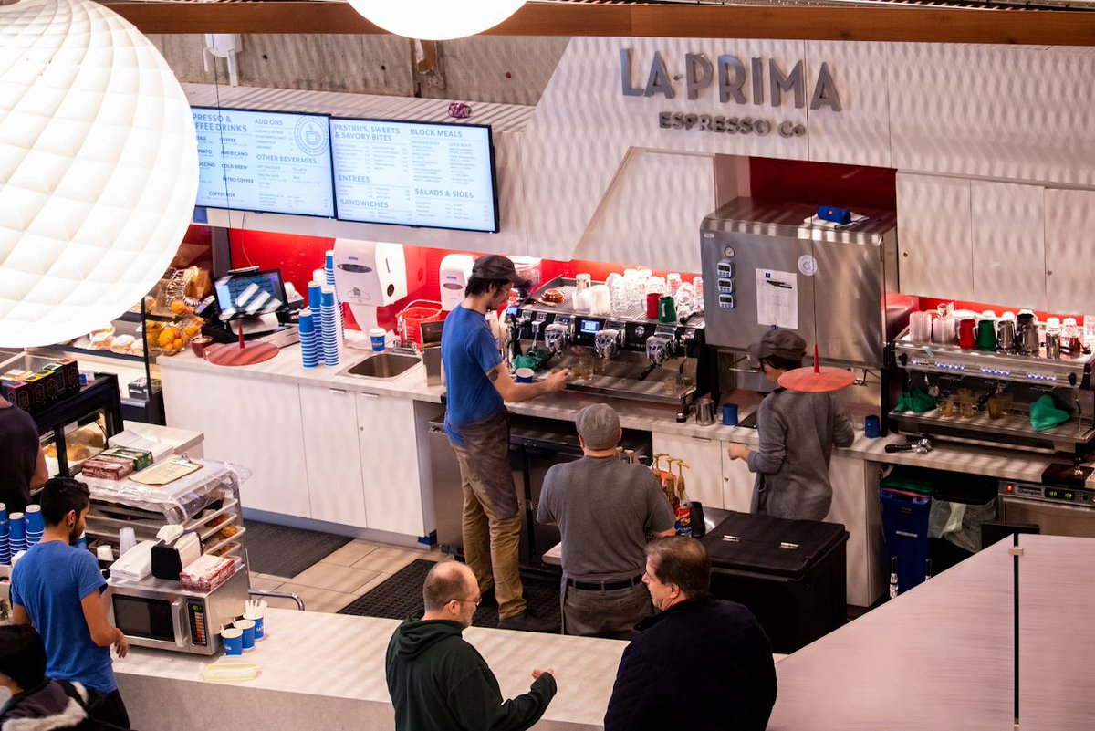
Interpolation (I)
Stops for a cup of coffee
Building Personal Websites
Lecture 07 | Basic Animations

Slide 7
Interpolation (I)
speed
Interpolation tells us what the man does during the range of time t
Building Personal Websites
Lecture 07 | Basic Animations

Slide 8
Interpolation (I)
speed
This is also possible too.
Building Personal Websites
Lecture 07 | Basic Animations

Slide 9
Interpolation (I)
Change in property (Δ) None (We start and end in the same place)
Time (t) 10 mins
Interpolation (I) sin( 2*pi * t / 10 )
Building Personal Websites
Lecture 07 | Basic Animations

Slide 10
Animations: Overview
Basic Animations: A CSS Approach
Building Personal Websites
Lecture 07 | Basic Animations

Slide 11
Transition Property
.css-transition {
width: 50%; }
.css-transition:hover {
width: 100%;
transition-property: width; transition-duration: 2s; transition-timing-function: linear; transition-delay: 1s; }
Change in property (Δ) width += 50%
Time (t) 2 sec
Interpolation (I) (50 / 2) (%/sec)
When we hover, the width increases linearly by 50% over 2 seconds with a 1 second delay.
When we unhover, the width decreases linearly by 50% over 2 seconds with a 1 second delay.
Building Personal Websites
Lecture 07 | Basic Animations

Slide 12
Transition Property
These two are equivalent.
.css-transition:hover {
width: 100%;
transition: width 2s linear 1s;
}
.css-transition:hover {
width: 100%;
transition-property: width; transition-duration: 2s; transition-timing-function: linear; transition-delay: 1s; }
Building Personal Websites
Lecture 07 | Basic Animations

Slide 13
Transition Property
We can have separate animation cycles for different values.
.css-transition {
width: 50%;
height: 50%;
opacity: 0.5;
}
.css-transition:hover {
width: 100%;
height: 100%;
opacity: 1;
transition: width 2s linear 1s,
height 2s linear 1s;
opacity 3s cubic 0s;
}
Or we can have all properties share the same interpolation.
.css-transition {
width: 50%;
height: 50%;
opacity: 0.5;
}
.css-transition:hover {
width: 100%;
height: 100%;
opacity: 1;
transition: all 2s linear 0s, }
Building Personal Websites
Lecture 07 | Basic Animations

Slide 14
Transition Timing Functions
linear
ease
ease-in
ease-out
ease-in-out
Building Personal Websites
Lecture 07 | Basic Animations

Slide 15
Transition Timing Functions
Easing Demo
https://www.w3schools.com/css/tryit.asp?filename=trycss3_transition_speed
Building Personal Websites
Lecture 07 | Basic Animations

Slide 16
Transition Timing Functions
Can also specify custom easing properties
.css-transition:hover {
width: 100%;
transition: width 2s cubic-Bezier(.17,.67,.83,.67) 1s;
}
Easy Interface (Highly Recommend Bookmarking)
http://cubic-bezier.com/#.17,.67,.83,.67
Building Personal Websites
Lecture 07 | Basic Animations

Slide 17
Live Demo
Building Personal Websites
Lecture 07 | Basic Animations

