Slide 1
Inspecting Elements
Building Personal Websites
Lecture 05 | Inspecting Elements

Slide 2
Loading Webpages From Servers
Modifying CSS In Browser
Viewing Sources
Local Host
Building Personal Websites
Lecture 05 | Inspecting Elements

Slide 3




Receiving a Request
When you load a webpage, you are sending a GET request with the url for the webpage.
GET www.google.com
A server will send to the client local copies of the files necessary to load the webpage.
Browsers will interpret these files into webpages that we can read and interact with.
Building Personal Websites
Lecture 05 | Inspecting Elements

Slide 4
Editing a Response
Sometimes we want to edit these files ourselves, so we use inspect elements to do so.
Since the server sent us local copies of the files, editing them won’t edit the original files stored on the server.
Building Personal Websites
Lecture 05 | Inspecting Elements

Slide 5
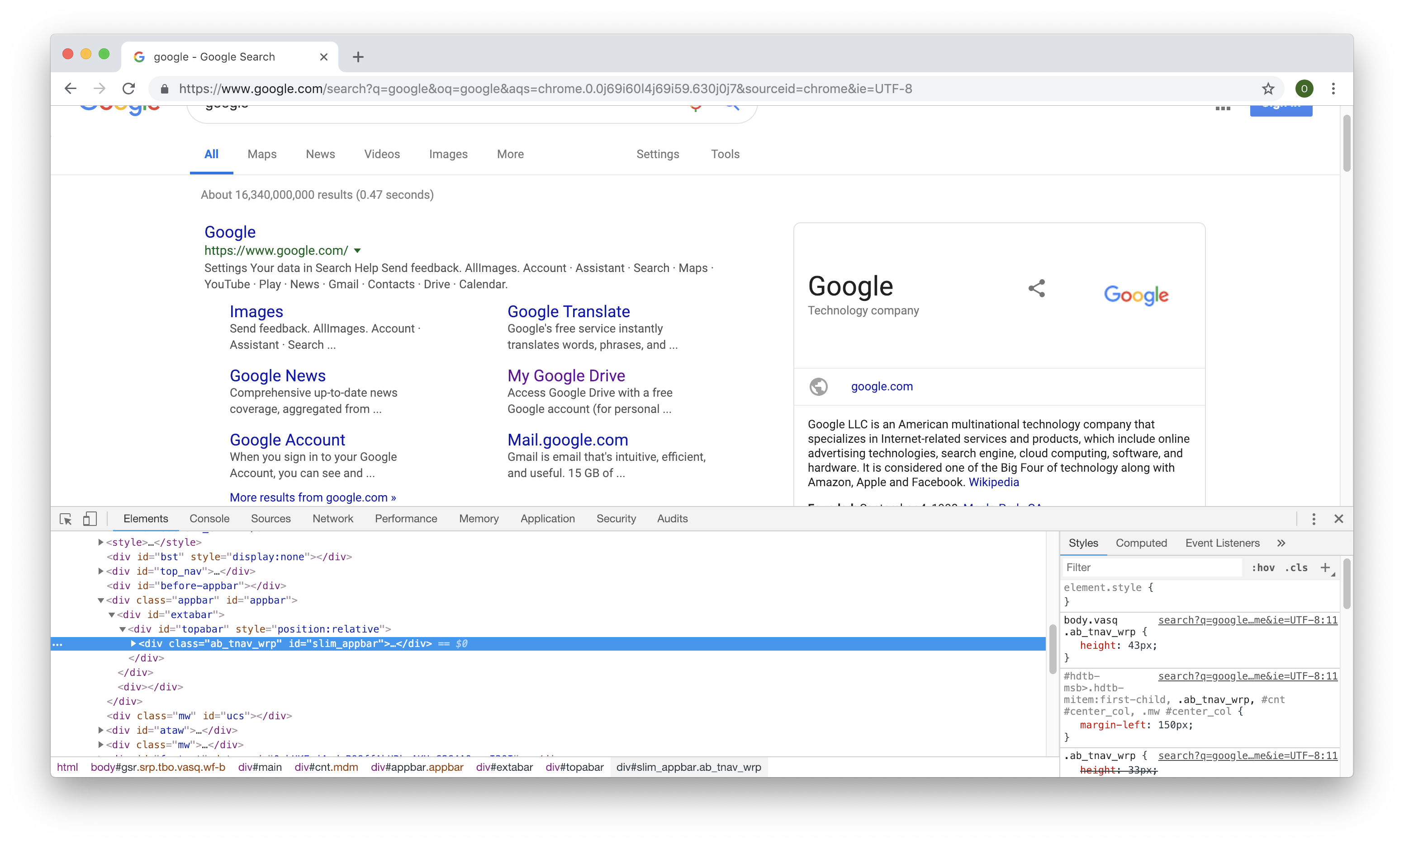
Inspecting Elements
Inspect Elements is a prompt that allows you to show and edit the files used to load your webpage.
Building Personal Websites
Lecture 05 | Inspecting Elements

Slide 6
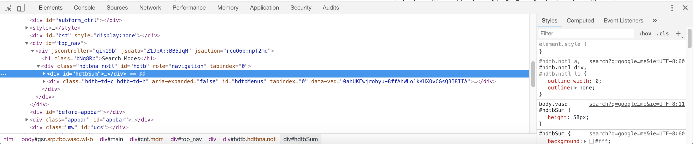
Inspecting Elements
Inspect Elements gives us direct access to these files to edit locally.
HTML side
CSS side
Building Personal Websites
Lecture 05 | Inspecting Elements

Slide 7
Loading Webpages From Servers
Modifying CSS In Browser
Viewing Sources
Local Host
Building Personal Websites
Lecture 05 | Inspecting Elements

Slide 8
CSS In Browser
We can use the CSS tab to experiment and debug CSS properties directly in browser.
HTML side
CSS side
When an HTML element is selected, all relevant CSS classes and IDs will be displayed on the CSS side.
Depending on the browser, we can toggle between CSS properties in a given class or ID. Changing these properties will change it for all other elements that share the same class or ID.
Building Personal Websites
Lecture 05 | Inspecting Elements

Slide 9
Loading Webpages From Servers
Modifying CSS In Browser
Viewing Sources
Local Host
Building Personal Websites
Lecture 05 | Inspecting Elements

Slide 10
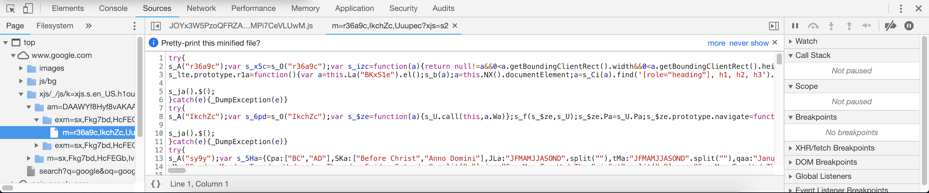
Viewing Sources
The Sources tab lists all the files retrieved from the server to load the webpage.
Allows users to view and edit original HTML, CSS, and JavaScript files along with images, texts, SQL, and other files.
Building Personal Websites
Lecture 05 | Inspecting Elements

Slide 11
Loading Webpages From Servers
Modifying CSS In Browser
Viewing Sources
Local Host
Building Personal Websites
Lecture 05 | Inspecting Elements

Slide 12
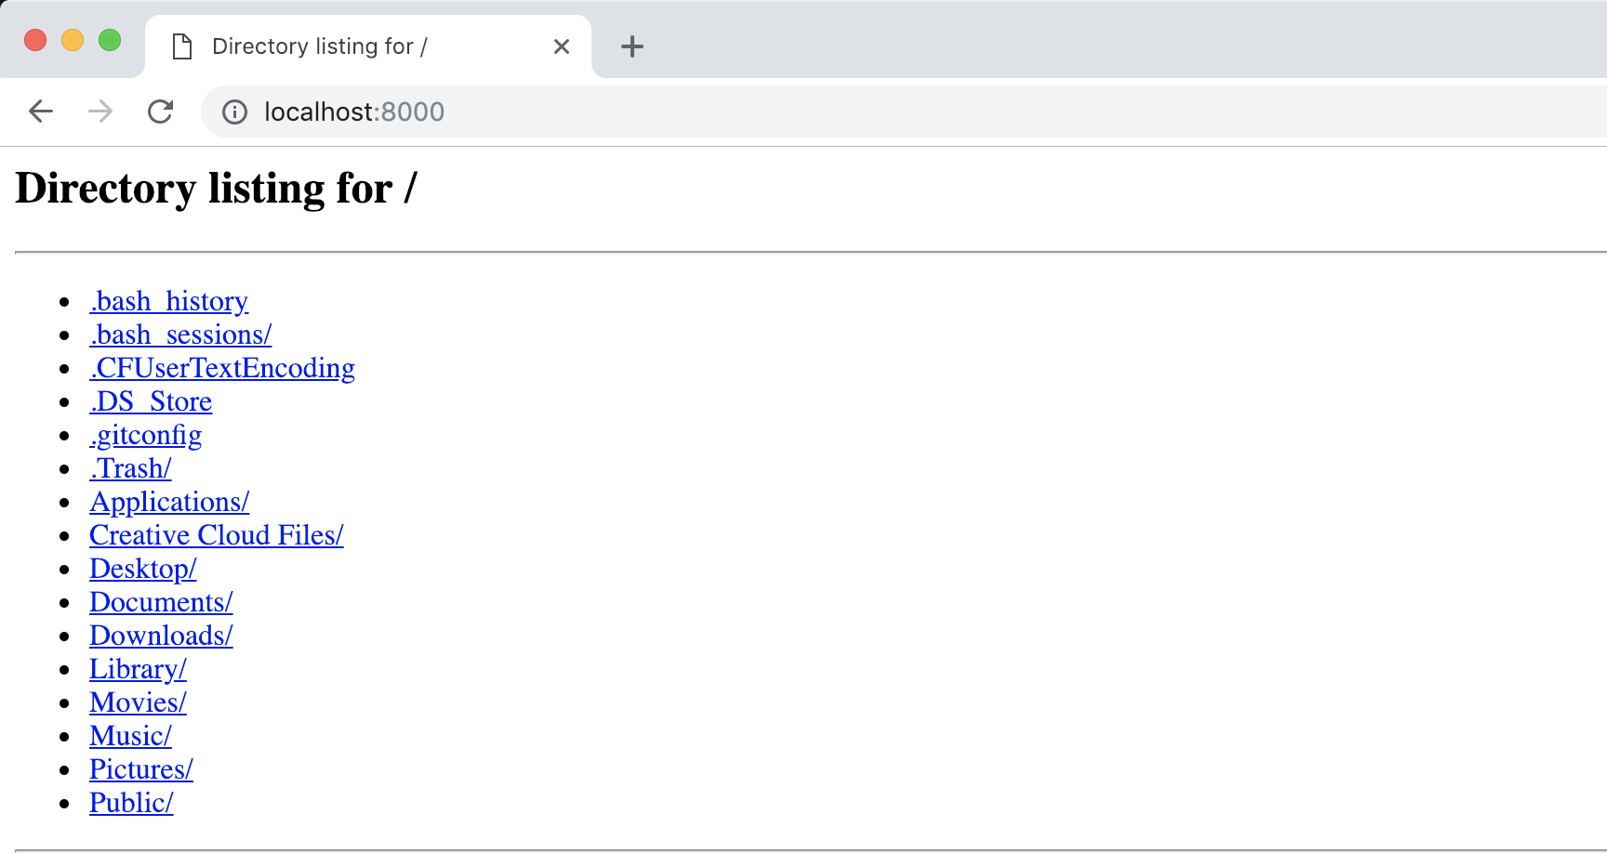
Local Host
As we will learn later with JSON Parsing, not everything can be loaded directly from clicking on index.html. Sometimes we need to create a local host to give our files and address so that our HTML and JavaScript files can refer to them.
Building Personal Websites
Lecture 05 | Inspecting Elements

Slide 13
Creating a Local Host
Make sure you have Python installed. In a command prompt, type the following:
Python 2.7
python –m SimpleHTTPServer
Python 3.6
python –m http.server
Building Personal Websites
Lecture 05 | Inspecting Elements

Slide 14
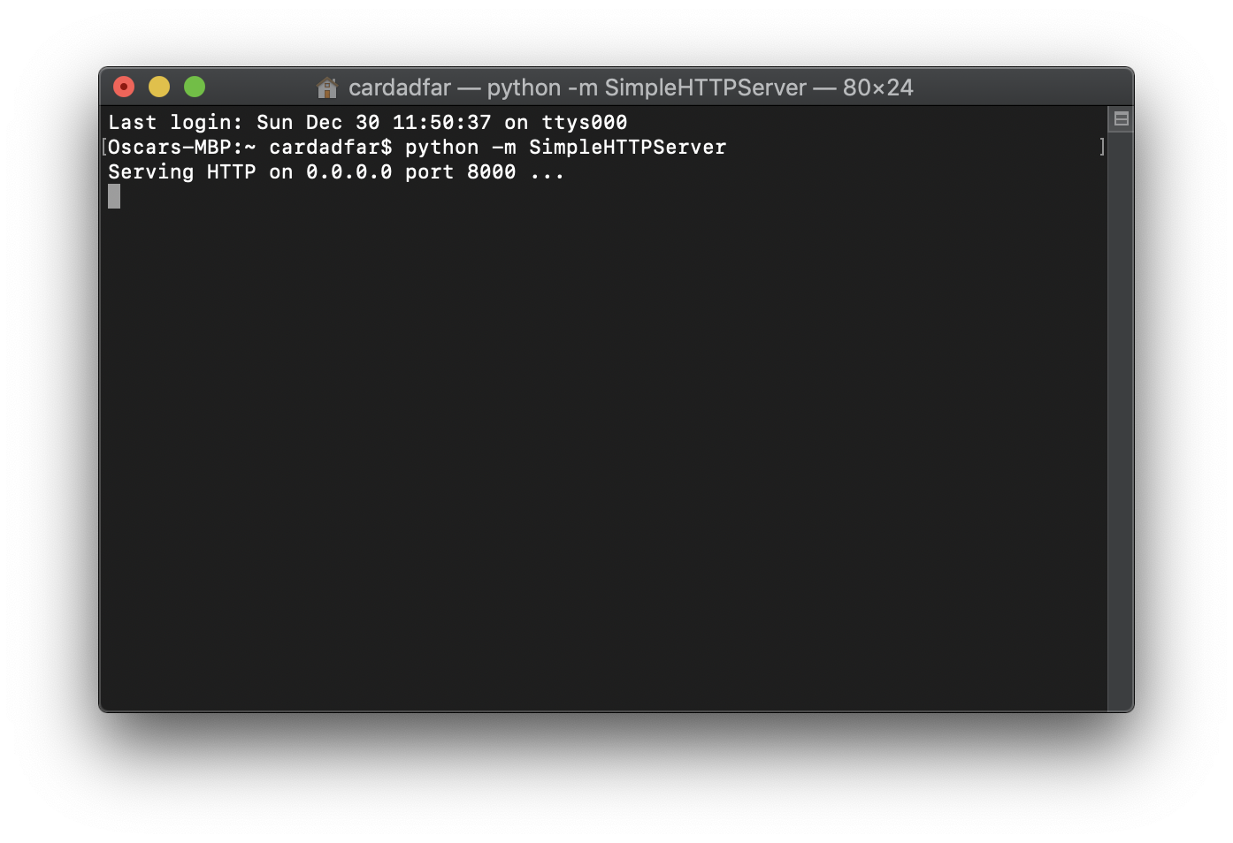
Creating a Local Host
You will get a response that a connection has been opened on a port (often 8000).
Building Personal Websites
Lecture 05 | Inspecting Elements

Slide 15
Creating a Local Host
Using a browser, go to localhost:portnumber
The directory you open your local host in will be the directory displayed by your local host
Building Personal Websites
Lecture 05 | Inspecting Elements

Slide 16
Homework Ideas
Use Inspect Elements to debug any issues that you may be experiencing.
Use Inspect Elements to quickly test out new CSS features live for faster results.
Add additional content/styling to site.
Building Personal Websites
Lecture 05 | Inspecting Elements

Slide 17
Live Demo
Building Personal Websites
Lecture 05 | Inspecting Elements

