Slide 1
Automated watering system

Slide 2
What's in the package
* Android app (Water)
* Arduino algorithm (selfWater)
* TCP<->Serial bridge (tcp_serial_bridge)
* misc files (res)

Slide 3
Android app (Water)
* Simple interface to track the sensors
* Can be imported to an IDE (perhaps android studio)
* SERVERIP variable should be modified (TCPClient.java)
* One could change the used port as well if needed (SERVERPORT)

Slide 4
Arduino algorithm (selfWater)
* Arduino is a micro-controller
* setup, functions and loop blocks
* Sensors run on analog pins (heads up)
  * When the sole is dry, it increases the resistance
  * When water is added, the resistance decreases
  * This means that the sensors can be calibrated to inform when there is enough water or not.
* A pump is controlled by Arduino using a power circuit
* When the sensors indicate that the sole is getting dry, they trigger the pump cycle (3 runs defined)

Slide 5
Arduino algorithm (selfWater)
* The controller can also read/write serial events
* It uses the usb interface in order to send the sensor's information
* Since there are no Ethernet interfaces on this tiny controller, a Raspberry Pi was used to connect to the world
* The Raspberry works just as a proxy converting TCP/IP requests in serial and vice-versa

Slide 6
TCP<->Serial bridge (tcp_serial_bridge)
* The bridge is a simple TCP<-->Serial proxy
* When the Android device connects to the target URL it should query for the sensors information, the Raspberry will then send the requested information the usb port and finally Arduino would reply with the sensors readings, average and if the sole is dry

Slide 7
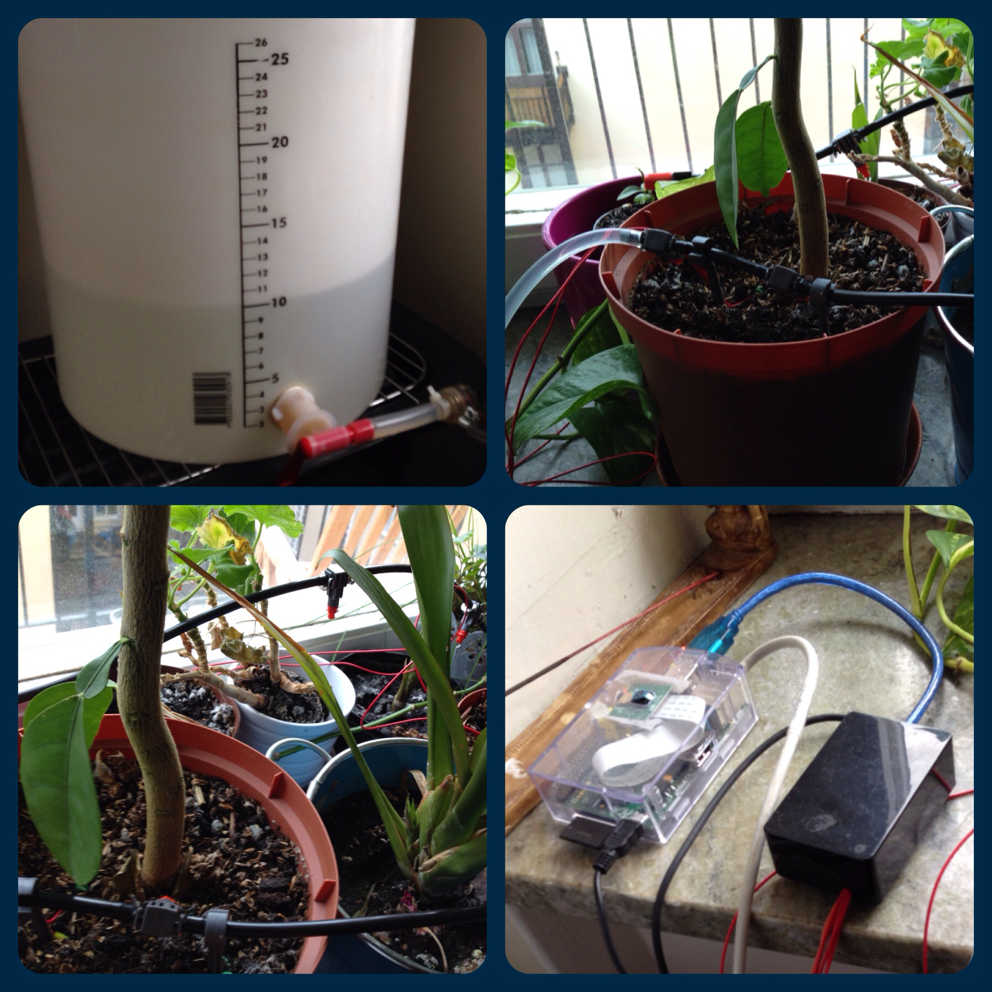
A few pictures... long time ago J

