Slide 1

Project 1100242 – Python 3 SDK PoA – Milestone #1
March 2023

Slide 2
Table of Content
Context
Executive Summary
Evidence #1
Evidence #2
Evidence #3
Evidence #4
Backlog
Roadmap
Annexes

Slide 3
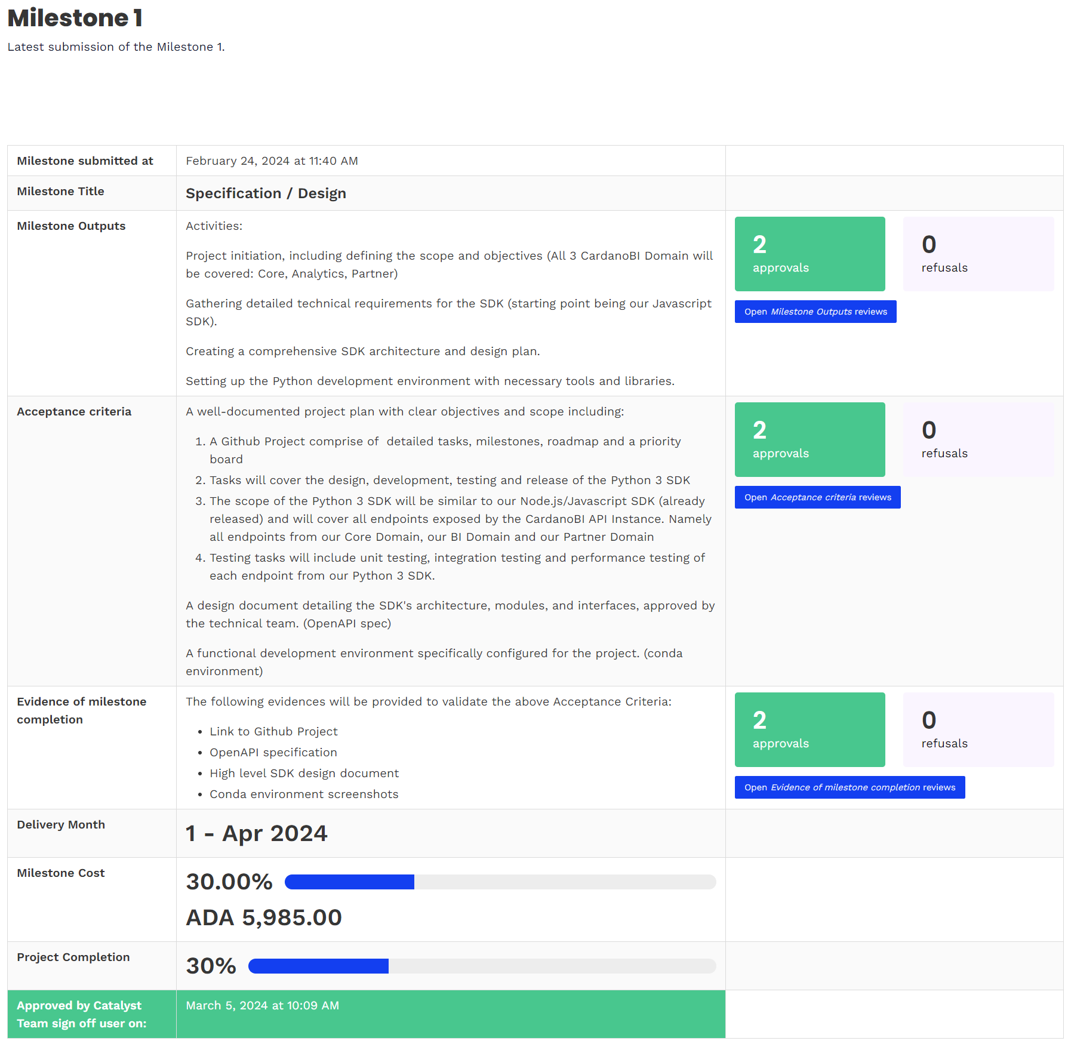
Context
The purpose of this document is to collect all required evidence to validate the “Specification / Design” Milestone (M1)

Slide 4
Executive Summary
The “Specification / Design” Milestone (M1) has been completed as per the Outputs and Acceptance Criteria defined in the Milestone Module.
The following evidences are provided to validate the said Acceptance Criteria:
Link to Github Project
OpenAPI specification
High level SDK design document:
The design diagram is provided in this document further down below.
Conda environments screenshots:
These are provided in this document further down below.

Slide 5
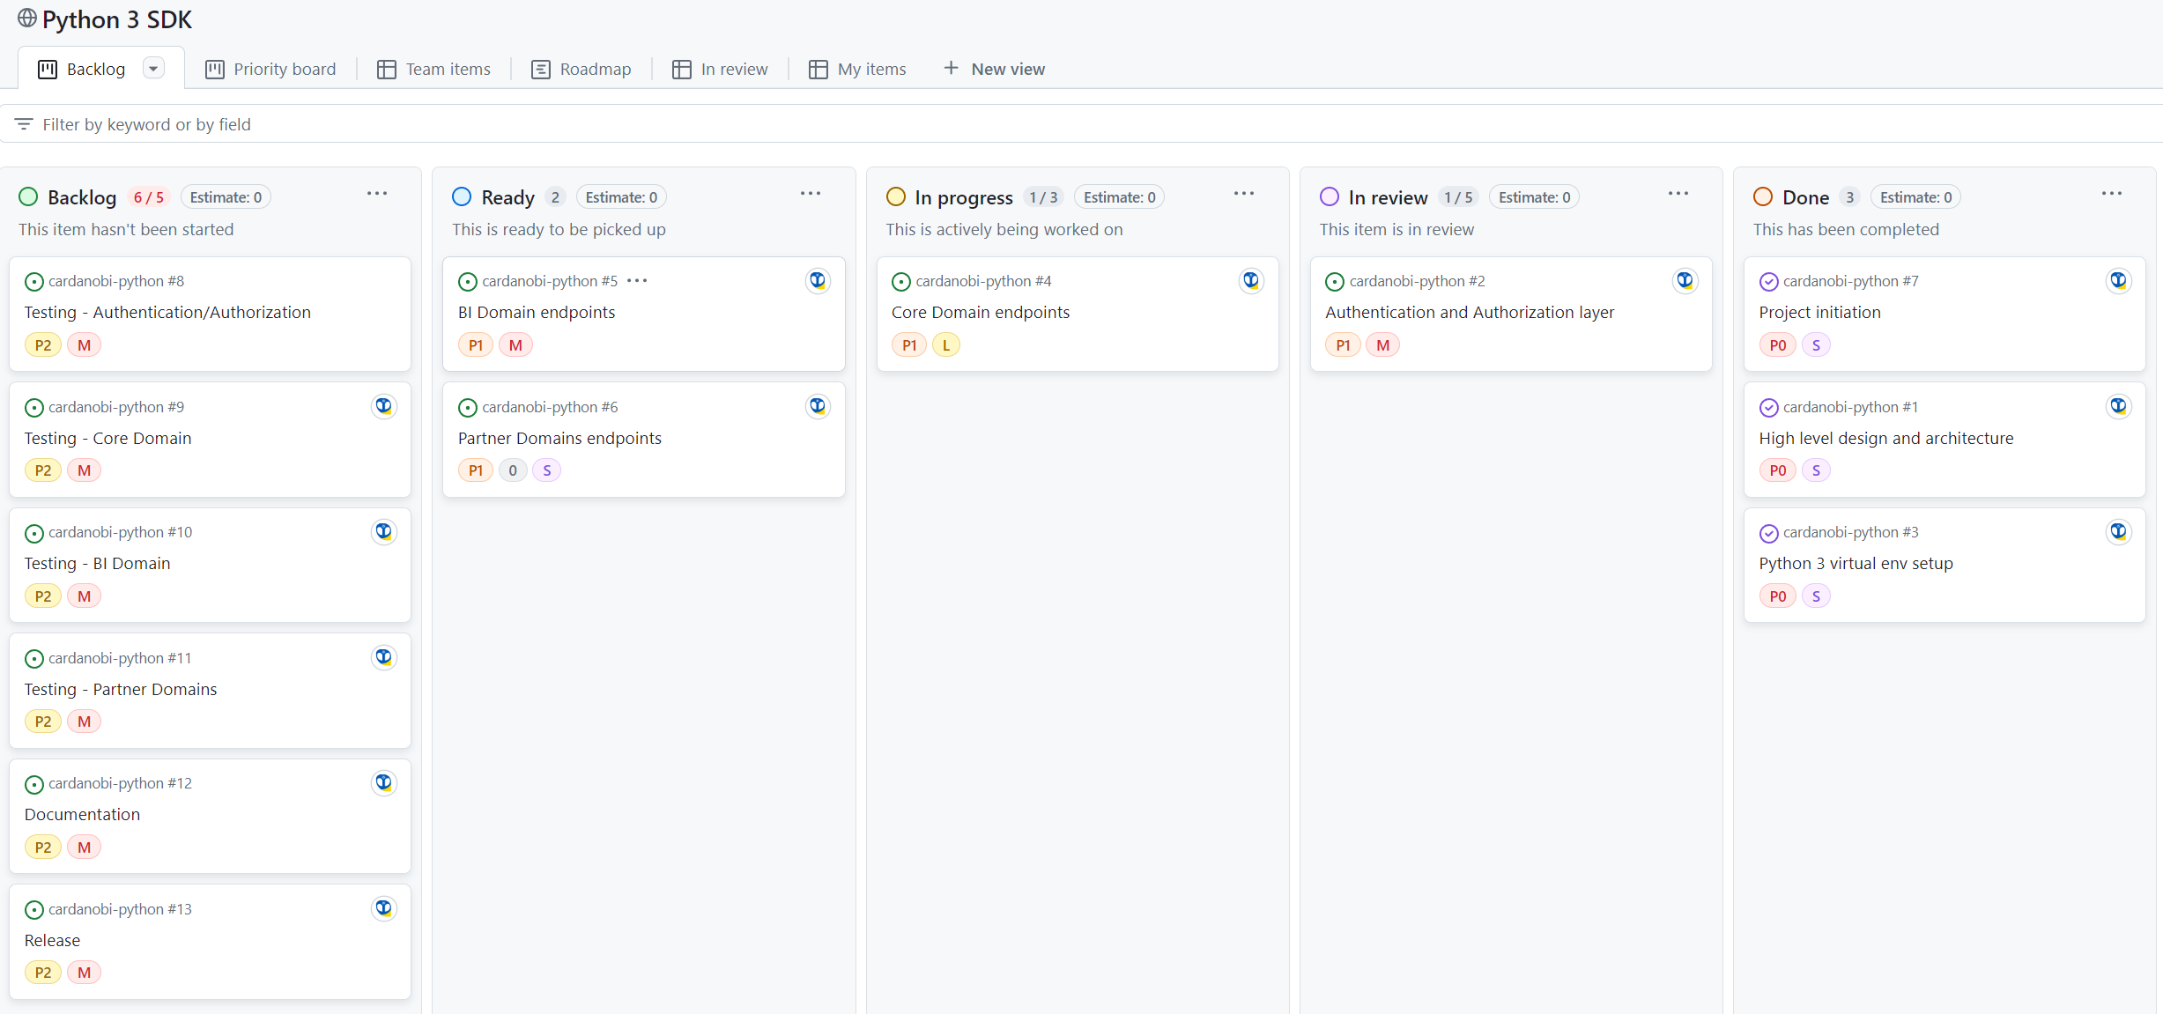
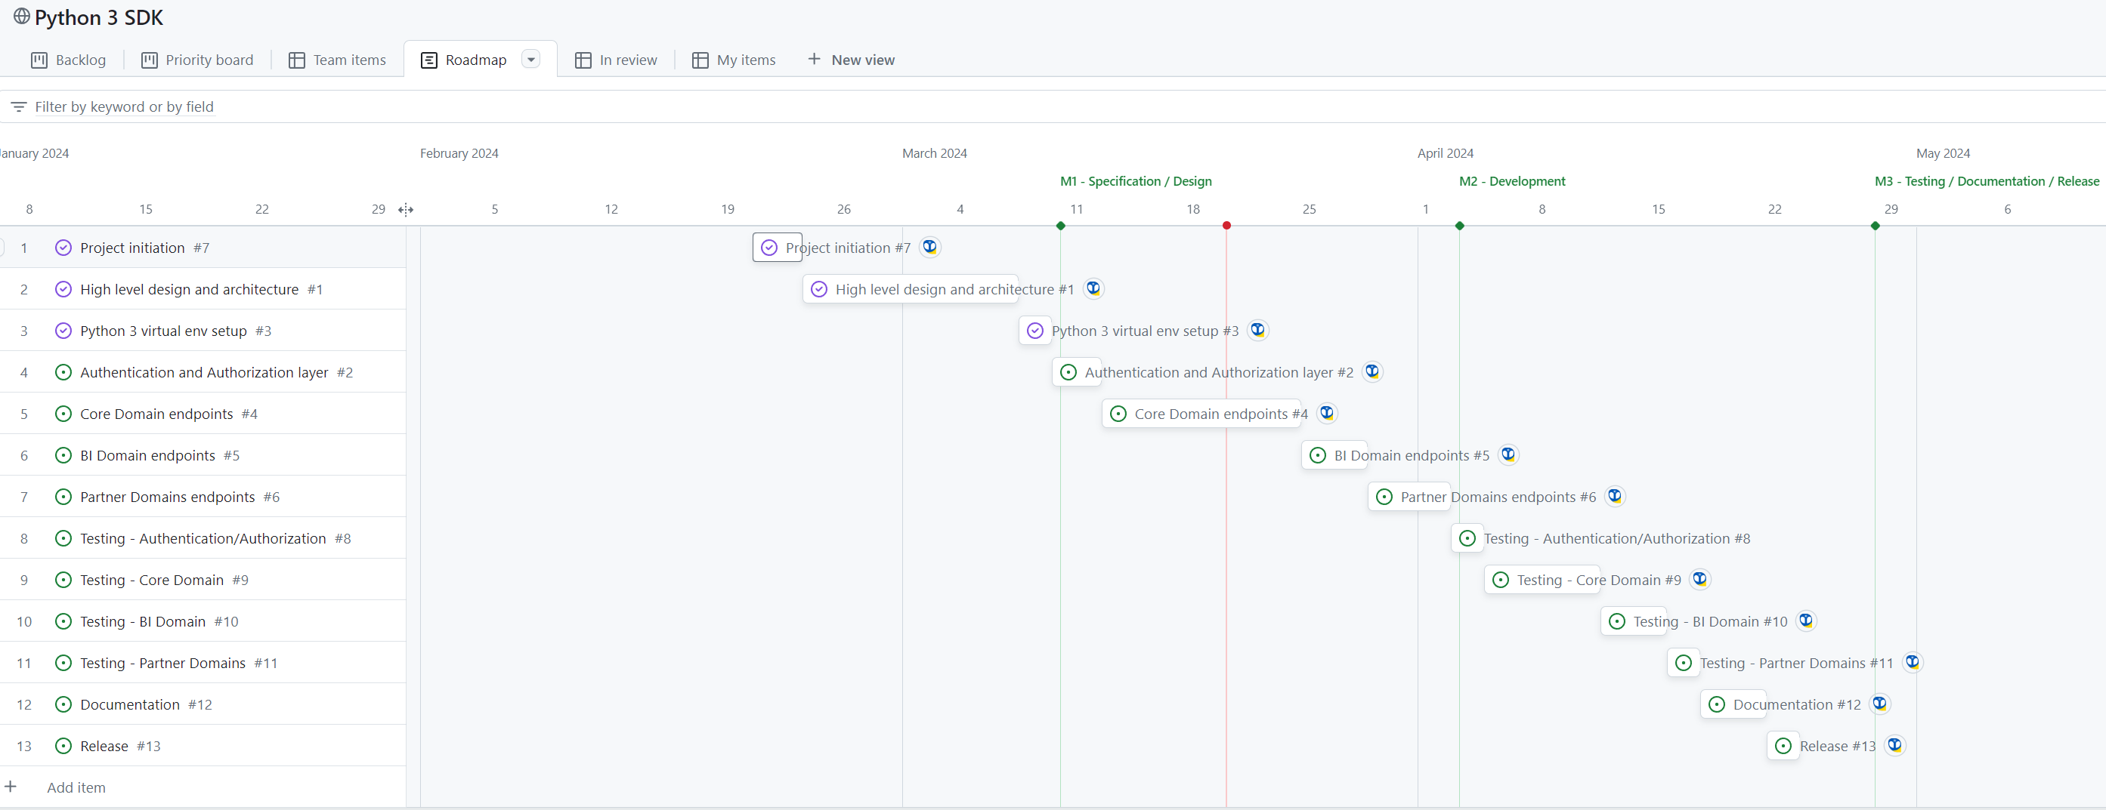
Evidence #1 – Link to Github Projects
Link: Github Project
In this GH Project you’ll find several useful views to track our progress:
Backlog:
Roadmap:

Slide 6
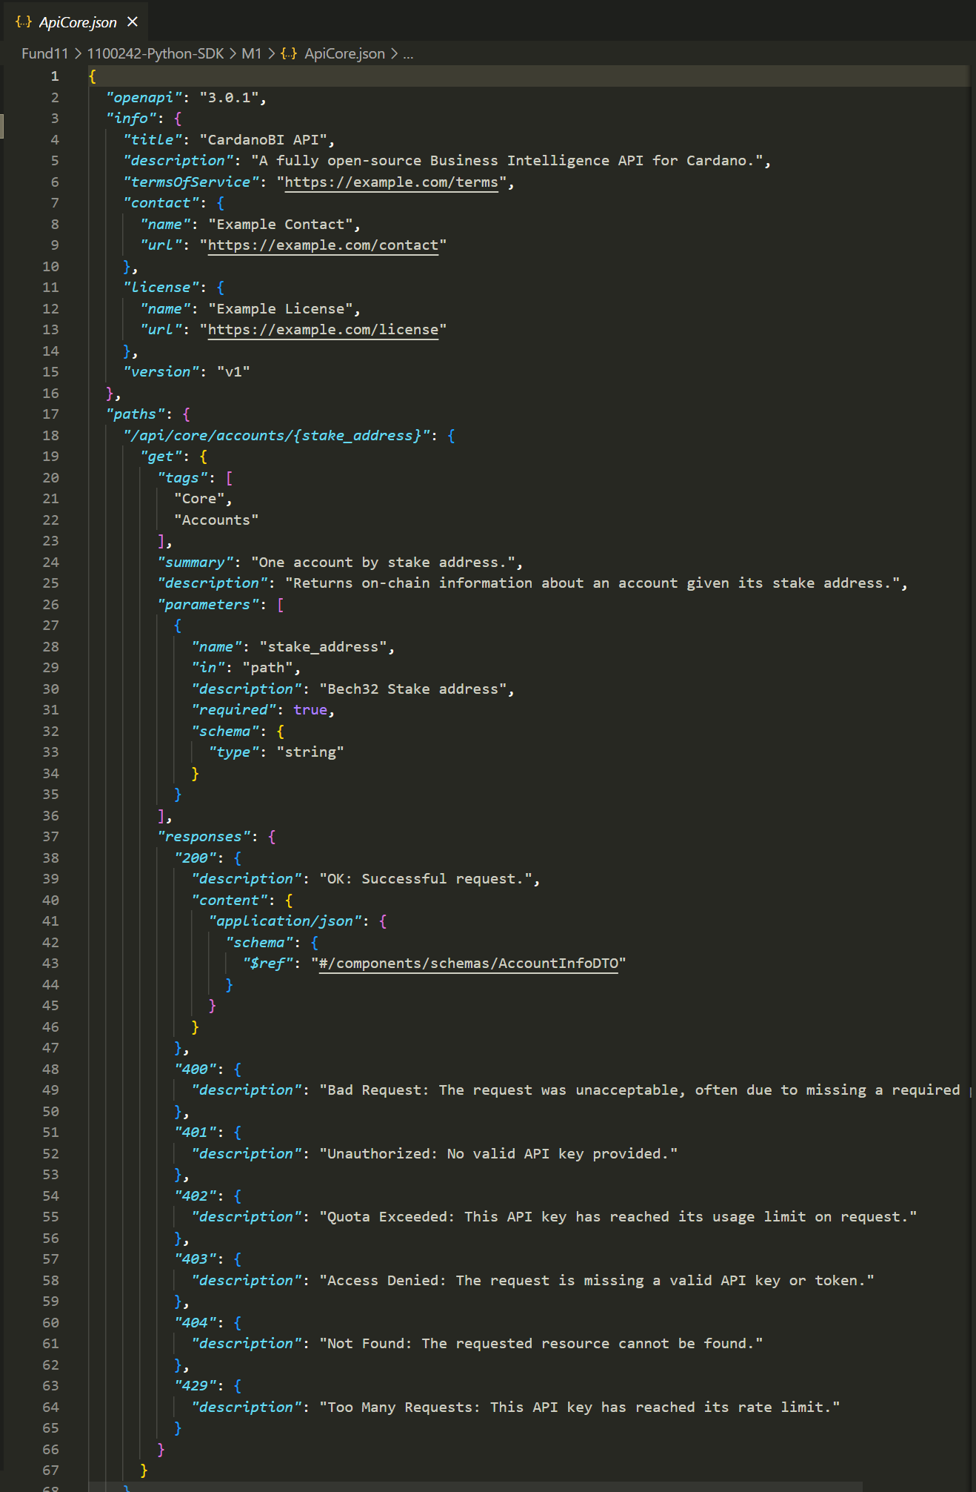
Evidence #2 – OpenAPI specification
Link: OpenAPI specification
The aim of that document is to provide a specification of the CardanoBI API endpoints that the Python SDK will have to build client endpoints for.
An excerpt is provided below:

Slide 7
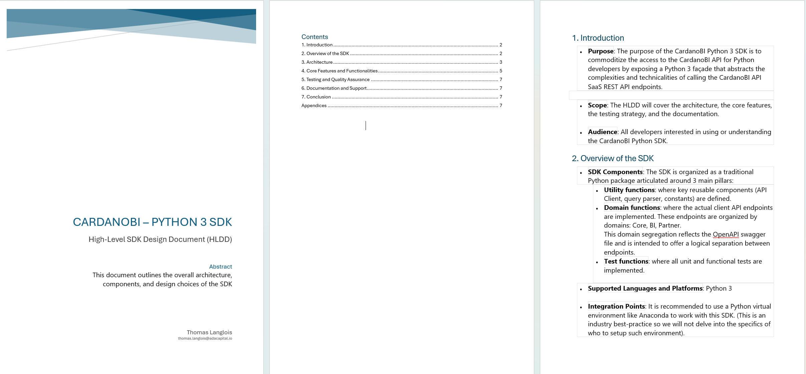
Evidence #3 – High level SDK design document
Link: HLDD document
The aim of that document is to provide a High-Level design for the Python 3 SDK.
An excerpt is provided below:

Slide 8
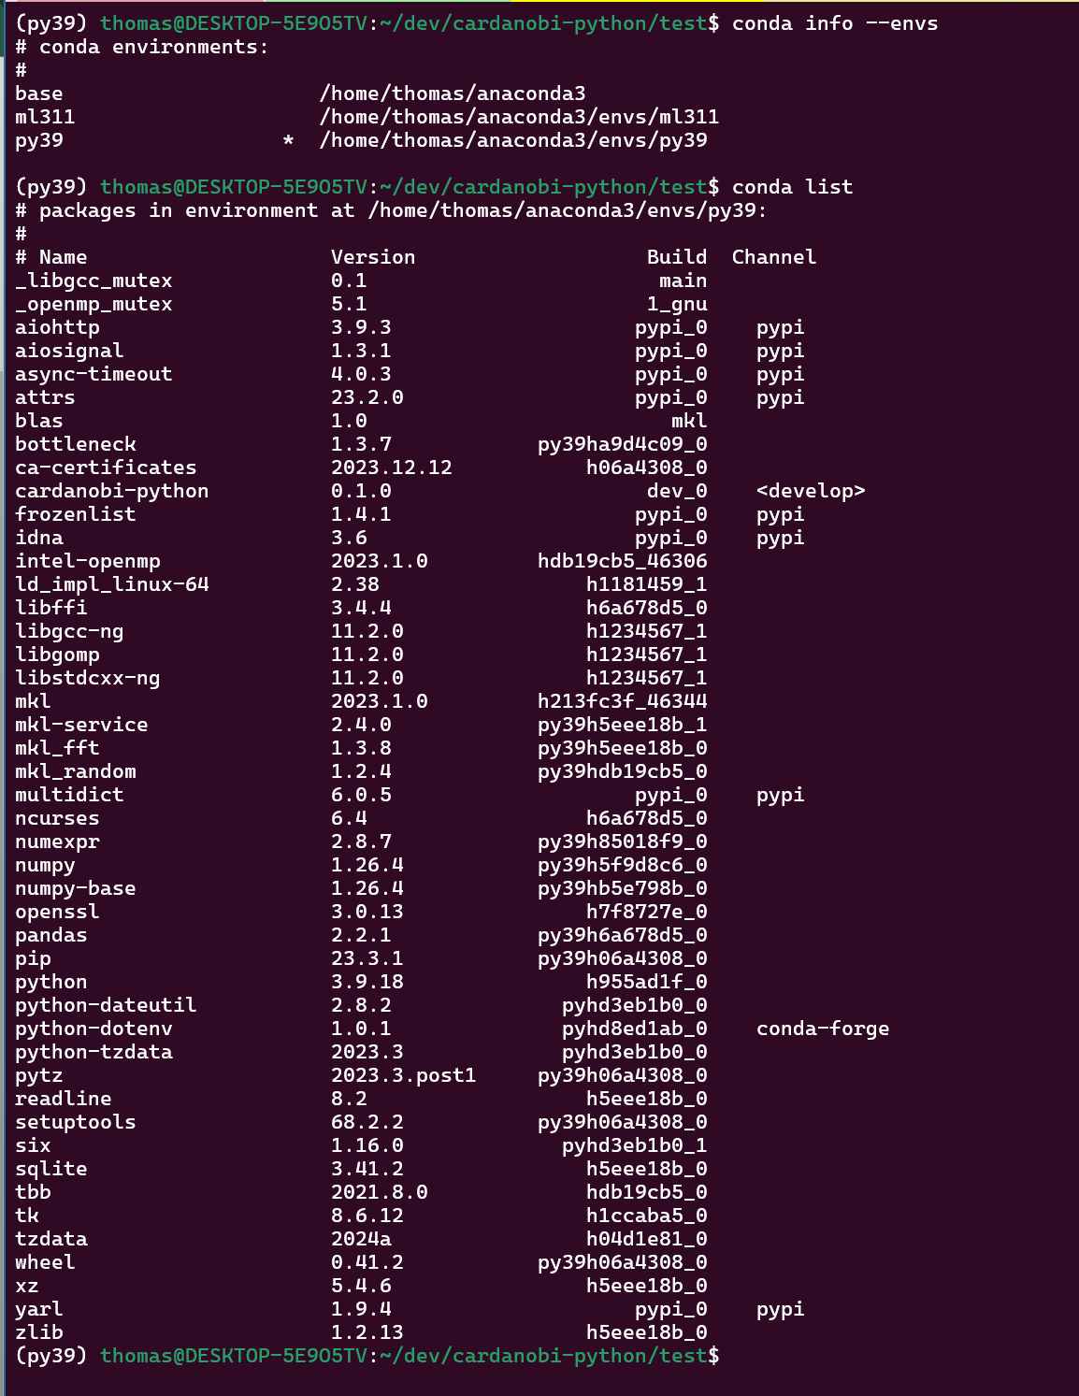
Evidence #4 – Conda environment screenshots
We’ve successfully set up our Anaconda environment to manage package dependencies and provide a seamless developer experience to our software engineer.
Screenshots are provided below:
In this screenshot you can see that our Conda environments are: `base`, `ml311` and `py39`. This last environment is the one the CardanoBI Python SDK is being developed under.
Lastly, `conda list` provides a listing of all the Python packages currently installed in `py39`.

Slide 9
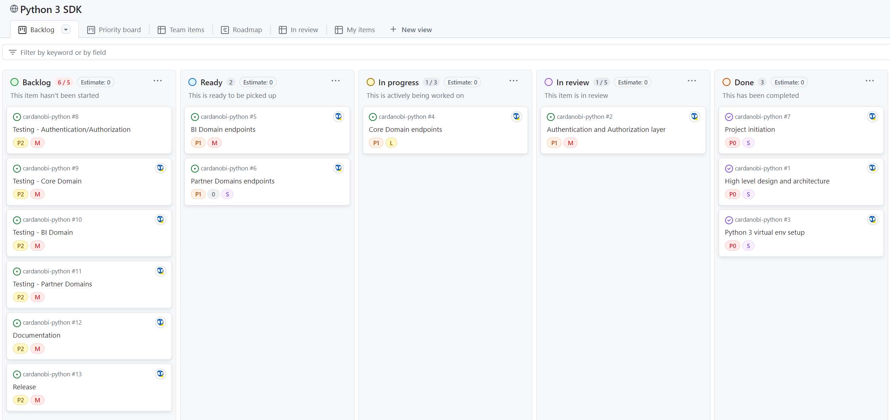
Backlog
Github Project - Backlog View

Slide 10
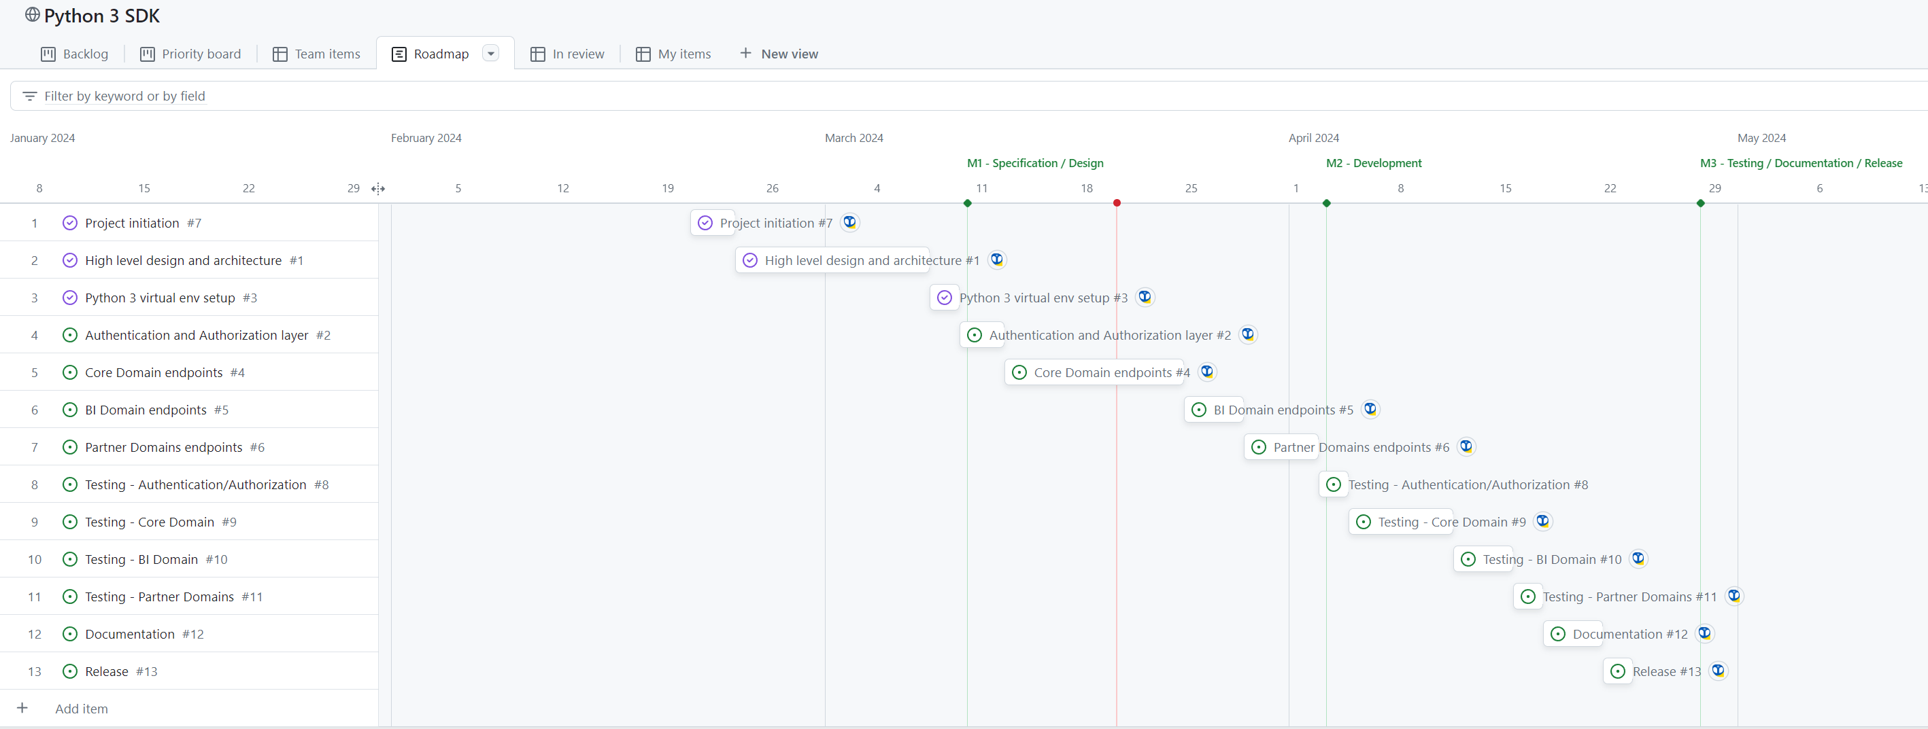
Roadmap
Github Project - Roadmap

Slide 11
Annexes

Slide 12
Thank you
Thomas Langlois​
cardanobi.io

