Slide 1

Project 1100242 – Python 3 SDK
PoA – Milestone #2
April 2024

Slide 2
Table of Content
Context
Executive Summary
Evidence #1
Evidence #2
Backlog
Roadmap
Annexes

Slide 3
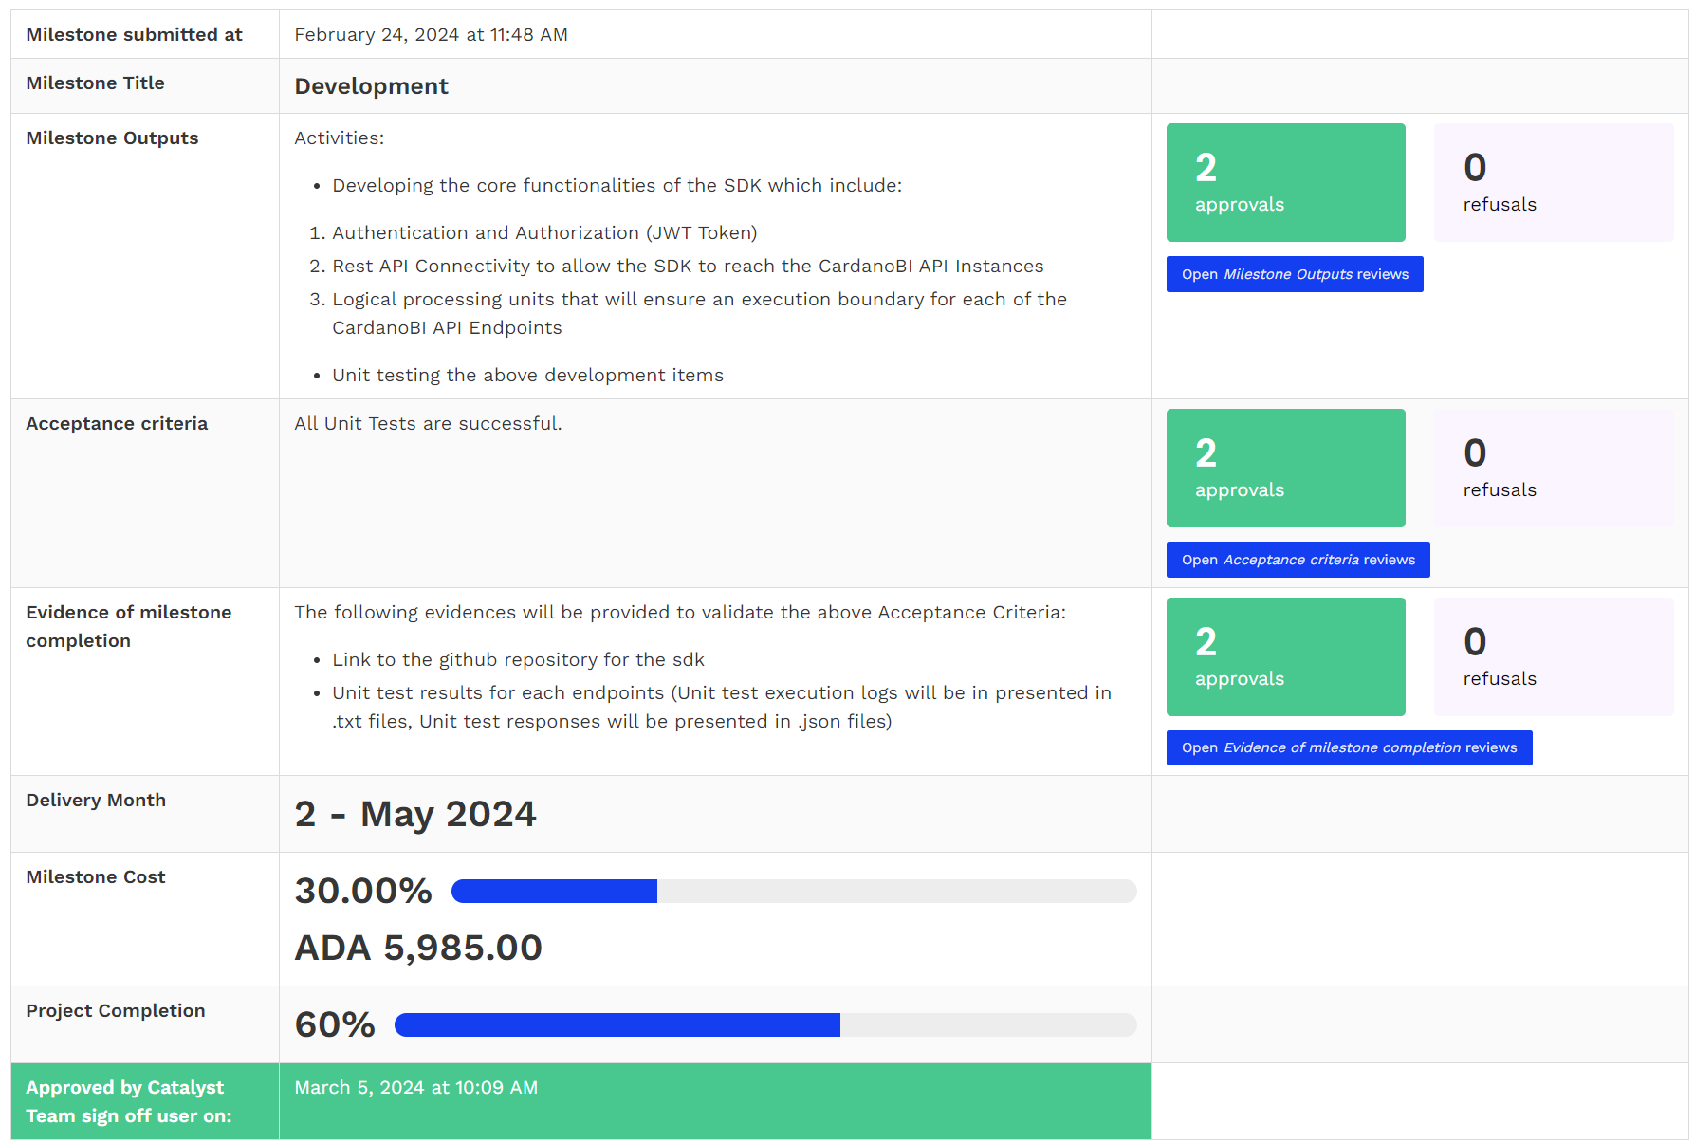
Context
The purpose of this document is to collect all required evidence to validate the “Development” Milestone (M2)

Slide 4
Executive Summary
The “Development” Milestone (M2) has been completed as per the Outputs and Acceptance Criteria defined in the Milestone Module.
The following evidences are provided to validate the said Acceptance Criteria:
  Link to github repository
  Integration test results:
  Please note that we decided to kill 2 birds with 1 stone and to provide integration tests in M2 as we were able to extend the coverage of our unit tests to all CardanoBI API endpoints, thus turning our unit tests into full blown integration tests against the CardanoBI mainnet instance.
  The results of those integration tests can be found in the following links:
    Execution Logs
    Execution Responses

Slide 5
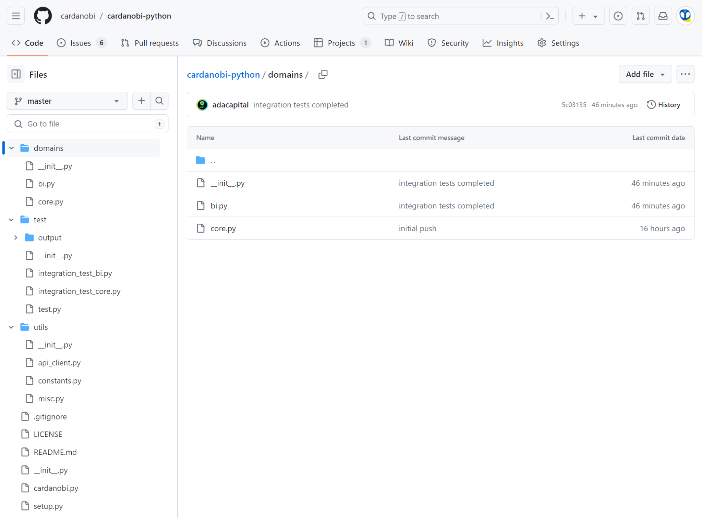
Evidence #1 – Link to Github Repository
Link: Link to github repository
In this Repository you’ll find all the source code for the SDK, including integration tests:

Slide 6
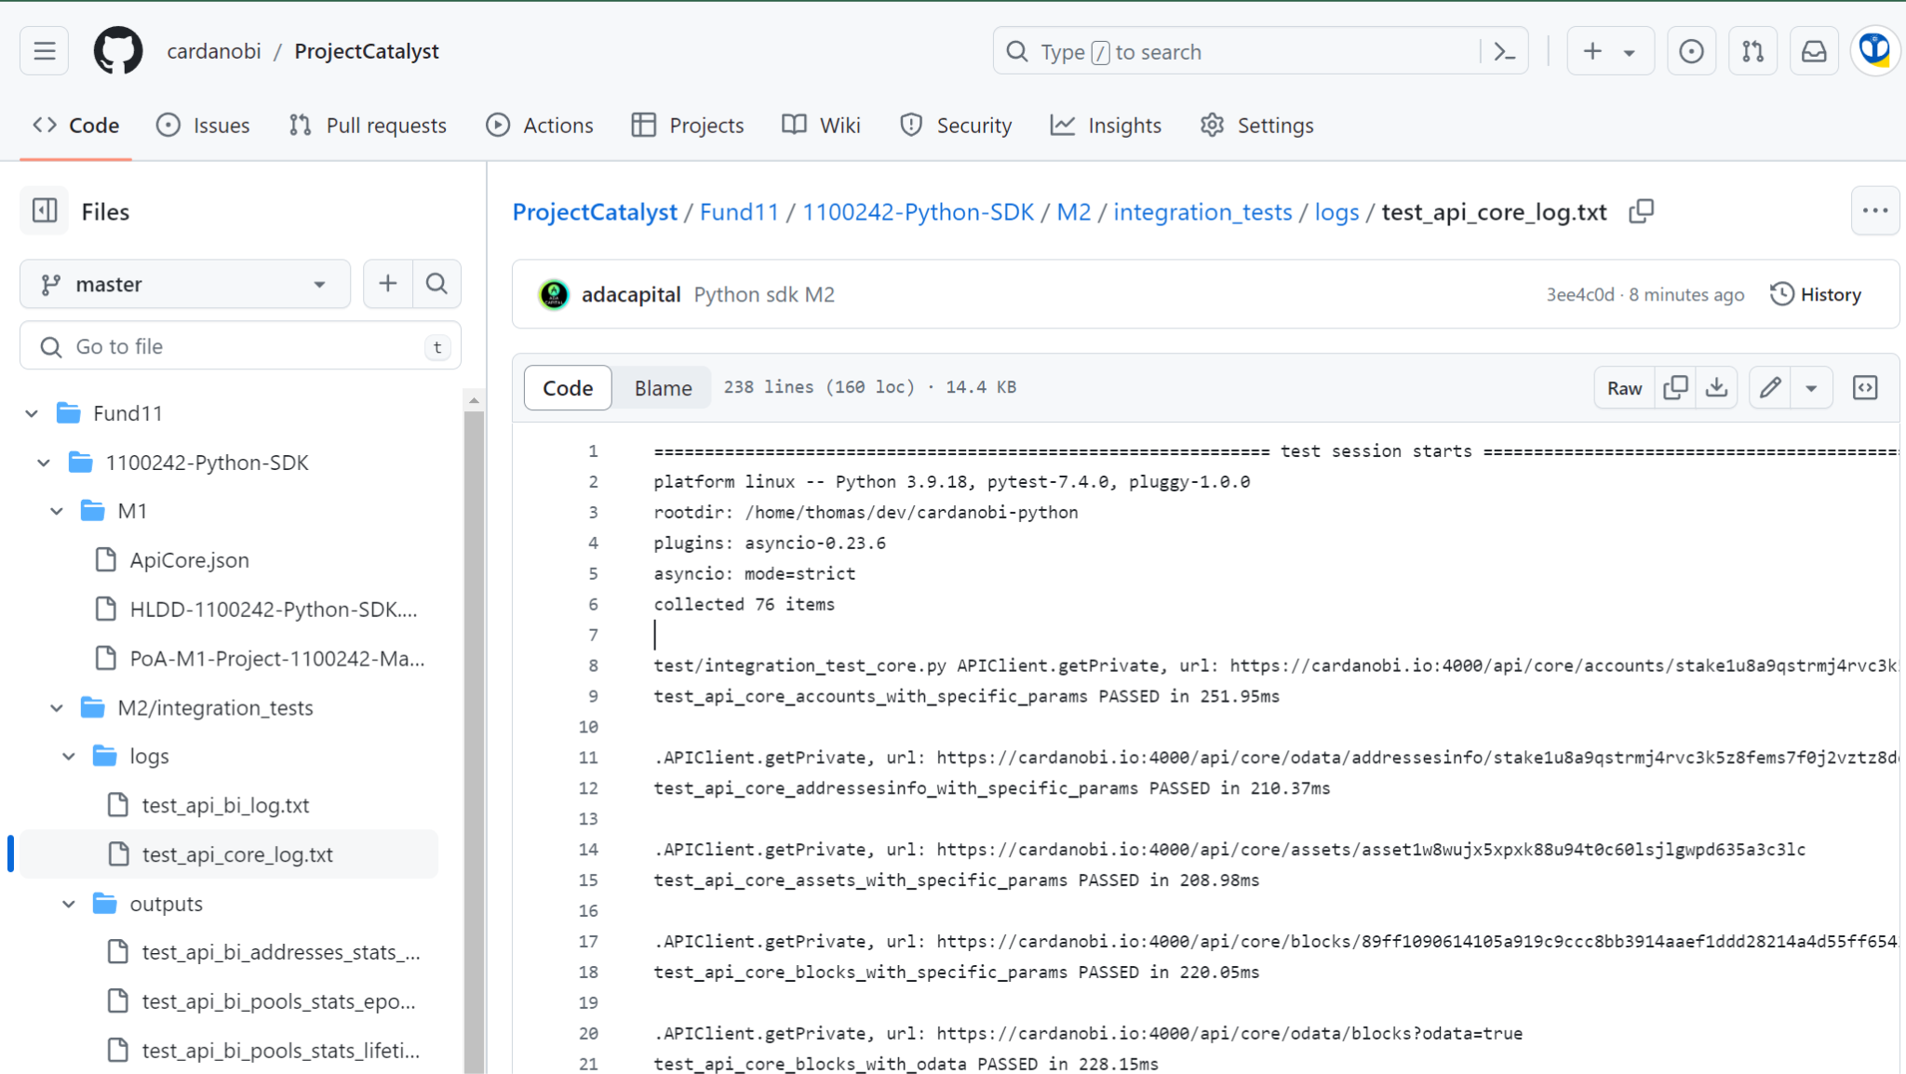
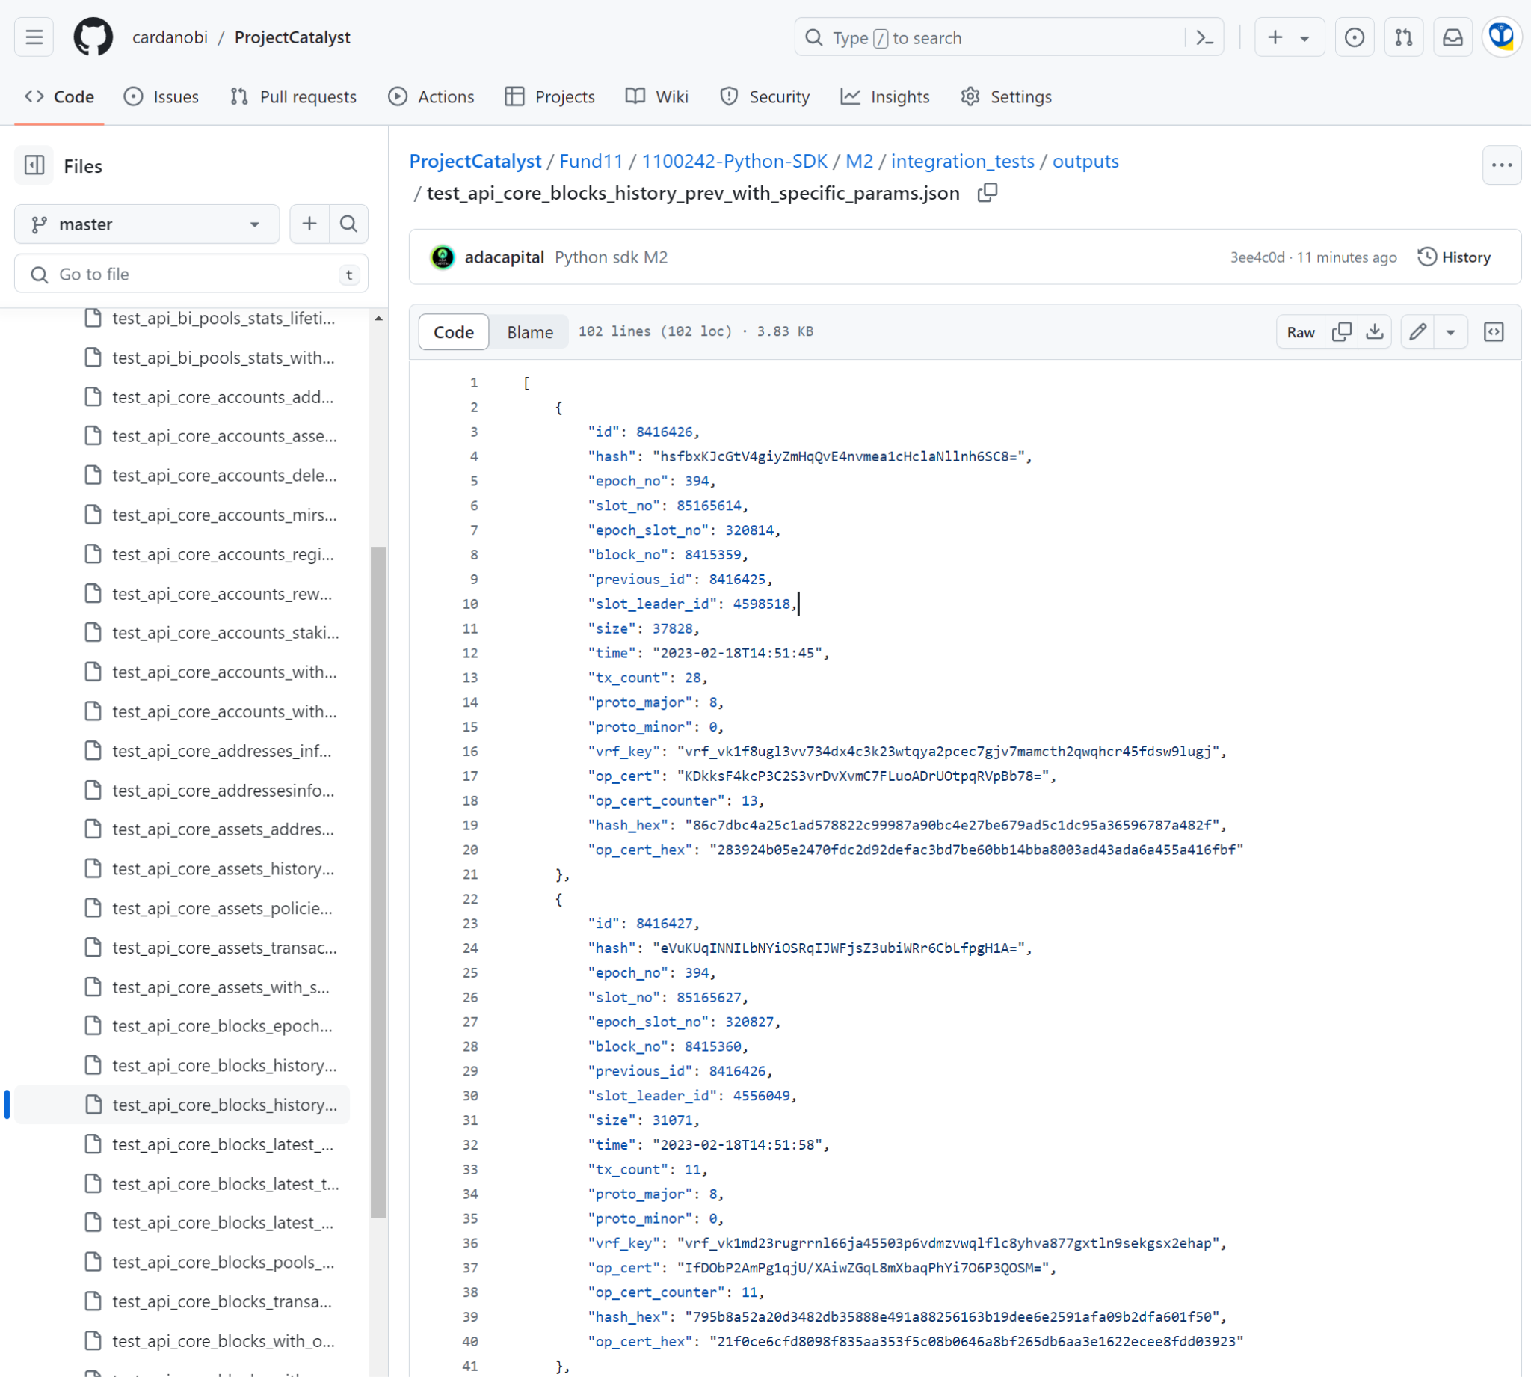
Evidence #2 – Integration test results
Execution Logs
Execution Responses

Slide 7
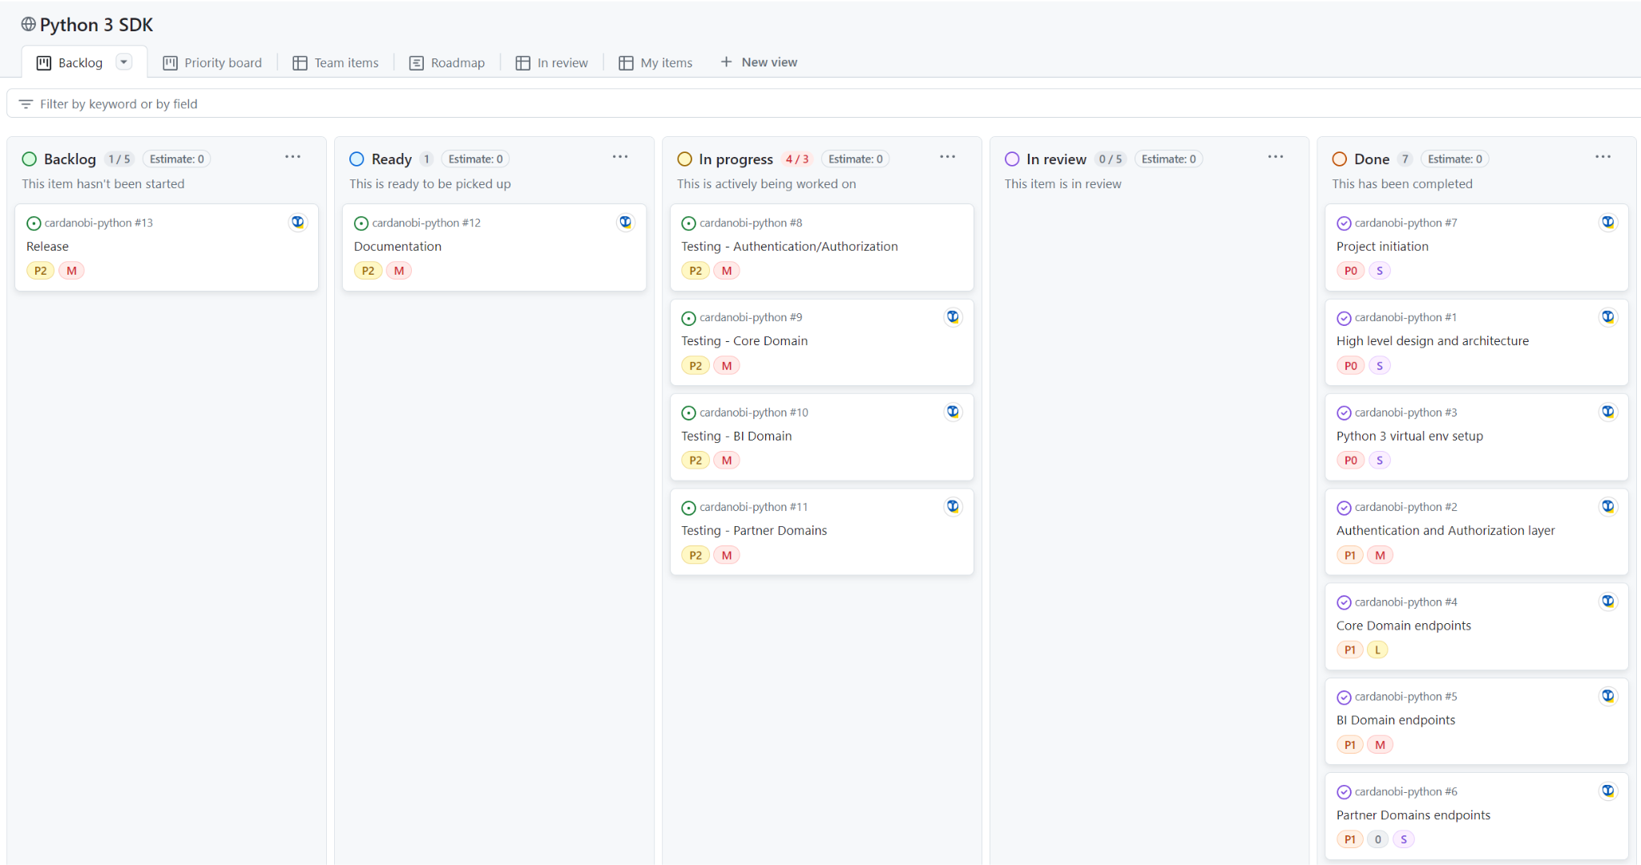
Backlog
Github Project - Backlog View

Slide 8
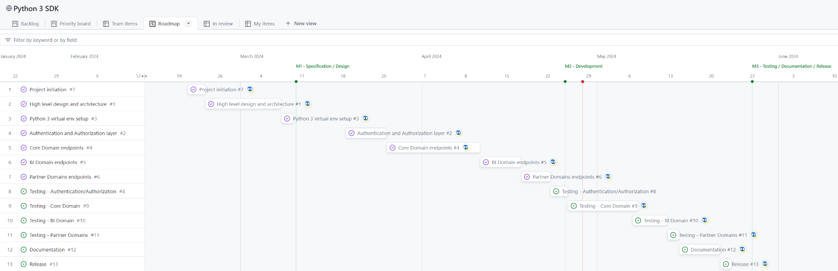
Roadmap
Github Project - Roadmap

Slide 9
Annexes

Slide 10
Thank you
Thomas Langlois​
cardanobi.io

