Slide 1
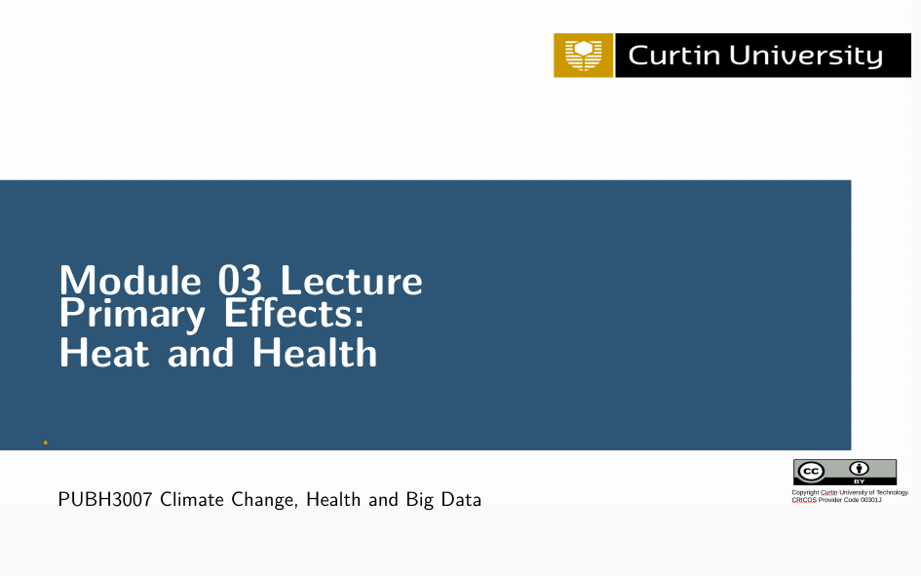
R coding advice
Ivan Hanigan,
School of Population Health

Slide 2
There are better systems than a single script
The single script approach is limited
Advantages to shorter scripts include:
If you correct an error, you need to verify that none of the later commands are affected
It is easier to keep track of corrected results from shorter scripts
It is easier to review the results of shorter scripts, especially in collaborative work
The unit learning material for this module is online: https://cardat.github.io/air-health-sws-r-targets-technique-tweaking-tinkering/index.html

Slide 3
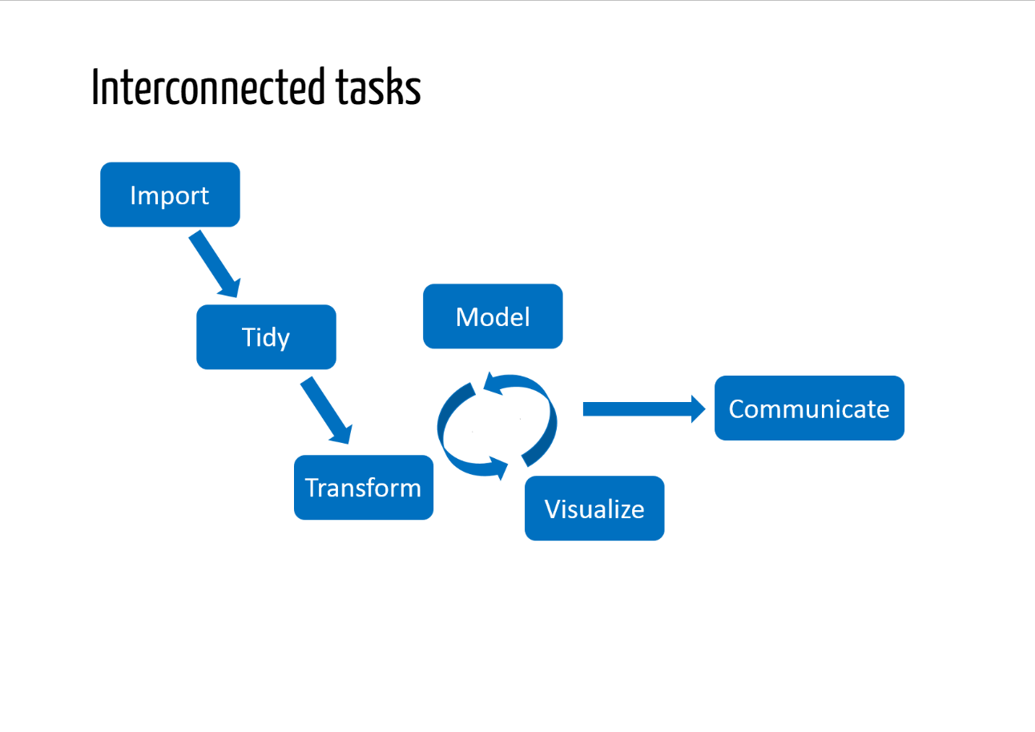
This is called a Workflow
Source: https://wlandau.github.io/targets-tutorial/

Slide 4
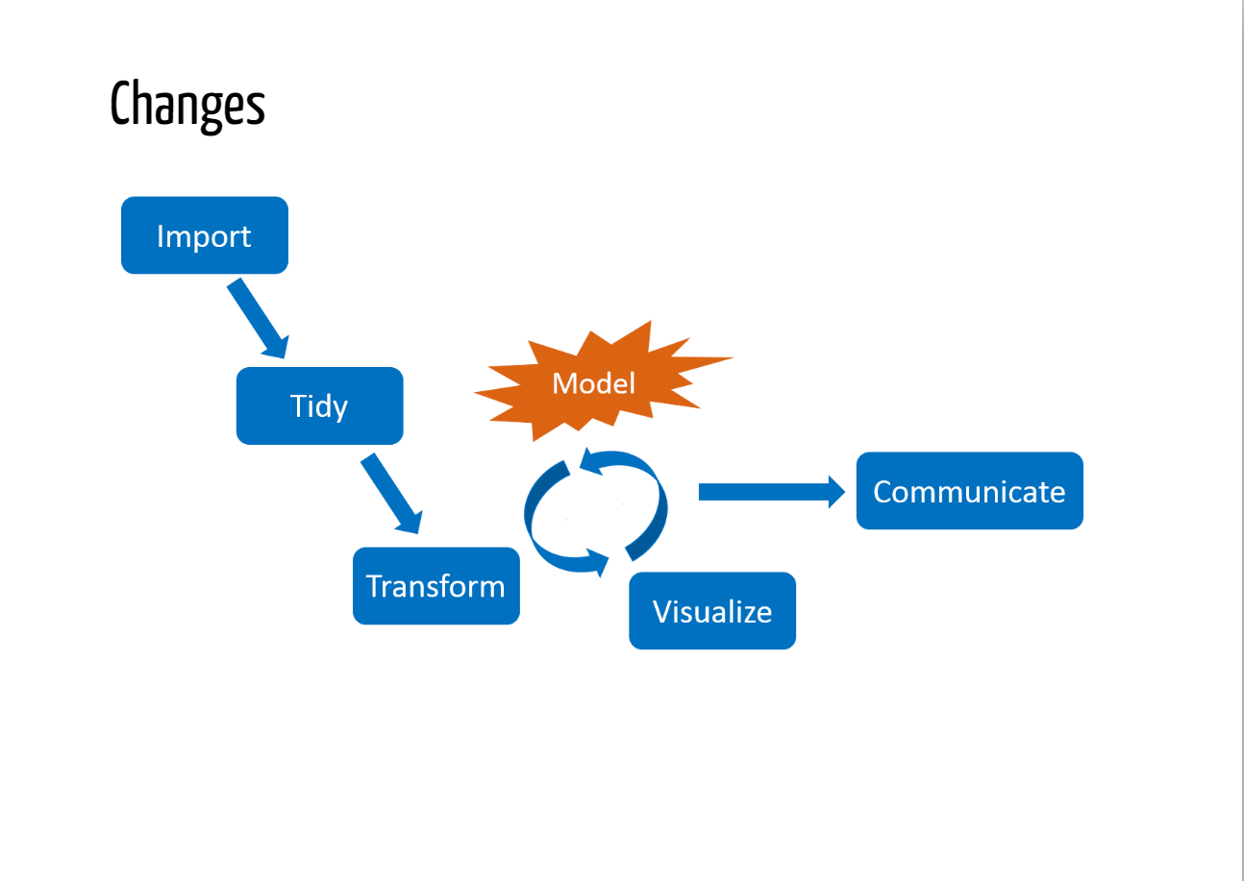
Source: https://wlandau.github.io/targets-tutorial/

Slide 5
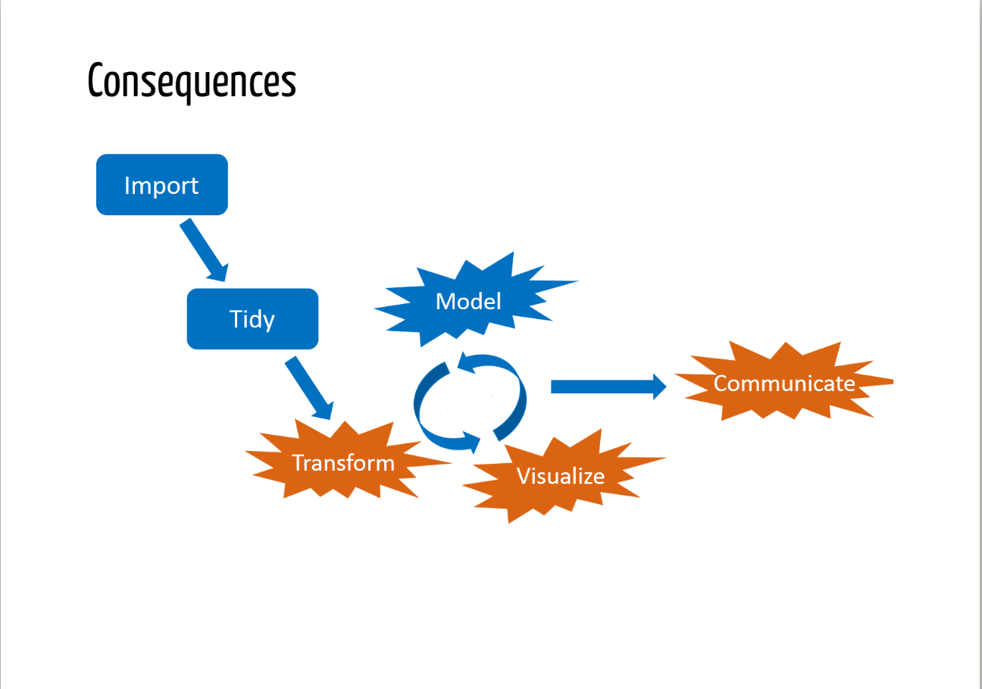
Source: https://wlandau.github.io/targets-tutorial/

Slide 6
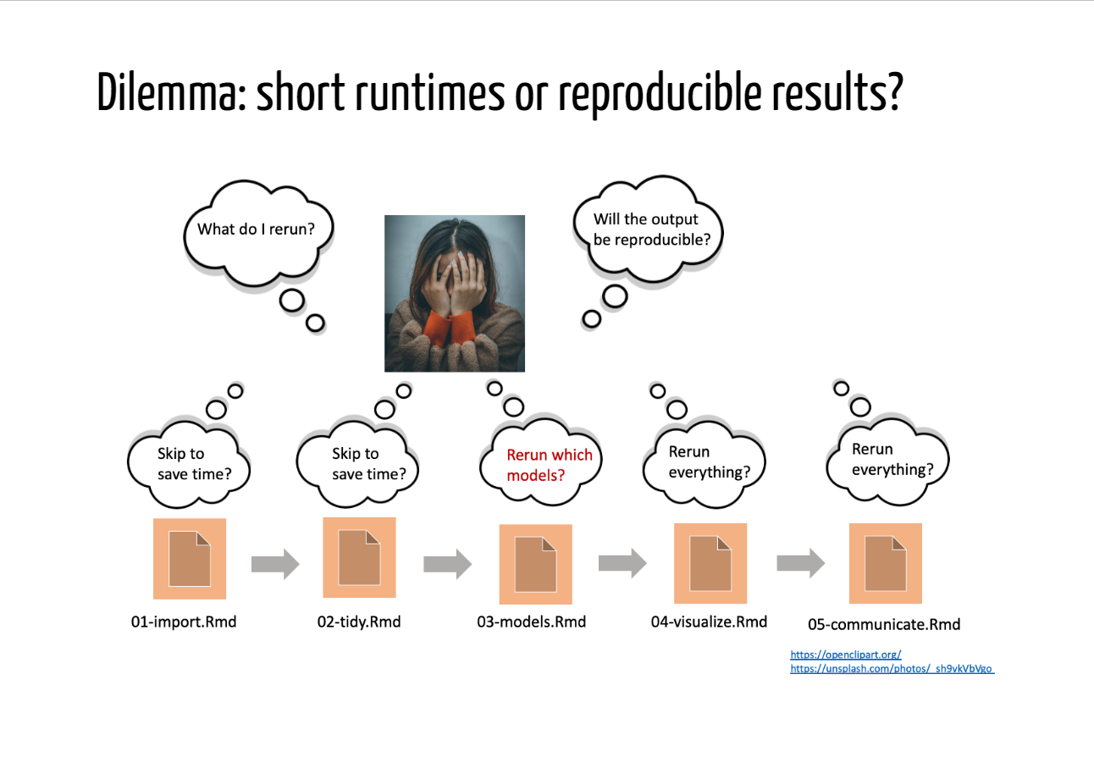
Source: https://wlandau.github.io/targets-tutorial/

Slide 7
There is a long tradition of using “numbered imperative scripts”
Parent Directory {The project directory}
main.R {This is where you set global variables, and call the other scripts.}
data_provided/ {A data directory to hold your data files.}
code/ {A code directory containing the other code files.}
load.R {This is where you insert code to load in libraries and data files.}
clean.R {This is where you perform any messy data cleanup.}
func.R {This is where you write all the functions that you need.}
do.R {This is where the actual work is done.}
https://github.com/cran/makeProject
> install.packages("makeProject")
> makeProject::makeProject("my_analysis")

Slide 8
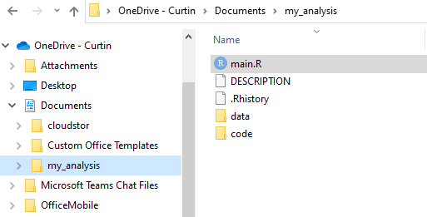
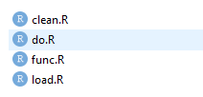
Concept: use small scripts and a ‘master’
https://github.com/cran/makeProject
> install.packages("makeProject")
> makeProject::makeProject("my_analysis")
The numbered imperative scripts approach has some nice features
Start by converting the single script into smaller components

Slide 9
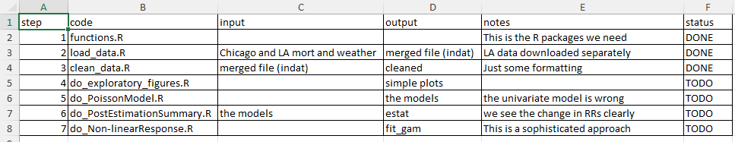
Recommendation: Keep track of Workflow steps in a table
In a big project this can be incredibly useful
You can do this with a pen and paper notebook
I have mocked up a spreadsheet of what the Case Study could look like

Slide 10
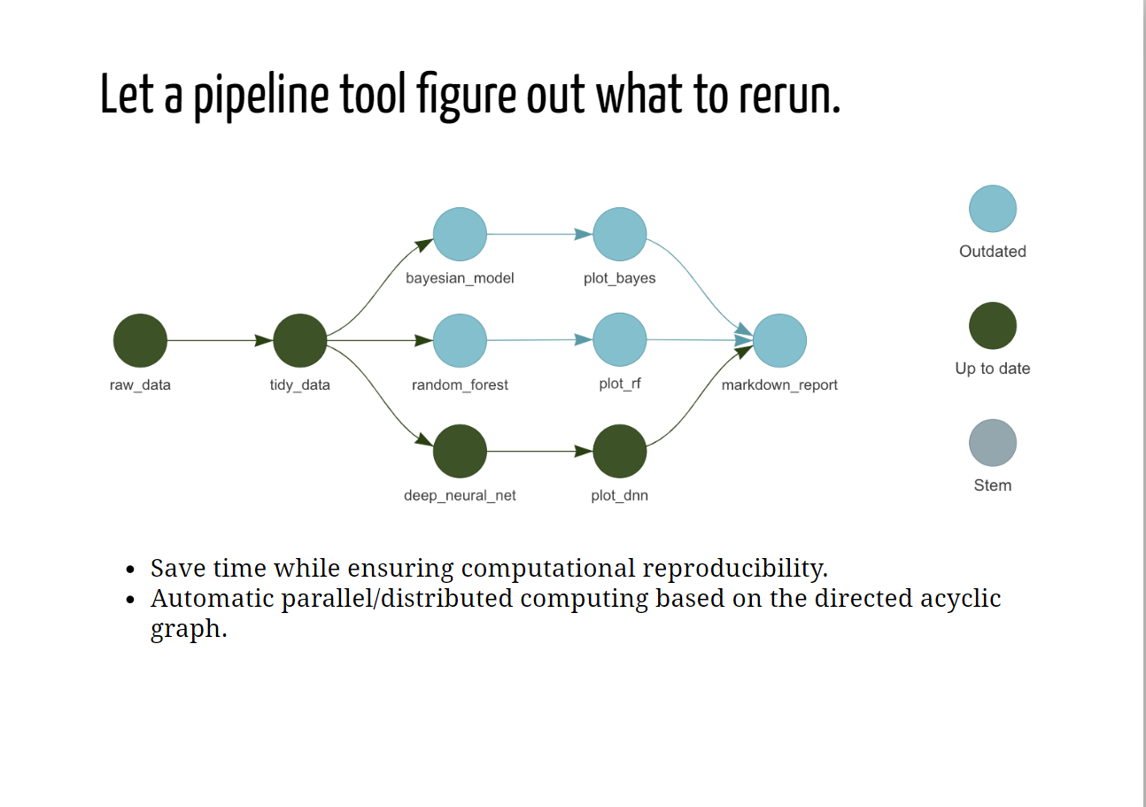
Source: https://wlandau.github.io/targets-tutorial/
Finally, The most advanced types of data science projects need serious tools!
Use of a ‘pipeline approach’ has emerged as the best practice (R-targets).

Slide 11
Above all else:
Just Know What You Did!
The Readings are essential:
Peng, R. D. (2015). The reproducibility crisis in science: A statistical counterattack. Significance, 12(3), 30–32. https://doi.org/10.1111/j.1740-9713.2015.00827.x
Barnes, N. (2010). Publish your computer code: It is good enough. Nature, 467(7317), 753–753. https://doi.org/10.1038/467753a

