Slide 1

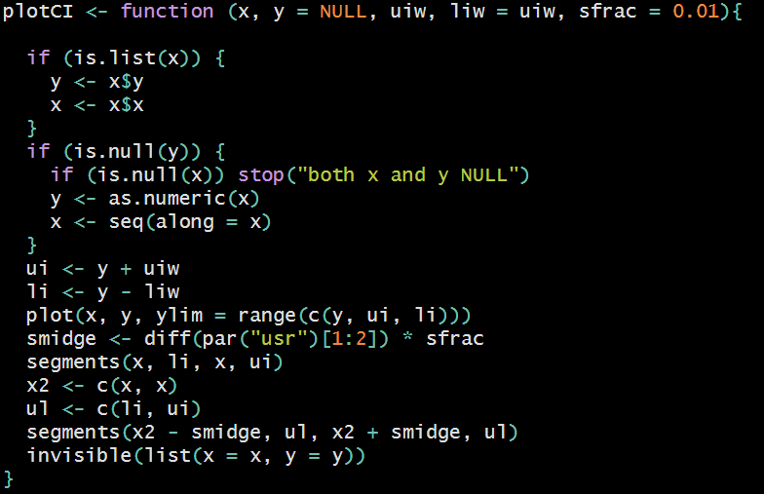

Slide 2
Name

Slide 3
Arguments

Slide 4
Curly braces

Slide 5
Check stuff

Slide 6
Do stuff

Slide 7
Return the result

Slide 8
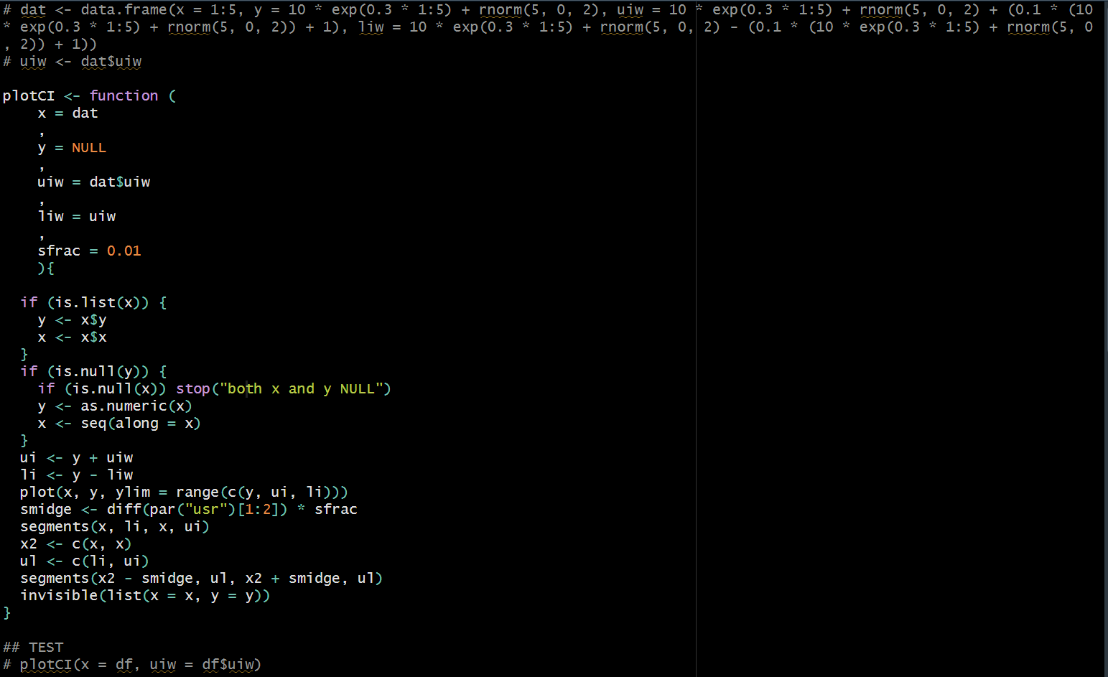
Easy to run these bits for building the function in interactive mode

Slide 9
