Slide 1

Mothur MiSeq Processing

Slide 2
Objectives Requirements
Learn how to run mothur with Miseq data.
Understand rationale behind steps.
Used processed data for diversity analysis.
A computer Mas/PC/Linux with Mothur installed
Protocol
Documents also here
https://github.com/carden24/

Slide 3
What is mothur
Software to process and analyze microbial community census data
Free, open source
Handles Illumina, 454, Ion Torrent, PacBio data. Incorporates tools from other under one plattform.
Broad user community
Development is based on research
Many custom options
Slow
Memory intensive
Creates many temporary files

Slide 4
How can I run mothur?
1. Interactively
Move required files into mothur folder
Initialize mothur
Type commands
2. Batch mode
Prepare plain text script with commands
Execute script with
mothur <script.batch>
3. GUI (RIP)

Slide 5
Join pairs
Filter seqs
Remove badly aligned
Filter alignment
(Dereplicate)
(Precluster)
(Dereplicate)
Align
Clean Sequences
Raw Sequences
Aligned sequences
Refined alignment
Classify
Remove
Chimeras and contaminants
Phylotypes
Greedy
clustering
Final alignment
Create
matrix
Cluster
split
Distance matrix
+ Classify OTUs
Create table
Cluster
Sites by species table
Clustering result

Slide 6
Pipeline
Sequencing files
(Pairs of fastq files
per sample)
Script
(Instructions)
<.batch>
List of files
<.files>
Master alignment
<.fasta>
Taxonomic scheme

Slide 7
stability.files
Sample
Pair1
Pair2
F3D0 | F3D0_S188_L001_R1_001.fastq | F3D0_S188_L001_R2_001.fastq
F3D141 | F3D141_S207_L001_R1_001.fastq | F3D141_S207_L001_R2_001.fastq
F3D142 | F3D142_S208_L001_R1_001.fastq | F3D142_S208_L001_R2_001.fastq
F3D143 | F3D143_S209_L001_R1_001.fastq | F3D143_S209_L001_R2_001.fastq
F3D144 | F3D144_S210_L001_R1_001.fastq | F3D144_S210_L001_R2_001.fastq
F3D145 | F3D145_S211_L001_R1_001.fastq | F3D145_S211_L001_R2_001.fastq
F3D146 | F3D146_S212_L001_R1_001.fastq | F3D146_S212_L001_R2_001.fastq
F3D147 | F3D147_S213_L001_R1_001.fastq | F3D147_S213_L001_R2_001.fastq
F3D148 | F3D148_S214_L001_R1_001.fastq | F3D148_S214_L001_R2_001.fastq
F3D149 | F3D149_S215_L001_R1_001.fastq | F3D149_S215_L001_R2_001.fastq
F3D150 | F3D150_S216_L001_R1_001.fastq | F3D150_S216_L001_R2_001.fastq
F3D1 | F3D1_S189_L001_R1_001.fastq | F3D1_S189_L001_R2_001.fastq
F3D2 | F3D2_S190_L001_R1_001.fastq | F3D2_S190_L001_R2_001.fastq
F3D3 | F3D3_S191_L001_R1_001.fastq | F3D3_S191_L001_R2_001.fastq
F3D5 | F3D5_S193_L001_R1_001.fastq | F3D5_S193_L001_R2_001.fastq
F3D6 | F3D6_S194_L001_R1_001.fastq | F3D6_S194_L001_R2_001.fastq
F3D7 | F3D7_S195_L001_R1_001.fastq | F3D7_S195_L001_R2_001.fastq
F3D8 | F3D8_S196_L001_R1_001.fastq | F3D8_S196_L001_R2_001.fastq
F3D9 | F3D9_S197_L001_R1_001.fastq | F3D9_S197_L001_R2_001.fastq
Mock | Mock_S280_L001_R1_001.fastq | Mock_S280_L001_R2_001.fastq

Slide 8
Contents of stability.batch
 |  | pcr.seqs(fasta=silva.bacteria.fasta, start=11894, end=25319, keepdots=F)
 |  | rename.file(input=silva.bacteria.pcr.fasta, new=silva.v4.fasta)
 |  | make.contigs(file=stability.files, processors=2)
 |  | screen.seqs(fasta=current, group=current, summary=current, maxambig=0, maxlength=275)
 |  | unique.seqs(fasta=current)
 |  | count.seqs(name=current, group=current)
 |  | align.seqs(fasta=current, reference=silva.v4.fasta)
 |  | screen.seqs(fasta=current, count=current, start=1968, end=11550, maxhomop=8)
 |  | filter.seqs(fasta=current, vertical=T, trump=.)
 |  | unique.seqs(fasta=current, count=current)
 |  | pre.cluster(fasta=current, count=current, diffs=2)
 |  | chimera.vsearch(fasta=current, count=current, dereplicate=t)
 |  | remove.seqs(fasta=current, accnos=current)
 |  | classify.seqs(fasta=current, count=current, reference=trainset14_032015.pds.fasta, taxonomy=trainset14_032015.pds.tax, cutoff=80)
 |  | remove.lineage(fasta=current, count=current, taxonomy=current, taxon=Chloroplast-Mitochondria-unknown-Archaea-Eukaryota)
 |  | cluster.split(fasta=current, count=current, taxonomy=current, splitmethod=classify, taxlevel=4, cutoff=0.03)
 |  | make.shared(list=current, count=current, label=0.03)
 |  | classify.otu(list=current, count=current, taxonomy=current, label=0.03);
Quality control step
Reducing computational stress step

Slide 9
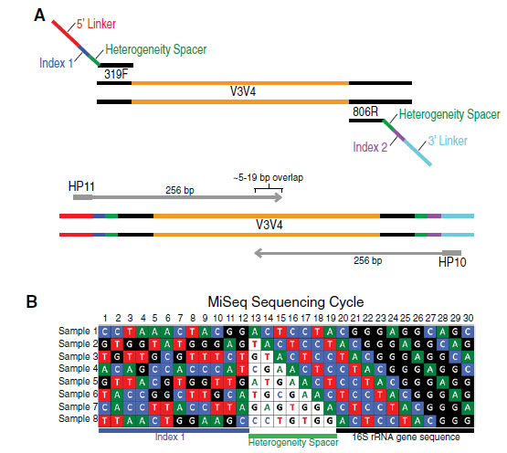

Multiplex approach
Allow for sequencing of multiple samples in one run.

Slide 10
Make.contigs()

Slide 11
What is pre-clustering

Slide 12
Analysis of communities
Today’s task
Run the pipeline
Open .shared file in Excel
Open .design file in Excel
Today’s questions
How many species were detected in total?
Which treatment has more species?
Which treatment has higher diversity?

