Slide 1
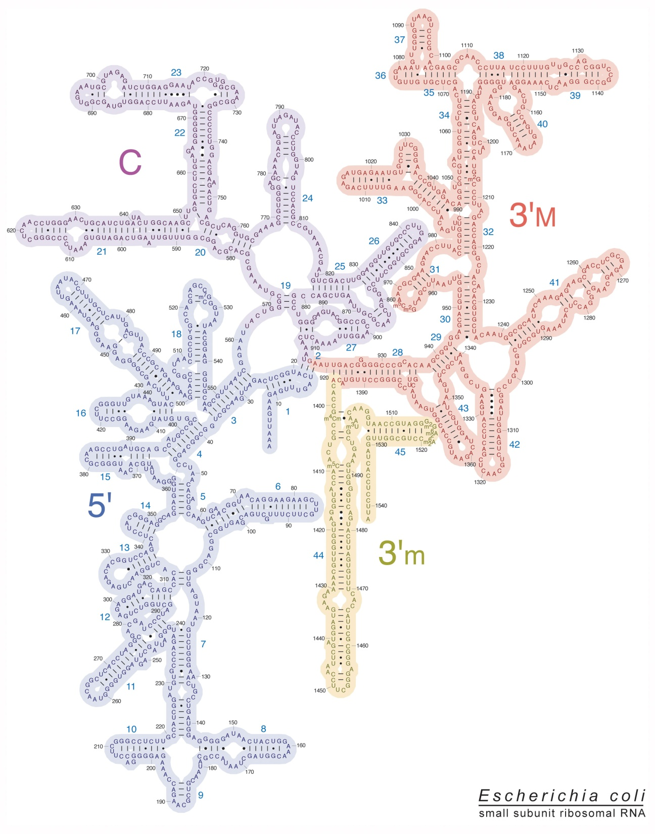
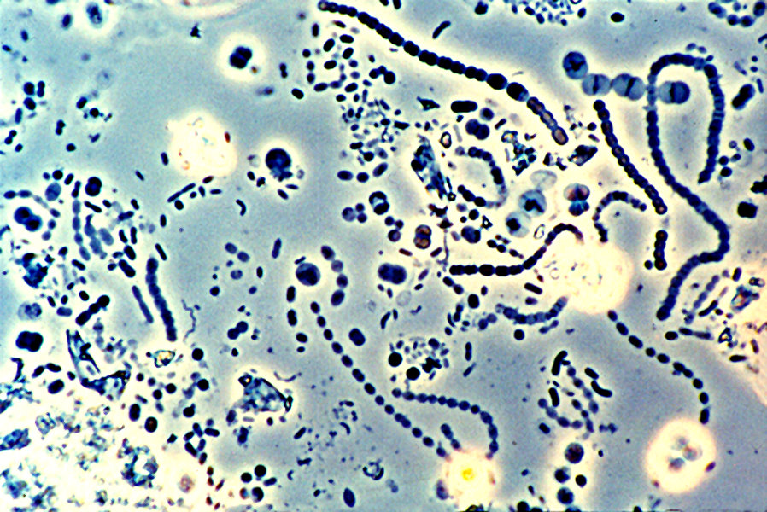
Microbial community analysis by
16S rRNA gene sequencing

Slide 2
Objectives
Student will be able to
Identify characteristics of that makes 16S rRNA a good phylogenetic marker
Explain what is an OTU

Slide 3
Phylogenetic marker requirements
Characteristics
Universal distribution.
Homologous function in all organisms.
No horizontal gene transfer.
Some highly conserved zones and some variable regions.
Long enough (information).
Examples
16S rRNA (18S rRNA)
23S rRNA
rpoN
recA
Internal transcribed spacer (ITS)
Mitochondrial DNA

Slide 4
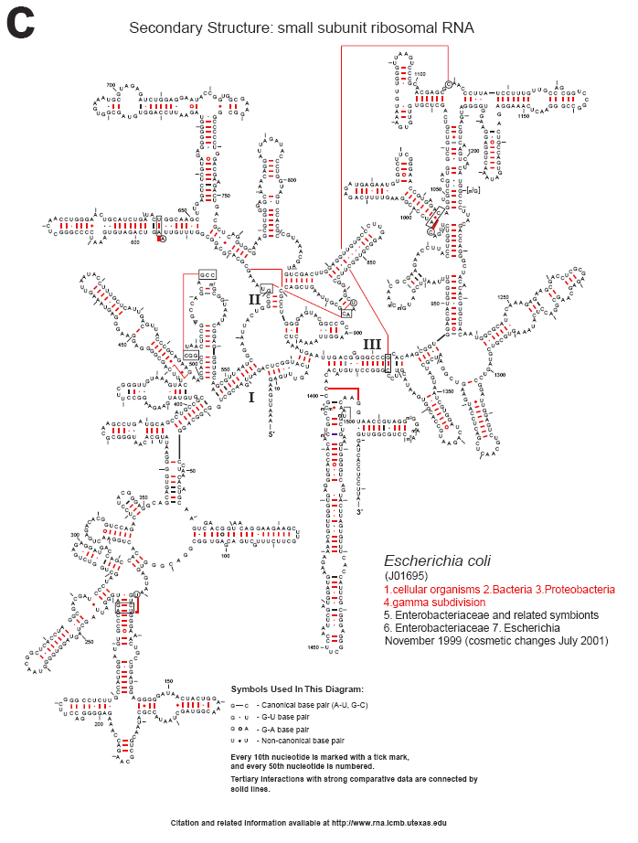
Essential function
Highly conserved sequence (1°, 2°)
No HGT*
Highly conserved (primers) and variable regions (information)
Long ~ 1500 bases
Variable copy number
No universal primers
Difference among operons
Cannone, 2002. BMC Bioinformatics. 3:2

Slide 5
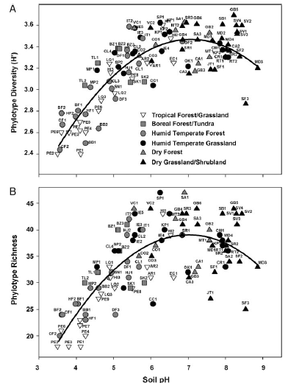
Traditional approach
Fingerprinting
TRFLP
DGGE
Easy
Inexpensinve
Low resolution

Slide 6
Traditional approach
Clone libraries
Comparison with databases
Phylogenetic tres
High resolution
Expensive
Labor-intesive

Slide 7
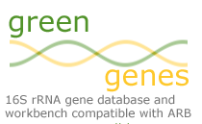
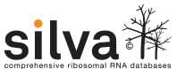

Tools for rRNA analysis
Features:
Data is organized under a taxonomic structure
Sequences are aligned
Curated sequences
Some metadata
Provide specialized analysis tools
Specialized Databases

Slide 8


Pipelines for processing and analysis of rRNA
Features:
Pipelines that incorporate tools from different sources.
Processing can be done in your own computer.
Have problems of their own:
Installation
Resource-intensive
Versions
Default parameters
DADA2

Slide 9
General processing flow
Phylogeny
Raw data
Clean data
Aligned sequences
Distance matrix
OTUs
table
Taxonomic classification
Diversity analysis
Traditional processing does
not scale well….
Notes:
Traditional approaches do not scale well.
New approaches were developed in order to work with massive data.

Slide 10
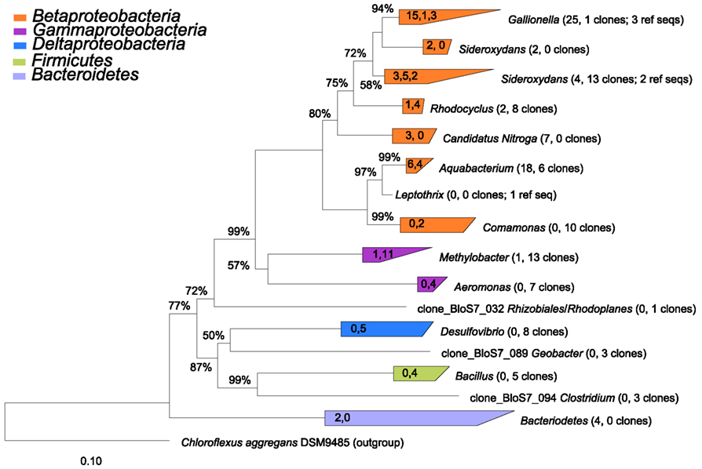
Taxonomic classification I – Phylogenetic trees
Phylogenetic tree reconstruction
Require references
Needs alignments
Slow, does not scale well
Front. Microbiol., 22 May 2012 | http://dx.doi.org/10.3389/fmicb.2012.00172

Slide 11
Taxonomic classification II - Classifiers
Features
Assign sequences to pre-existing taxonomy
Does not need alignment (Memory)
Fast and precise
Sufficient for some analysis.
Classification scheme may change over time.
Groups may not be internally consistent.
Examples
RDP Bayesian classifier
K-nearest neighbours (KNN)

Slide 12
Taxonomic classification III: K-Nearest neighbours
Seq1
Seq2
Query
Seq3
Database
Seq4
Seq5
Seq5
k related sequences vote for taxonomic assignment.
Consensus taxonomy is assigned
3
Query word’s frequency
(8-mers)
Database word frequency
(8-mer)
1
2

Slide 13
Taxonomic classification IV: Bayesian Classifier¹
Seq1
Seq2
Query
Seq3
Database
Seq4
Seq5
3
Seq5
Compares frequency to assign probability for each genus.
Reports genus with highest probability
Includes bootstrap value
Query word’s frequency
(8-mers)
Database word frequency
(8-mer)
1
2
¹Wang et al. 2007: doi:10.1128/AEM.00062-07

Slide 14
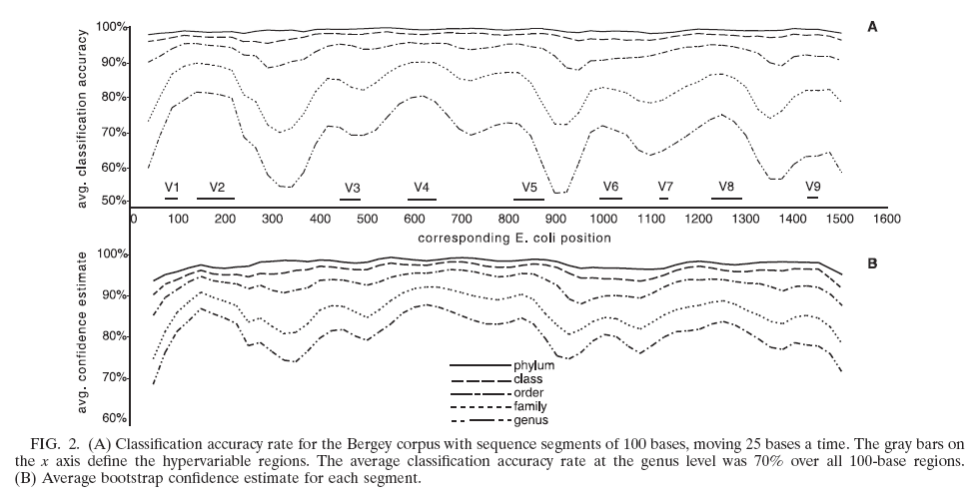
16S rRNA gene regions provide different amount of information
Wang Q, Garrity GM, Tiedje JM, Cole JR.
Appl Environ Microbiol. 2007 Aug;73(16):5261-7. Epub 2007 Jun 22.

Slide 15
Operational taxonomic units (OTUs) analysis
Hard to define species in bacteria
OTUs are species proxies.
Groups based on distances among aligned sequences.
Groups with at least 97% similarity (3% distances) are considered to be from the same species*.
Sequences
Aligned sequences
Distance
matrix
Clustering groups
Sample x OTU table

Slide 16
Alignment I - Approaches
Traditional
Compare all sequences, align closest pair, add more sequences until no more remain
Implemented in ClustalW, Muscle
Slow
Does not scale well (N²)
New models
NAST aligner (Greengenes)
RDP aligner

Slide 17
Alignment II - NAST aligner
Master alignment
1
4
All query sequences are
aligned to model and
thus to each other
Identify relative in master alignment
using k-mers or via BLAST
Align candidate against reference
using gaps of model and
Needleman–Wunsch algorithm
2
3

Slide 18
RDP Model aligner
Model uses both primary and secondary structure information.
Once sequences are aligned to se model they are aligned to each other.
Uses a Hidden Markov model.
1. Nawrocki et al 2009. Bioinformatics. May 15;25(10):1335-7. Epub 2009 Mar 23.

Slide 19
Distance matrix
Complete linkage clustering
Aligned sequences
Guarantees distance within a group
Can have some artefacts
Singletons can have closely related sequences
Number of OTUs can change when more samples are added

Slide 20
Clustering methods comparisons
Furthest neighbor
Complete linkage
4 OTUs
1
2
3
4
Nearest neighbor
Single linkage
2 OTUs
1
1
2
2
●
●
Average neighbor
Single linkage
1
1
2
3

Slide 21
Species x sites table (OTU x Samples)
 | OTU1 | OTU2 | OTU3 | OTU4 | OTU5 |  | H’ | S
Sample1 | 20 | 15 | 50 | 10 | 0 |  | 1.194 | 4
Sample2 | 15 | 30 | 35 | 20 | 0 |  | 1.335 | 4
Sample3 | 0 | 12 | 0 | 100 | 0 |  | 0.3405 | 2
Sample4 | 0 | 10 | 100 | 0 | 1 |  | 0.3533 | 3
0.32
Sample 4
0.16
 | Sample1 | Sample2 | Sample3 | Sample4
Sample1 | 0.000 | 0.231 | 0.787 | 0.417
Sample2 | 0.231 | 0.000 | 0.698 | 0.573
Sample3 | 0.787 | 0.698 | 0.000 | 0.910
Sample4 | 0.417 | 0.573 | 0.910 | 0.00
Coordinate 2
Sample 3
0.00
Sample 1
-0.16
-0.32
Sample 2
-0.80
-0.48
-0.16
0.16
0.48
Coordinate 1
Sample 4
Sample 2
Sample 1
Sample 3
0.2
0.3
0.4
0.5
0.6
0.7
0.8
0.9
1.0
Bray-Curtis similarity

Slide 22
Alignment-independent methods Greedy algorithm
Traditional algorithms
Nearest, average, farthest neighbour.
Require a distance matrix (memory).
Systematic.
Guaranteed consistency.
Sequences
Aligned sequences
Distance
matrix
Clustering groups
Sample x OTU table

Slide 23
Greedy clustering
Query
Database (Seeds)
Clusters

Slide 24
Alignment-independent methods Greedy algorithm
Does not need global alignment.
Does not need a distance matrix (Low memory).
Extremely fast.
Good if sequences do not align well.
Heuristics, may not be optimal or consistent.
Usearch (UCLUST)
Vsearch
CrunchClust
VCLUST

Slide 25
Reference based methods
OTU1
OTU2
OTU3
OTU4
OTU1
OTU2
OTU3
OTU4
OTU5
1
Curated master alignment
Already defined OTU representatives
4
OTU counts are assigned
2
Sequences are compared against the database and sequences assigned to the reference OTU
Unaligned sequences are discarded
(Closed reference)
or
Unaligned sequences are aligned to each other to create OTUs de novo
(Open reference)
3a
3b

Slide 26
Reference based methods
Fast and parallelizable
Useful when comparing sequences from different regions
E.g. Metanalysis
Implemented in QIIME
Database dependent
Not useful if sequences are too different from those from database

Slide 27
What is the coming?
Better replication, more robust statistical analysis
More longitudinal, spatial analysis
More, more, more data
New challenges
New algorithms
Wider market penetration
Role of microbiome in more diseases
Routine analysis for monitoring

Slide 28
General processing flow
Phylogeny
Raw data
Clean data
Aligned sequences
Distance matrix
OTUs
table
Taxonomic classification
Diversity analysis
Notes:
Traditional approaches do not scale well.
New approaches were developed in order to work with massive data.

Slide 29
Single molecule sequencing
Technology | Outputs (Gb/day) | Error rate | Read Length
Illumina NextSeq | 2.0 | 1.3% (Substitutions) | 150 PE | 150K
PacBio | 3.0 | 2-15% (Substitutions) | 430 – 2900 | 750K
Ion Torrent | 2.0 | 1.5% (Indels) | 100-240 | 50K
Nanopore Minion | 0.5 MB | 2-13% (Substitutions) | 10-100Kb (Record 1Mb) | 1K

Slide 30
Artificial long reads ; LoopSeq
DNA is barcoded with a sample barcode
Each molecule is labeled with a unique molecule barcode
Labelled samples are mixed and sequenced
Reads are assembled as in a metagenome, each molecule is covered 20X.
Full length sequences with 1/40 error rate
Expensive
200 partial reads -> 1 full length read

Slide 31
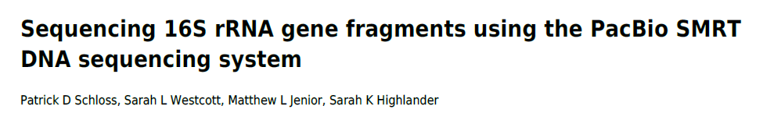
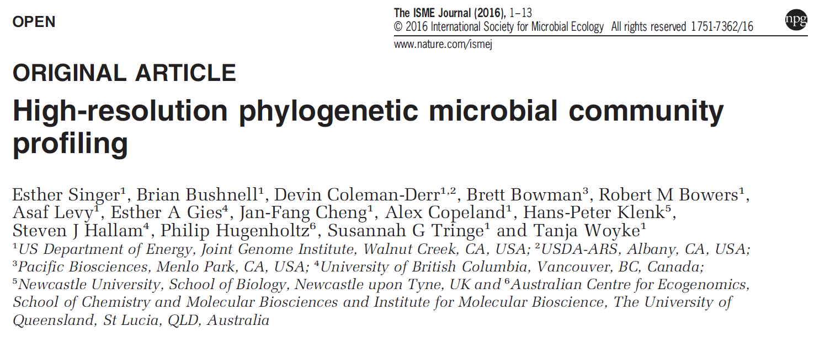
2015. PeerJ PrePrints. e778v1. DOI: 10.7287/peerj.preprints.778v1.

Slide 32
Long read = Complete 16S rRNA gene
Pros
Higher resolution
Improvement of 16S rRNA databases
Cons
Lower throughput
More expensive
May no resolve species

Slide 33
Summary
16S rRNA gene is the preferred phylogenetic marker
OTUs are proxy for species
97% = Species
Specialized tools and procedures are required to navigate computational problems
Strong method-dependency

Slide 34
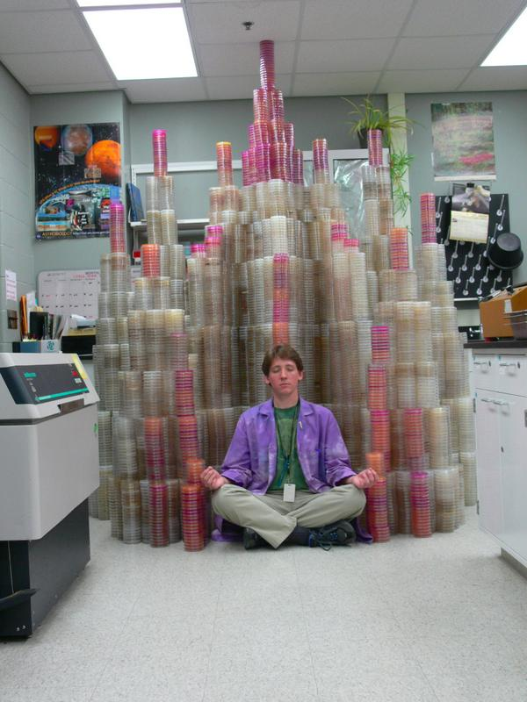

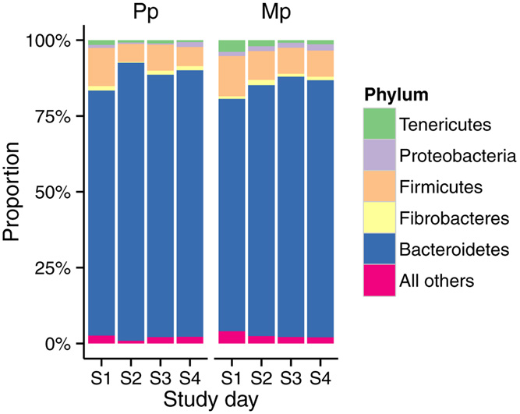
Literatura
Diseño experimental
@M00967:43:000000000-A3JHG:1:1101:18278:3345 1:N:0:188
TACGGAGGATGCGAGCGTTATCCGGATTTACTGGGTGTAAAGGGAGCGTAGACGGTGATGCAAGTCTGAAGTGAAAGGCGGGGGCTCAACCCCCGGACTGCTTTGGAAACTGTATGACTGGAGTGCAGGAGAGGTAAGTGGAATTCCTAGTGTAGCGGTGAA
+
ABBBBBBBBFFFGGGGGGGGGGHGGGGGHHHHHHHHGFHHHHHGHGGGGGGGHGGDHGHHHHHHHHHHHHHHHHHHHGHGGGGGGGHHHHHGGGGGGGGHHHHHHHFHHHHHHHHHGHHHHHHHHHHHHEFEGGFFGGGGGGGGGGG
Publicación
 | OTU1 | OTU2 | OTU3 | OTU4 | OTU5
Sample1 | 20 | 15 | 50 | 10 | 0
Sample2 | 15 | 30 | 35 | 20 | 0
Sample3 | 0 | 12 | 0 | 100 | 0
Sample4 | 0 | 10 | 100 | 0 | 1
Experimento
Análisis
Muestras
Datos
Secuencias

