Slide 1
Análisis de comunidades microbianas
Erick Cardenas Poire
University of British Columbia

Slide 2
Workshop structure
Session 1: Diversity review.
Session 2: How to work with 16S rRNA data.
Session 3: Hands on session with mothur using Miseq data.
Material available at:
https://github.com/carden24/MIC506-Workshop.
Slides.
Files required for computer session.
Other learning resources.

Slide 3
Objetivos
By the end of workshop you will be able to:
1.1 Distinguish between alpha and beta diversity.
1.2 Estimate diversity indices.
2.1 Summarize the characteristic of a good phylogenetic marker.
2.2 Explain the concept of operational taxonomic units.
3.1 Complete the Miseq standard operational protocol for Mothur.
3.2 Modify the Mothur script to adapt it to other samples.

Slide 4
FAQs in Microbial ecology
How many different species are in my samples?
What it the diversity of my sample?
How is the microbial community structured?
How novel are my organisms?
Where have my organisms been seen before?
How similar are the communities of my samples?
How do the communities changes across this environmental gradient?
Are communities from treatments X, Y, Z different?
What organisms differentiate groups A an B?

Slide 5
Diversity, definitions
Biodiversidad:
Totality of genes, species and ecosystems of a region
Magurran:
The variety and abundance of species in a defined study unit.
Alpha diversity:
Diversity in a spatial unit
Within community
Beta diversity
A measurement of how two or more spatial units differ
Among communities

Slide 6
Alpha diversity
Richness (S): How many different species exist.
Evenness: How similar are the species in their abundnace.
=
>
Richness
Evenness
=
<

Slide 7
Alpha diversity indices
A metric that considers one or more diversity components
Shannon (H’)
Simpson (D)
Chao1

Slide 8
Shannon diversity index (H’)
Proportion of the community contributed by species i
Number of species

Slide 9
Shannon’s index limits
Range : 0 - ∞
Heavily influenced by richness

Slide 10
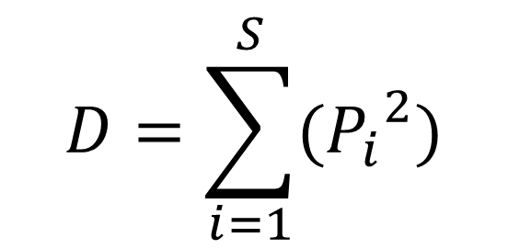
Simpson’s index (D)
Proportion of the community contributed by species i
Number of species
$$D=\sum_{i=1}^{S}{({P_{i}}_{}^{2})}$$
Probability of selecting the same species when sampling two members at random the same

Slide 11
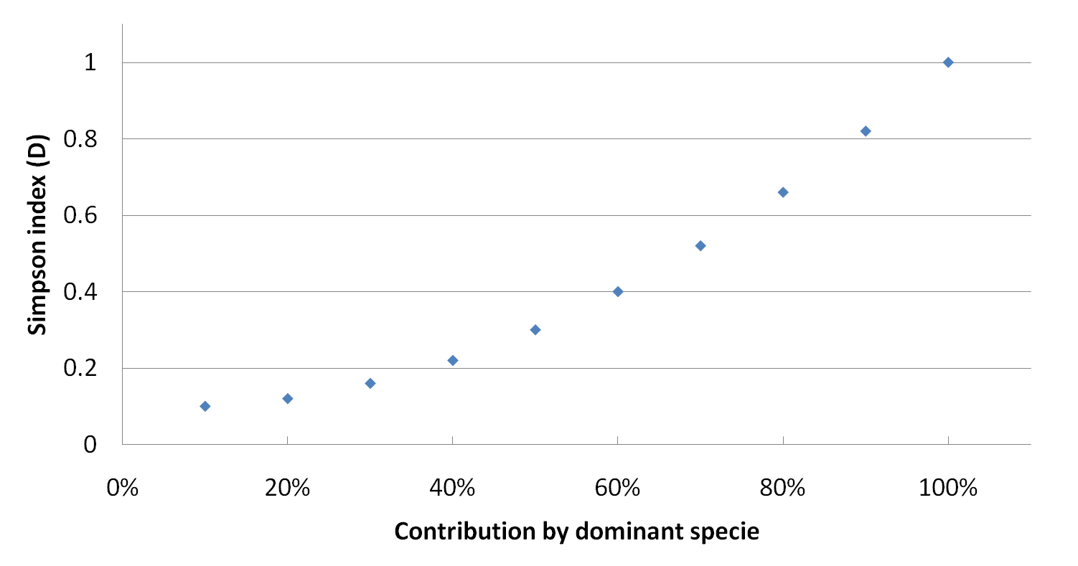
Simpson’s index (D)
Range : < 0 – 1 ]
Strongly influenced by evenness.
Usually expressed as (1-D) - more intuitive.
Contribution by dominant species

Slide 12
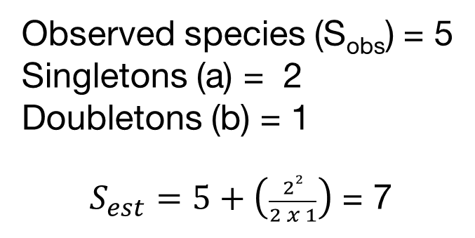
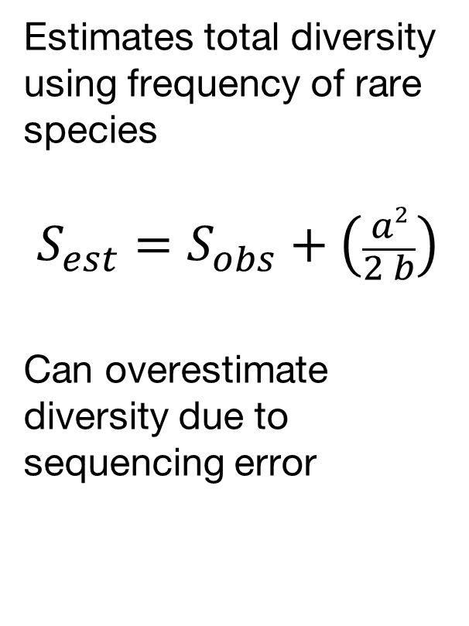
Chao1index
Estimates total diversity using frequency of rare species
$$S_{est}=S_{obs}+\left(\frac{a2}{2 b}\right)$$
Can overestimate diversity due to sequencing error
Observed species (S_{obs}) = 5
Singletons (a) = 2
Doubletons (b) = 1
$S_{est}=5+\left(\frac{22}{2 x 1}\right)$ = 7

Slide 13
Simpson evenness index
(1/D)
Limits 1/S - S
Dominant species contribution

Slide 14
Rank-Abundance curves
Show both richness and evenness
Steep slopes suggest strong selective pressure
Curves can indicate distribution of resources
Species in order of abundance

Slide 15
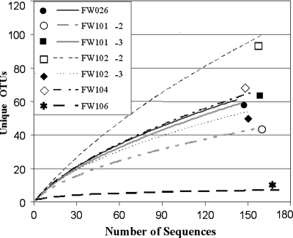
Rarefaction curves
Used to compare diversity when sampling was done at different levels.
Sometimes used to estimate if coverage has reached a plateau.
Are only informative when saturated.

Slide 16
Beta diversity indices
Quantify diversity among communities
Range: 0 – 1
0 = 100% similarity, 0% distance
1 = 0% similarity, 100% distance
Can use abundance and occurrence
Commonly used indices
Jaccard (Occ.)
Sørensen (Occ.)
Bray-Curtis (Occ. + Ab.)
Chao-Sørensen (Occ. + Ab.)

Slide 17
Presence/absences indices
a
b
c
Sample 1
Sample 2
Jaccard = b / (a+b+c)
Sorensen (QS) = 2b /(a+2b+c))
More weight to shared species

Slide 18

Indices using both abundance and occurrence
Bray -Curtis
Chao-Sorensen
Considers both abundance and assumes suboptimal sampling.
Absolute differences in abundance for i in samples j and k
$$d_{jk}=\frac{\sum_{i}^{s}{\left|x_{ij} −x_{ik}\right|}}{\sum_{i}^{s}{\left(x_{ij} −x_{ik}\right)}}$$
Sum of abundance for
i in samples j and k

Slide 19
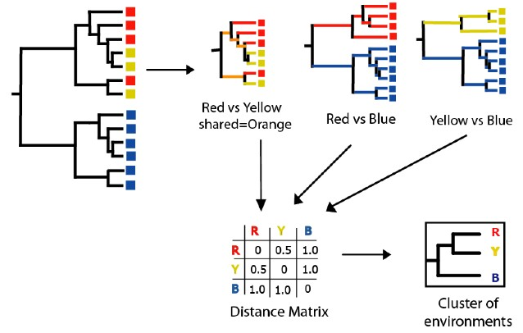
Tree-based indices
UNIFRAC
Based on phylogenetic diversity.
Useful when comparing very different environments with not many common species.

Slide 20
How to present beta diversity
 | OTU1 | OTU2 | OTU3 | OTU4 | OTU5
Sample1 | 20 | 15 | 50 | 10 | 0
Sample2 | 15 | 30 | 35 | 20 | 0
Sample3 | 0 | 12 | 0 | 100 | 0
Sample4 | 0 | 10 | 100 | 0 | 1
Create a table:
Samples (rows)
x Species (cols)
Create a
Distance matrix
0.32
Sample 4
0.16
Coordinate 2
Sample 3
 | Sample1 | Sample2 | Sample3 | Sample4
Sample1 | 0.000 | 0.231 | 0.787 | 0.417
Sample2 | 0.231 | 0.000 | 0.698 | 0.573
Sample3 | 0.787 | 0.698 | 0.000 | 0.910
Sample4 | 0.417 | 0.573 | 0.910 | 0.00
0.00
Sample 1
-0.16
-0.32
Sample 2
-0.80
-0.48
-0.16
0.16
0.48
Coordinate 1
Sample 4
Sample 2
Sample 1
Create a clustering tree or ordination
Sample 3
0.2
0.3
0.4
0.5
0.6
0.7
0.8
0.9
1.0
Bray-Curtis similarity

Slide 21
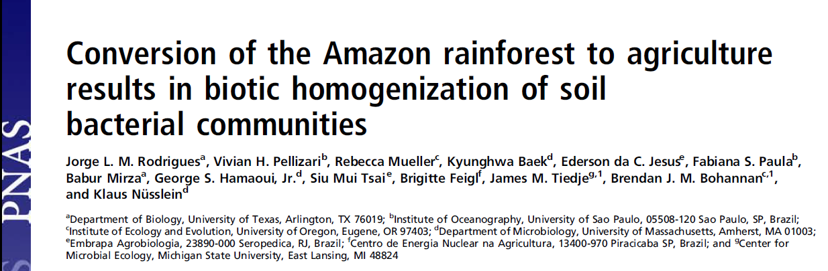
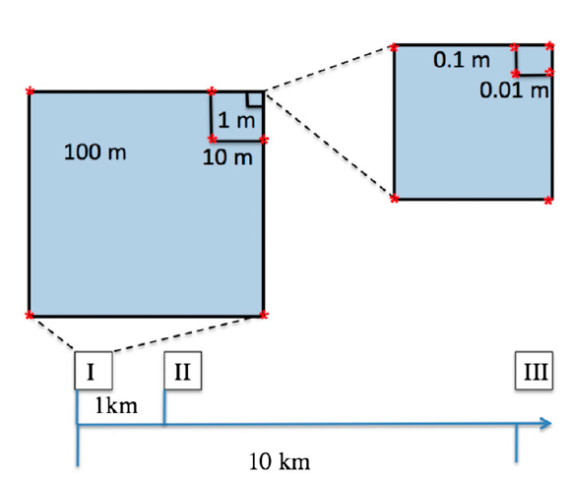
Nested blocks design
Natural forest converted to pastures
Diversity analysis of 16S rRNA data using 454 data with MOTHUR and RDP

Slide 22
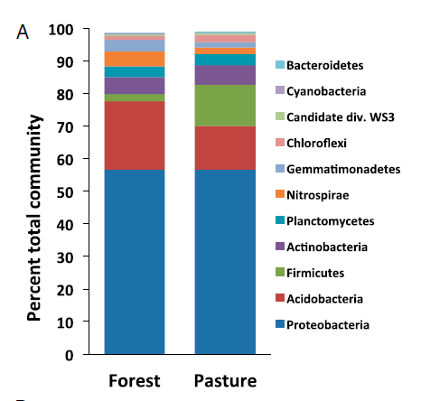
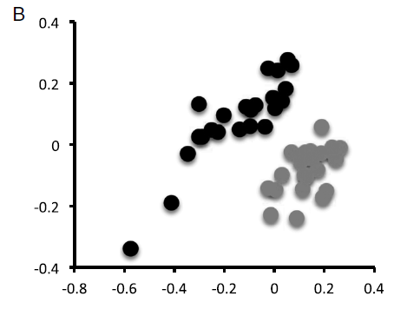
Conversion to agriculture affects the community composition
Forest
Pasture
Classification using representative sequences
NMDS using
Bray-Curtis distances
Notes:
Is this a alpha or beta diversity analysis?

Slide 23
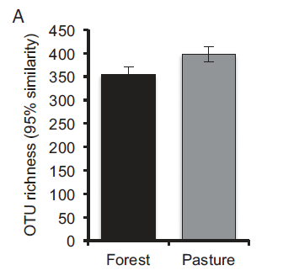
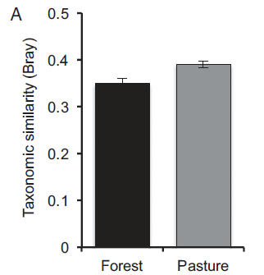
Conversion increases the communities’ diversity
Notes:
Is this a alpha or beta diversity analysis?

Slide 24
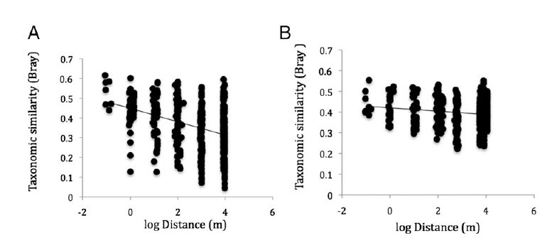
Conversion to agriculture homogenizes the communities
Forest
Pasture
Notes:
Is this a alpha or beta diversity analysis?

Slide 25
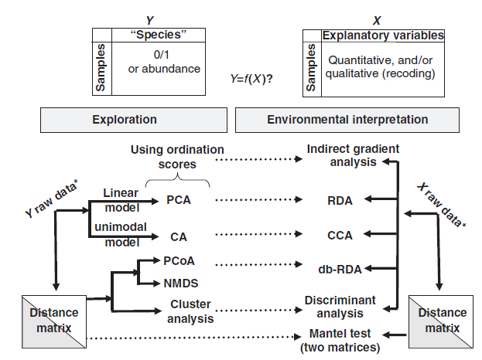
General analysis approach for multivariate data

Slide 26
Resources
Multivariate analysis in microbial ecology [Minireview].
Tree diversity analysis [Book]. (Free, includes R codes).
Available at the workshop repository.
https://github.com/carden24/MIC506-Workshop

Slide 27
Diversity - Summary
The variety and abundance of species in a defined study unit.
Alpha
Within a community (Species diversity in a site or habitat)
Richness, evenness
Chao1, Simpson, Shannon Index
Beta
Among communities (Differentiation of habitats)
Sorensen, Jaccard, Bray-Curtis, Unifrac
Clustering, ordination

Slide 28
FAQs in Microbial ecology
How many different species are in my samples? (Alpha diversity)
What it the diversity of my sample? (Alpha diversity)
How is the microbial community structured? (Alpha diversity)
How novel are my organisms? (Comparison with db)
Where have my organisms been seen before? (Comparison with db)
How similar are the communities of my samples? (Beta diversity, exploratory analysis such as Principal components)
How do the communities changes across this environmental gradient? (Exploration interpretation, gradient analysis such as CCA)
Are communities from treatments X, Y, Z different? (Exploration interpretation, PERMANOVA, ANOSIM)
What organisms differentiate groups A an B? (Exploration interpretation, differential abundance using Deseq, Random forests analysis)

