Slide 1

Mothur MiSeq Processing

Slide 2
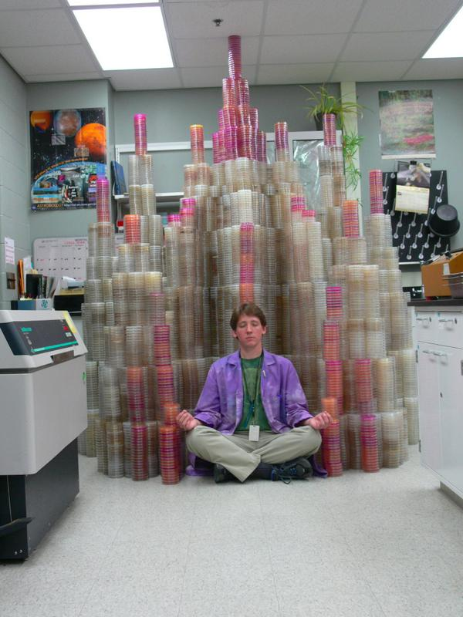

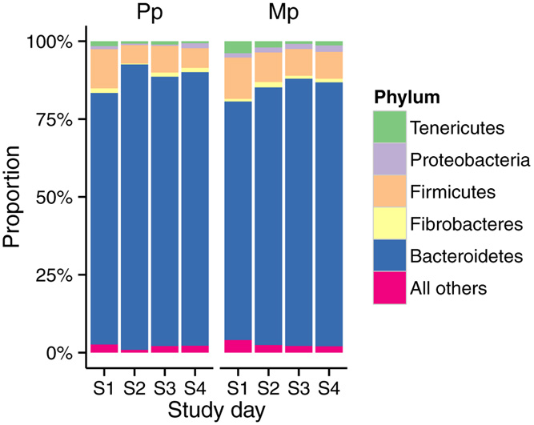
Literature
Experimental
design
Publication
@M00967:43:000000000-A3JHG:1:1101:18278:3345 1:N:0:188
TACGGAGGATGCGAGCGTTATCCGGATTTACTGGGTGTAAAGGGAGCGTAGACGGTGATGCAAGTCTGAAGTGAAAGGCGGGGGCTCAACCCCCGGACTGCTTTGGAAACTGTATGACTGGAGTGCAGGAGAGGTAAGTGGAATTCCTAGTGTAGCGGTGAA
+
ABBBBBBBBFFFGGGGGGGGGGHGGGGGHHHHHHHHGFHHHHHGHGGGGGGGHGGDHGHHHHHHHHHHHHHHHHHHHGHGGGGGGGHHHHHGGGGGGGGHHHHHHHFHHHHHHHHHGHHHHHHHHHHHHEFEGGFFGGGGGGGGGGG
 | OTU1 | OTU2 | OTU3 | OTU4 | OTU5
Sample1 | 20 | 15 | 50 | 10 | 0
Sample2 | 15 | 30 | 35 | 20 | 0
Sample3 | 0 | 12 | 0 | 100 | 0
Sample4 | 0 | 10 | 100 | 0 | 1
Experiment
Analysis
Samples
Data
Sequences

Slide 3

Other practical considerations

Slide 4
Gene matters
Gene | Group targeted | Features
Bacterial 16S rRNA | Bacteria | Not all groups are well amplified
16S rRNA Universal | Bacterial and archaea | Bacteria may be overwhelming, not all groups are well targeted
18S rRNA | Small eukaryotes, fungi | Relevant in aquatic environments, May have host DNA
ITS region 1 | Fungi | Good for environmental fungi, hard to align
ITS region 2 | Fungi | Good for environmental fungi, hard to align
Archaeal 16S rRNA | Archaea | Poor databases
rpoN | Bacterial | More variable than 16S, poor database

Slide 5
Regions matters
Region | Best plattform | Features
V1-V3 (68F-518R) | 454 Titanium, Illumina Miseq V3 | Good resolution for skin Noiser data, smaller overlap
V3-V4 (341F-806R) | 454 Titanium Illumina Miseq V3 | Good resolution for skin Noiser data, smaller overlap
V4 (515F-806R) | Illumina Miseq V2 | Poor resolution and bias for some groups
V6-V7 (967F-1391R) | Early Illumina | Poor information, variable length

Slide 6
DNA extraction matters

Slide 7
Storage condition matters

Slide 9
Conclusion
Ideal
Treatment
Reality
Experimental design
Sampling device
Sample storage
DNA extraction
Sequencing technology
Gene targeted
Variable region

Slide 10
Objectives
Learn how to run mothur with Miseq data.
Understand rationale behind steps.
Used processed data for diversity analysis.

Slide 11


What is mothur
Software to process and analyze microbial community census data
Free, open source
Handles Illumina, 454, Ion Torrent, PacBio data
Incorporates tools from others under one plattform.
Broad user community
Development is based on research
Many custom options
DOTUR
SONS
MOTHUR

Slide 12
Alternatives
QIIME
Multiple programs and scripts
Some different features
Close reference/Open reference OTU picking
DADA2
Based on R
Own error-correction method
Produces amplicon sequence variants (ASV)
ASV = 100% OTU
Easier to integrate

Slide 13
Requirements
A computer Mas/PC/Linux with Mothur installed
Protocol
Documents also here
https://github.com/carden24/2018_Taller_Genomica_ambiental

Slide 14
How can I run mothur?
1. Interactively
Move required files into mothur folder
Initialize mothur
Type commands
2. Batch mode
Prepare plain text script with commands
Execute script with
mothur <script.batch>

Slide 15
Join pairs
Filter seqs
Remove badly aligned
Filter alignment
(Dereplicate)
(Precluster)
(Dereplicate)
Align
Joined Sequences
Raw Sequences
Aligned sequences
Refined alignment
Classify
Remove
Chimeras and contaminants
Phylotypes
Greedy
clustering
Final alignment
Create
matrix
Cluster
split
Distance matrix
+ Classify OTUs
Create table
Cluster
Sites by species table
Clustering result

Slide 16
Join pairs
Filter seqs
Remove badly aligned
Filter alignment
(Dereplicate)
(Precluster)
(Dereplicate)
Align
Joined Sequences
Raw Sequences
Aligned sequences
Refined alignment
Classify
Remove
Chimeras and contaminants
Phylotypes
Greedy
clustering
Final alignment
Create
matrix
Cluster
split
Distance matrix
+ Classify OTUs
Create table
Cluster
Sites by species table
Clustering result

Slide 17
Pipeline
Sequencing files
(Pairs of fastq files
per sample)
Script
(Instructions)
<.batch>
List of files
<.files>
Master alignment
<.fasta>
Taxonomic scheme

Slide 18
stability.files
Sample
Pair1
Pair2
F3D0 | F3D0_S188_L001_R1_001.fastq | F3D0_S188_L001_R2_001.fastq
F3D141 | F3D141_S207_L001_R1_001.fastq | F3D141_S207_L001_R2_001.fastq
F3D142 | F3D142_S208_L001_R1_001.fastq | F3D142_S208_L001_R2_001.fastq
F3D143 | F3D143_S209_L001_R1_001.fastq | F3D143_S209_L001_R2_001.fastq
F3D144 | F3D144_S210_L001_R1_001.fastq | F3D144_S210_L001_R2_001.fastq
F3D145 | F3D145_S211_L001_R1_001.fastq | F3D145_S211_L001_R2_001.fastq
F3D146 | F3D146_S212_L001_R1_001.fastq | F3D146_S212_L001_R2_001.fastq
F3D147 | F3D147_S213_L001_R1_001.fastq | F3D147_S213_L001_R2_001.fastq
F3D148 | F3D148_S214_L001_R1_001.fastq | F3D148_S214_L001_R2_001.fastq
F3D149 | F3D149_S215_L001_R1_001.fastq | F3D149_S215_L001_R2_001.fastq
F3D150 | F3D150_S216_L001_R1_001.fastq | F3D150_S216_L001_R2_001.fastq
F3D1 | F3D1_S189_L001_R1_001.fastq | F3D1_S189_L001_R2_001.fastq
F3D2 | F3D2_S190_L001_R1_001.fastq | F3D2_S190_L001_R2_001.fastq
F3D3 | F3D3_S191_L001_R1_001.fastq | F3D3_S191_L001_R2_001.fastq
F3D5 | F3D5_S193_L001_R1_001.fastq | F3D5_S193_L001_R2_001.fastq
F3D6 | F3D6_S194_L001_R1_001.fastq | F3D6_S194_L001_R2_001.fastq
F3D7 | F3D7_S195_L001_R1_001.fastq | F3D7_S195_L001_R2_001.fastq
F3D8 | F3D8_S196_L001_R1_001.fastq | F3D8_S196_L001_R2_001.fastq
F3D9 | F3D9_S197_L001_R1_001.fastq | F3D9_S197_L001_R2_001.fastq
Mock | Mock_S280_L001_R1_001.fastq | Mock_S280_L001_R2_001.fastq

Slide 19
Contents of stability.batch
 |  | pcr.seqs(fasta=silva.bacteria.fasta, start=11894, end=25319, keepdots=F)
 |  | rename.file(input=silva.bacteria.pcr.fasta, new=silva.v4.fasta)
 |  | make.contigs(file=stability.files, processors=2)
 |  | screen.seqs(fasta=current, group=current, summary=current, maxambig=0, maxlength=275)
 |  | unique.seqs(fasta=current)
 |  | count.seqs(name=current, group=current)
 |  | align.seqs(fasta=current, reference=silva.v4.fasta)
 |  | screen.seqs(fasta=current, count=current, start=1968, end=11550, maxhomop=8)
 |  | filter.seqs(fasta=current, vertical=T, trump=.)
 |  | unique.seqs(fasta=current, count=current)
 |  | pre.cluster(fasta=current, count=current, diffs=2)
 |  | chimera.vsearch(fasta=current, count=current, dereplicate=t)
 |  | remove.seqs(fasta=current, accnos=current)
 |  | classify.seqs(fasta=current, count=current, reference=trainset14_032015.pds.fasta, taxonomy=trainset14_032015.pds.tax, cutoff=80)
 |  | remove.lineage(fasta=current, count=current, taxonomy=current, taxon=Chloroplast-Mitochondria-unknown-Archaea-Eukaryota)
 |  | cluster.split(fasta=current, count=current, taxonomy=current, splitmethod=classify, taxlevel=4, cutoff=0.03)
 |  | make.shared(list=current, count=current, label=0.03)
 |  | classify.otu(list=current, count=current, taxonomy=current, label=0.03);
Quality control step
Reducing computational stress step

Slide 20
Quality control and noise reduction I
Joining overlapping reads
Correct bases call using best information possible
Remove host sequences
Mitochondria
Chloroplast
Remove non-target sequences
Eukarya
Archaea

Slide 21
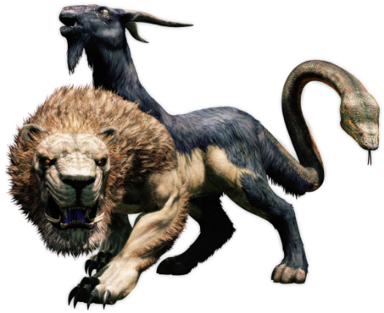
Quality control and noise reduction II
Remove PCR artifacts
Chimeras
Non-specific targets
Sequences too long or too short

Slide 22
Quality control and noise reduction III
Pre-clustering

Slide 23
Alignment and DBs
Results depend on the DBs used
Silva is considered the best alignment, Greengenes is bad.
Greengenes taxonomy is the best, not updated
RDP is very conservative
Check the standards in your field first
You can create your own database

Slide 24
Summary
Results are tool-dependent
All tools are wrong, some tools are useful.

