Slide 1

Microbial community analysis using Mothur

Slide 2
Amplicon sequencing
Alpha/beta diversity
Mothur/QIIME/DADA2
Linux

Slide 3
FAQs in Microbial ecology
How many different species are in my samples?
What it the diversity of my sample?
How is the microbial community structured?
How novel are my organisms?
Where have my organisms been seen before?
How similar are the communities of my samples?
How do communities changes across this environmental gradient?
Are communities from treatments X, Y, Z different?
What organisms differentiate groups A and B?

Slide 4
Workshop structure
Session 1: Diversity review.
Session 2: How to work with 16S rRNA data.
Session 3: Hands on session with mothur using Miseq data.
Material available at:
https://github.com/carden24/2018_Taller_Genomica_ambiental/
Files required for computer session.
Other learning resources.

Slide 5
Objetives
By the end of workshop you will be able to:
1.1 Distinguish between alpha and beta diversity.
1.2 Estimate diversity indices

Slide 6
Diversity, definitions
Biodiversity:
Totality of genes, species and ecosystems of a region
Magurran:
The variety and abundance of species in a defined study unit.
Alpha diversity:
Diversity in a spatial unit
Within community
Beta diversity
A measurement of how two or more spatial units differ
Among communities

Slide 7
Alpha diversity
Richness (S): How many different species exist.
Evenness: How similar are the species in their abundnace.
=
>
Richness
Evenness
=
<

Slide 8
Alpha diversity indices
A metric that considers one or more diversity components
Shannon (H’)
Simpson (D)
Chao1

Slide 9
Shannon diversity index (H’)
Proportion of the community contributed by species i
Number of species

Slide 10
Shannon’s index limits
Range : 0 - ∞
Heavily influenced by richness

Slide 11
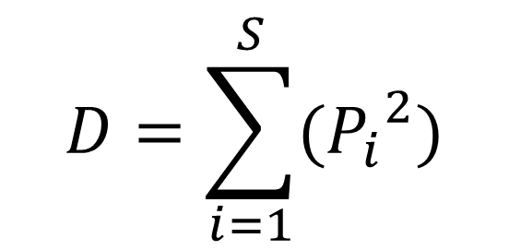
Simpson’s index (D)
Proportion of the community contributed by species i
Number of species
$$D=\sum_{i=1}^{S}{({P_{i}}_{}^{2})}$$
Probability of selecting the same species when sampling two members at random the same

Slide 12
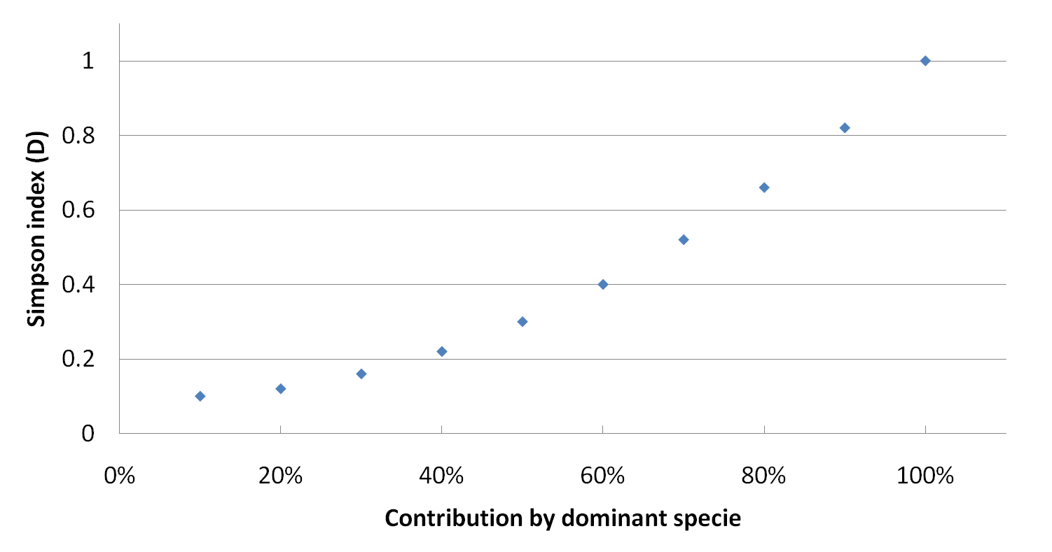
Simpson’s index (D)
Range : < 0 – 1 ]
Strongly influenced by evenness.
Usually expressed as (1-D) - more intuitive.
Contribution by dominant species

Slide 13
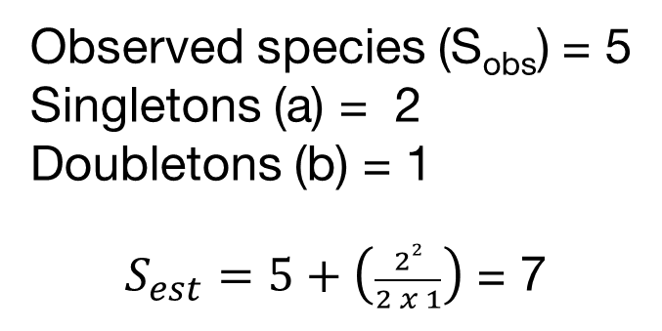
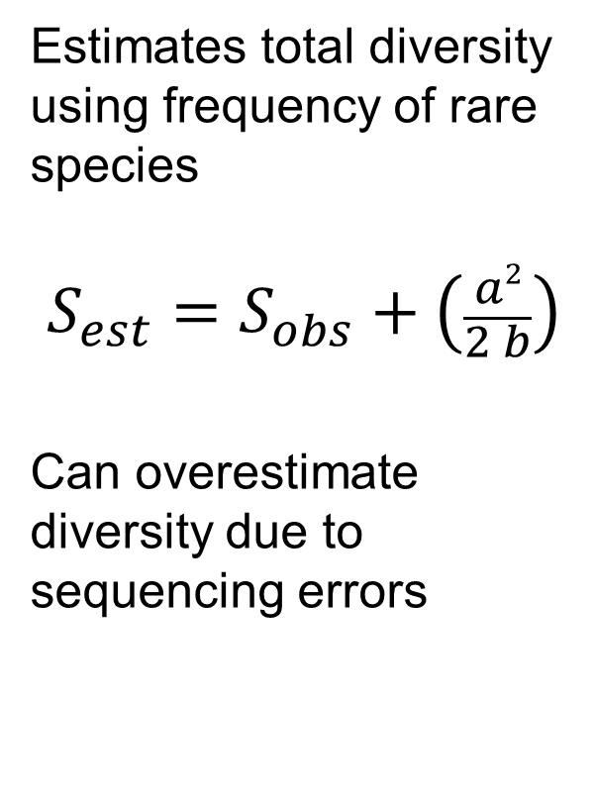
Chao1index
Estimates total diversity using frequency of rare species
$$S_{est}=S_{obs}+\left(\frac{a2}{2 b}\right)$$
Can overestimate diversity due to sequencing errors
Observed species (S_{obs}) = 5
Singletons (a) = 2
Doubletons (b) = 1
$S_{est}=5+\left(\frac{22}{2 x 1}\right)$ = 7

Slide 14
Simpson evenness index
(1/D)
Limits 1/S - S
Dominant species contribution

Slide 15
Rank-Abundance curves
Show both richness and evenness
Steep slopes suggest strong selective pressure
Curves can indicate distribution of resources
Species in order of abundance

Slide 16
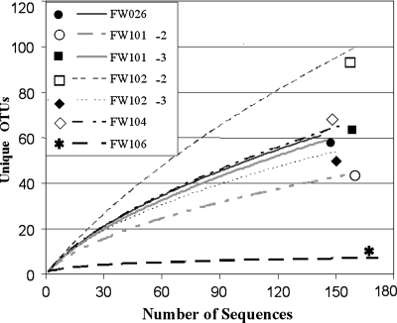
Rarefaction curves
Used to compare diversity when sampling was done at different levels.
Sometimes used to estimate if coverage has reached a plateau.
Are only informative when saturated.

Slide 17
Beta diversity indices
Quantify diversity among communities
Range: 0 – 1
0 = 100% similarity, 0% distance
1 = 0% similarity, 100% distance
Can use abundance and occurrence
Commonly used indices
Jaccard (Occ.)
Sørensen (Occ.)
Bray-Curtis (Occ. + Ab.)
Chao-Sørensen (Occ. + Ab.)

Slide 18
Presence/absences indices
a
b
c
Sample 1
Sample 2
Jaccard = b / (a+b+c)
Sorensen (QS) = 2b /(a+2b+c))
More weight to shared species

Slide 19

Indices using both abundance and occurrence
Bray -Curtis
Chao-Sorensen
Considers both abundance and assumes suboptimal sampling.
Absolute differences in abundance for i in samples j and k
$$d_{jk}=\frac{\sum_{i}^{s}{\left|x_{ij} −x_{ik}\right|}}{\sum_{i}^{s}{\left(x_{ij} −x_{ik}\right)}}$$
Sum of abundance for
i in samples j and k

Slide 20
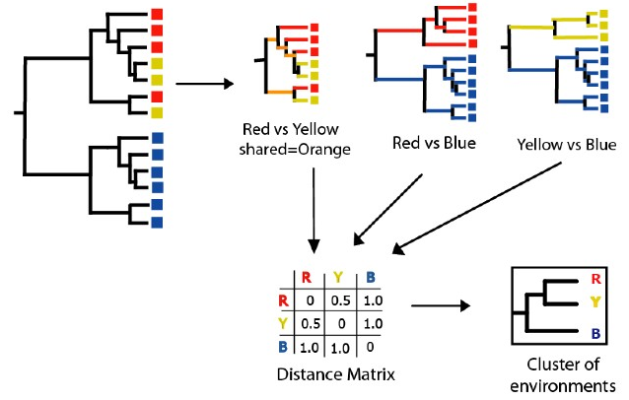
Tree-based indices
UNIFRAC
Based on phylogenetic diversity.
Useful when comparing very different environments with few common species.

Slide 21
How to present beta diversity
 | Sp1 | Sp2 | Sp3 | Sp4 | Sp
Sample1 | 20 | 15 | 50 | 10 | 0
Sample2 | 15 | 30 | 35 | 20 | 0
Sample3 | 0 | 12 | 0 | 100 | 0
Sample4 | 0 | 10 | 100 | 0 | 1
Create a table:
Samples (rows)
x Species (cols)
Create a
Distance matrix
0.32
Sample 4
0.16
Coordinate 2
Sample 3
 | Sample1 | Sample2 | Sample3 | Sample4
Sample1 | 0.000 | 0.231 | 0.787 | 0.417
Sample2 | 0.231 | 0.000 | 0.698 | 0.573
Sample3 | 0.787 | 0.698 | 0.000 | 0.910
Sample4 | 0.417 | 0.573 | 0.910 | 0.00
0.00
Sample 1
-0.16
-0.32
Sample 2
-0.80
-0.48
-0.16
0.16
0.48
Coordinate 1
Sample 4
Sample 2
Sample 1
Create a clustering tree or ordination
Sample 3
0.2
0.3
0.4
0.5
0.6
0.7
0.8
0.9
1.0
Bray-Curtis similarity

Slide 22
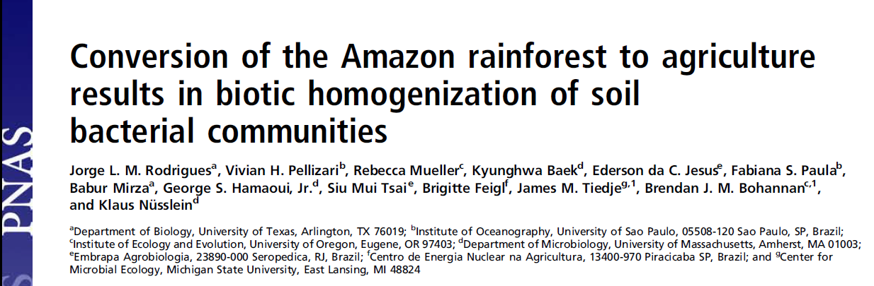
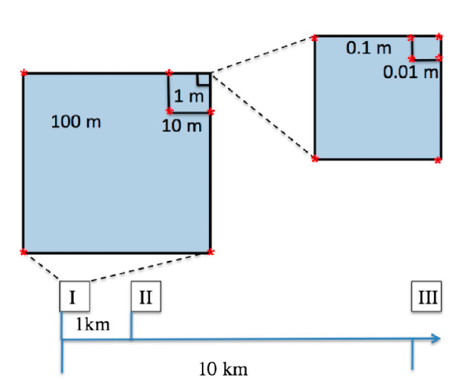
Nested blocks design
Natural forest converted to pastures
Diversity analysis of 16S rRNA data using 454 data with MOTHUR and RDP

Slide 23
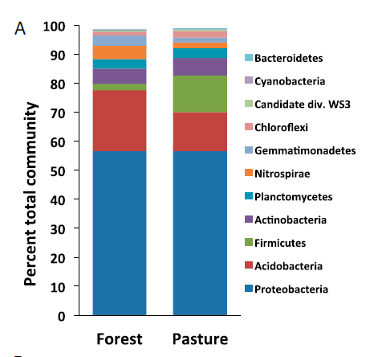
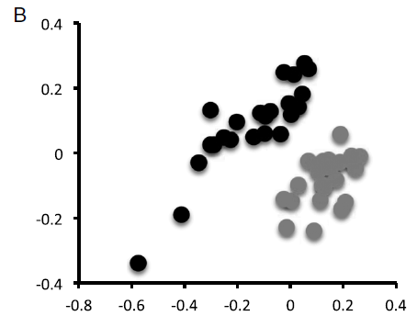
Conversion to agriculture affects the community composition
Forest
Pasture
Classification using representative sequences
NMDS using
Bray-Curtis distances
Notes:
Is this a alpha or beta diversity analysis?

Slide 24
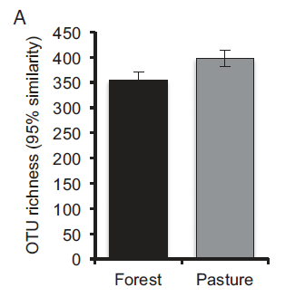
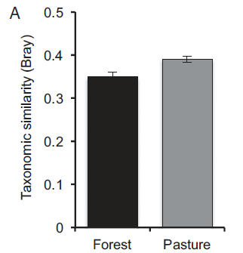
Conversion increases the communities’ diversity
Notes:
Is this a alpha or beta diversity analysis?

Slide 25
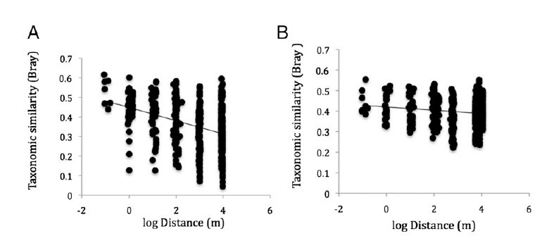
Conversion to agriculture homogenizes the communities
Forest
Pasture
Notes:
Is this a alpha or beta diversity analysis?

Slide 26
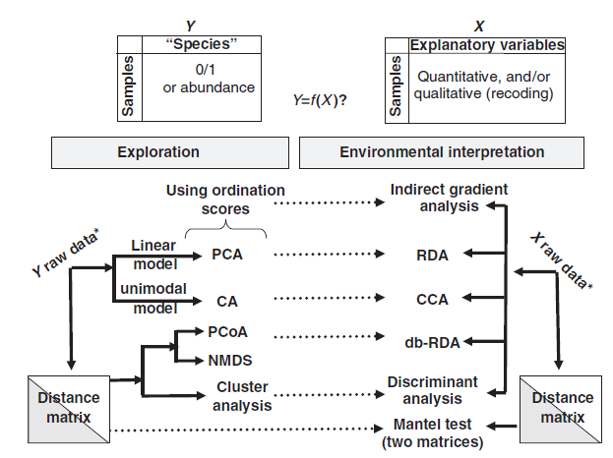
General analysis approach for multivariate data

Slide 27
FAQs in Microbial ecology
How many different species are in my samples? (Alpha diversity)
What it the diversity of my sample? (Alpha diversity)
How is the microbial community structured? (Alpha diversity)
How novel are my organisms? (Comparison with db)
Where have my organisms been seen before? (Comparison with db)
How similar are the communities of my samples? (Beta diversity, exploratory analysis such as NMDS)
How do communities changes across this environmental gradient? (Exploration interpretation, gradient analysis such as CCA)
Are communities from treatments X, Y, Z different? (Exploration interpretation, PERMANOVA, ANOSIM)
What organisms differentiate groups A and B? (Exploration interpretation, differential abundance using Deseq, Random forests analysis)

Slide 28
Learning mothur
Learn how to run mothur with Miseq data.
Understand rationale behind steps.
Used processed data for diversity analysis.

Slide 29


What is mothur
Software to process and analyze microbial community census data
Free, open source
Handles Illumina, 454, Ion Torrent, PacBio data
Incorporates tools from others under one plattform.
Broad user community
Development is based on research
Many custom options
DOTUR
SONS
MOTHUR

Slide 30
Alternatives
QIIME
Multiple programs and scripts
Some different features
Close reference/Open reference OTU picking
DADA2
Based on R
Own error-correction method
Produces amplicon sequence variants (ASV)
ASV = 100% OTU
Easier to integrate

Slide 31
Requirements
A computer Mas/PC/Linux with Mothur installed
Protocol
Documents also here
https://github.com/carden24/BCREGMEGD_Microbiome_sequencing_workshop_2020

Slide 32
How can I run mothur?
1. Interactively
Move required files into mothur folder
Initialize mothur
Type commands
2. Batch mode
Prepare plain text script with commands
Execute script with
mothur <script.batch>

Slide 33
Join pairs
Filter seqs
Remove badly aligned
Filter alignment
(Dereplicate)
(Precluster)
(Dereplicate)
Align
Joined Sequences
Raw Sequences
Aligned sequences
Refined alignment
Classify
Remove
Chimeras and contaminants
Phylotypes
Greedy
clustering
Final alignment
Create
matrix
Cluster
split
Distance matrix
+ Classify OTUs
Create table
Cluster
Sites by species table
Clustering result

Slide 34
Join pairs
Filter seqs
Remove badly aligned
Filter alignment
(Dereplicate)
(Precluster)
(Dereplicate)
Align
Joined Sequences
Raw Sequences
Aligned sequences
Refined alignment
Classify
Remove
Chimeras and contaminants
Phylotypes
Greedy
clustering
Final alignment
Create
matrix
Cluster
split
Distance matrix
Create table
Cluster
Sites by species table
Clustering result

Slide 35
Pipeline
Sequencing files
(Pairs of fastq files
per sample)
Script
(Instructions)
<.batch>
List of files
<.files>
Master alignment
<.fasta>
Taxonomic scheme

Slide 36
stability.files
Sample
Pair1
Pair2
F3D0 | F3D0_S188_L001_R1_001.fastq | F3D0_S188_L001_R2_001.fastq
F3D141 | F3D141_S207_L001_R1_001.fastq | F3D141_S207_L001_R2_001.fastq
F3D142 | F3D142_S208_L001_R1_001.fastq | F3D142_S208_L001_R2_001.fastq
F3D143 | F3D143_S209_L001_R1_001.fastq | F3D143_S209_L001_R2_001.fastq
F3D144 | F3D144_S210_L001_R1_001.fastq | F3D144_S210_L001_R2_001.fastq
F3D145 | F3D145_S211_L001_R1_001.fastq | F3D145_S211_L001_R2_001.fastq
F3D146 | F3D146_S212_L001_R1_001.fastq | F3D146_S212_L001_R2_001.fastq
F3D147 | F3D147_S213_L001_R1_001.fastq | F3D147_S213_L001_R2_001.fastq
F3D148 | F3D148_S214_L001_R1_001.fastq | F3D148_S214_L001_R2_001.fastq
F3D149 | F3D149_S215_L001_R1_001.fastq | F3D149_S215_L001_R2_001.fastq
F3D150 | F3D150_S216_L001_R1_001.fastq | F3D150_S216_L001_R2_001.fastq
F3D1 | F3D1_S189_L001_R1_001.fastq | F3D1_S189_L001_R2_001.fastq
F3D2 | F3D2_S190_L001_R1_001.fastq | F3D2_S190_L001_R2_001.fastq
F3D3 | F3D3_S191_L001_R1_001.fastq | F3D3_S191_L001_R2_001.fastq
F3D5 | F3D5_S193_L001_R1_001.fastq | F3D5_S193_L001_R2_001.fastq
F3D6 | F3D6_S194_L001_R1_001.fastq | F3D6_S194_L001_R2_001.fastq
F3D7 | F3D7_S195_L001_R1_001.fastq | F3D7_S195_L001_R2_001.fastq
F3D8 | F3D8_S196_L001_R1_001.fastq | F3D8_S196_L001_R2_001.fastq
F3D9 | F3D9_S197_L001_R1_001.fastq | F3D9_S197_L001_R2_001.fastq
Mock | Mock_S280_L001_R1_001.fastq | Mock_S280_L001_R2_001.fastq

Slide 37
Contents of stability.batch
 |  | pcr.seqs(fasta=silva.bacteria.fasta, start=11894, end=25319, keepdots=F)
 |  | rename.file(input=silva.bacteria.pcr.fasta, new=silva.v4.fasta)
 |  | make.contigs(file=stability.files, processors=2)
 |  | screen.seqs(fasta=current, group=current, summary=current, maxambig=0, maxlength=275)
 |  | unique.seqs(fasta=current)
 |  | count.seqs(name=current, group=current)
 |  | align.seqs(fasta=current, reference=silva.v4.fasta)
 |  | screen.seqs(fasta=current, count=current, start=1968, end=11550, maxhomop=8)
 |  | filter.seqs(fasta=current, vertical=T, trump=.)
 |  | unique.seqs(fasta=current, count=current)
 |  | pre.cluster(fasta=current, count=current, diffs=2)
 |  | chimera.vsearch(fasta=current, count=current, dereplicate=t)
 |  | remove.seqs(fasta=current, accnos=current)
 |  | classify.seqs(fasta=current, count=current, reference=trainset14_032015.pds.fasta, taxonomy=trainset14_032015.pds.tax, cutoff=80)
 |  | remove.lineage(fasta=current, count=current, taxonomy=current, taxon=Chloroplast-Mitochondria-unknown-Archaea-Eukaryota)
 |  | cluster.split(fasta=current, count=current, taxonomy=current, splitmethod=classify, taxlevel=4, cutoff=0.03)
 |  | make.shared(list=current, count=current, label=0.03)
 |  | classify.otu(list=current, count=current, taxonomy=current, label=0.03);
Quality control step
Reducing computational stress step

Slide 38
Quality control and noise reduction I
Joining overlapping reads
Correct bases call using best information possible
Remove host sequences
Mitochondria
Chloroplast
Remove non-target sequences
Eukarya
Archaea

Slide 39
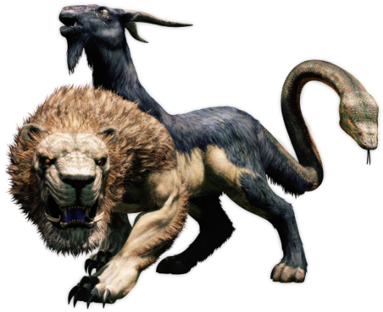
Quality control and noise reduction II
Remove PCR artifacts
Chimeras
Non-specific targets
Sequences too long or too short

Slide 40
Quality control and noise reduction III
Pre-clustering

Slide 41
Alignment and DBs
Results depend on the DBs used
Silva is considered the best alignment, Greengenes is bad.
Greengenes taxonomy is the best, not updated
RDP has a very conservative taxonomy
Check the standards in your field first
You can create your own database

Slide 42
Summary
Results are tool-dependent
All tools are wrong, some tools are useful.
https://github.com/carden24/BCREGMEGD_Microbiome_sequencing_workshop_2020
shorturl.at/afrEK

Slide 43
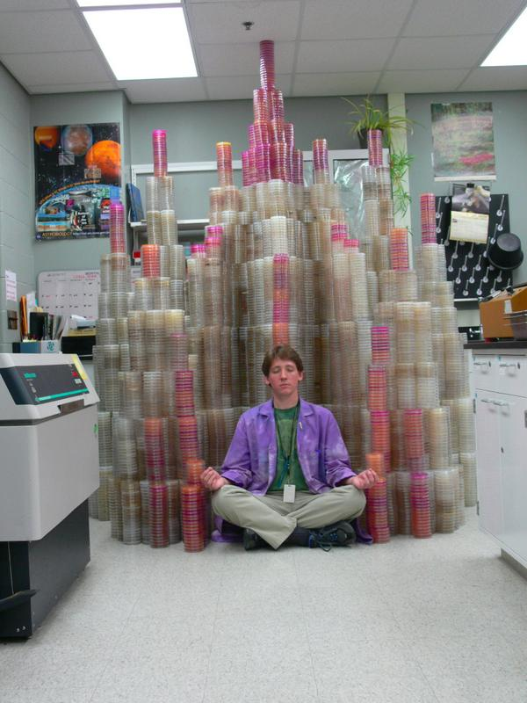

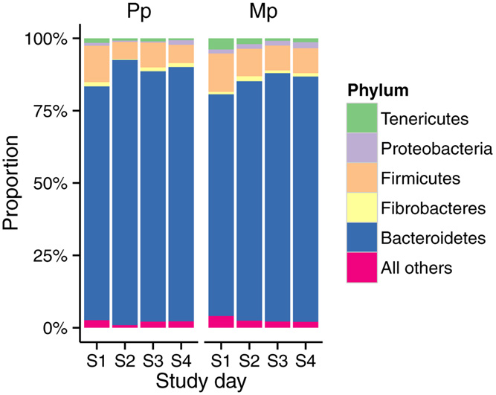
Literature
Experimental
design
Publication
@M00967:43:000000000-A3JHG:1:1101:18278:3345 1:N:0:188
TACGGAGGATGCGAGCGTTATCCGGATTTACTGGGTGTAAAGGGAGCGTAGACGGTGATGCAAGTCTGAAGTGAAAGGCGGGGGCTCAACCCCCGGACTGCTTTGGAAACTGTATGACTGGAGTGCAGGAGAGGTAAGTGGAATTCCTAGTGTAGCGGTGAA
+
ABBBBBBBBFFFGGGGGGGGGGHGGGGGHHHHHHHHGFHHHHHGHGGGGGGGHGGDHGHHHHHHHHHHHHHHHHHHHGHGGGGGGGHHHHHGGGGGGGGHHHHHHHFHHHHHHHHHGHHHHHHHHHHHHEFEGGFFGGGGGGGGGGG
 | OTU1 | OTU2 | OTU3 | OTU4 | OTU5
Sample1 | 20 | 15 | 50 | 10 | 0
Sample2 | 15 | 30 | 35 | 20 | 0
Sample3 | 0 | 12 | 0 | 100 | 0
Sample4 | 0 | 10 | 100 | 0 | 1
Experiment
Analysis
Samples
Data
Sequences

Slide 44

Other practical considerations

Slide 45
Gene matters
Gene | Group targeted | Features
Bacterial 16S rRNA | Bacteria | Not all groups are well amplified
16S rRNA Universal | Bacterial and archaea | Bacteria may be overwhelming, not all groups are well targeted
18S rRNA | Small eukaryotes, fungi | Relevant in aquatic environments, May have host DNA
ITS region 1 | Fungi | Good for environmental fungi, hard to align
ITS region 2 | Fungi | Good for environmental fungi, hard to align
Archaeal 16S rRNA | Archaea | Poor databases
rpoN | Bacterial | More variable than 16S, poor database

Slide 46
Regions matters
Region | Best plattform | Features
V1-V3 (68F-518R) | 454 Titanium, Illumina Miseq V3 | Good resolution for skin Noiser data, smaller overlap
V3-V4 (341F-806R) | 454 Titanium Illumina Miseq V3 | Good resolution for skin Noiser data, smaller overlap
V4 (515F-806R) | Illumina Miseq V2 | Poor resolution and bias for some groups
V6-V7 (967F-1391R) | Early Illumina | Poor information, variable length

Slide 47
DNA extraction matters

Slide 48
Storage condition matters

Slide 50
Conclusion
Ideal
Treatment
Reality
Experimental design
Sampling device
Sample storage
DNA extraction
Sequencing technology
Gene targeted
Variable region

