Slide 1
Análisis de comunidades microbianas
Erick Cardenas Poire
University of British Columbia

Slide 2
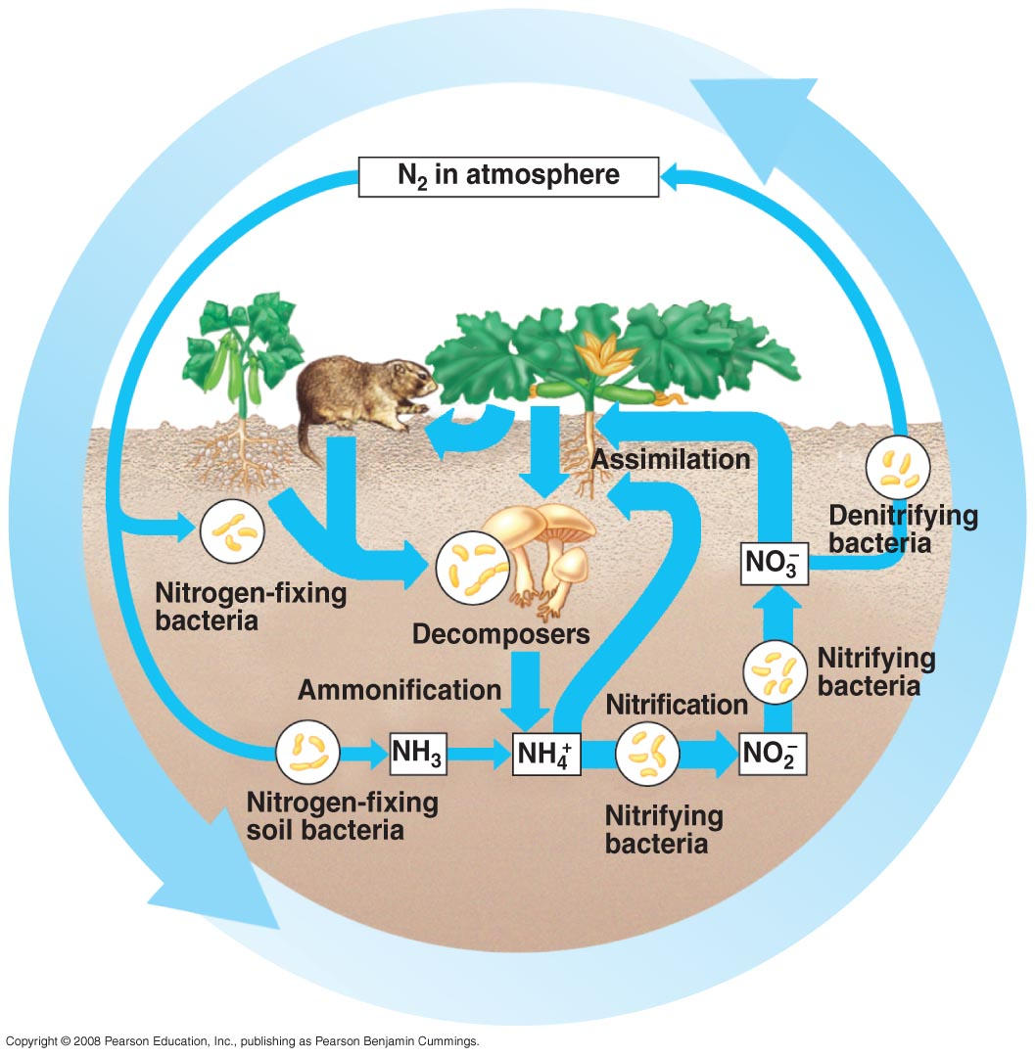
Why is this course relevant?
1. Microbes have important roles in biology
Microbes are key players in biogeochemical cycles
Microbes show great metabolic diversity
Biotechnological potential
http://apbiosemonefinalreview.pbworks.com/f/55_14cNitrogenCycle-L.jpg

Slide 3
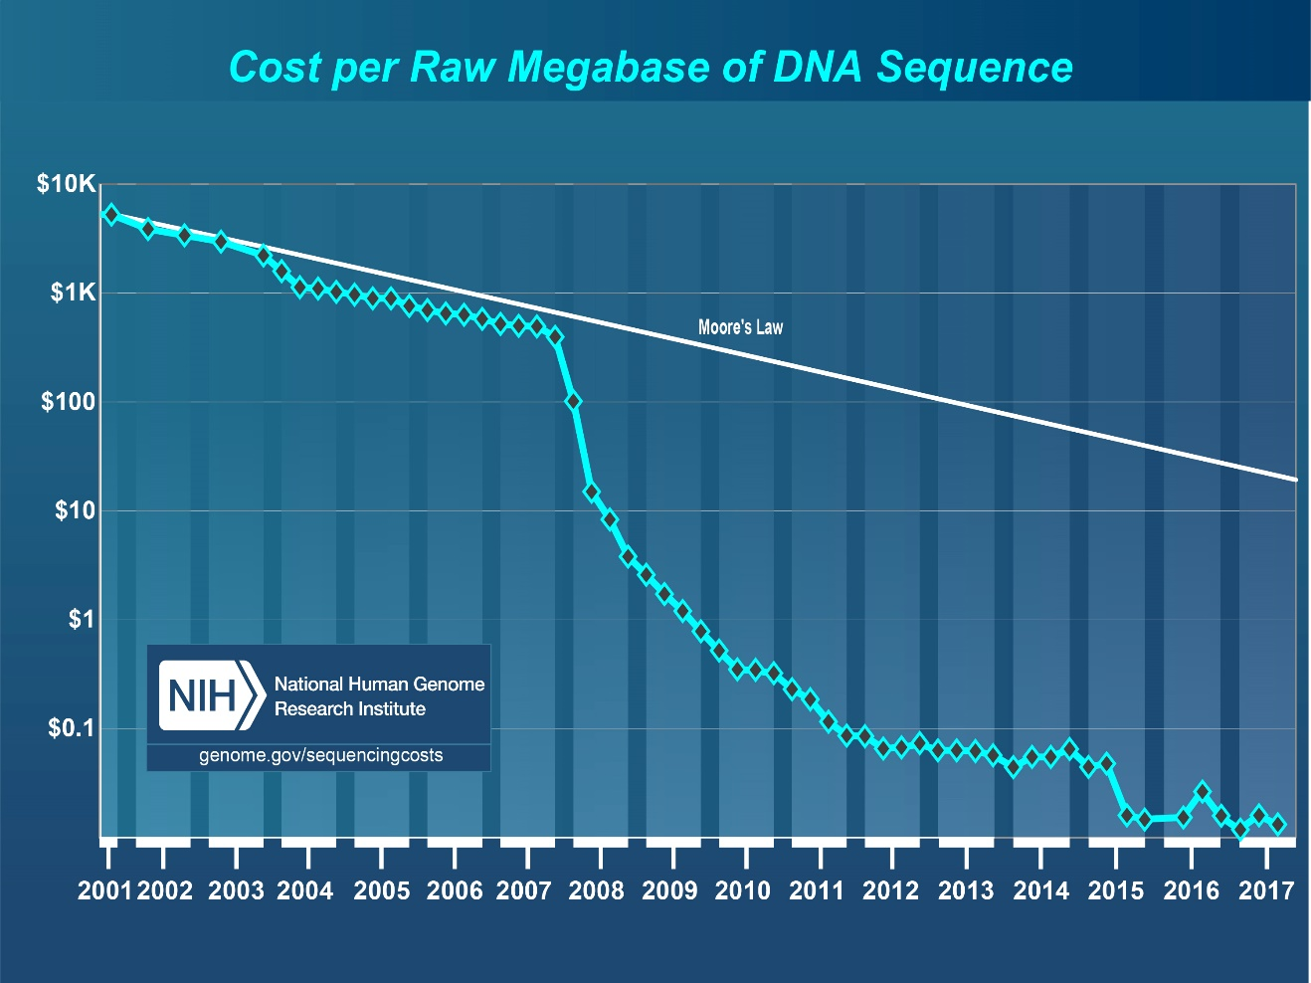
Why is this course relevant?
2. Sequencing has become cheaper and more with massive outputs

Slide 4
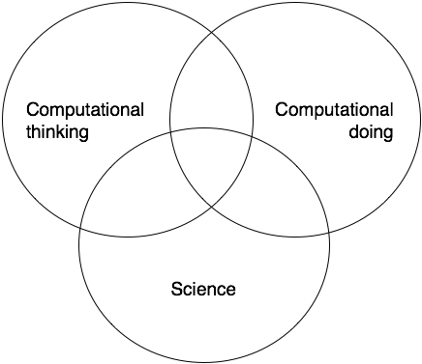
Why is this course relevant?
3. The limiting steps has moved to data analysis
Good computational scientist are needed
Does the computation work as intended?
Does it address the scientific question?
Does it answer the question?
Does the answer make sense?
Would we be able to tell if the answer was right?

Slide 5
Why is this course relevant?
4. Bioinformatics is becoming an important part of biology
General knowledge
What is possible?
Limitations of techniques
How can we use it for my research?
Critical thinking when reviewing bioinformatics work

Slide 6
FAQs in Microbial ecology
How many different species are in my samples?
What it the diversity of my sample?
How is the microbial community structured?
How novel are my organisms?
Where have my organisms been seen before?
How similar are the communities of my samples?
How do the communities changes across this environmental gradient?
Are communities from treatments X, Y, Z different?
What organisms differentiate groups A an B?

Slide 7
Workshop structure
Session 1: Diversity review.
Session 2: How to work with 16S rRNA data.
Session 3: Hands on session with mothur using Miseq data.
Material available at:
https://github.com/carden24/2018_Taller_Genomica_ambiental/
Files required for computer session.
Other learning resources.

Slide 8
Objetives
By the end of workshop you will be able to:
1.1 Distinguish between alpha and beta diversity.
1.2 Estimate diversity indices

Slide 9
Diversity, definitions
Biodiversity:
Totality of genes, species and ecosystems of a region
Magurran:
The variety and abundance of species in a defined study unit.
Alpha diversity:
Diversity in a spatial unit
Within community
Beta diversity
A measurement of how two or more spatial units differ
Among communities

Slide 10
Alpha diversity
Richness (S): How many different species exist.
Evenness: How similar are the species in their abundnace.
=
>
Richness
Evenness
=
<

Slide 11
Alpha diversity indices
A metric that considers one or more diversity components
Shannon (H’)
Simpson (D)
Chao1

Slide 12
Shannon diversity index (H’)
Proportion of the community contributed by species i
Number of species

Slide 13
Shannon’s index limits
Range : 0 - ∞
Heavily influenced by richness

Slide 14
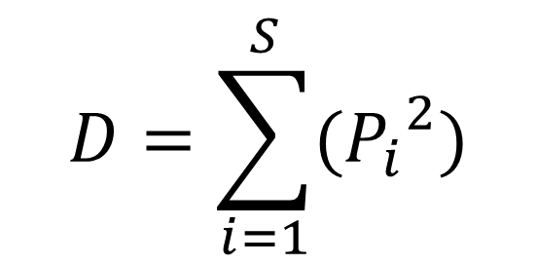
Simpson’s index (D)
Proportion of the community contributed by species i
Number of species
$$D=\sum_{i=1}^{S}{({P_{i}}_{}^{2})}$$
Probability of selecting the same species when sampling two members at random the same

Slide 15
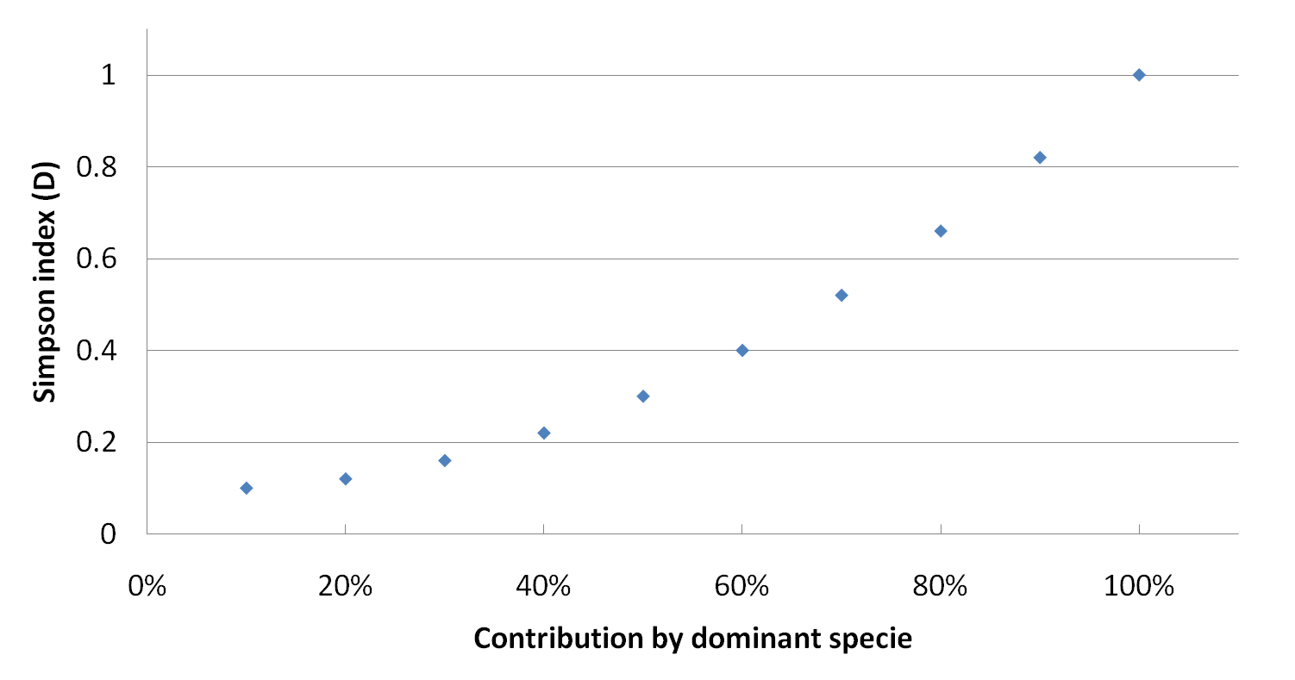
Simpson’s index (D)
Range : < 0 – 1 ]
Strongly influenced by evenness.
Usually expressed as (1-D) - more intuitive.
Contribution by dominant species

Slide 16
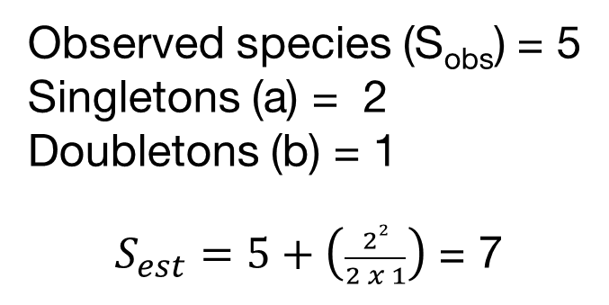
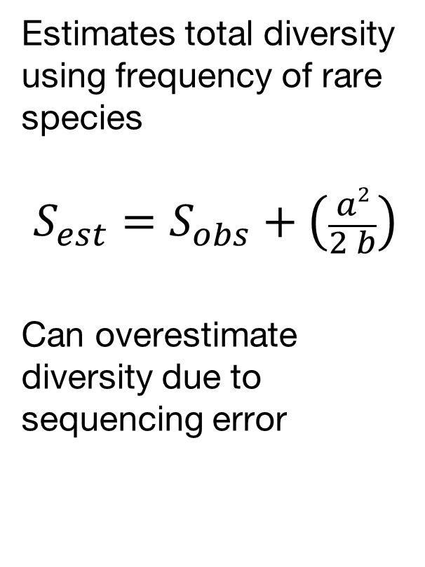
Chao1index
Estimates total diversity using frequency of rare species
$$S_{est}=S_{obs}+\left(\frac{a2}{2 b}\right)$$
Can overestimate diversity due to sequencing error
Observed species (S_{obs}) = 5
Singletons (a) = 2
Doubletons (b) = 1
$S_{est}=5+\left(\frac{22}{2 x 1}\right)$ = 7

Slide 17
Simpson evenness index
(1/D)
Limits 1/S - S
Dominant species contribution

Slide 18
Rank-Abundance curves
Show both richness and evenness
Steep slopes suggest strong selective pressure
Curves can indicate distribution of resources
Species in order of abundance

Slide 19
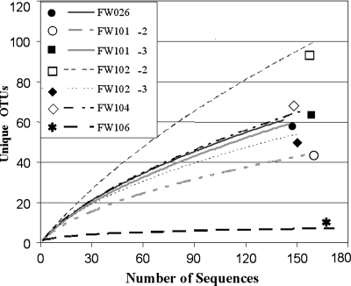
Rarefaction curves
Used to compare diversity when sampling was done at different levels.
Sometimes used to estimate if coverage has reached a plateau.
Are only informative when saturated.

Slide 20
Beta diversity indices
Quantify diversity among communities
Range: 0 – 1
0 = 100% similarity, 0% distance
1 = 0% similarity, 100% distance
Can use abundance and occurrence
Commonly used indices
Jaccard (Occ.)
Sørensen (Occ.)
Bray-Curtis (Occ. + Ab.)
Chao-Sørensen (Occ. + Ab.)

Slide 21
Presence/absences indices
a
b
c
Sample 1
Sample 2
Jaccard = b / (a+b+c)
Sorensen (QS) = 2b /(a+2b+c))
More weight to shared species

Slide 22

Indices using both abundance and occurrence
Bray -Curtis
Chao-Sorensen
Considers both abundance and assumes suboptimal sampling.
Absolute differences in abundance for i in samples j and k
$$d_{jk}=\frac{\sum_{i}^{s}{\left|x_{ij} −x_{ik}\right|}}{\sum_{i}^{s}{\left(x_{ij} −x_{ik}\right)}}$$
Sum of abundance for
i in samples j and k

Slide 23
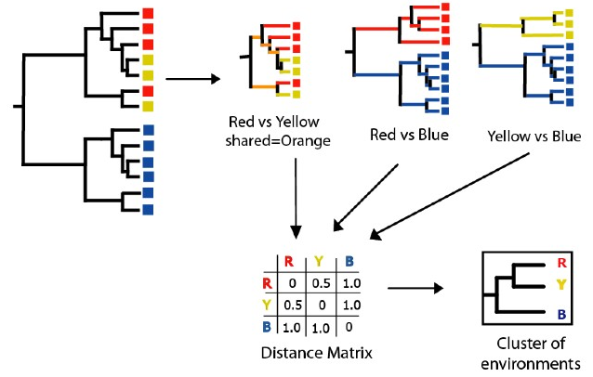
Tree-based indices
UNIFRAC
Based on phylogenetic diversity.
Useful when comparing very different environments with few common species.

Slide 24
How to present beta diversity
 | Sp1 | Sp2 | Sp3 | Sp4 | Sp
Sample1 | 20 | 15 | 50 | 10 | 0
Sample2 | 15 | 30 | 35 | 20 | 0
Sample3 | 0 | 12 | 0 | 100 | 0
Sample4 | 0 | 10 | 100 | 0 | 1
Create a table:
Samples (rows)
x Species (cols)
Create a
Distance matrix
0.32
Sample 4
0.16
Coordinate 2
Sample 3
 | Sample1 | Sample2 | Sample3 | Sample4
Sample1 | 0.000 | 0.231 | 0.787 | 0.417
Sample2 | 0.231 | 0.000 | 0.698 | 0.573
Sample3 | 0.787 | 0.698 | 0.000 | 0.910
Sample4 | 0.417 | 0.573 | 0.910 | 0.00
0.00
Sample 1
-0.16
-0.32
Sample 2
-0.80
-0.48
-0.16
0.16
0.48
Coordinate 1
Sample 4
Sample 2
Sample 1
Create a clustering tree or ordination
Sample 3
0.2
0.3
0.4
0.5
0.6
0.7
0.8
0.9
1.0
Bray-Curtis similarity

Slide 25
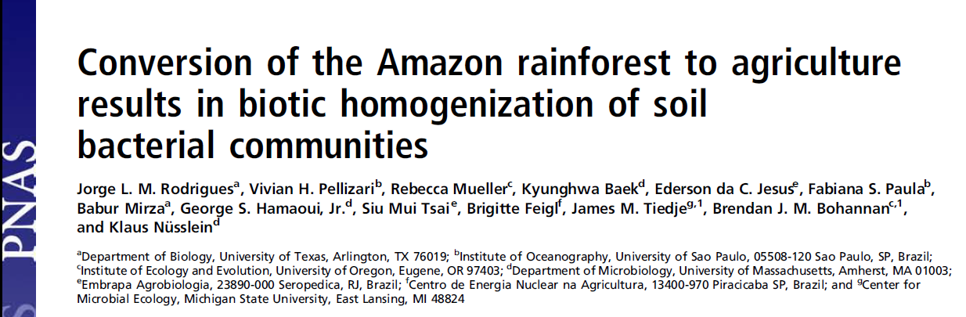
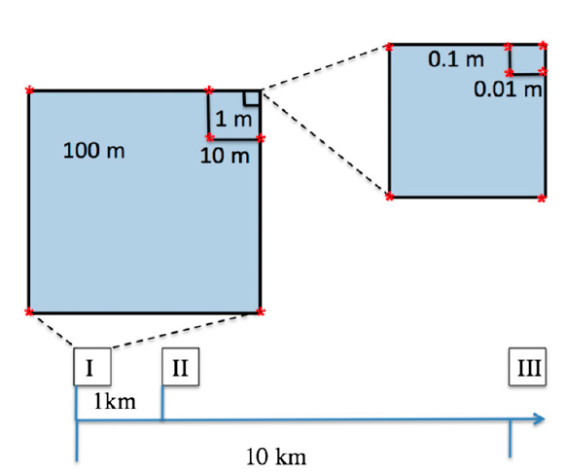
Nested blocks design
Natural forest converted to pastures
Diversity analysis of 16S rRNA data using 454 data with MOTHUR and RDP

Slide 26
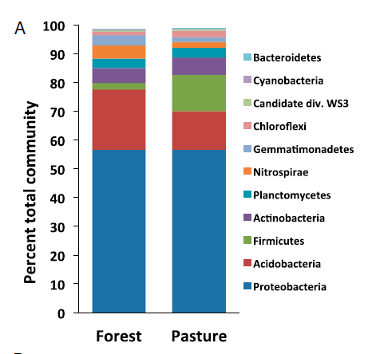
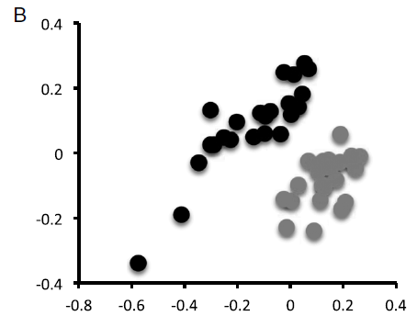
Conversion to agriculture affects the community composition
Forest
Pasture
Classification using representative sequences
NMDS using
Bray-Curtis distances
Notes:
Is this a alpha or beta diversity analysis?

Slide 27
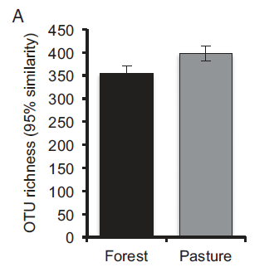
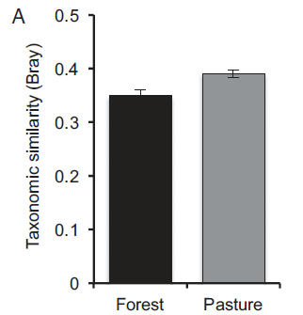
Conversion increases the communities’ diversity
Notes:
Is this a alpha or beta diversity analysis?

Slide 28
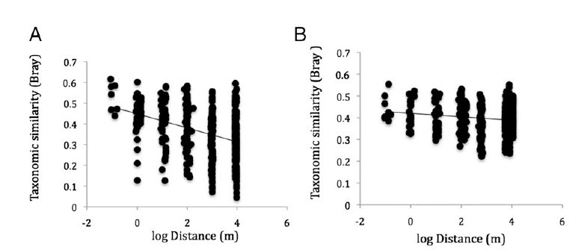
Conversion to agriculture homogenizes the communities
Forest
Pasture
Notes:
Is this a alpha or beta diversity analysis?

Slide 29
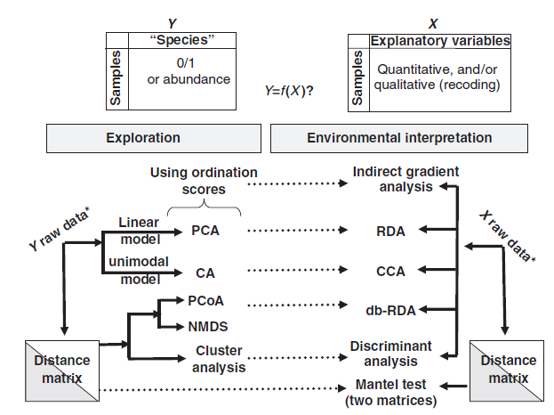
General analysis approach for multivariate data

Slide 30
Resources
Multivariate analysis in microbial ecology [Minireview].
Tree diversity analysis [Book]. (Free, includes R codes).
Available at the workshop repository.
https://github.com/carden24/2018_Taller_Genomica_ambiental

Slide 31
Diversity - Summary
The variety and abundance of species in a defined study unit.
Alpha
Within a community (Species diversity in a site or habitat)
Richness, evenness
Chao1, Simpson, Shannon Index
Beta
Among communities (Differentiation of habitats)
Sorensen, Jaccard, Bray-Curtis, Unifrac
Clustering, ordination

Slide 32
FAQs in Microbial ecology
How many different species are in my samples? (Alpha diversity)
What it the diversity of my sample? (Alpha diversity)
How is the microbial community structured? (Alpha diversity)
How novel are my organisms? (Comparison with db)
Where have my organisms been seen before? (Comparison with db)
How similar are the communities of my samples? (Beta diversity, exploratory analysis such as NMDS)
How do the communities changes across this environmental gradient? (Exploration interpretation, gradient analysis such as CCA)
Are communities from treatments X, Y, Z different? (Exploration interpretation, PERMANOVA, ANOSIM)
What organisms differentiate groups A an B? (Exploration interpretation, differential abundance using Deseq, Random forests analysis)

